Slide 1

Media Streaming with cloud Video Streaming.
Innovation

Slide 2
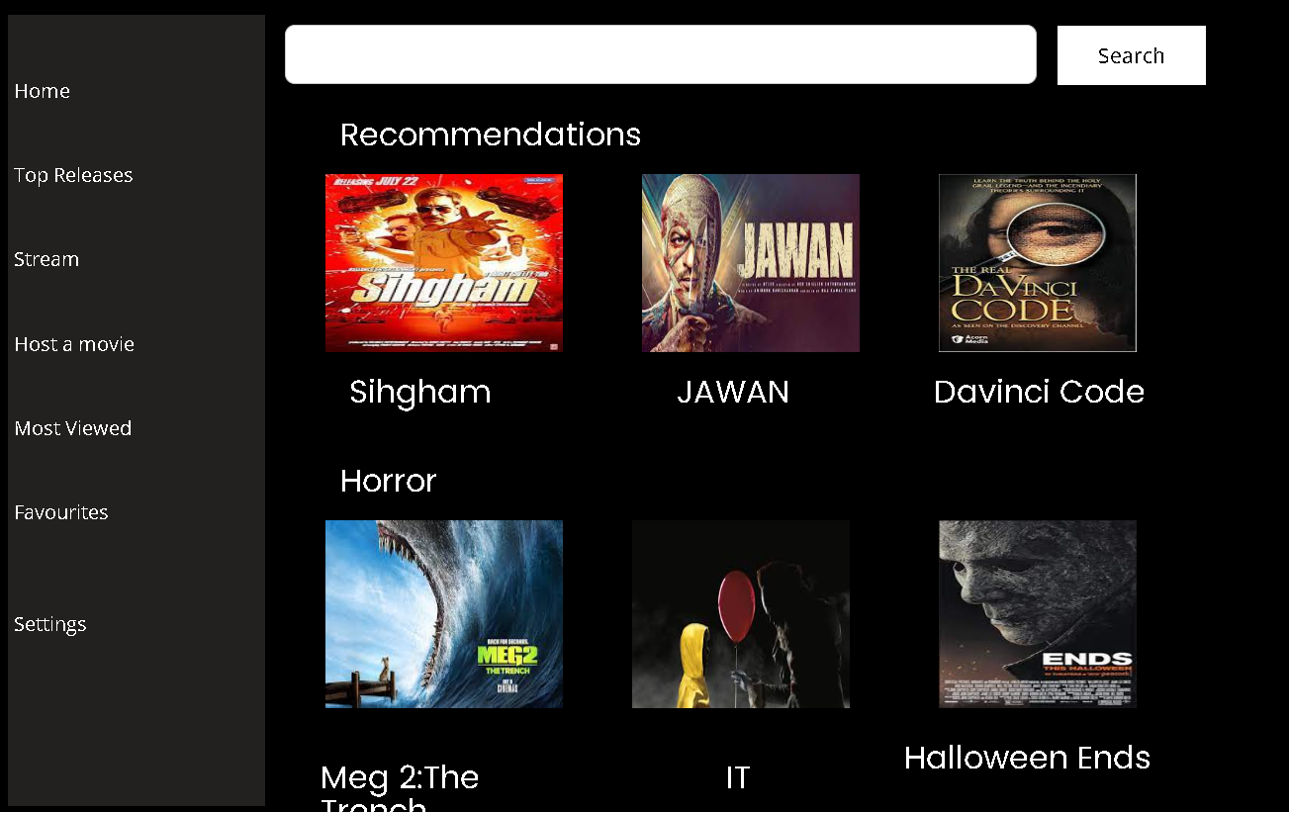
Hosting a movie :
As you can know or even used media streaming application such as Netflix, Amazon prime.
They provide video streaming in high definitions but it doesn’t provide the feel of watching movies with friends and families.
So the hosting option provides features of staring a group or join a group.
After creating or joining a group we can sit still and enjoy the movie .
The media streaming application offers a seamless group video streaming experience, allowing friends and family to enjoy their favorite content together, no matter where they are.

Slide 3
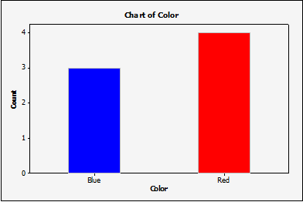
Pools :
Of course if we watch movie with our friends and families there will be definitely will be in choosing which movie to play.
So, we can select the movie by conducting a pool selection to solve the
Problems.
The other members on the group can also add and modify the pool options to their need , to solve inequality.
Results

Slide 4

Download Media’s:
The major drawbacks of Netflix , Amazon Prime are the video stream are only possible with internet.
If we are moving to our native location or a village without any network access even though we have a subscription it is useless.
So, we can download movies from this application and play it in offline after sometime or when we have our free time.
If we allow to download all the movies ,it would be a cheat to our self’s ,so we allow only to download two or three movies a month.

Slide 5
Easy Interface Customization :
One of the standout features of this media streaming application is its user-friendly customization options.
Whether you're a tech-savvy enthusiast or a casual viewer, tailoring the app to suit your preferences is a breeze.
With an intuitive interface and a range of customizable settings, users can effortlessly adjust video quality, audio preferences, and even personalize their homepage to showcase their favorite genres or shows.
This level of flexibility ensures that each user can create a personalized streaming experience that perfectly matches their tastes and viewing habits.
Whether it's fine-tuning the playback settings or curating a unique content feed, easy user customization is at the heart of this application's user experience.

