Slide 1

Employee Management System
Presented by:
ARAVIND BHUKYA
BATCH NO : 474

Slide 2
Agenda
Introduction
Objective of the Project
About Tables
ER Diagram and schema explanation
Key analysis questions (use cases)
SQL query results with screenshots or summaries
Final business insights and recommendations
Conclusion (Key finding overall).

Slide 3
Introduction
This Employee Management System (EMS) is a SQL-powered platform that brings together all staff information into one organized digital hub.
It tracks everything from an employee's personal profile and job role to their professional qualifications and daily attendance.
The system removes manual errors by automatically calculating final paychecks, factoring in specific bonuses and salary deductions based on leaves.
By linking multiple tables, it provides clear insights into company spending, department sizes, and the overall skill level of the workforce.

Slide 4
Objective
To design and implement a system that efficiently stores and manages employee-related data, including job roles, salary, and payroll .
Keeps everything in one place of all employee details
It automatically calculates monthly pay and bonuses so HR doesn't have to do it manually.
Tracks Attendance: It keeps a clear record of when employees take sick leave or vacation days.
Ensures Accuracy: By connecting different tables (like "Employees" and "Departments"), it makes sure that if an employee's info changes, the whole system updates correctly.
Saves Time: It allows managers to quickly search for information, like "who are the top performers?" or "which department is the most expensive?".

Slide 5
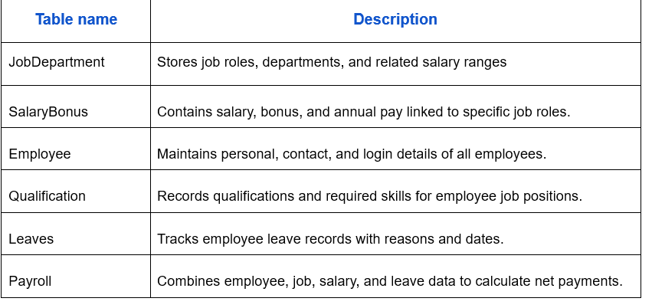
This project includes 6 interrelated tables:

Slide 6
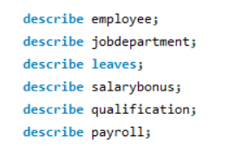
ABOUT TABLES
Job Department Table
Purpose: Stores job roles, departments, and salary ranges.
Columns: 5 (Job_ ID, job dept, name, description, salary range) .
Primary Key: Job_ ID.
2. Salary Bonus Table
Purpose: Contains specific salary, bonus, and annual pay details linked to roles.
Columns: 5 ( salary_ ID, Job_ ID, amount, annual, bonus) .
Primary Key: salary_ ID.
Foreign Key: Job_ ID (links to Job Department).
3. Employee Table
Purpose: Maintains personal, contact, and login details for all staff.
Columns: 9 ( emp_ ID, first name, last name, gender, age, contact_ add, emp_ email, emp_ pass, Job_ ID)
Primary Key: emp_ ID.
Foreign Key: Job_ ID (links to Job Department) .

Slide 7
4. Qualification Table
Purpose: Records skills and requirements for specific employee positions.
Columns: 5 (Qual ID, Emp_ ID, Position, Requirements, Date_ In) .
Primary Key: Qual ID.
Foreign Key: Emp_ ID (links to Employee) .
5. Leaves Table
Purpose: Tracks employee leave history, dates, and reasons.
Columns: 4 ( leave_ ID, emp_ ID, date, reason) .
Primary Key: leave_ ID.
Foreign Key: emp_ ID (links to Employee).
6. Payroll Table
Purpose: The central hub that combines all data to calculate net payments.
Columns: 8 ( payroll_ ID, emp_ ID, job_ ID, salary_ ID, leave_ ID, date, report, total_ amount) .
Primary Key: payroll_ ID.
Foreign Keys: emp_ ID, job_ ID, salary_ ID, and leave_ ID

Slide 8
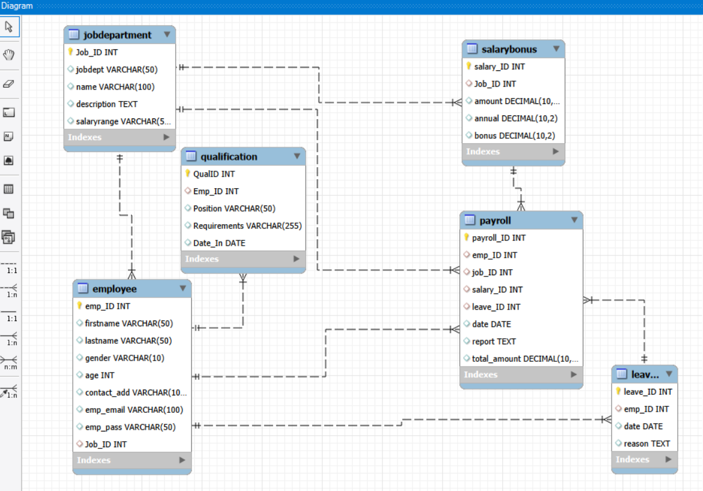
ER Diagram and schema explanation
● ER diagram show’s One-to-Many (1:N) relationships .
EXAMPLE :
● One-to-Many from job department to employee ● One-to-Many from job department to salarybonus ● One-to-Many from employee to qualification ● One-to-Many from employee to payroll ● One-to-Many from salary bonus to payroll ● One-to-Many from job department to payroll ● One-to-Many from employee to leave ● One-to-Many from leave to payroll

Slide 9
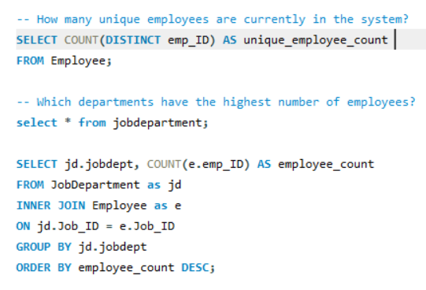

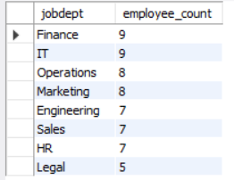
EMPLOYEE INSIGHTS
OUTPUT

Slide 10
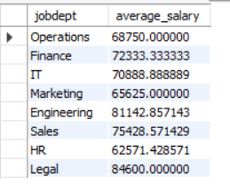
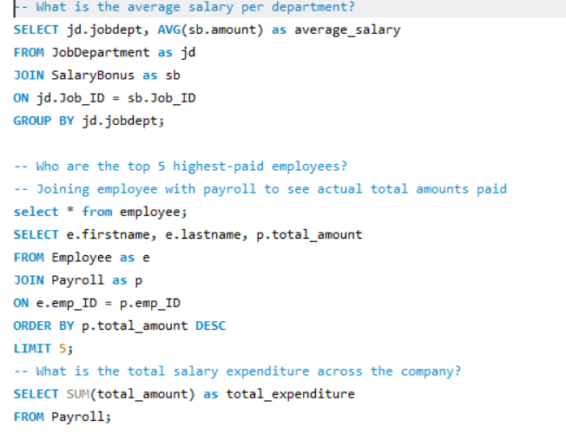
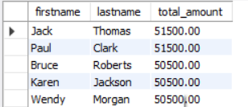

QUERY
OUTPUT

Slide 11
Employee key Insights
Total Workforce: This tells us the exact number of people currently working in the company, ensuring no one is counted twice.
Biggest Departments: This identifies which parts of the company (like IT or Sales) have the most staff, helping managers see where the team is largest.
Average Pay by Department: This shows the typical salary for each department, making it easy to compare how different teams are paid.
Top Earners: This highlights the 5 employees who have the highest salaries in the entire organization.
Total Company Spend: This calculates the grand total of all salaries combined, showing exactly how much the company spends on its employees every month or year.

Slide 12
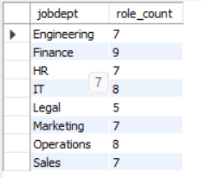
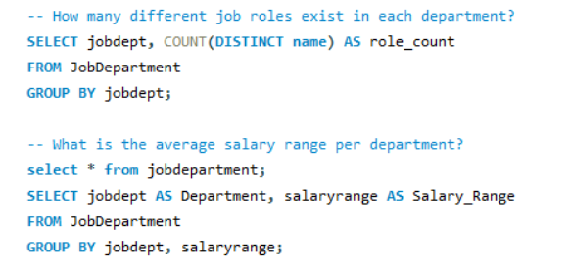
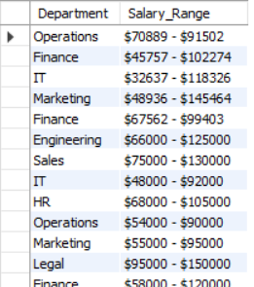
JOB ROLE AND DEPARTMENT ANALYSIS
OUTPUT
KEY INSIGHTS
Role Variety: This shows how many different types of jobs (like Manager, Developer, or Assistant) are available within each department.
Typical Pay Scales: This identifies the average salary range for every department, helping the company understand the standard pay for different teams.

Slide 13
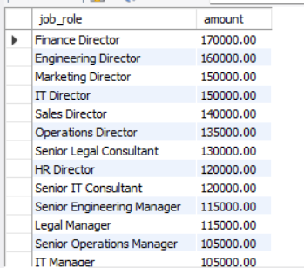
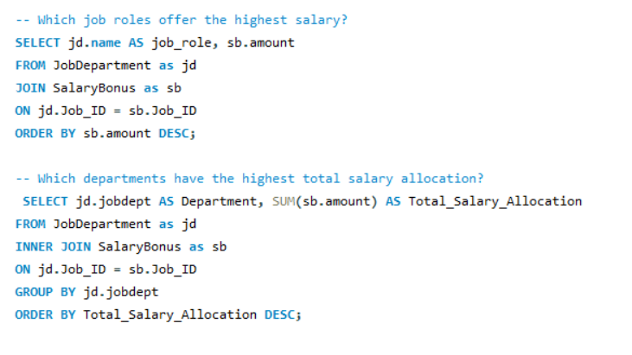
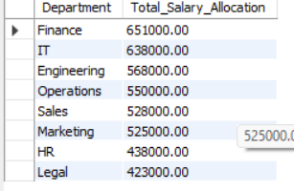
QUERY
OUTPUT
KEY INSIGHTS
Highest-Paying Roles: This pinpoints the specific job titles that offer the most money, showing which roles are the most valued in the organization.
Departmental Budgeting: This reveals which departments are the most expensive to run by showing who gets the largest share of the total salary budget

Slide 14

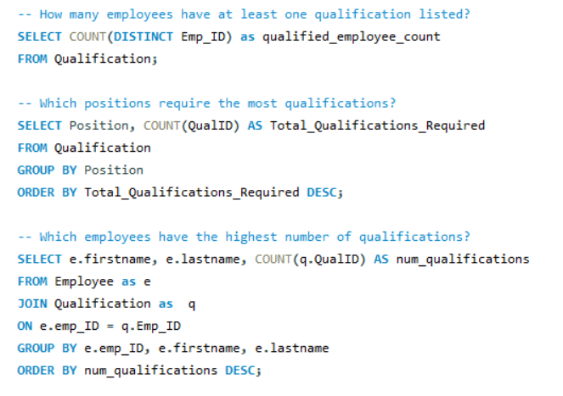
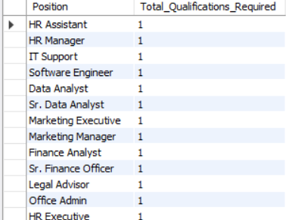
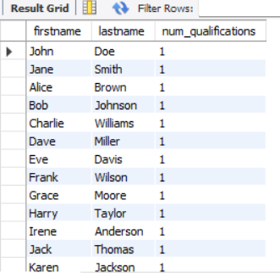
QUALIFICATION AND SKILLS ANALYSIS
OUTPUT

Slide 15
KEY INSIGHTS
Qualified Workforce: This tells us how many employees have at least one professional degree or special skill registered in the system.
High-Demand Roles: This identifies which specific job positions are the most complex and require the highest number of qualifications to perform.
Top Talent Identification: This highlights the "star" employees who have the most certifications and skills on their profile.

Slide 16
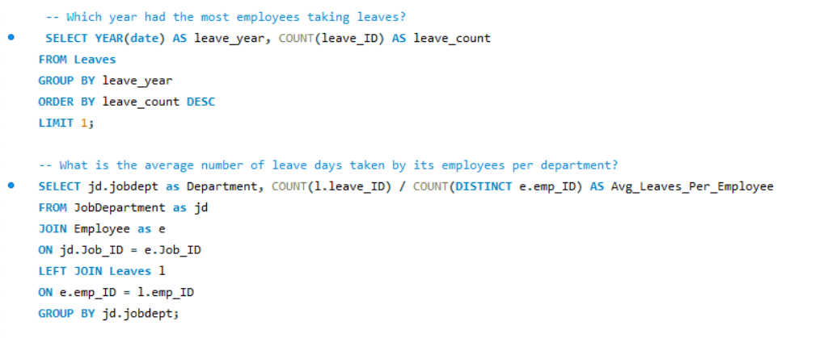

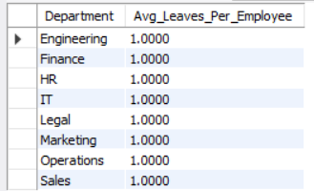
LEAVE AND ABSENCE PATTERNS
OUTPUT
KEY INSIGHTS
Busiest Leave Year: This identifies the specific year when the most employees were away from work, helping the company spot long-term attendance trends.
Departmental Absence: This shows the average number of days employees in each department are absent, highlighting which teams might be understaffed or overworked.

Slide 17
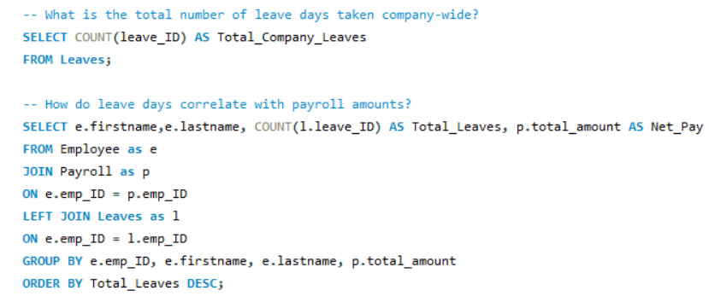

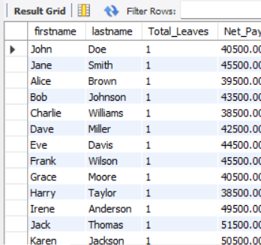
OUTPUT
KEY INSIGHTS
Company-Wide Total: This calculates the grand total of every single leave day taken by all staff, showing the overall impact on working hours.
Impact on Paychecks: This analyzes how taking days off directly changes the final payroll amount, showing how absences lead to salary deductions

Slide 18
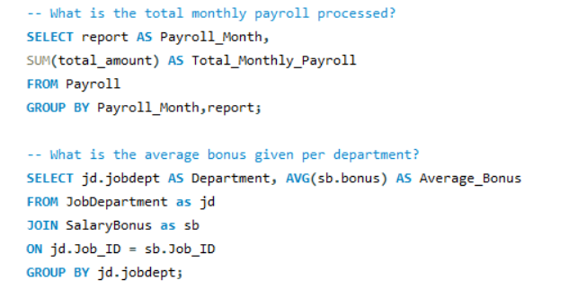

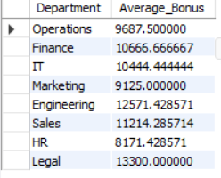
PAYROLL AND COMPENSATION ANALYSIS
OUTPUT
KEY INSIGHTS
Total Monthly Payroll: This calculates the grand total of money the company pays out to all employees every single month.
Average Bonus by Department: This identifies the typical bonus amount given to employees in different teams, helping to see which departments are being rewarded the most.

Slide 19
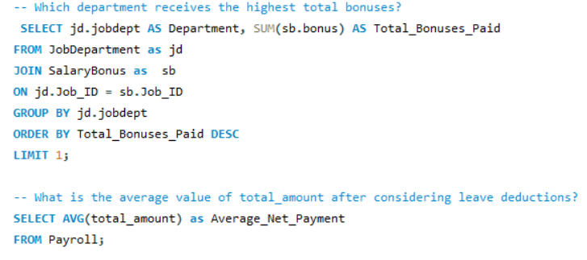


OUTPUT
KEY INSIGHTS
Highest Bonus Recipient: This pinpoints the specific department that gets the largest "pot" of bonus money, highlighting the most rewarded area of the company.
Final Take-Home Pay: This shows the average amount employees actually receive after the system subtracts money for the days they were absent (leave deductions)

Slide 20
Final Insights
The system successfully connects people, their jobs, their pay, and their time off. Instead of looking at different files, a manager can see everything about an employee in one click.
Automatic Paychecks: The system is smart. It doesn't just look at a "base salary"—it automatically adds bonuses and subtracts money for days someone was away (leaves) to find the exact final pay .
Finding the "Stars": By looking at the qualification table, the company can easily see who has the most skills and who is ready for a promotion.
Budget Tracking: The system shows which departments are the most expensive. For example, if "Engineering" costs way more than "Sales," the company can see exactly why.
Absence Trends: We can see which years or which teams take the most sick leave, which might show where employees are feeling too much stress.

Slide 21
Recommendations
Move People Around: If the data shows one department has too many people and another is struggling, the company should move employees to where they are needed most.
Train from Within: Since we know which jobs need the most qualifications, the company should offer classes to current employees so they can get promoted into those roles.
Plan for Busy Months: Because the system tracks when people take leaves, the company can predict which months will be "short-staffed" and plan ahead.
Check High Expenses: If one department’s total pay is very high, managers should check if those roles are bringing in enough value to match the cost.
Keep Data Clean: To keep the system working perfectly, HR should make sure to delete old employee records so the "Total Employee Count" is always 100% accurate

Slide 22
Conclusion
The Employee Management System successfully integrates personal, professional, and financial data into a single automated platform, ensuring that employee records and payroll calculations are both accurate and easy to manage. By uncovering key patterns in departmental spending, high-value skills, and leave-related deductions, the system provides managers with the essential insights needed to optimize their budget and reward top performers. Moving forward, the organization should use this data to plan for future staffing needs, offer targeted training for complex roles, and maintain high data integrity for long-term business growth.

Slide 23


THANK
YOU

