Slide 1


SMART INDIA HACKATHON 2026
Problem Statement ID – SIH26164
Problem Statement Title - Enterprise Cryptographic Discovery & Analysis Tool (ECDAT)
Theme - Blockchain & Cybersecurity
PS Category - Software
Team Name - Asterisks

Slide 2
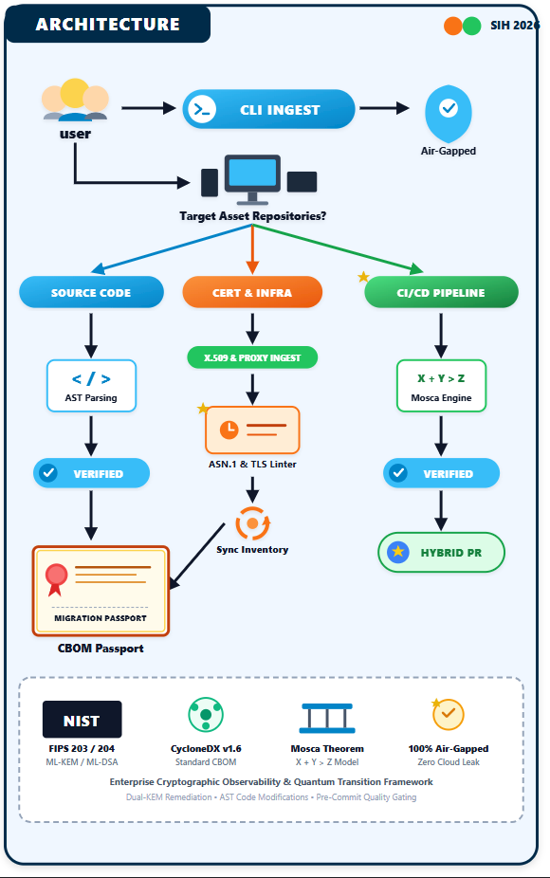
ECDAT (Automated CBOM Discovery & NIST Post-Quantum Transition)
Team
Asterisks
THE EXISTING PROBLEM
HNDL Threat: Attackers steal encrypted data today to decrypt via future quantum systems (Harvest Now, Decrypt Later).
Zero Crypto Visibility: No unified inventory of classical algorithms across source code, certificates, and reverse proxies.
Blind SCA/SAST Tools: Traditional scanners only check package versions, missing in-tree crypto calls and hardcoded keys.
PROPOSED SOLUTION
Full-Stack AST Discovery: Parses multi-language code (Python, Java), X.509 certificates, and TLS configs.
CycloneDX 1.6 CBOM: Generates standardized Cryptographic Bills of Materials with NIST quantum security levels.
Mosca-Weighted Scoring: Quantifies real-world migration urgency using Mosca's Theorem (X + Y > Z) and shelf-life metrics.
Migration Passports: Delivers FIPS 203/204/205 hybrid-cipher remediation blueprints (AST-mapped, developer-reviewed) for merge-ready adoption.
UVP (UNIQUE VALUE PROPOSITION)
CycloneDX 1.6 Native: Standard-compliant CBOMs instead of proprietary JSON formats.
Shelf-Life Prioritization: Distinguishes ephemeral session tokens from 20-year archived records to eliminate alert fatigue.
Hybrid Migration Blueprints: Produces developer-reviewed dual-KEM (X25519 + ML-KEM-768) remediation guidance, not unattended code rewriting.
100% Air-Gapped & CI/CD Native: Runs locally with zero cloud API dependency or data-exfiltration risk.

Slide 3
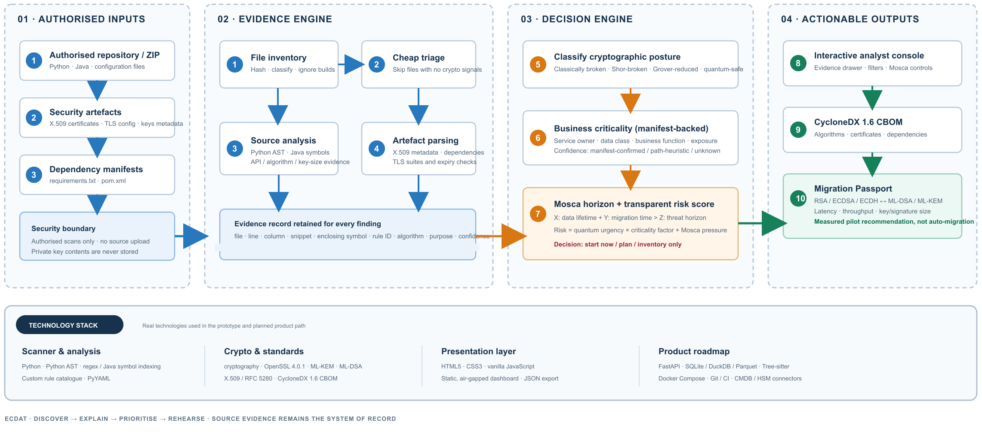
TECHNICAL WORKFLOW & TECH STACK

Slide 4
FEASIBILITY AND VIABILITY
FEASIBILITY
Technical: Proven AST parsing and ASN.1 certificate decoding provide deterministic, zero-hallucination crypto discovery without runtime overhead.
Data Compliance: Built against NIST SP 800-57 key-size minimums, FIPS 203/204/205, NIST IR 8547 transition timelines, and the CycloneDX 1.6 CBOM standard.
Operational: Standalone, lightweight CLI binary integrates directly into developer workstations and existing CI/CD pipelines in <5 minutes.
Economic: Open-core architecture eliminates per-scan software fees and proprietary cloud-analysis costs.
VIABILITY
Market Opportunity: BFSI, defense, healthcare, and digital governance face growing PQC-migration pressure through 2030-2035, anchored by NSA CNSA 2.0's 2033 federal deadline; enterprise cryptographic-inventory tooling is an emerging compliance category.
Policy Alignment: Complements CERT-In incident-reporting obligations and RBI information-security guidance; positions users ahead of future crypto-agility expectations tied to India's National Quantum Mission.
ROI & Efficiency: Targets a large cut in manual audit effort versus a typical multi-month review, with lower ongoing migration-planning cost (early estimate, to be validated during the pilot).
Scalability: Content-hash incremental rescanning skips unchanged files instead of re-parsing a monorepository each run — measured at an 8x speedup on the prototype's own corpus; multi-worker parallelism is planned, not yet built.
TECHNICAL CHALLENGES & MITIGATION
Risk: Dynamically loaded crypto providers, runtime reflection (e.g., Java Cipher.getInstance(var)), or environment-variable-driven key configurations escaping static AST.
Mitigation: Pair static AST scanning with fallback regex heuristics and configuration schema linting, with an extensible rule catalog to flag dynamic reflection instances as high-priority manual review targets.
BUSINESS / USER CHALLENGES & MITIGATION
Risk: Developer inertia and fear of breaking legacy production banking APIs during cryptographic replacement.
Mitigation: Enforce Hybrid Cryptography Blueprints (X25519 + ML-KEM-768) and AST-guided remediation blueprints that preserve classical fallbacks while introducing quantum resistance safely.

Slide 5
IMPACT AND BENEFITS
IMPACTS & BENEFITS
Economic & Financial Infrastructure Protection:
Prevents catastrophic loss of non-repudiation in long-term financial transactions, sovereign debt ledgers, and digital payment gateways.
National Security & Data Sovereignty:
Mitigates Harvest Now, Decrypt Later (HNDL) attacks against citizen identity vaults (KYC/Aadhaar integrations), health registries, and defense records.
Compliance & Governance Transformation:
Automates continuous cryptographic audit trails for ISO/IEC 27001, SOC2, RBI, and DPDP Act compliance.
HOW ECDAT OPERATES (3 SCAN MODES)
Mode 1: Static Codebase & AST Ingestion:
Parses raw application code (Java, Python), mapping cryptographic calls directly to file, line number, and function context.
Mode 2: Infrastructure & Certificate Linting:
Ingests deployment assets (.pem, .crt, .nginx.conf, .yaml), identifying weak key lengths, deprecated ciphers, and upcoming certificate expirations.
Mode 3: Migration Passport & Measured Migration Cost:
Emits machine-readable migration passports naming the FIPS replacement algorithm, with signing, key-establishment and certificate-size cost measured on the host.
FEATURE COMPARISON MATRIX:
Capability | CBOMkit (IBM Research, OSS) | SandboxAQ AQtive Guard | ECDAT (proposed)
Source-code AST crypto discovery | Yes (Java, Python) | No — ingests pre-built CBOMs only | Yes (Java, Python + certs/TLS configs)
CycloneDX 1.6 CBOM output | Yes — generates it | Ingest-only, does not generate CBOMs | Yes — generates it
Business-criticality scoring | Not publicly documented | Asset/risk analytics (not criticality-specific) | Manifest-backed criticality engine
Measured migration cost (speed + size) | Not publicly documented | Not publicly documented | Migration Passport (measured on-host)
Capabilities verified against each vendor's own public documentation (IBM Research CBOMkit blog/GitHub; docs.aqtiveguard.com) — Sept 2026. “Not publicly documented” means not claimed anywhere public, not confirmed absent.

Slide 6
RESEARCH AND REFERENCES
SOLUTIONS ALREADY EXIST vs. HOW ECDAT STANDS OUT
Existing Solutions: Fragmented, expensive enterprise tools focused purely on network TLS sniffing or simple dependency version checking, leaving internal application code uninventoried.
ECDAT Breakthrough: Provides end-to-end full-stack inventory (Code + Certs + Configs), produces standards-compliant CycloneDX CBOMs, and turns each finding into a developer-reviewed hybrid migration blueprint with its cost measured, rather than a passive vulnerability log.
RESEARCH & REGULATORY FOUNDATIONS
NIST FIPS Standards (2024): FIPS 203 (ML-KEM), FIPS 204 (ML-DSA), FIPS 205 (SLH-DSA) defining final post-quantum cryptographic standards.
Mosca's Theorem (2018): Grounded mathematical framework defining the urgency of cryptographic migration based on data retention (X), migration time (Y), and quantum advent (Z).
CycloneDX v1.6 Standard: OWASP specification establishing cryptographic assets, algorithms, and dependencies inside modern software supply chains.
NSA CNSA 2.0 Advisory: Published migration timelines mandating PQC adoption for US national-security systems — the firmest public deadline enterprises now plan against.
PROJECT RESOURCES
Working Prototype & Console:
Standalone interactive dashboard (ecdat-console.artifact.html), with a built-in seven-step guided walkthrough
Benchmarking & Validation Targets:
Validated on nivesh-core (our own BFSI-style demo estate), django, jjwt, and paramiko
Repository & Source Engine:
Core scanner, criticality engine, and CBOM pipeline scripts
Architecture & Master Documentation:
Complete implementation specifications and jury review briefs.

Slide 7
SMART INDIA HACKATHON 2026
THANK YOU

