Slide 1
A comprehensive analysis on job descriptions data with a job recommendation system based on skillset
Team Members:
Aravind Bhimanathini (XO66614)
Vijaya Amruth Krishna Kavaturi (SX34377)

Slide 2

Project Description
GOAL: The primary goal of this project is to provide comprehensive insights into the job market by analyzing various dimensions such as industry demand, geographical distribution, and salary trends. By identifying the most in-demand skills and roles, the project aims to assist job seekers in targeting their career development effectively. Additionally, it serves organizations by highlighting current hiring trends and helping optimize their recruitment strategies to address market and industry needs efficiently.
DATA :
Size of dataset: Approximately 755 MB.
Number of Records: 648,354 individual records.
The large dataset size necessitates leveraging distributed computing capabilities, and the complexity of the analysis demands scalable solutions to extract actionable insights from the wealth of information within the Jobs Description Data

Slide 3


Motivation
Skill Gap Analysis
Economic Development
Recruitment Efficiency
Career Planning and Development
Business Strategy and Competitive Advantage

Slide 4
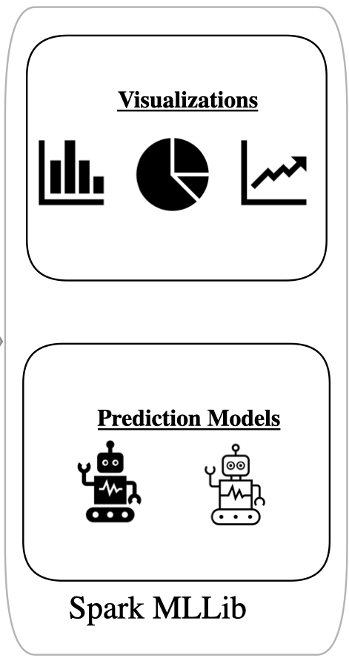



Implementation of Architecture
Input Data Source
Platform
Processing

Slide 5
Feature Engineering & Exploratory Data Analysis (EDA)
The dataset is being prepared for analysis by splitting the 'Experience' and 'Salary Range' columns into separate minimum and maximum values, converting these values to integers, and removing unnecessary columns for a cleaner and more focused dataset.
Location Analysis
To analyze the distribution of job postings by country to identify trends and pinpoint where the majority of job opportunities are concentrated, helping businesses and job seekers understand global employment dynamic.
It provides job seekers with valuable information on potential job markets, aiding them in making informed decisions about relocation or remote work opportunities to enhance their career prospects.
Distribution of job postings by location (city, state, country)

Slide 6
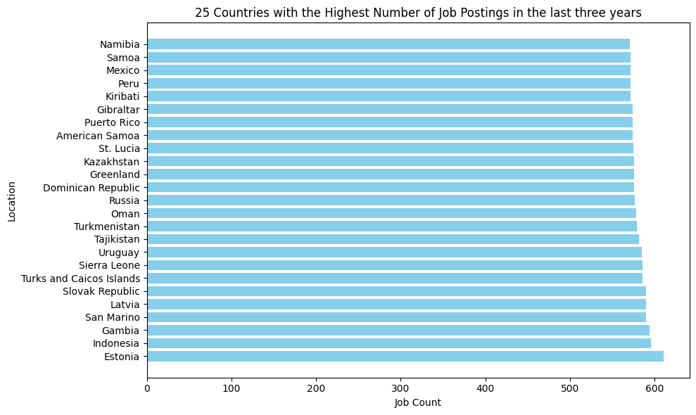
Location Analysis
Estonia indeed has the highest number of job postings among the top 25 countries listed, approaching 600 postings, while Namibia has the fewest among the top 25. This highlights Estonia as a significant hub for job opportunities in this dataset.

Slide 7
Qualification Analysis
Distribution of qualifications across job titles or sectors.
Most common qualifications required for different roles.
To analyze the distribution of qualifications across job titles to identify the educational requirements most in demand, helping organizations tailor their recruitment strategies and job seekers understand what qualifications enhance their employability.
The below graph shows the qualifications that required by the industries for Data Engineers to Data Scientists.

Slide 8
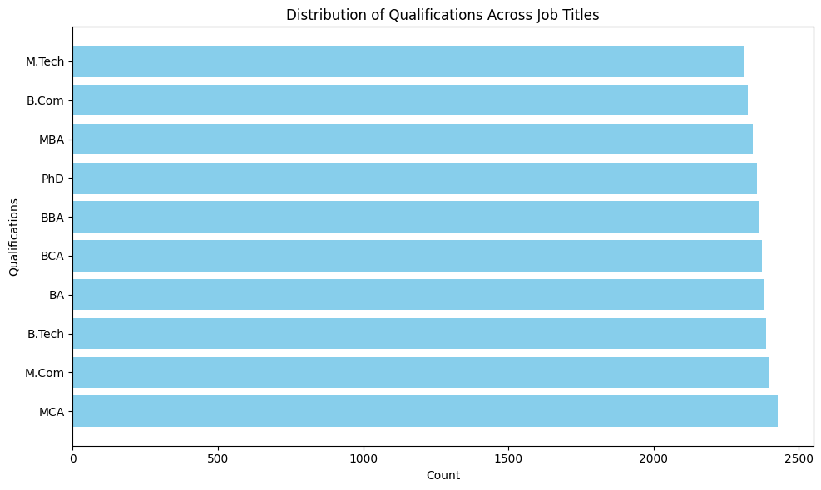
Qualification Analysis
The analysis shows that Bachelor's degrees like B.Tech BA are the most common qualifications listed, followed closely by master’s degrees such as MBA and M.Tech, indicating a high demand for both undergraduate and graduate educational backgrounds in the job market.

Slide 9
Skillset Analysis
To analyze the skillset distribution to identify the most sought-after skills in job profiles.
This analysis helps in aligning educational programs and professional training to meet the demands of the market, ensuring that the workforce is adequately prepared with the right competencies.
It assists companies in understanding current skill shortages, allowing them to tailor their recruitment efforts and invest in targeted employee development.
It provides job seekers with insights into which skills are most valuable and in demand, guiding their personal development and helping them prioritize learning and certification efforts.

Slide 10
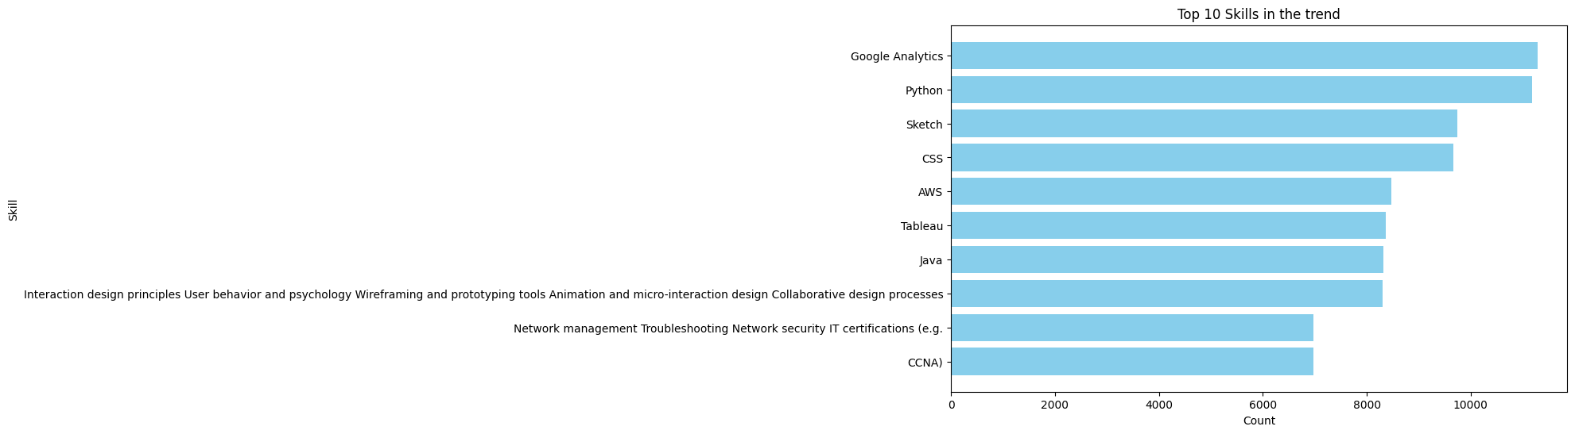
Skillset Analysis
The bar chart indicates that Google Analytics, Python, and Sketch are the most in-demand skills among job postings, highlighting the strong market need for data analysis, programming, and design expertise

Slide 11
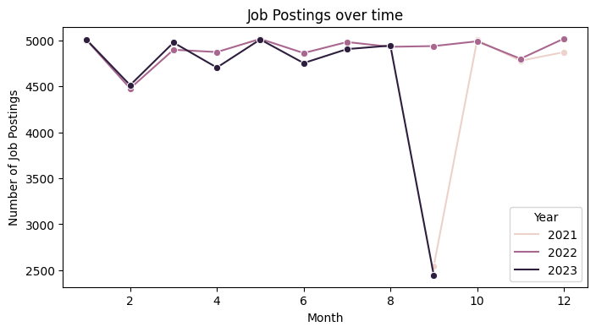
Job Posting Date Trends
(Seasonal variations in job availability)
The line chart illustrates a significant fluctuation in job postings, with a noticeable dip in September 2021 and 2023 followed by a steady recovery in 2021, suggesting seasonal impacts and possibly economic factors influencing job market dynamics.

Slide 12
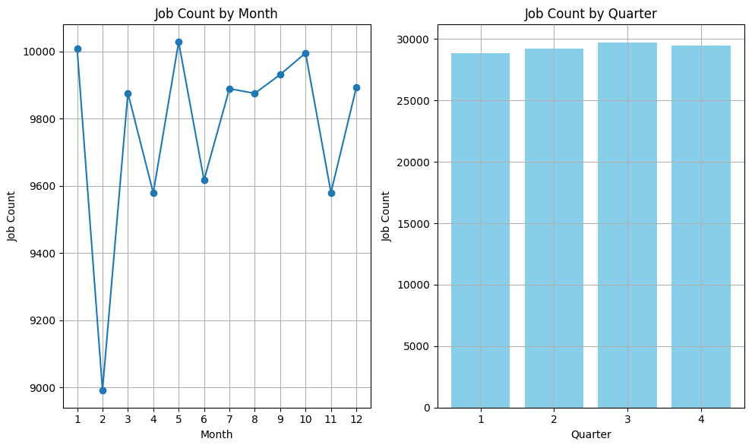
Seasonal Variations in the Job
The graphs reveal notable monthly fluctuations in job postings, with a significant drop in February and consistent quarterly job posting volumes, indicating stable hiring activity across each quarter despite monthly variations.

Slide 13
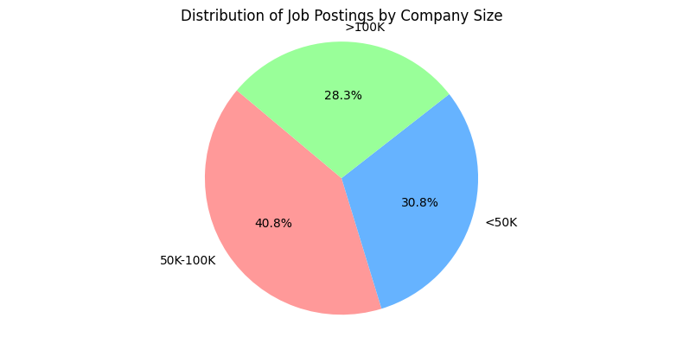
Company Size Insights
The pie chart displays a balanced distribution among different company sizes, with companies having employees in the range of 50,000 and 1,00,000 making up the largest segment at 40.8%, indicating a diverse job market that spans small, medium, and large enterprises

Slide 14
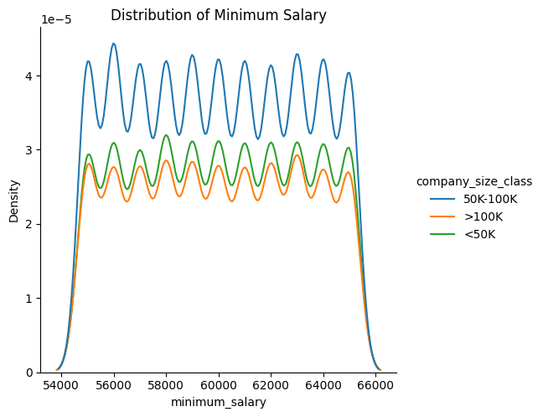
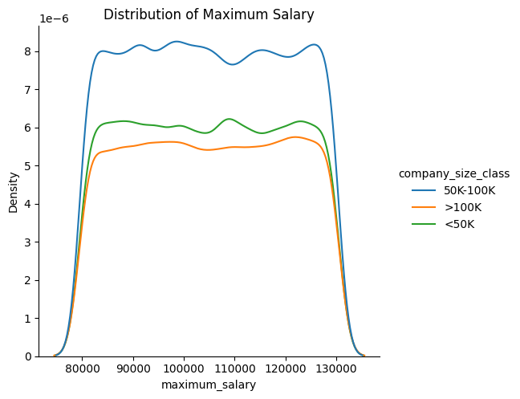
Distribution of salaries across company size categories
The KDE plots show that smaller companies (<50K employees) have a narrower range of minimum and maximum salaries, while larger companies (>100K employees) offer a broader range of both minimum and maximum salaries, indicating a more diverse compensation strategy in larger organizations.

Slide 15
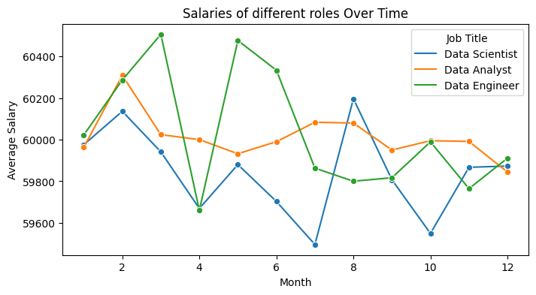
Average Salary comparison between various roles
The line chart shows significant fluctuations in average minimum salaries over the months for Data Scientists, Data Analysts, and Data Engineers, with Data Scientists generally receiving higher salaries and notable peaks and troughs in salary trends for all roles throughout the years.

Slide 16
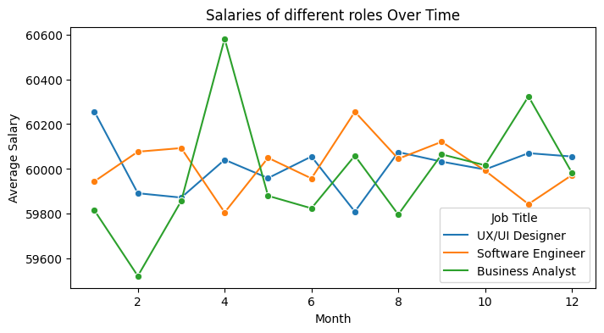
The line chart illustrates monthly fluctuations in average minimum salaries for UX/UI Designers, Software Engineers, and Business Analysts, showing that UX/UI Designers occasionally peak above the others, while overall, salary trends for these roles closely align throughout the year.

Slide 17
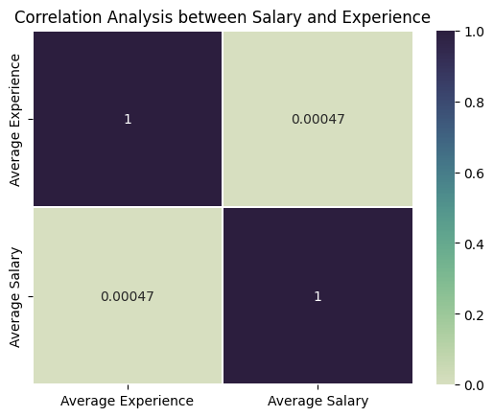
Correlation Matrix
The correlation analysis between average salary and average experience reveals a very low correlation coefficient of 0.00047, indicating that there is virtually no linear relationship between years of experience and salary levels in the dataset analyzed

Slide 18
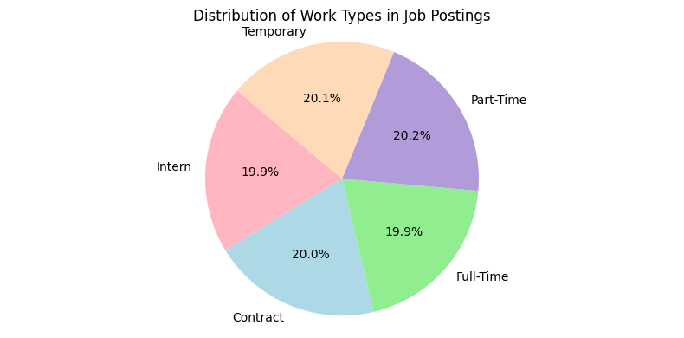
Distribution of Work Types
The pie chart reveals a remarkably even distribution among different work types, with full-time, part-time, temporary, intern, and contract roles each comprising around 20% of job postings.

Slide 19
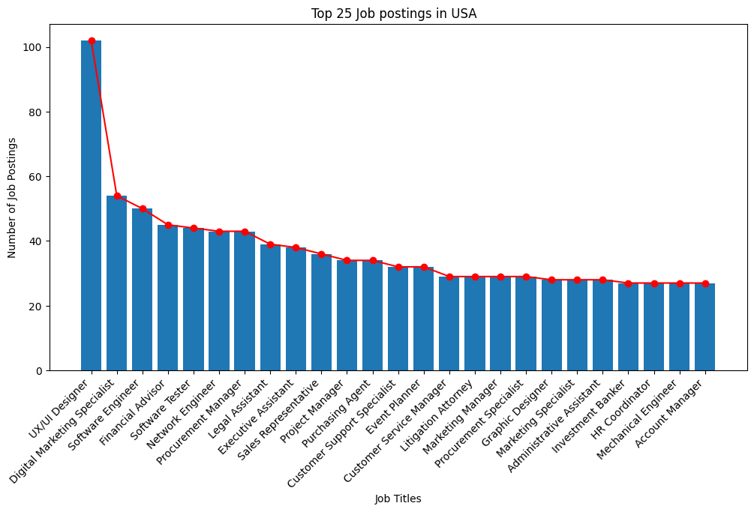
Analysis on Top 25 postings Job roles in USA
The data shows a significant concentration in a few job roles, with the majority of postings for UX/UI Designers and Digital Marketing Specialists, followed by a gradual decline across other professions in the USA.

Slide 20
Machine Learning in Job Market Recommendations
Machine Learning:
Machine learning is an application of artificial intelligence that provides systems the ability to automatically learn and improve from experience without being explicitly programmed.
In job market analysis, machine learning is used to understand complex patterns in employment data and to predict future trends.
Purpose of the Project:
This project leverages machine learning to analyze job titles and descriptions across various industries to extract insights about skill requirements, role expectations, and employment trends.
This analysis helps bridge the gap between job seekers’ qualifications and the demands of the job market.
Importance for Stakeholders:
For Recruiters, such insights can optimize recruitment strategies by identifying critical skills gaps and high-demand roles.
For job seekers, it enhances career development by aligning their skills with market demands.

Slide 21
ML Workflow
Data Preprocessing
Cleaning: Remove duplicates, and address missing values.
Normalization: Standardize formats for dates and numbers.
Text Preparation: Tokenization, lowercase conversion, punctuation and stop words removal.
Feature Extraction
TF-IDF Vectorization: Transform text data into numerical format.
Skill Extraction: Identify key skills using NLP techniques.
Model Training
Algorithm: K-Means clustering.
Parameter Tuning: Optimizing the number of clusters and other parameters.
Model Evaluation
Silhouette Score: Measure of clustering quality.
PCA Visualization: Two-dimensional visualization of clusters.
Tools and Technologies
Software: Python, Pandas. MLlib
Visualization: Matplotlib, Seaborn.
Platform: Apache Spark, Databricks

Slide 22
Modeling in Job Market Analysis
Need for Modeling in Job Analysis:
Job markets are characterized by complex relationships between various factors such as roles, required skills, and industry standards.
Modeling these relationships allows us to predict changes in job requirements and the emergence of new roles, facilitating proactive adaptation by both job seekers and companies.
Clustering:
Clustering helps in segmenting job roles into distinct groups based on similarity in skills and responsibilities.
This segmentation aids in identifying overarching trends and niche demands within the job market, enabling targeted training programs and recruitment drives.
Impact on Recruitment and Career Planning:
By clustering similar job roles, companies can more effectively map candidate profiles to job requirements, while job seekers can identify potential career paths based on their current skill sets.

Slide 23
K-Means Clustering
K-Means Clustering:
K-Means is a popular unsupervised learning algorithm used to divide data into k distinct clusters based on feature similarity. In this project, K-Means is employed to find patterns in job roles across different sectors.
K-Means is chosen for its simplicity and efficiency in handling large datasets.
It works well on numerical data derived from text processing of job descriptions and titles, providing clear and actionable insights into job categorization.
Application in Job Role Analysis:
Applying K-Means has allowed us to identify key groups of job roles that share common attributes, facilitating the understanding of job roles that require similar skill sets and aiding in the formulation of specialized training programs.
Cosine similarity:
It measures the angle between two vectors. In job analysis, it's used to compare the text of job descriptions, seeing how similar they are based on the presence and frequency of certain words.
We use it because it efficiently determines how closely related different job roles are based on their skillsets, which helps in accurately matching job seekers with suitable job openings based on their skills and experience

Slide 24
Key Insights from Job Market Analysis
Jobs are effectively grouped by similar skills, enabling precise recommendations based on user-inputted skills.
Skills in data analysis, software development, and cybersecurity are in high demand across various job roles.
Larger companies offer a wider range of roles and salaries, while smaller companies provide specialized opportunities.
There are clear seasonal fluctuations in job postings, indicating the best times for job seekers to apply.
The model successfully recommends job roles closely aligned with the user’s skills, enhancing job search efficiency.

Slide 25
Future Scope
Advanced Job Role Matching: Building on current capabilities, this project can be integrated with platforms like LinkedIn and other job portals to enhance their filtering options. By allowing job seekers to input specific skillsets, the system can accurately recommend job roles that perfectly match their qualifications and expertise.
Automated Personalized Training Recommendations: Integrate with educational platforms to offer personalized course suggestions for job seekers, helping them acquire the trending skills required for their targeted job roles.
Enhanced Employer Recruitment Tools: Provide employers with tools to craft more accurate job descriptions based on the detailed skillset analysis, attracting better-suited candidates and improving the recruitment process.
Global Job Market Trends Analysis: Expand the scope to include global data, providing insights into international job market trends and enabling a broader understanding of opportunities and skill demands worldwide.

Slide 26
References
System data: https://www.kaggle.com/datasets/ravindrasinghrana/job-description-dataset/data
Cosine Similarity: https://analyticsindiamag.com/cosine-similarity-in-machine-learning/
K-Means Clustering using Pyspark: https://towardsdatascience.com/k-means-clustering-using-pyspark-on-big-data-6214beacdc8b

Slide 27
Thank You…

