Slide 1

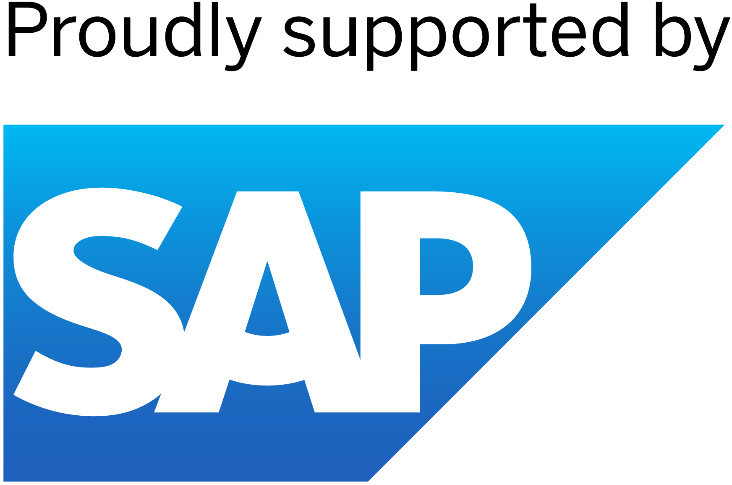

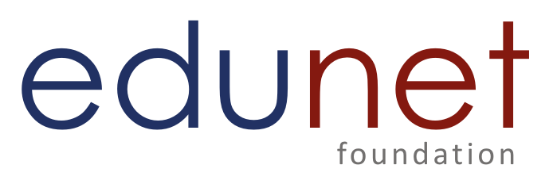
Project Title : MEDPREDICT
CU_CP_Team_5637
UNDER THE GUIDANCE OF
PAVAN SAI KUNDUM
Team Leader : MITHESH RAYABARAPU
Team Member 1 : ARAVINDA SWAMY TELU
Team Member 2 : HARISH PASUNOORI

Slide 2

Project Objectives
Problem Statement
Project Overview – Introduction
End Users
Wow Factor in Project
Block Diagram
Result
Conclusion
Future Perspective

Slide 3
Problem Statement
Predicting and Visualizing Patient Health Conditions Based on Vital Data
Monitoring patient health through vital signs like heart rate, blood pressure, and oxygen levels is crucial for early detection of medical conditions. However, traditional methods are often reactive and time-consuming. This project aims to develop a predictive model that analyzes real-time and historical vital data to forecast potential health risks. Using machine learning, the system will detect patterns and provide early warnings for conditions ,by visualizing predictions through dashboards, healthcare providers can make faster, data-driven decisions, improving patient care and reducing hospital readmissions.

Slide 4
Project overview - Introduction
This project focuses on predicting patient health conditions using real-time and historical vital sign data. By leveraging machine learning, the system will analyze key health indicators such as heart rate, blood pressure, oxygen levels, and body temperature to detect early warning signs of critical conditions.
The predictive model will help healthcare providers anticipate risks like sepsis, cardiac issues, and respiratory failure, enabling timely interventions. Additionally, a user-friendly dashboard will visualize these predictions, making it easier for doctors and medical staff to monitor patient health efficiently.
The goal is to improve patient outcomes, reduce hospital readmissions, and enhance decision-making through data-driven insights, ultimately making healthcare more proactive and effective.

Slide 5
End User
Doctors: Get help seeing patterns and making diagnoses.
Nurses: Can monitor patients more closely and respond quickly.
Patients: Can get early warnings and better care.
Hospitals: Can improve patient care and use resources wisely.
Anyone who wants to live a healthier life!

Slide 6
Wow Factor in Solution
Predicting the Future: We can see potential health problems before they happen.
Personalized Help: Each person gets health insights tailored to them.
Real-Time Monitoring :We can keep track of health even when people are at home
Saving Lives: Early warnings can help prevent serious health crises.
Imagine: Knowing if you are at risk of a heart attack days before it happens.

Slide 7
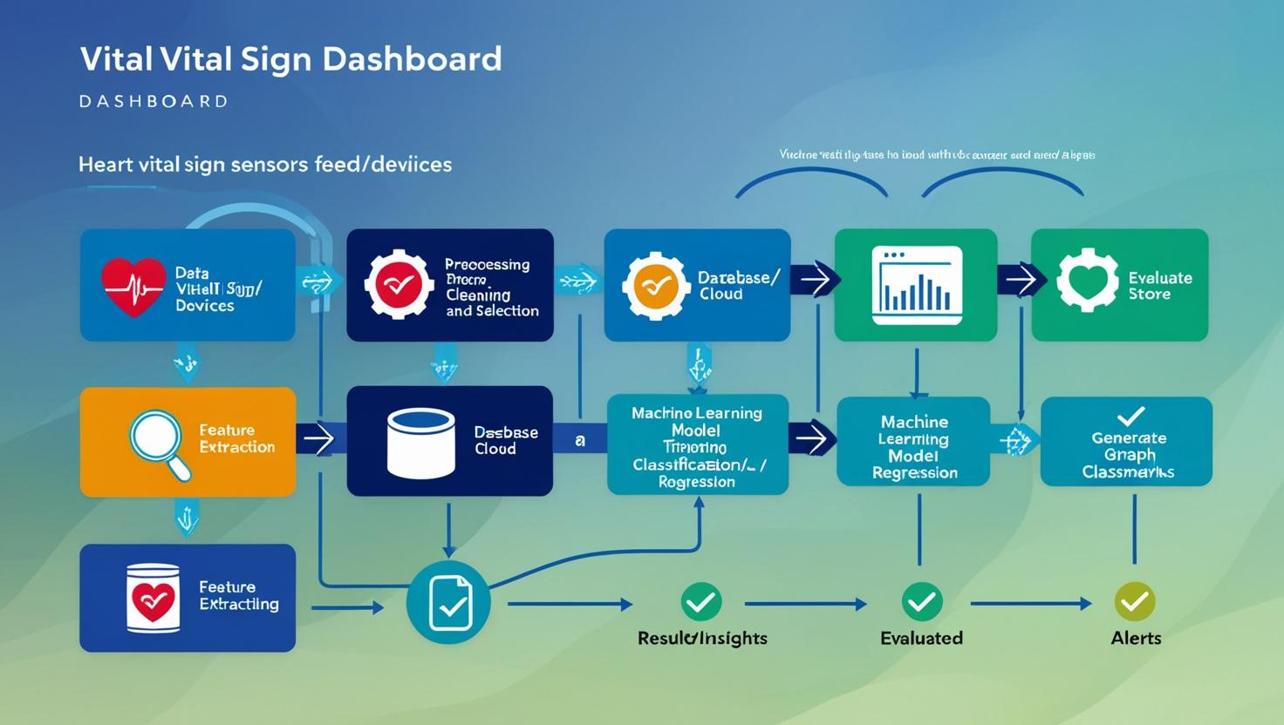
Modelling

Slide 8
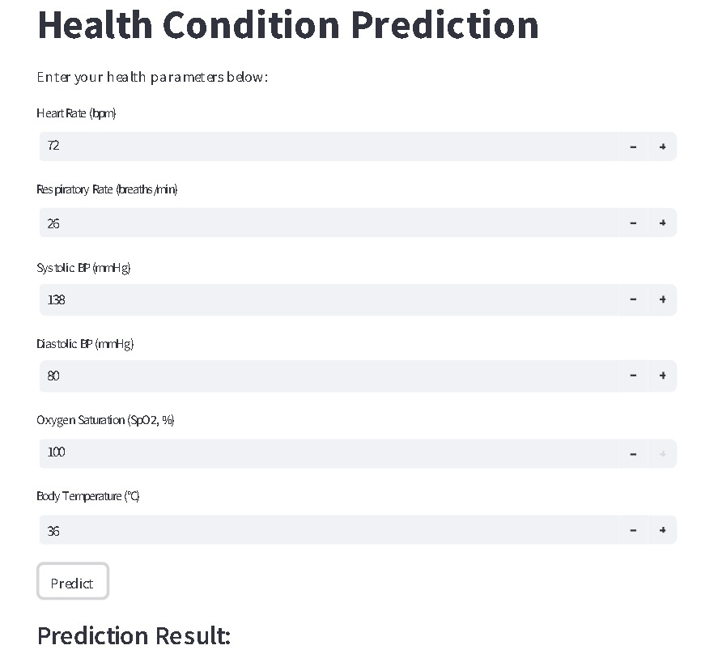
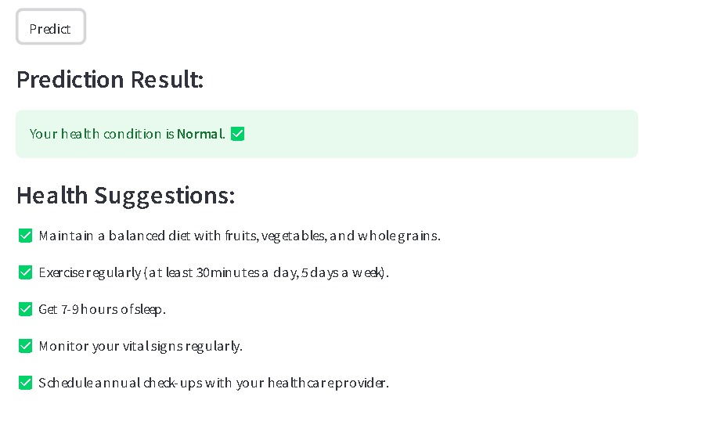
Output
After entering the parameters and click on predict button here u can see the output of patient condition with health suggestions
.

Slide 9
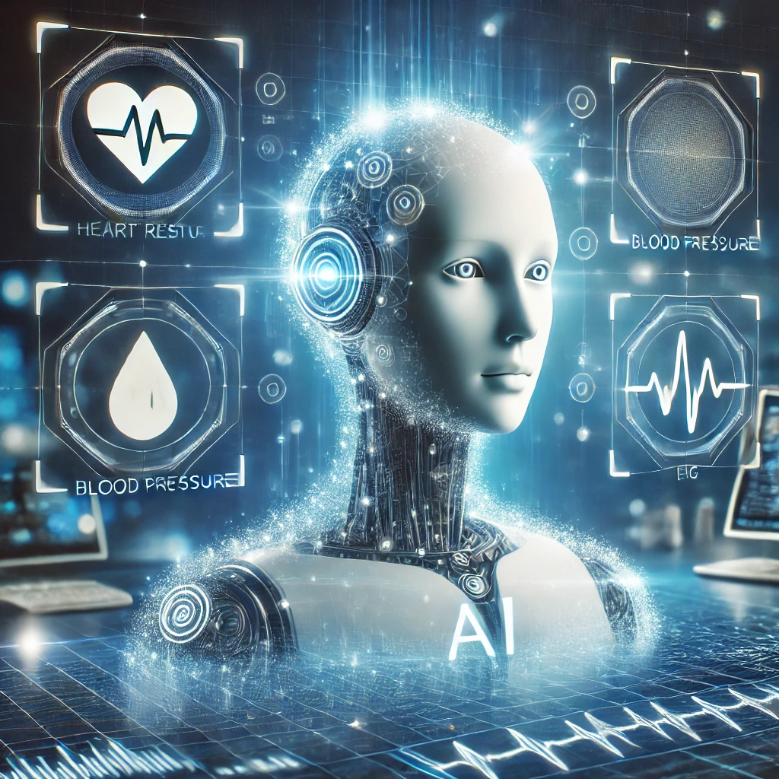
Conclusion
Predicting patient health conditions using vital data can improve early diagnosis, patient monitoring, and healthcare decision-making. By using machine learning, this approach helps detect health risks in advance, leading to timely medical intervention and better patient outcomes. Despite challenges like data accuracy and system integration, this solution can enhance healthcare efficiency and save lives.

Slide 10
Future Perspective
Integration with Wearable Devices
– Smartwatches and medical wearables will enable real-time health monitoring.
AI-Driven Personalized Healthcare
– AI will provide customized health insights based on individual patient data.
Remote Patient Monitoring (RPM)
– AI-powered systems will allow doctors to monitor patients remotely.
Automated Health Alerts
– AI will send early warnings about potential health risks to doctors and patients.
Smart Hospitals and AI-Powered Healthcare
– AI will optimize hospital operations and improve patient care.
By implementing these future advancements, this project can significantly enhance preventive healthcare, reduce hospital workloads, and improve patient safety and well-being.

Slide 11
Thank you...!
Notes:
11

