Slide 1
Welcome

Slide 2

TALLA PADMAVATHI COLLEGE OF ENGINEERING
DEPARTMENT OF COMPUTER SCIENCE AND ENGINEERING
TECHNICAL SEMINAR PRESENTATION
ON
“GREEN COMPUTING”
PRESENTED BY:
TELU ARAVINDA SWAMY
21UC1AO568

Slide 3

CONTENTS
Abstract
Introduction
Literature Survey
What is Green Computing?
Principles of Green Computing
Importance of Green Computing
Benefits of Green Computing
Applications
Advantages
Disadvantages
Conclusion
References

Slide 4
ABSTRACT
Green computing, also known as sustainable computing, refers to the practice of designing, manufacturing, using, and disposing of computers, servers, and associated systems efficiently and with minimal impact on the environment. As energy consumption and electronic waste continue to rise, green computing aims to mitigate these issues by focusing on energy efficiency, resource optimization, and responsible e-waste management.

Slide 5
INTRODUCTION
Green computing, also known as sustainable computing, is the practice of designing, using, and managing computing resources in an environmentally responsible and energy-efficient manner.
It aims to minimize the environmental impact of technology by reducing energy consumption, limiting waste, and promoting sustainability throughout the lifecycle of devices and systems.
This approach covers various aspects of technology, from manufacturing eco-friendly hardware to developing energy-efficient software and implementing policies for the responsible disposal of e-waste.

Slide 6
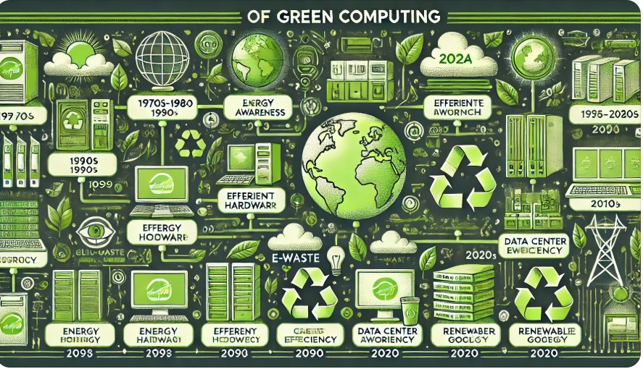
LITERATURE SURVEY
1990s: Industry Adoption
Energy Star Program (1992)
The U.S. Environmental Protection Agency (EPA) launched the Energy Star program to encourage energy-efficient products, including computers and monitors.
2000s: Rise of Sustainable Computing
Green IT Initiatives
Virtualization became a popular solution to optimize server usage. Companies launched green IT strategies, focusing on energy-efficient hardware, renewable energy sources, and sustainable practices.

Slide 7
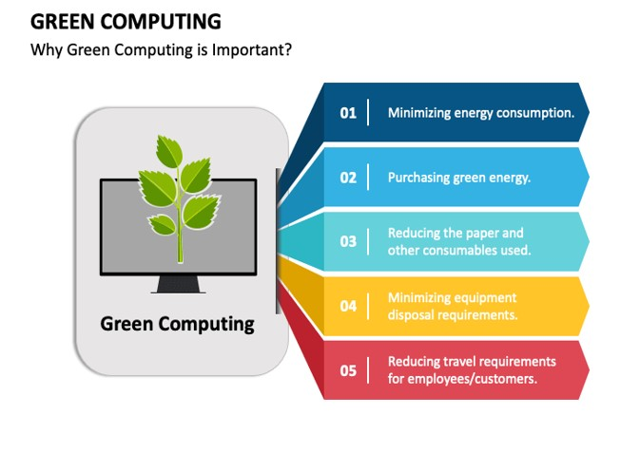
WHAT IS GREEN COMPUTING?
Green computing, also known as sustainable computing, refers to the practice of designing, manufacturing, using, and disposing of computers, servers, and related systems in an environmentally responsible and energy-efficient manner. Its goal is to minimize the negative environmental impact of technology while maximizing efficiency and sustainability.

Slide 8

PRINCIPLES OF GREEN COMPUTING
1.Energy Efficiency
2. Sustainable Design
3. E-Waste Management
4. Renewable Energy Integration
5. Green Software Development
6. Collaboration and Innovation

Slide 9

IMPORTANCE OF GREEN COMPUTING
Emission Reduction
Less energy consumption leads to a smaller carbon footprint. This mitigates climate change.
E-waste Mitigation
It promotes recycling and responsible disposal. This minimizes harmful electronic waste.
CSR Enhancement
Green computing aligns with corporate social responsibility goals. This improves brand image.

Slide 10

BENEFITS OF GREEN COMPUTING
Environmental Benefits
Reduced Carbon Footprint
Less Electronic Waste
Conservation of Resources
2.Economic Benefits
Lower Energy Costs
Virtualization
Tax Incentives
3. Social Benefits
Corporate Social Responsibility (CSR)
Promoting Awareness

Slide 11
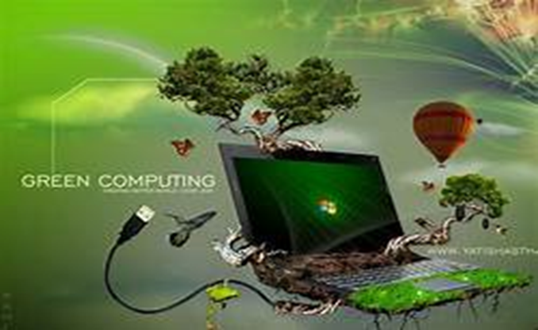
APPLICATIONS
Energy-Efficient Data Centers
Sustainable Hardware
E-Waste Management and Recycling
Renewable Energy Integration
Green Software Development
Remote Work and Virtual Collaboration
Smart Building Management
Green AI and Machine Learning
Education and Awareness Tools

Slide 12
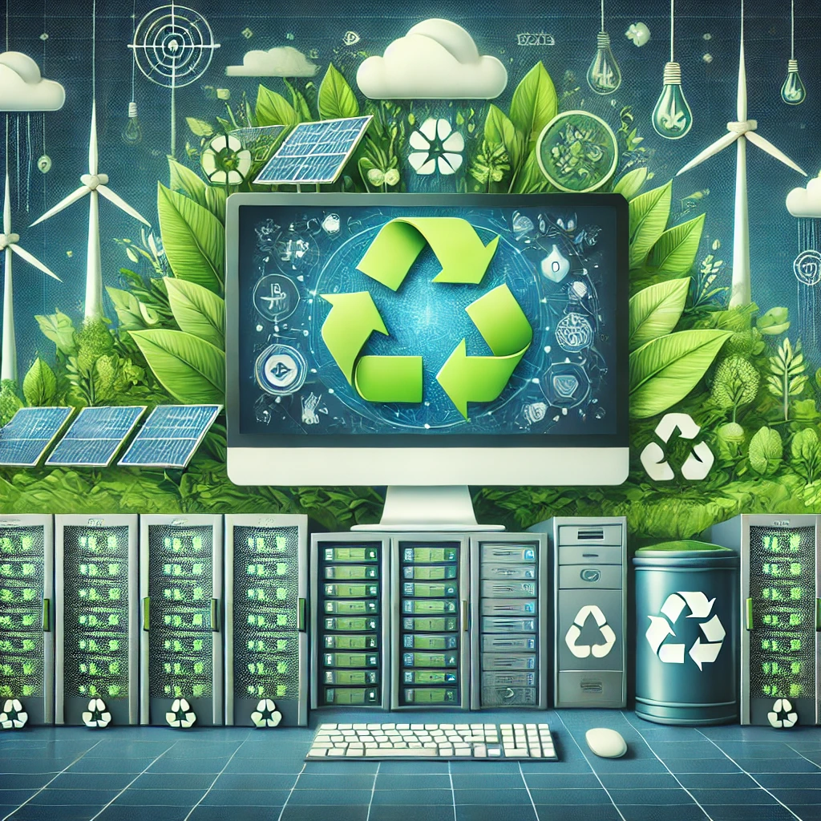
ADVANTAGES
Decreased E-Waste
Conservation of Resources
Lower Operational Costs
Prolonged Hardware Lifespan
Compliance with Regulations
Regulatory Compliance
Brand Reputation and Consumer Trust
Performance and Innovation
Health and Safety
Global Impact
Innovation and Efficiency

Slide 13

DISADVANTAGES
High Initial Costs
Limited Availability of Green Products
Compatibility Issues
Maintenance Challenges
Complex Implementation
E-Waste Recycling Challenges
Short Technology Lifespan

Slide 14

CONCLUSION
Green computing emphasizes the sustainable use of technology to reduce environmental impact while optimizing energy efficiency and resource usage. It promotes the adoption of eco-friendly practices, such as energy-efficient hardware, virtualization, cloud computing, and proper e-waste disposal. By reducing carbon footprints and conserving energy, green computing not only supports environmental conservation but also lowers operational costs and enhances organizational sustainability

Slide 15
REFERENCES
[1] http://gcomputing2011.blogspot.in/p/green-computing.html
[2] http://www.blackle.com/about/
[3] https://www.energystar.gov
[4] http://www.mbtmag.com/article/194428
[5] www.zonbu.com/download/EPEAT-June-07.pdf
[6] www.asus.com/Notebooks_Ultrabooks/Eee_PC_S101

Slide 16


Slide 17
Thank you

