Slide 1
Electric Vehicle Dataset Analysis
Exploratory Data Analysis (EDA)
Univariate, Bivariate & Multivariate
(No Machine Learning)

Slide 2
Project Overview
• Dataset: Electric Vehicle Specifications
• Goal: Perform complete EDA
• Methods: Statistical analysis & visualization
• Tools: Python, Pandas, Matplotlib

Slide 3
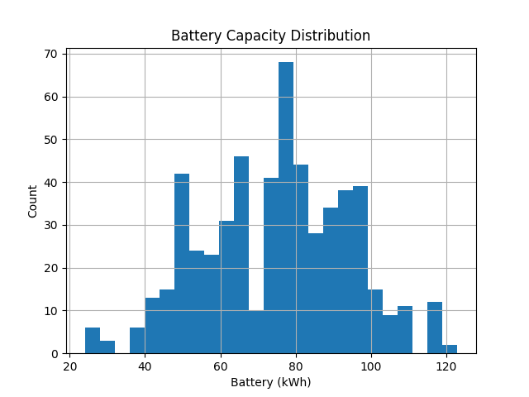
Battery Capacity Distribution

Slide 4
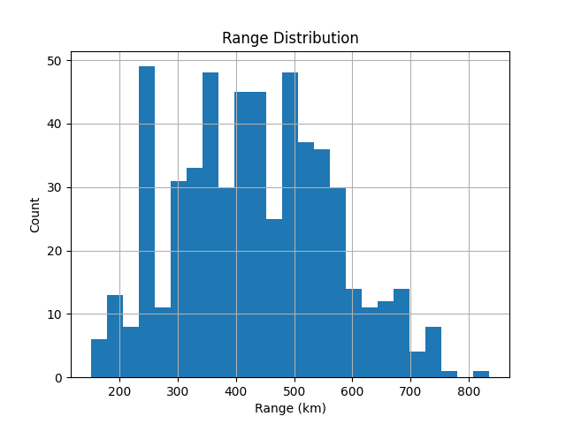
Range Distribution

Slide 5
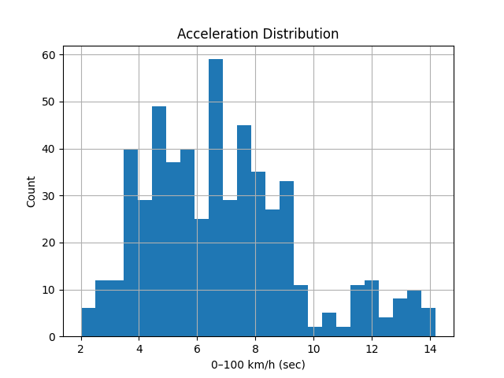
Acceleration Distribution

Slide 6
Bivariate Analysis
• Battery vs Range: Strong positive relationship
• Weight vs Acceleration: Heavier EVs accelerate slower
• Range vs Price/km: Value differs across brands

Slide 7
Multivariate Analysis
• Battery, Range & Weight are correlated
• Charging speed depends on battery & technology
• Brand strategy influences EV specifications

Slide 8
Key Insights
• Most EVs have 50–80 kWh batteries
• Typical driving range is 300–500 km
• Premium EVs offer faster charging & performance

Slide 9
Conclusion
• Dataset cleaned and validated
• EDA provides strong business & technical insights
• Suitable for analytics, reports & interviews
• No Machine Learning used

