Slide 1
Javascript
Aravind

Slide 2
Day 2: Java script

Slide 3
Topics for Discussion
Introduction to Javascript
Data Types and operators
Conditional statements
Loops
Variable declarations

Slide 4
Introduction to Javascript
JavaScript is an object-based scripting language which is lightweight and cross-platform.
JavaScript Translator (embedded in the browser) is responsible for translating the JavaScript code for the web browser.
It is an interpreted, full-fledged programming language that enables dynamic interactivity on websites when applied to an HTML document
With JavaScript, users can build modern web applications to interact directly without reloading the page every time. The traditional website uses js to provide several forms of interactivity and simplicity.

Slide 5
Features Of Javascript
All popular web browsers support JavaScript as they provide built-in execution environments.
JavaScript follows the syntax and structure of the C programming language. Thus, it is a structured programming language.
JavaScript is a weakly typed language, where certain types are implicitly cast (depending on the operation).
JavaScript is an object-oriented programming language that uses prototypes rather than using classes for inheritance.
It is a light-weighted and interpreted language.
It is a case-sensitive language.
JavaScript is supportable in several operating systems including, Windows, macOS, etc.
It provides good control to the users over the web browsers.

Slide 6
Usage
Within Script tag
With Head tag
Use of alert (pop up )
Using External File (name.js)

Slide 7
Javascript Comment
To make code easy to understand
Avoid unnecessary code
Single line represented by → //
Multi line represented by → /**/

Slide 8
Datatypes and Operators
Primitive Data types
String → “”,’’
Number → 1,2,3
Boolean → true/false
Undefined → hoisting
Null → no value
Non-Primitive Data types
Object
Array

Slide 9
contd
Operators:
Addition - +
Subtraction - -
Multiplication - *
Division -/
Modulus (Remainder) - %
Increment - ++
Decrement - --

Slide 10
contd
Operator | Description | Example
== | Is equal to | 10==20 = false
=== | Identical (equal and of same type) | 10==20 = false
!= | Not equal to | 10!=20 = true
!== | Not Identical | 20!==20 = false
> | Greater than | 20>10 = true
>= | Greater than or equal to | 20>=10 = true
< | Less than | 20<10 = false
<= | Less than or equal to | 20<=10 = false

Slide 11
Variable Declaration
Variable declaration happens by using 3 keywords
Name must start with a letter (a to z or A to Z), underscore( _ ), or dollar( $ ) sign
After first letter we can use digits (0 to 9), for example value1
JavaScript variables are case sensitive, for example x and X are different variables
Below are the keywords
Let (old way of usage)
Var - can be changed
Const - cannot be changed once declared

Slide 12
Loops and Conditional Statement
If
If else
If else if
Switch
For
For in
While
Do-while

Slide 13
Day 3 Javascript

Slide 14
Topics for discussion
Arrays and Array Methods
Js Function
Working with objects
String and Numbers

Slide 15
Javascript Array
Javascript array is a representation of similar elements
How to represent
By array literal
By creating instance of Array directly (using new keyword)
By using an Array constructor (using new keyword)

Slide 16
JS Function
Used to perform operations
Used to reuse a block of code
Syntax:
function name(){
// block of code
}

Slide 17
Function - usage
apply() → method is used to call a function contains this value and an argument contains elements of an array.
bind() → method is used to create a new function
call() → method is used to call a function contains this value and an argument provided individually.
toString() → method returns a string.

Slide 18
Working with Objects
object is an entity having state and behavior (properties and method)
Syntax as below,
object={property1:value1,property2:value2.....propertyN:valueN}

Slide 19
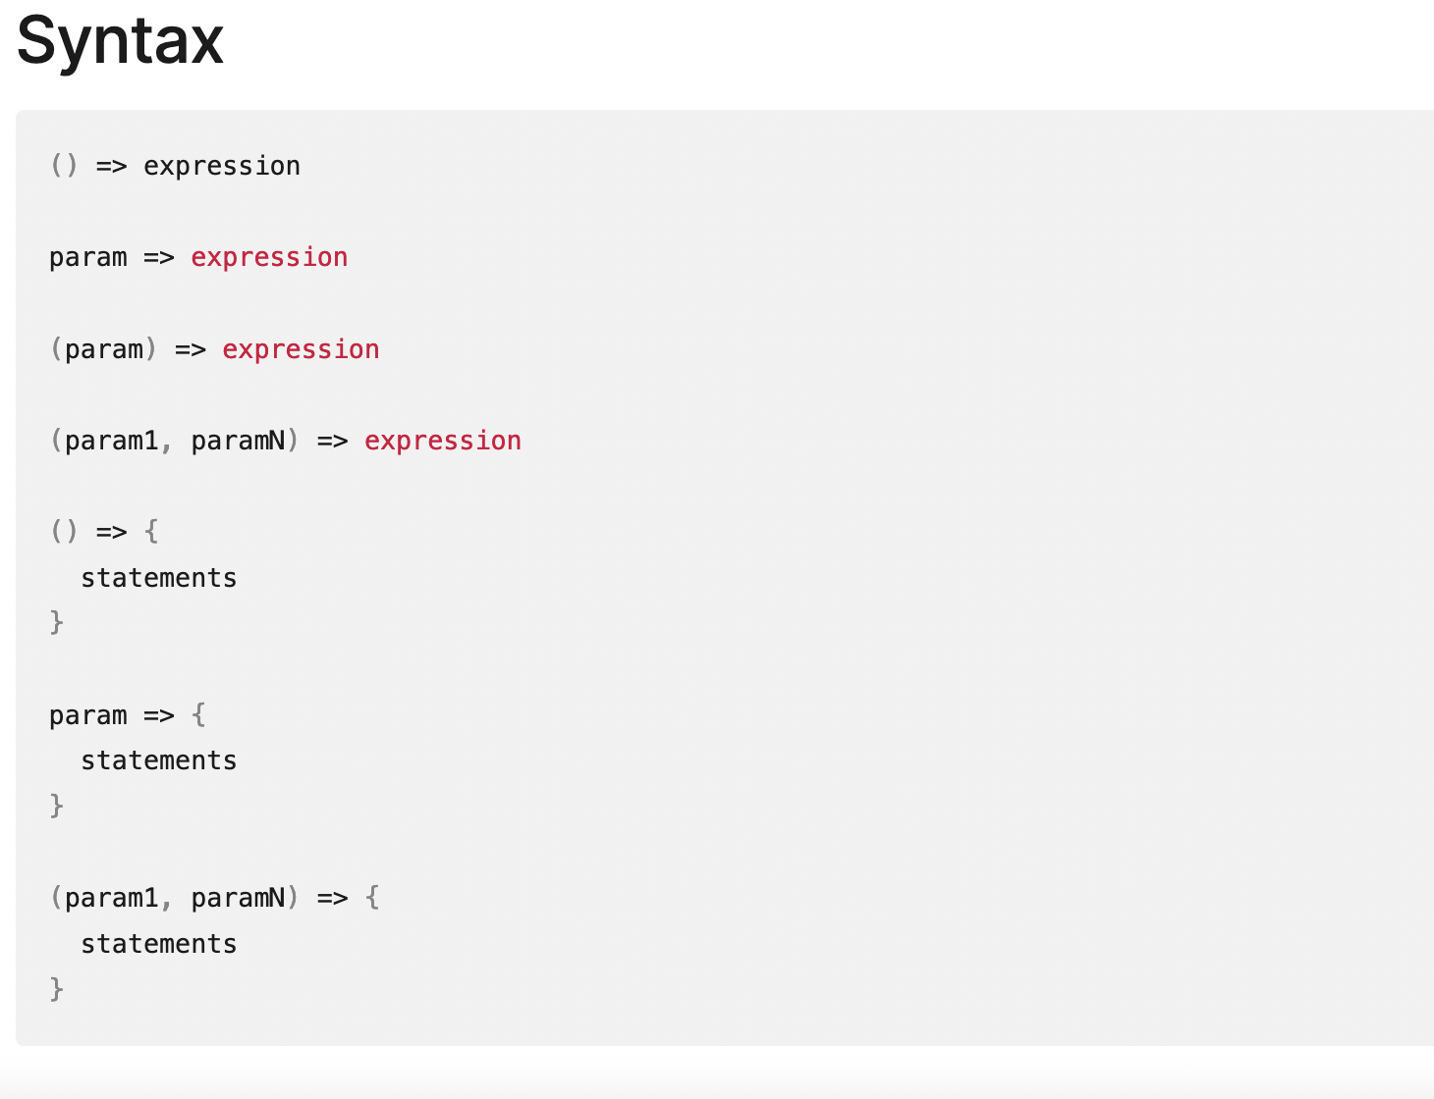
Representation of Functions

Slide 20
Day 4

Slide 21
Topics to Discuss
OOPS concept in JavaScript
Inheritance- Types with Def and Examples,Super keyword
Prototype in JavaScript
Polymorphism in JavaScript

Slide 22
OOPS
OOP(Object Oriented Program) is to separate concerns and responsibilities into entities
OOP is very useful on large scale projects, as it facilitates code modularity and organization.
Entities are coded as objects, and each entity will group a given set of information (properties) and actions (methods) that can be performed by the entity.

Slide 23
What is Class
Classes are the blueprints or molds that we're going to use to create the actual objects.
Class names are declared with a capital first letter and camelCase by convention. The class keyword creates a constant, so it cannot be redefined afterwards.
Example: ClassA
classA
Classes must always have a constructor method that will later on be used to instantiate that class.
A constructor in JavaScript is just a plain old function that returns an object.
The “this” keyword points to the class itself and is used to define the class properties within the constructor method.
Methods can be added by simply defining the function name and its execution code.

Slide 24
OOPS - Inheritance
Inheritance is the ability to create classes based on other classes
we can define a parent class (with certain properties and methods), and then children classes that will inherit from the parent class all the properties and methods that it has.
we use the extends keyword to declare the parent class we want to inherit from.
Class nameA extends nameB
Then on the constructor method, we have to declare the "power" parameter and use the “super” function to indicate that property is declared on the parent class.
A class can only have one parent class to inherit from.
If a child class inherits any properties from a parent class, it must first assign the parent properties calling the super() function before assigning its own properties.
Children classes can override the parent's properties and methods.

Slide 25
OOPS- Encapsulation
Encapsulation decides which information to show and which information to hide
Encapsulation is implemented through public and private properties and methods.
Javascript by default is always public
Encapsulation is useful in cases where we need certain properties or methods for the inner working of the object, but we don't want to expose that to the exterior.

Slide 26
Javascript Prototype
JavaScript is a prototype-based language that facilitates the objects to acquire properties and features from one another.
Syntax is as below ,
ClassName.prototype.methodName
Whenever an object is created in JavaScript, its corresponding functions are loaded into memory. So, a new copy of the function is created on each object creation

Slide 27
OOPS- Abstraction
Abstraction is the process of hiding the implementation details and to show only the functionality
Please note that an instance of Abstract Class cannot be created.
JavaScript Abstraction reduces the duplication of the code.
Use of “instanceof” - used to check the type of object at runtime
Returns true or false
If the returned value is true, then it indicates that the object is an instance of a particular class and if the returned value is false then it is not.
Syntax : var myVar = objectName instanceof objectType
The Object.create() static method creates a new object, using an existing object as the prototype of the newly created object.
We cannot have implementation of the function inside the abstract class

Slide 28
OOPS - Polymorphism
Polymorphism is a core concept of an object-oriented paradigm that provides a way to perform a single action in different forms.
Overloading - compile time polymorphism
Overriding - runtime polymorphism
It provides an ability to call the same method on different JavaScript objects.

Slide 29
Exception Handling
Exception handling is a process or method used for handling the abnormal statements in the code and executing them
Throw statement is used
Try…catch block is used
Exception Handling Statement,
throw statements
try…catch statements
Can have one try block and multiple catch blocks
try…catch…finally statements
Finally → whatever we write in finally that will get displayed or performed . Irrespective of the function/method output

Slide 30
Read and Write using JS
‘fs’ in javascript is nothing but the module required by javascript to perform the operation
Fs → File System module
fs.readFile() and fs.writeFile() methods are used to read and write the files
fs.readFile()
fs.readFile( file_name, encoding, callback_function )
filename: It contains the filename to be read, or the whole path if the file is saved elsewhere.
encoding: It stores the file’s encoding. ‘utf8’ is the default setting.
callback function: This is a function that is invoked after the file has been read. It requires two inputs:
err: If there was an error.
data: The file’s content.
fs.writeFile()
fs.writeFile( file_name, data, options, callback )
file_name: It’s a string, a buffer, a URL, or a file description integer that specifies the location of the file to be written. When you use a file descriptor, it will function similarly to the fs. write() method.
data: The data that will be sent to the file is a string, Buffer, TypedArray, or DataView.
options: It’s a string or object that may be used to indicate optional output options. It includes three more parameters that may be selected.
callback: This function gets invoked when the method is run.

Slide 31
JSON using JS
Read and writing json is same as text file but there few keywords
JSON.stringify (data) → return json format which can be written to file
JSON.parse(data) →takes JSON data as input and returns a new JavaScript object.

Slide 32
JS Map and JS Set
JS Map - it is used to map key to values
Always exists as key-value pair
Syntax → new Map([iterable])
Iterable → is usually a array
A map object cannot contain the duplicate keys.
A map object can contain the duplicate values.
The key and value can be of any type (allows both object and primitive values).
A map object iterates its elements in insertion order.

Slide 33
Js Set
JS Set - used to store the elements with unique values
Syntax:
new Set([iterable])
iterable - It represents an iterable object whose elements will be added to the new Set.
A set object uses the concept of keys internally.
A set object cannot contain the duplicate values.
A set object iterates its elements in insertion order.

Slide 34
JS Promise
It provides value after a asynchronous call
Asynchronous is nothing but the tasks can be started parallely without waiting for any
Asynchronous helps to complete more tasks in shorter period of time
How to handle Asynchronous
Use of call back
Using promise

Slide 35
Intro to Promise
Promise is a special JavaScript object. It produces a value after an asynchronous operation completes successfully, or an error happens
Success → resolve
Failure → reject
Syntax
let promise = new Promise(function(resolve, reject) { }
new Promise() will return promise as object
Internal properties/states of promise → state,pending,fulfilled,rejected
Promise used executor function
Uses then(), try/catch() and finally()

Slide 36
Call back
callback is a function which is to be executed after another function has finished execution.
Any function that is passed as an argument to another function so that it can be executed in that other function is called as a callback function.
callback's primary purpose is to execute code in response to an event.

Slide 37
JS - async/await

