Slide 1
FILLING STATION MANAGEMENT SYSTEM
By: -
AP19110010196 - Aravind
AP19110010239 - Nitya
AP19110010254 - Gowtham
AP19110010283 - Deepak

Slide 2
INTRODUCTION
Our website ‘Stake and Stock’ is a web application for filling stations.
Filling Station Management System
Basic idea – calculate, store and retrieve the stock and sales details of a filling station on a daily basis.
Stakeholders/ target audience – Fuel/ filling station managers
This Photo by Unknown Author is licensed under CC BY

Slide 3
Primary Goal –
Digitalize the records
Ease the work of fuel station managers
Features/ options offered in the developed site –
Calculate sales on a daily basis
Store the records for various purposes
Retrieve the data entered

Slide 4
EXISTING SYSTEM/ LITERATURE SURVEY
According to literature survey there are many existing applications which are developed for fuel filling stations for their management. Here are few existing applications:
1)Petrol Pump Management System using PHP and MySQL.
2)Gas station management system using PHP and SQLite

Slide 5
EXISTING SYSTEM/ LITERATURE SURVEY
(a)Petrol Pump Management System using PHP and MySQL:
The main objective is to overcome the manual errors and make a computerized system. In this system there are several modules are used which mainly are:-
i)Sales module: We can create,read,update and delete sales from this module.
ii)Tankers: All operations related to tankers is managed in this module.
iii)Meter Readings: Developed for managing meter readings.
iv)Inventory: Manages the inventory.
v)Stock: Stock operations are managed in this module.

Slide 6
EXISTING SYSTEM/ LITERATURE SURVEY
(b)Gas station management system using PHP and SQLite:
This is a web based application that provides gas stations with an automated platform for managing sales, customer balances and customer payments. This application is developed to help the administrators save records and retrieve data easily. It has simple user interface and user-friendly features. Here it has two types of system users which are the admin and the cashier. The admin user is incharge of managing important lists such as petrol type and customer list. The cashier user can access only point of sale feature and generate sales reports.

Slide 7
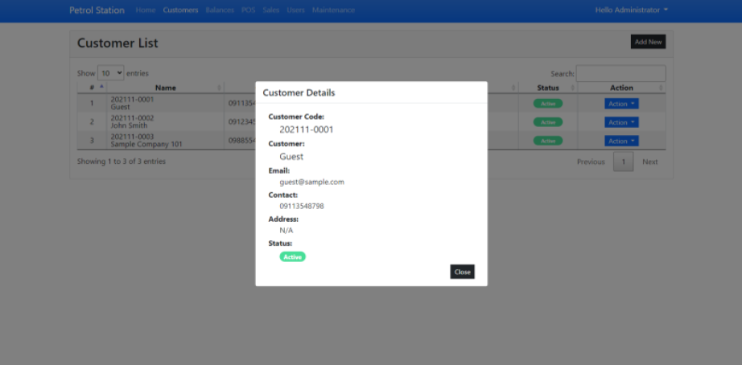

Slide 8
SYSTEM REQUIREMENTS
User Interface Requirements:
The user interface should be very user-friendly, and it should serve the function of each choice integrated in the website. The user interface should be simple enough that even inexperienced clients will have no trouble navigating the website.

Slide 9
SYSTEM REQUIREMENTS
Hardware requirements:
● A laptop or computer with internet access
● Mouse
● Keyboard
● 512 MB of RAM 9
Software requirements:
● Functioning OS
● Web browser
Communication requirements:
● HTTPS
● TCP/IP
● SMTP

Slide 10
Proposed System
Main system functionalities :
Sale, Stock and Density Calculation
Records Display
Account section
Required steps to achieve our Aim

Slide 11
Sale, Stock and Density Calculation
Done for both Petrol and Diesel
Diesel/Petrol Sale :
In this field we will calculate Total Meter Sale, and Total Amount
Total Meter Sale = SaleForNozzle1 + SaleForNozzle2 + SaleForNozzle3 + SaleForNozzle4
Actual sale = Total Meter Sale - Testing
Total Amount = Actual Sale * Rate

Slide 12
Sale, Stock and Density Calculation
Diesel/Petrol Stock :
In this field we will calculate Total stock , Closing Stock and Variation
Total stock = opening stock + receipt stock
Closing Stock = Total Stock - Actual Sale
Variation = Actual Dip - Closing Stock
Diesel/Petrol Density :
In this field we will calculate Density Difference
Density Difference = Receipts Density - As Per Challan Density

Slide 13
Records Display and Account Section
After calculation records are stored in Database
All the records will be appeared on your screen after submitting the inputs
In Account section the dealer can store the details about money transactions , Quantity of fuel received in a receipt, Payment Date, Short/Excess and etc….

Slide 14
RESULTS/ PERFORMANCE EVALUATION

Slide 15
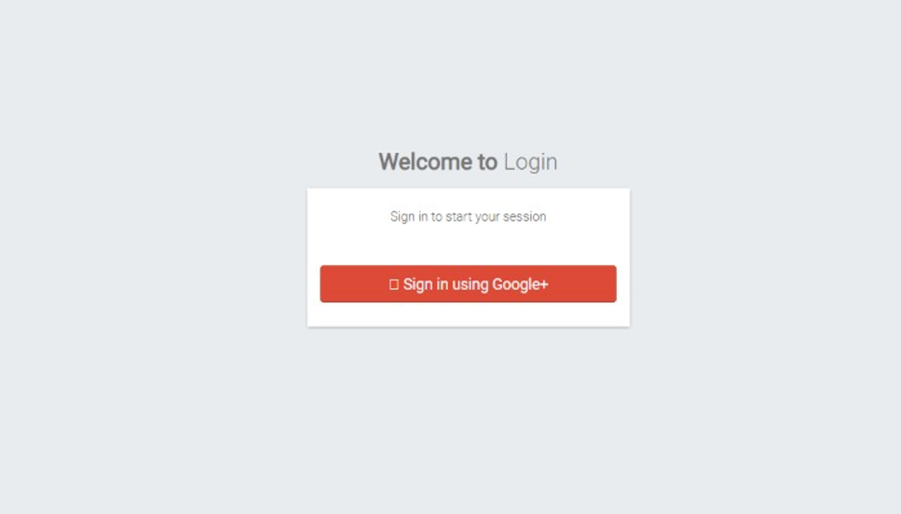
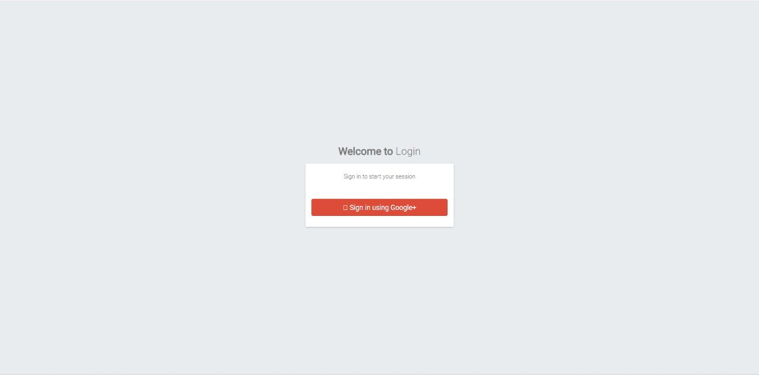

Slide 16
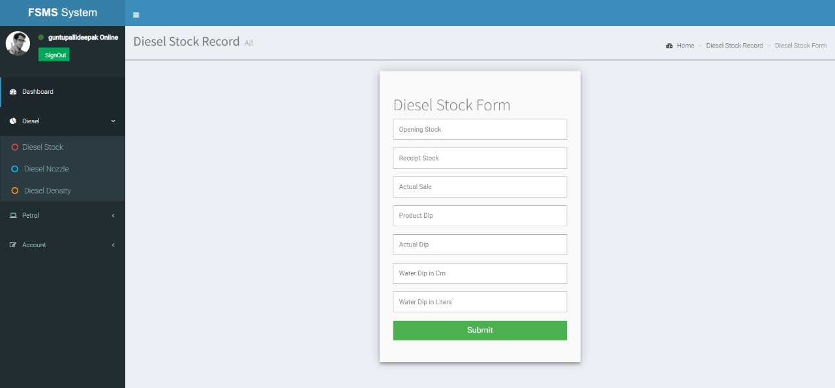

Slide 17
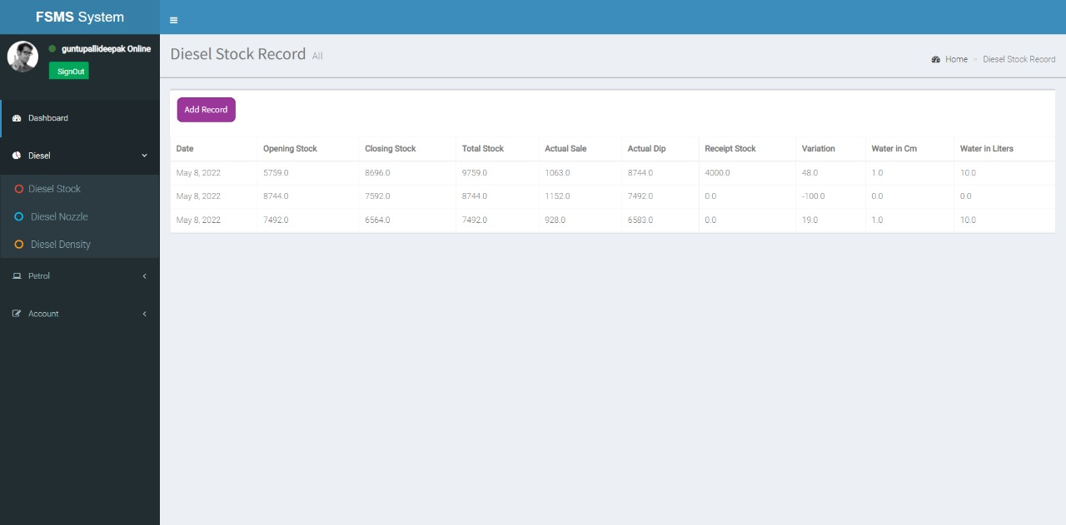

Slide 18
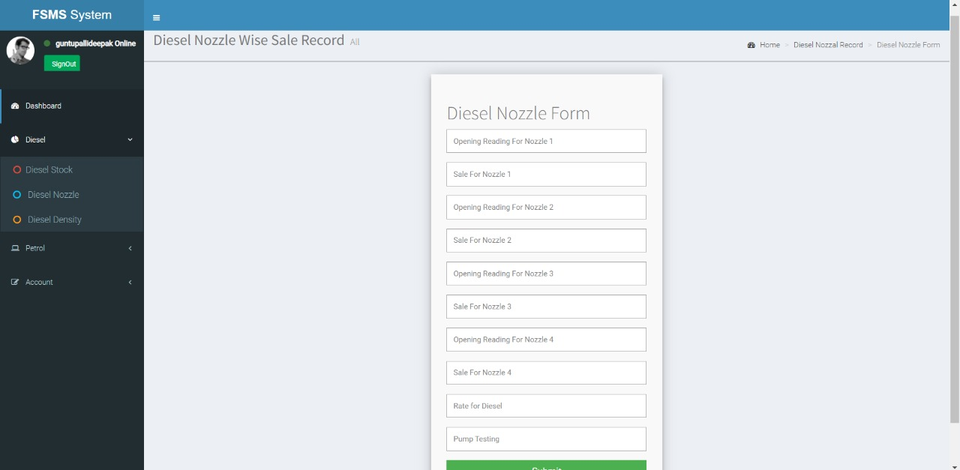

Slide 19


Slide 20
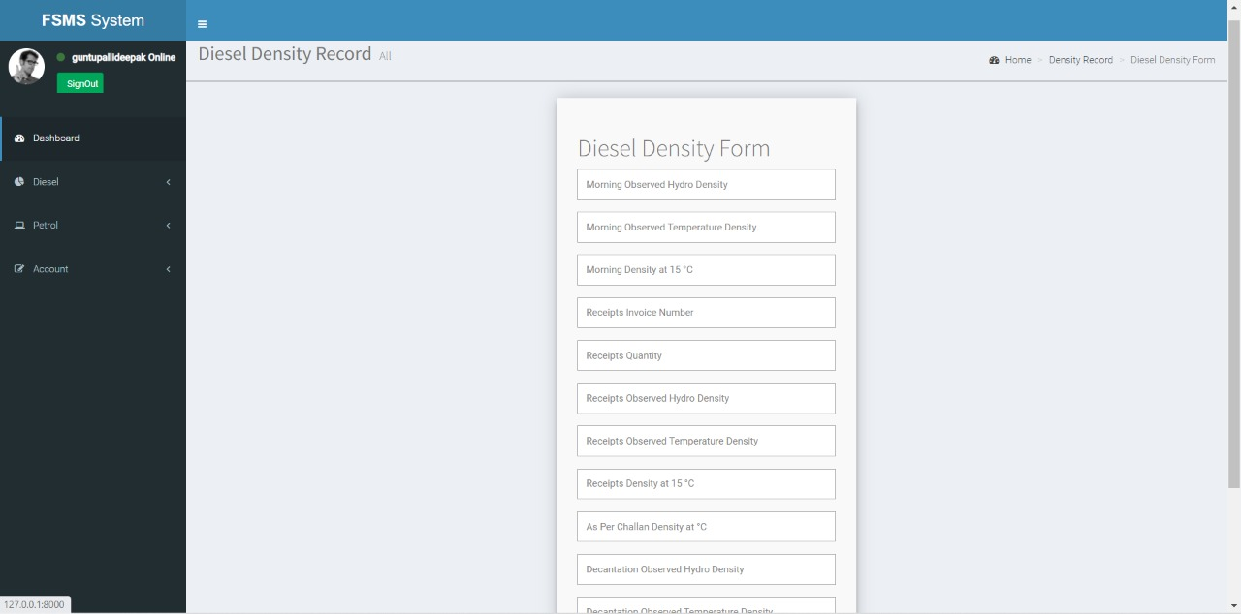

Slide 21
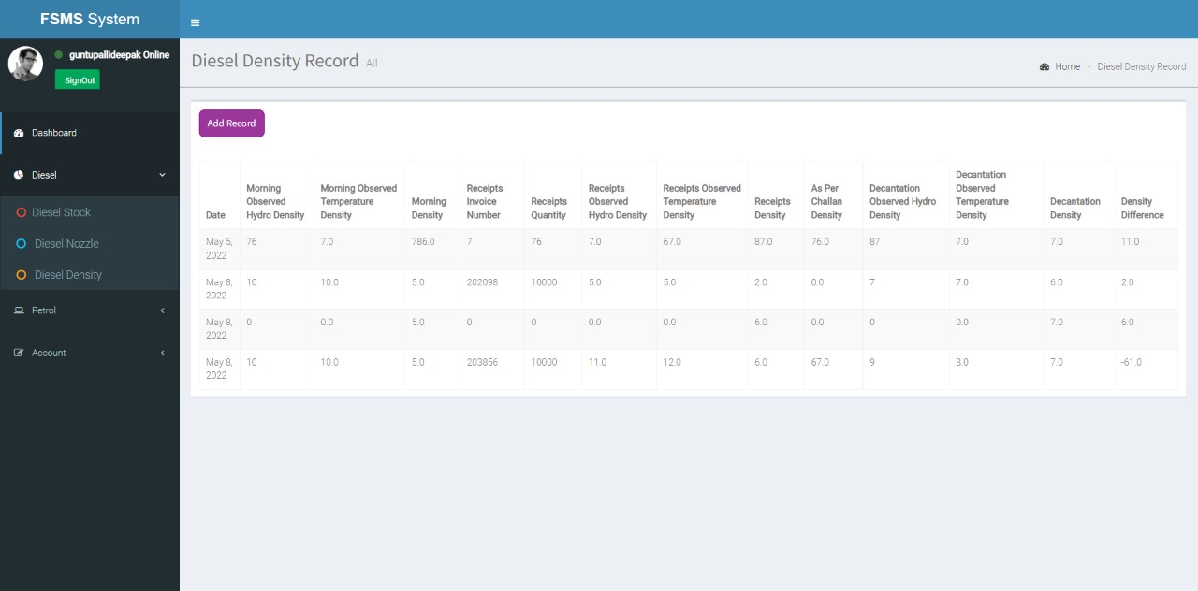

Slide 22


Slide 23
CONCLUSION
By taking every variable into consideration and correcting the maximum of the problems, we have calculated all the sales with varying stock and digitalized all the data.

Slide 24
The End
Thank you

