Slide 1
Influence Maximization In Social Network By Using Centrality Measures
CSE340 - Undergraduate Research Opportunities Program
MENTOR: Dr. Murali Krishna Enduri
By :-
AP19110010196 - Aravind
AP19110010239 - Nitya
AP19110010254 - Gowtham

Slide 2
INTRODUCTION
Problem Statement:
Finding Influential Nodes and its maximization
What are influential nodes?
Nodes of the network that possess high degrees and play an important role in the network’s structure.
Influential nodes are often represented by large circles in graph illustrations (if they can be determined from the data).
What is influential node maximization?
It is the problem of selecting a small subset of seed nodes in a social network, such that their overall influence on other nodes in the network is maximized.

Slide 3
Paper Implemented -
‘Identifying vital nodes from local and global perspectives in complex networks’
What is a network? What is a network made up of ?
A network is simply a number of points/ nodes that are connected by links.
Nodes make up the network.
In order to create a network, you need nodes and some of them need to be influential - they serve as the center of a traffic pattern.
Social networks are naturally modeled as graphs, which we sometimes refer to as social graphs. The entities are the nodes and an edge connects two nodes if the nodes are related by the relationship that characterizes the network.
Generally, in social network analysis, the nodes are people and the links are any social connection between them. For example, friendship, family ties etc.
A social network can be represented as a graph.
A social graph helps to illustrate and map the overall structure and interrelation of social network members.

Slide 4
Example -
In social media or an information networking site, which typically have many users and connections between them, some users stand out due to their activities, number of connections - these are influential people and we consider them as influential nodes.
Influential nodes may have many followers and friends, people with a lot of mentions, maximum shares for a post.
In a social network, an influential node may be more active, have more connections than any ordinary member.
Achieving many connections also makes it easy for people to spread information in a way like forwarding the information to their connections.

Slide 5
Applications
Identifying influential nodes in complex networks plays an important role in understanding the dynamics of infection in each outbreak of infectious disease. In the outbreak of most infectious diseases, the activity of some major nodes can cause the rapid transmission of the disease in the population. Identifying and rapidly isolating these influential nodes can effectively prevent the transmission of the disease. A recent example is COVOID-19.
Publishing Ads for global reach for many organizations and influencers on social media create a great impact on people by advertising.Not surprisingly, more and more customers have come to trust influencers, and this marketing method has become mainstream and widely used.
Disease Modeling by addressing the issue of efficiently discovering influential nodes in social networks according to the Vulnerability / Infection / Vulnerability model.
Viral Marketing is a business strategy that uses existing social networks to promote their own products which indeed refers to how consumers spread the information about a product with different people.

Slide 6
Centrality Measures
Centrality measures address the question:
“Who is the most important or central person in the network?”
There are a vast number of different centrality measures that have been proposed over the years.
We will look at some popular ones...

Slide 7
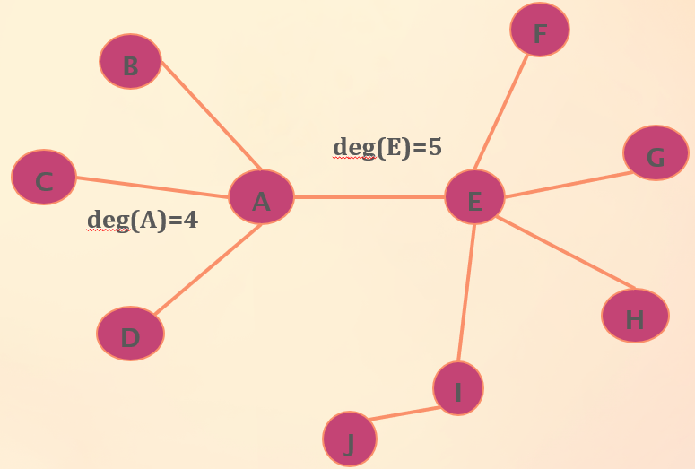


Degree Centrality
Degree centrality focuses on individual nodes – it simply counts the number of edges that a node has.
Degree Centrality:
Normalized Degree Centrality:
For node A, degree centrality is 4,
Normalized degree centrality is 4 / (10-1) = 4 / 9

Slide 8
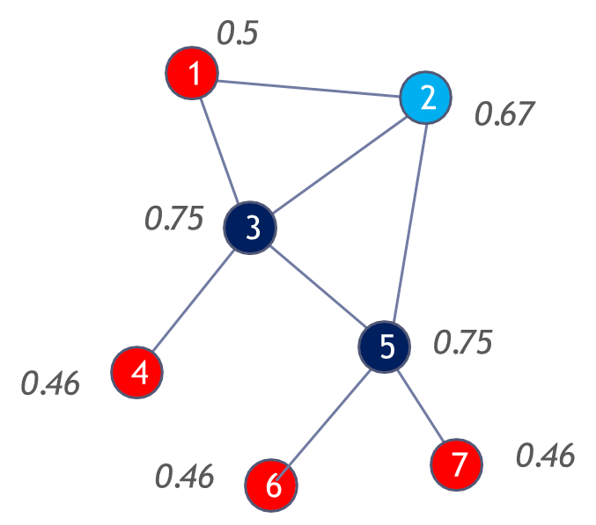

Closeness Centrality
Closeness centrality is a measure of the average shortest distance from each vertex to each other vertex.
It can describes how far and close vertices are.

Slide 9
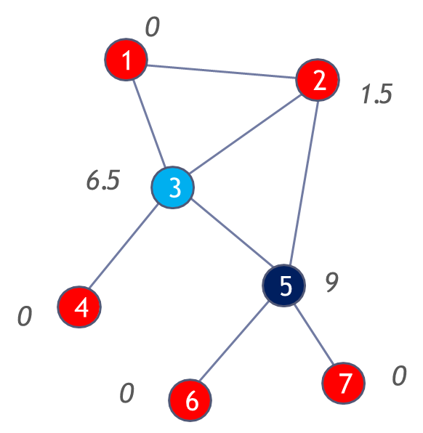

Betweenness Centrality
Betweenness Centrality BC(v) of a vertex v is defined as follows
where,
Total number of shortest paths between node u and w that pass through v
Total number of shortest paths between node u and w
For a given node v, calculate the number of shortest paths between nodes u and w that pass through v, and divide by all shortest paths between nodes u and w.

Slide 10
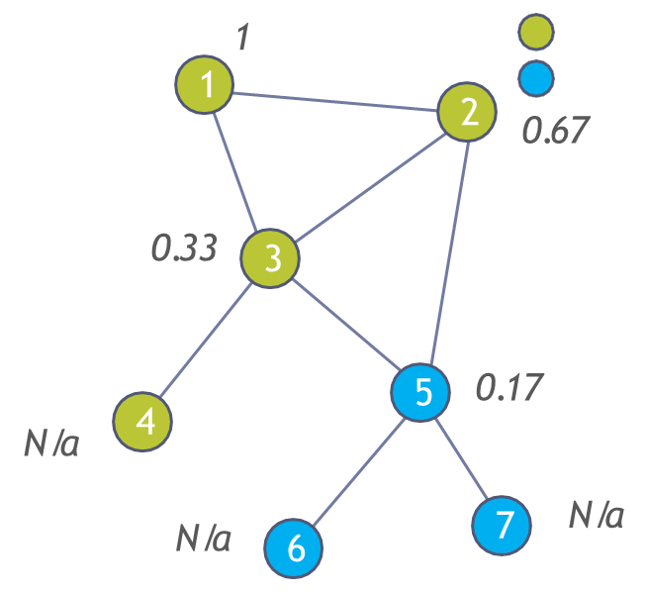

Clustering Coefficient Centrality
A node’s clustering coefficient is the number of closed triplets in the node’s neighborhood over the total number of triplets in the neighborhood. It is also known as transitivity.
Cluster A
Cluster B

Slide 11
RESULTS/ PERFORMANCE EVALUATION
We are implementing an algorithm which considers both local and global structure parameters to find the influential nodes. This algorithm is called LGC. LGC primarily follows three definitions which are:
1)Local Influence
2)Global Influence
3)Total influence

Slide 12
RESULTS/ PERFORMANCE EVALUATION
1)Local Influence: Represents the local information oh the graph.
LI_{v(i)} = d(v_{i})/n
2)Global Influence: The node not only influences itself but also considers the influence of neighboring nodes.
GI_{v(i)} = 𝝨 (√d(v_{j})+𝛼)/ d_{ij} ( where i≠j )
3)Total Influence: The combination of the above two aspects local-influence and global influence.
LGC_{v(i)} = LI_{v(i)} x GI_{v(i)}
Complexity: The total computational complexity of LGC is 𝑂(𝑛^2 ).

Slide 13
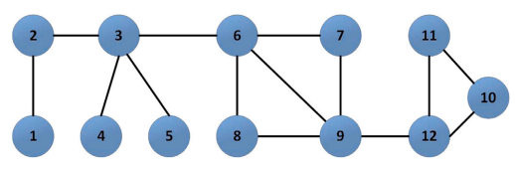
Explanation of LGC

Slide 14
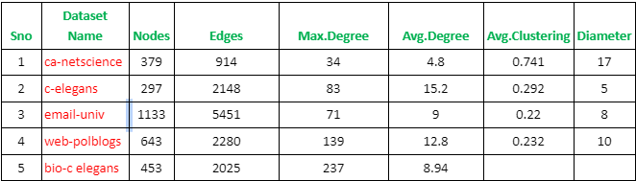
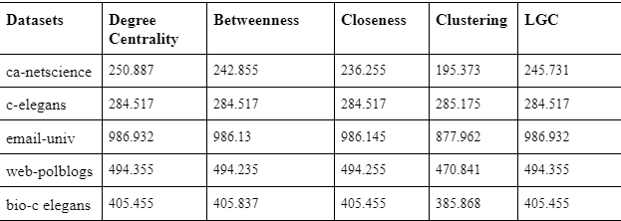
Explanation of LGC:

Slide 15
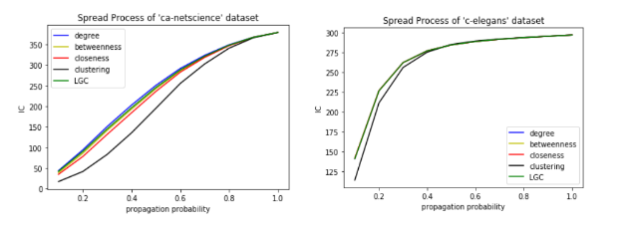
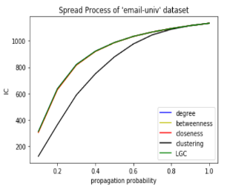

Slide 16
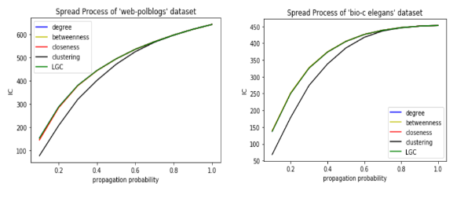

Slide 17
The End
Thank you

