Slide 1
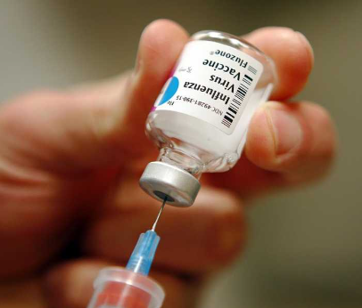
Vaccine-Usage-Analysis-and-Prediction
Aravind Chirshtopher Joseph

Slide 2
H1N1 Vaccine The H1N1 vaccine is designed to protect against the H1N1 influenza virus, also known as the swine flu. This strain of influenza caused a global pandemic in 2009, leading to the development of a specific vaccine to control its spread.

Slide 3
Types of H1N1 Vaccines
"Inactivated (Killed) Vaccine:" "This form of the vaccine contains an inactivated version of the H1N1 virus, which cannot cause illness but can stimulate the immune system to produce antibodies." "Live Attenuated Vaccine:" "This is a nasal spray vaccine containing a weakened form of the virus, also designed to provoke an immune response without causing the flu." "Both types of vaccines were widely distributed during the 2009 pandemic".
This vaccine is to be administered only by or under the supervision of your doctor or other health care professional.

Slide 4
Technologies used: * Python Scripting * Pandas * Seaborn *Matplotlib *Plotly *Streamlit

Slide 5
Approach
Data Collection and Preparation of the Dataset
Model Selection
Model Tuning
Model Evaluation and Performance Testing
Developing Streamlit Application

Slide 6
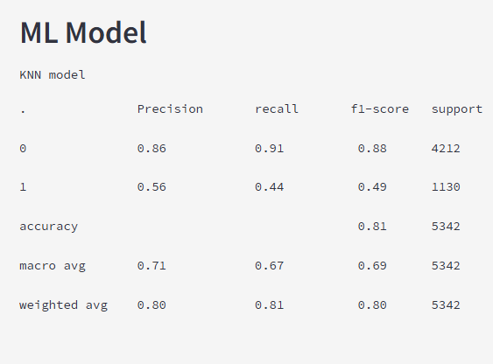
ML Model KNN model

Slide 7
Predictions Based on
previously received the H1N1 vaccine
Worry about the h1n1
Chronic medical Condition
Sick from H1N1 Vaccine
Doctor Recommendation
Based on Age
Based on Gender
Vaccine effectiveness

Slide 8
Results
The Streamlit app provides real-time predictions and allows health organizations to quickly assess the likelihood of vaccination for different population segments. This can inform better-targeted campaigns and resource allocation.
The KNN model performed well after tuning and the Streamlit application offers an accessible interface for end users, helping to optimize vaccination efforts.

Slide 9
Thank you

