Slide 1
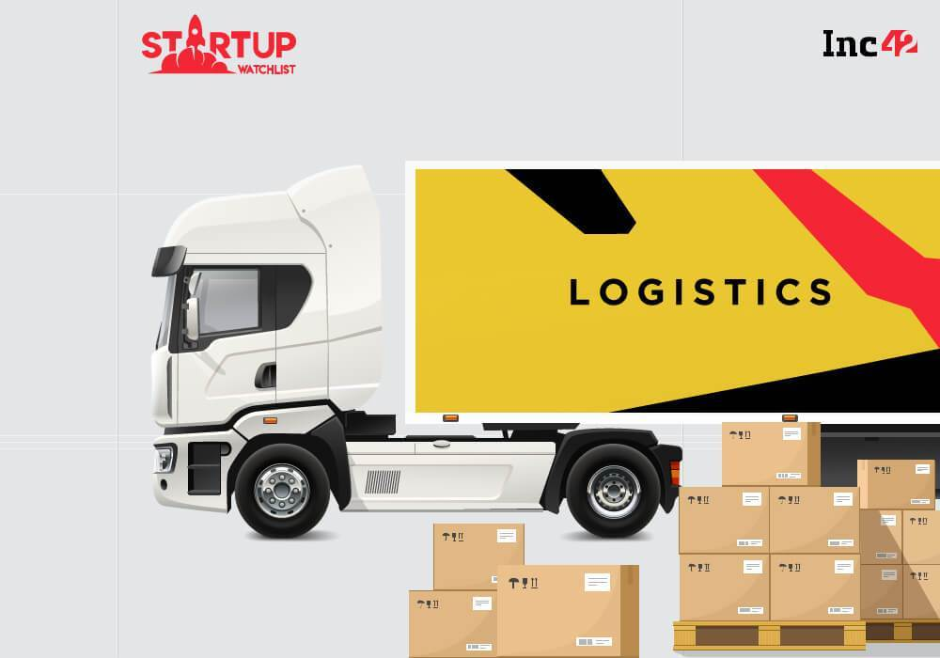
Transportation and Logistic Industry

Slide 2
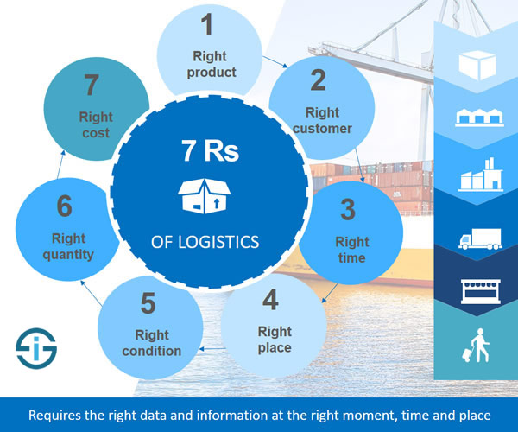
Role of Analytics in Logistics

Slide 3
Benefits of Analytics
The Last Mile of Shipping Can Be Quickened
Reliability Will Be More Transparent
Routes Will Be Optimized
Sensitive Goods Are Shipped With Higher Quality
Automation of Warehouses and The Supply Chain

Slide 4

Objective of Project
The main objective of this project is to predict the freight cost based on the delivery history data.
Why Freight Cost ?

Slide 5
Explanation of Dataset
This data set provides supply chain health commodity shipment and pricing data.
We believe that this data will help stakeholders make better, data-driven decisions and care should be taken to consider contextual factors when using the database.
Attributes/Features:
Country | Line Item Quantity
Fulfil via | Line Item Value
Vendor Inco terms | Pack Price
Shipment mode | Unit Price
Product group | Weight (kg’s)
Brand | Freight cost (USD)
Unit of Measure (Per Pack) | Line Item Insurance(USD)

Slide 6
Sequence of Steps
Import
Load the dataset
EDA
Drop Null Values
EDA
Model
Applied Different Models
Change Params
Feature Engineering

Slide 7
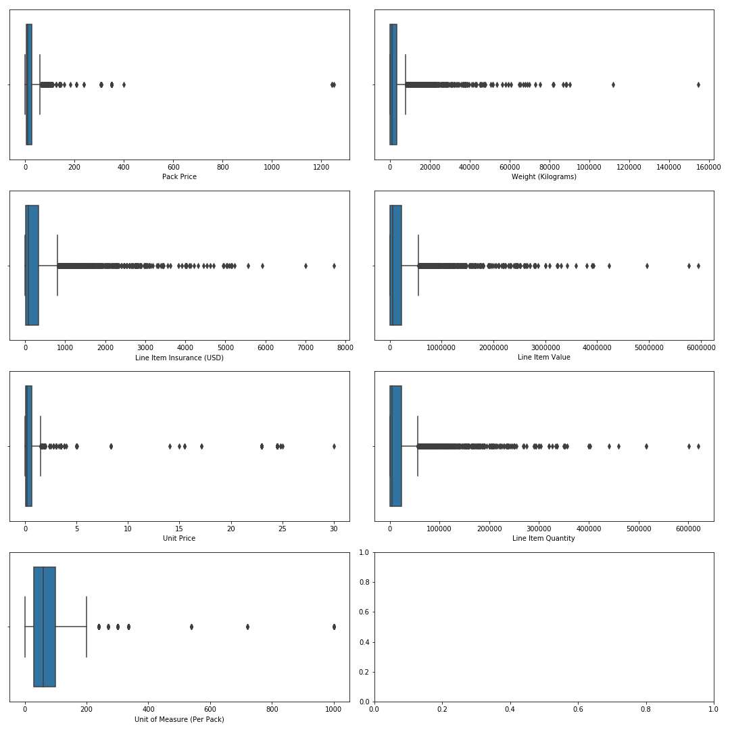
Box plots:

Slide 8
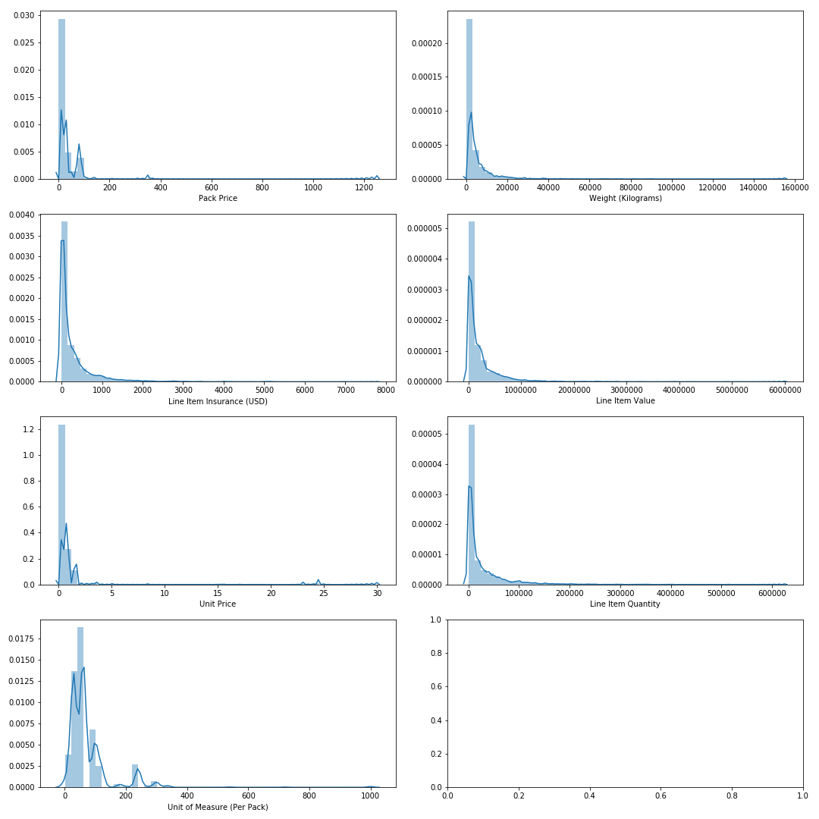
Dist Plot:

Slide 9
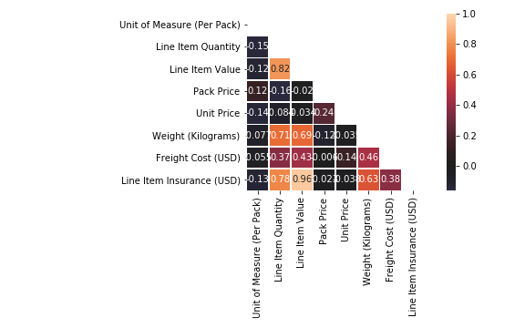
Correlation Matrix:

Slide 10
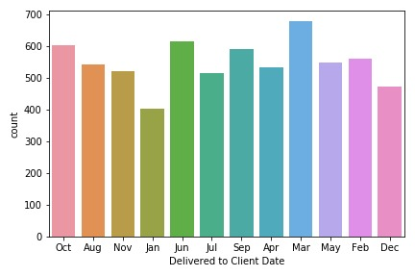
Month Wise Delivery

Slide 11
Before Model apply- Problems Faced
1. We did not find the proper dataset which have attribute predict
2. We are having less Null Values so we removed
3. We have removed 40% data from dataset because we found some values cannot be replaced with any value
4. We are having so many outliers(we can say that dataset is an outlier dataset)
5. Finally comes to Accuracy??
Freight Cost (USD)
See DN-998 (ID#:11568)
See DN-993 (ID#:11919)
See DN-992 (ID#:11602)
See DN-990 (ID#:11001)
See DN-988 (ID#:11022)
See DN-987 (ID#:12252)
See DN-987 (ID#:12252)
See DN-986 (ID#:10748)
See DN-969 (ID#:11593)
See DN-968 (ID#:11289)
See DN-965 (ID#:11563)
See DN-964 (ID#:10987)
See DN-960 (ID#:11945)
See DN-960 (ID#:11945)

Slide 12
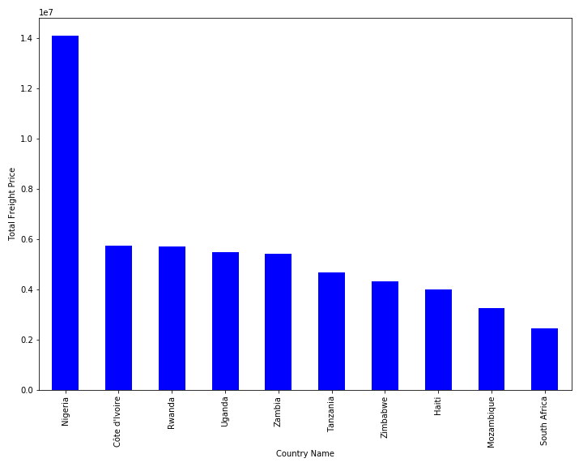
Top 10 Countries Freight Cost

Slide 13
Models Applied
Model Used | Accuracy(%) | Expected Accuracy(%)
Linear Regression | 30.1 | 95
Decision Tree | 39.7 | 96
Random Forest | 71.0 | 97
Bagging | 68.4 | 98
Boosting | 62.8 | 99.5
KNN | 61.3 | 99.7
Model Used | Accuracy(%) | Expected Accuracy(%)
Linear Regression | 37.8 | 90
Decision Tree | 65.6 | 90
Random Forest | 78.7 | 90
Bagging | 77.0 | 90
Boosting | 74.3 | 90
KNN | 71.9 | 90

Slide 14
Continued…
Model Used | Accuracy(%) Before Removal | Accuracy(%) After Removal
Linear Regression | 37.8 | 39.1
Decision Tree | 65.6 | 65.7
Random Forest | 78.7 | 79.2
Bagging | 77.0 | 78.5
Boosting | 74.3 | 71
KNN | 71.9 | 66.3

Slide 15
Steps tried to increase Accuracy
1. Removal of outliers Step by Step
2. Applied transformation techniques to make the data normalized
3. Applied GridSearchCV to find best params_

Slide 16
CONCLUSION

