Slide 1
Cohort Control Tower
OncoSys Cancer AI Lab | Track 1: Cohort Firewall
Is a new TCGA breast cancer release still fit for your research question?
Team Identity_Crisis | November 14, 2026
Aravind Sundaravadivelu, Aakruti Ghatole, Chirag Suthar, Madhu Vadhani Madasamy Romario Joseph
Notes:
About 10 seconds.
Good afternoon. We are Team Identity_Crisis, Track 1, Cohort Firewall. Cohort Control Tower answers one question for a research data engineer: is a new TCGA breast cancer release still fit for my research question?

Slide 2
A new release can swap, copy or drop samples while every count stays the same
The problem
Protein samples in the organizers' practice release
Why our user cares
747
747
The user. A research data engineer who keeps an analysis-ready copy of TCGA breast cancer data for the scientists who use it.
The cadence. The NCI Genomic Data Commons has shipped a new data release about every 4 to 5 months since 2024.
The risk. Swaps happen: one cross-omics method found 8 mismatched profile pairs among 317 TCGA breast tumors.
The gap. Row counts and schema checks pass a swapped sample, because every value is still valid.
in release A
in the new release
12 samples changed inside the same total
Source: organizers' practice envelope and reference output; GDC Data Release Notes, DR40 to DR46; MODMatcher, PLoS Comput Biol 2014
Notes:
About 30 seconds.
Here is the organizers' practice release. It still has 747 protein samples, so a row count sees nothing wrong. But two samples traded data, five are copies of other samples, and five real tumors, all HER2-enriched, are gone. Our user keeps an analysis-ready copy of this data, new releases keep arriving, and count and schema checks pass every one of these errors.

Slide 3
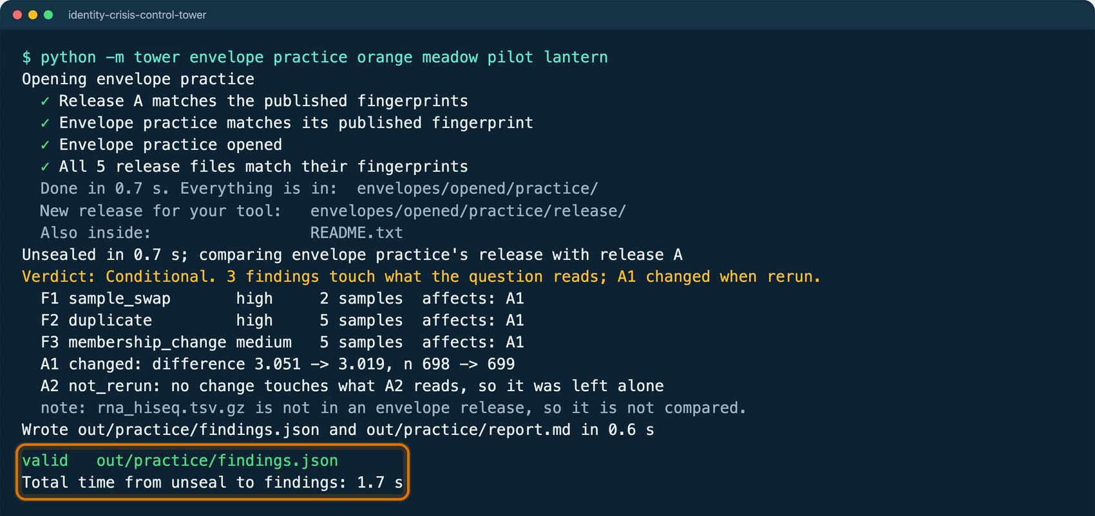
One command names every changed sample, reruns only what the changes touch, and judges the release for your question
How it works
1
Find what changed
Fingerprints every sample in every file, then names each swap, copy, loss and relabel, with every affected sample cited.
2
Rerun only what it touches
An analysis is rerun only if a change reaches what it reads. On the practice release, A1 is rerun and A2 is left alone.
3
Judge fitness for the question
The sealed-envelope command on the practice release: findings.json in the organizers' shared format, accepted by their validator, 1.7 seconds in total, unsealing included.
Ready, Conditional, Blocked or Insufficient Evidence, with reasons, next steps and what the tool can't tell you. A person signs off.
Source: tool output on the organizers' practice envelope, recorded in the team's demo video (docs/demo.mp4)
Notes:
About 35 seconds.
Cohort Control Tower fingerprints every sample in every file, so any change shows up, and names each one. It reruns only the analyses a change touches: here A1 is rerun and A2 is left alone. Then it judges the release against a specific research question. On the day, one command opens the sealed envelope and writes findings.json in the shared format, validated, in under two seconds.

Slide 4
It finds exactly the planted changes, and the research answer still holds
Results on the practice release
Changes found in the practice release
Mean ER-alpha protein by clinical ER status (A1)
Change | Samples | Severity | Why it matters
Swap between an ER-positive and an ER-negative tumor | 2 | High | A1 compares the wrong protein values in each group
Copies of other samples' profiles under new ids | 5 | High | The same measurements are counted twice
Samples removed, all HER2-enriched | 5 | Medium | The subgroup shrinks while the total stays the same
12 samples cited and none unchanged: the same samples and kinds as the organizers' reference answer.
Difference 3.051 to 3.019
Samples 698 to 699. The organizers' own reference script gives the same numbers. The answer survives 61 worst-case swaps between ER groups; this release made 1.
Source: tool output on the practice envelope; organizers' reference output (format/examples/control-tower-practice-B.json) and data/tcga-brca/reference_analyses.py
Notes:
About 35 seconds.
On the practice release it cites exactly the twelve changed samples and not one that didn't change, matching the organizers' reference answer. A1 moves from 3.051 to 3.019, and the organizers' own script gives the same number. Does the conclusion still hold? Yes: it survives 61 worst-case swaps between ER groups, and this release made one.

Slide 5
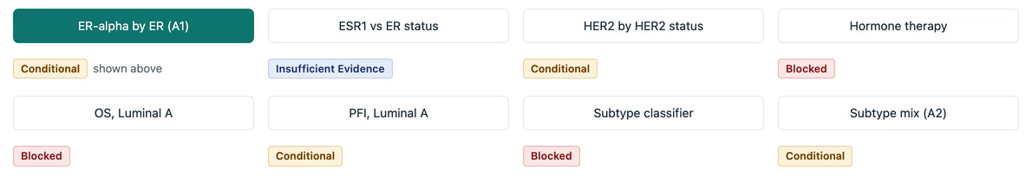
On the same release, the verdict changes with the research question, and each verdict states its reason
The verdict depends on the question
Overall survival, Luminal A: Blocked
Subtype classifier from RNA: Blocked
ESR1 versus ER status: Insufficient Evidence
Median follow-up is under three years, and the TCGA curators advise against overall survival for Luminal A. Progression-free interval, which they recommend, is Conditional.
The PAM50 label was computed from the same RNA, so high accuracy would only show the model relearned that rule.
The envelope has no RNA file, so the tool says it can't tell instead of guessing.
Source: tool output on the practice envelope (Overview page, team demo video); Liu et al., Cell 2018; Parker et al., J Clin Oncol 2009
Notes:
About 35 seconds.
The same release gets a different verdict for each question. Overall survival in Luminal A is Blocked: follow-up is under three years and the TCGA curators advise against it. Progression-free interval, which they recommend, is Conditional. A classifier trained on RNA to predict PAM50 is Blocked, because the label came from that same RNA. And with no RNA in the envelope, the ESR1 question is Insufficient Evidence, not a guess.

Slide 6
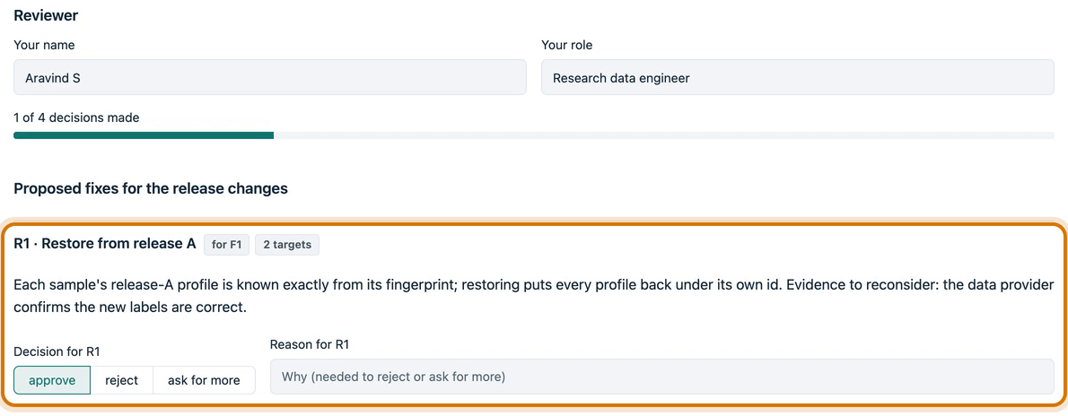
It was tested against answer keys written before it ran, and no fix is used until a person signs off
Testing and human review
20 of 20
test releases pass: 13 built with the organizers' generator, 7 it can't make, including damaged files
476 of 481
random releases from the organizers' generator match its answer key exactly
9 of 9
planted samples found in a Fool the Tower run, with no false alarms; judges can plant their own
Review and sign-off: a person approves, rejects or asks for more evidence on every proposed fix, and a rejection needs a reason. The signed record is saved in the shared format.
1.7 s
from unsealing the envelope to a validated findings.json
Hand us the envelope, plant your own errors, or ask your own research question.
Source: scripts/scorecard.py and README (481 random releases); team demo video (Fool the Tower, sign-off, envelope timing)
Notes:
About 30 seconds.
We tested it on 20 releases whose answer keys were written before it ran: all pass, and 476 of 481 random releases match exactly. No fix is applied on its own: a person approves, rejects or asks for more evidence, then signs off. Hand us the envelope, plant your own errors, or ask your own research question.

