Slide 1


Department Of CSE( ARTIFICIAL INTELLIGENCE MACHINE LEARNING) Title: Driver Drowsiness Detection System
Prepared by:
N.VIGNESH GOUD - 22R01A66H4
V.PRASHANTHI - 22R01A66J9
P.ARAVIND - 23R05A6615
T.ROHIT - 23R05A6618
Under the guidance of
M MOUNIKA
Department of
ARTIFICIAL INTELLIGENCE MACHINE LEARNING

Slide 2

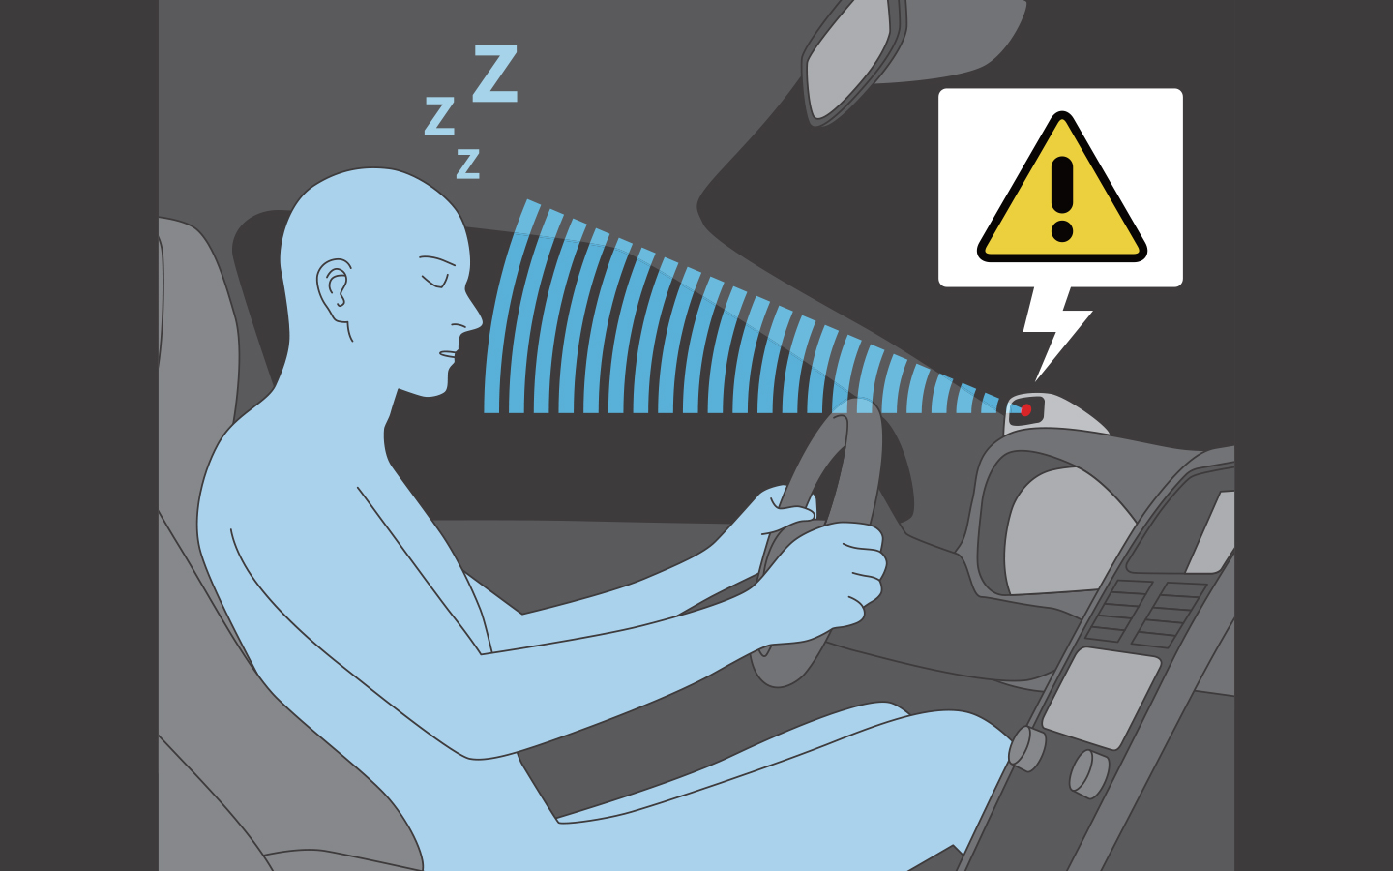
Abstract
In this project we are using opencv library for image processing and giving input as user live video and training data to detect if person in video is closing eyes or showing any symptoms of drowsiness and fatigue then application will verify with trained data and detect drowsiness and raise alarm which will alert driver.

Slide 3

Literature Survey:
Title: Real-Time Driver Drowsiness Detection Using OpenCV and Facial Landmarks
Author: John Doe, Jane Smith
Year of Publication:2015
Method used : OpenCV for facial feature detection and tracking, eye tracking algorithms for monitoring eye movement patterns indicative of drowsiness.
Observation: Difficulty in detecting drowsiness in drivers with certain eye conditions.

Slide 4
Title:Driver Drowsiness Detection Using OpenCV and Machine Learning Algorithms"
Author : Sarah Chen, Michael Brown
Year of Publication:2019
Method used:OpenCV for facial feature detection and extraction of relevant features, machine learning algorithms
Observation:limited generalization to diverse driver populations.

Slide 5
Introduction
The aim of this project is to develop a prototype drowsiness detection system.
The focus will be placed on designing a system that will accurately monitor the open or closed state of the driver's eyes in real time.
It is designed for computational efficiency and with a strong focus on real-time applications.
This is developed by using OpenCV & Python.

Slide 6
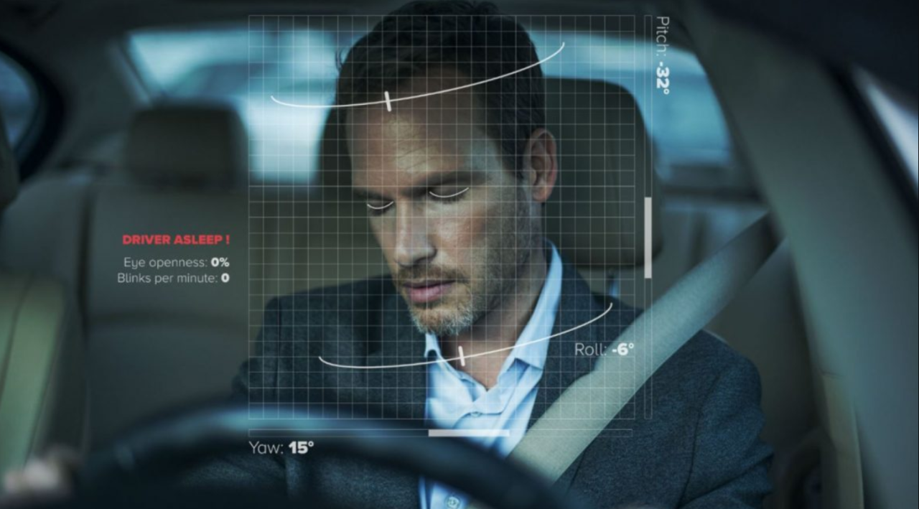
PROBLEM STATEMENT
Driver fatigue is a significant factor in a large number of vehicle accidents. Recent statistics estimate that annually 1,200 deaths and 76,000 injuries can be attributed to fatigue related crashes.
The development of technologies for detecting or preventing drowsiness at the wheel is a major challenge in the field of accident avoidance systems. Because of the hazard that drowsiness presents on the road, methods need to be developed for counteracting its affects.

Slide 7
EXISTING SYSTEM
There is various methods like detecting objects which are near to vehicle and front and rear cameras for detecting vehicles approaching near to vehicle and air bag system which can save lives after accident is accorded.

Slide 8
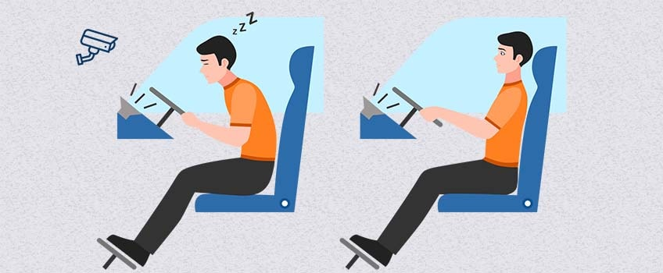
PROPOSED SYSTEM
To deal with this problem and provide an effective system a drowsiness detection system can be developed which can be placed inside any vehicle which will take live video of driver as input and compare with training data and if driver is showing any symptoms of drowsiness system will automatically detect and raise alarm which will alert driver and other passengers.

Slide 9



Objective
The objective of driver drowsiness detection using OpenCV (Open Source Computer Vision Library) is to develop a system that can automatically detect signs of drowsiness or fatigue in drivers based on analysis of their facial expressions, eye movements, and other visual cues captured through a camera. The primary goals of such a system include:
Safety Enhancement
Early Warning
Real-time Monitoring

Slide 10
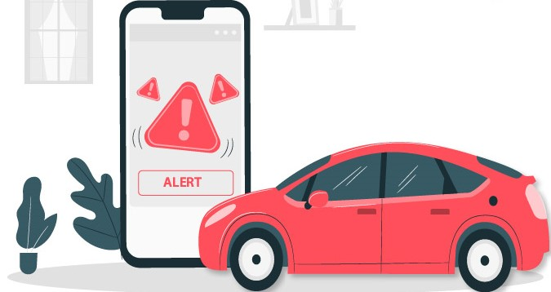

Scope
The scope for driver drowsiness detection using OpenCV is vast and encompasses various applications and areas of implementation. Some key aspects of the scope include:​
Transportation Safety,
Fleet Management,
Public Transportation.

Slide 11
Implementation Methodology
First the image is acquired by the webcam for processing. Then we use the Haar cascade file face.xml to search and detect the faces in each individual frame.
If no face is detected, then another frame is acquired.
If an eye is detected then there is no blink and the blink counter K is set to ‘0’. If the eyes are closed in a particular frame, then the blink counter is incremented and a blink is detected.

Slide 12
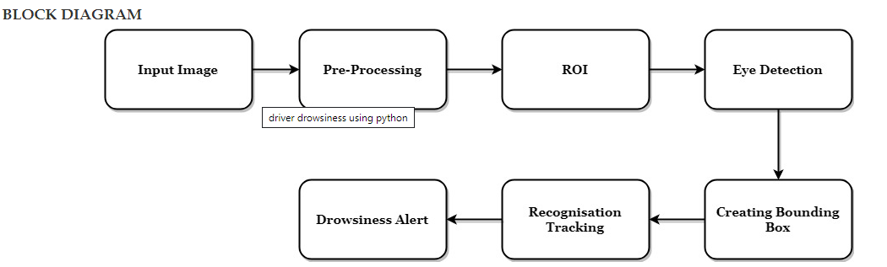
System Architecture

Slide 13
SOFTWARES REQUIREMENTS
Operating System : Windows 7
Coding Language : Python
Tool : Anaconda, Visual studio code
Libraries : OpenCV
You can also Jupiter Notebook or an Integrated Development Environment (IDE) like
Pycharm: These environments facilitate code development, execution, and debugging.

Slide 14
HARDWARE REQUIREMENTS
System : Pentium Dual Core.
Hard Disk : 120 GB.
Monitor : Anaconda, Visual studio code
Input Devices : Keyboard, Mouse
Ram : 1GB

Slide 15
Haar cascade classifier Algorithm
The Haar cascade classifier is based on a machine learning algorithm that uses a set of simple, rectangular features known as Haar-like features, named after the Hungarian mathematician Alfreed Haar. These features are calculated over adjacent rectangular regions at different scales and positions in an image.
Cascade Structure
Sliding Window

Slide 16
Algorithm Shape Land Mark Detection
Shape landmark detection algorithms are used in computer vision and image processing to identify and locate specific points of interest, known as landmarks or keypoints, within an object or shape. Landmark detection is commonly used in various applications such as facial recognition, medical image analysis, object tracking, and more.
Feature Extraction
Landmark Localization

Slide 17
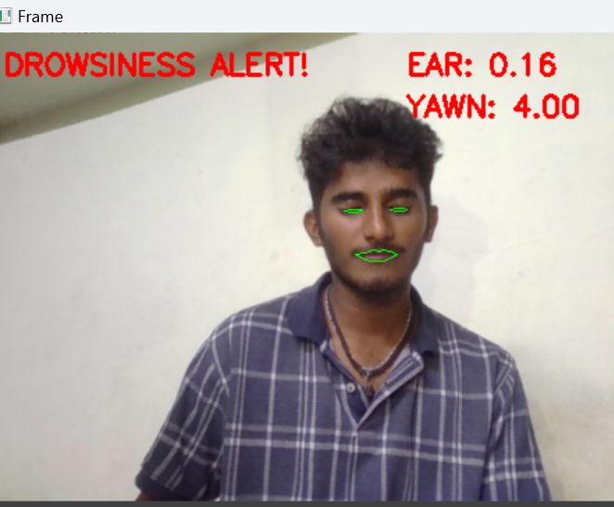

Screens

Slide 18
Test Cases
Sl # Test Case : ­ | UTC­1
Name of Test: ­ | Load Face Detection Model
Items being tested: ­ | Model loaded or not
Sample Input: ­ | Live video input
Expected output: ­ | Face must be detected
Actual output: ­ | Face detected
Remarks: ­ | Pass.

Slide 19
Sl # Test Case : ­ | ITC­2
Name of Test: ­ | Check drowsiness detection
Item being tested: ­ | If eye is closed drowsiness should be detected
Sample Input: ­ | Live video
Expected output: ­ | Drowsiness Detected
Actual output: ­ | Drowsiness detected with alaram
Remarks: ­ | Pass.

Slide 20

THANK YOU

