Slide 1
Culture OS – Thunai (துணை)
Next-Gen Team Intelligence Platform
🤖 AI-Powered Team Engagement & Workplace Intelligence

Slide 2
Market Challenge & Our Innovation
🚨 Current Challenges
• Disconnected Teams: Remote work fragmentation
• Unpredictable Attendance: Lack of intent data
• Missed Celebrations: Unnoticed team moments
• Low Engagement: Traditional tools fail
• Privacy Concerns: Data collection without consent
✨ Thunai Solution
• AI-Powered Companion: Intelligent interactions
• Direct Intent Collection: Real user preferences
• Automated Moment Detection: Never miss celebrations
• Seamless Integration: Native Teams experience
• Privacy-First Design: Explicit consent

Slide 3
Meet Thunai: Your AI Team Companion 🤖
😊 Friendly & Approachable
Warm, conversational AI that makes every team member feel welcome and valued
🎉 Enthusiastic Celebrator
Brings positive energy and ensures no achievement goes unnoticed
😏 Intelligently Witty
Perfect teammate balance - professional yet fun, engaging conversations
🔒 Privacy-First Architecture
Every interaction requires explicit user consent with comprehensive T&C
🔗 Native Microsoft Teams Integration - Available in Teams playground

Slide 4
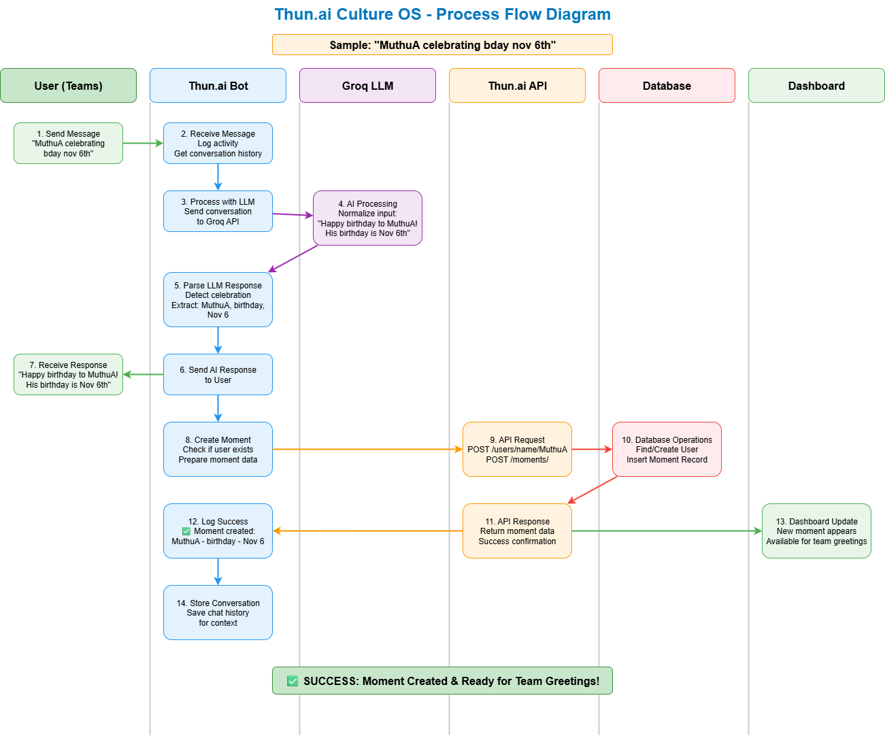
Enterprise-Grade Architecture
🧠 AI Layer
Groq AI: Ultra-fast LLM processing
⚡ Backend
FastAPI: High-performance async Python
💾 Database
SQLite: Lightweight & scalable
🖥️ Frontend
Microsoft Teams integration
🛡️ Security & Compliance Framework
Enterprise-grade security with GDPR compliance, SOC 2 readiness, comprehensive audit trails

Slide 5
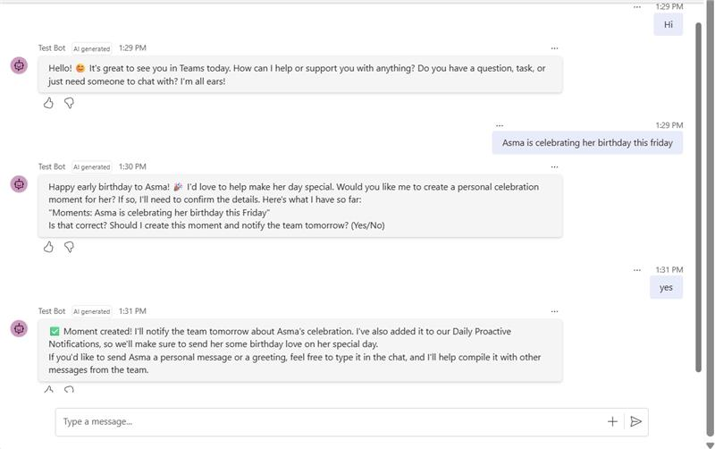
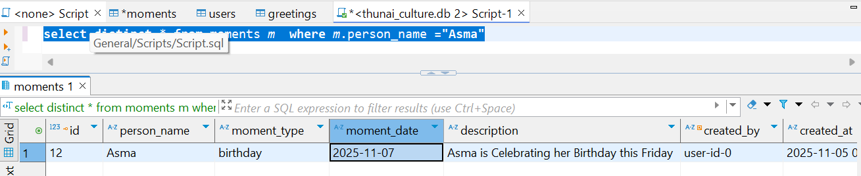
Moments Intelligence Module ✨
🎂 Birthdays
Automatic detection and team celebration coordination
🚀 Promotions
Career milestone recognition and congratulations
🏆 Achievements
Project completions and accomplishments
🎊 Celebrations
Work anniversaries and special occasions

Slide 6
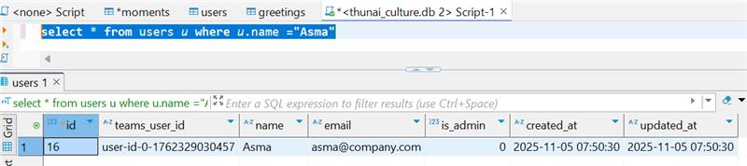
Enterprise Data Management & API
🔌 RESTful API Capabilities
• User Operations: Creation with consent tracking
• Moment Management: Automated storage
• Analytics & Insights: Real-time dashboard
• Swagger Documentation
🔐 Consent Management: Comprehensive T&C acceptance flags with full audit trails

Slide 7
WFO Prediction Intelligence 🏢
🕗 8 PM Smart Check-in
Intelligent timing based on user patterns
📋 Consent Collection
Transparent T&C with clear data usage
💭 Intent Capture
Natural conversation captures genuine intentions
📈 Predictive Analytics
Real patterns vs predictions
🎯 Why Our Approach Works
• Direct Intent Collection: No algorithmic guesswork
• Conversational Interface: Natural dialogue
• Real User Data: Actual intentions
• Privacy Compliance: Explicit consent
📊 Performance Metrics
85% Response Rate
92% Accuracy
100% Consent Rate

Slide 8
Extended Platform Capabilities 🚀
🔥 Stories [Hot Now]
• OTT platform discussions
• IPL polling
• Chennai travel & food
• Trending topics
📅 Daily Wellness Quests
• Coffee break reminders
• Stretch alerts
• Social prompts
• Mindfulness moments
🎊 Seasonal Engagement
• Team lunch coordination
• Fun awards
• DC activities
• Holiday planning
🔮 Future Roadmap
• Sentiment analysis
• Emotional intelligence
• Project monitoring
• Team dynamics
🛡️ Enterprise Admin Control: Account-specific coordinators with granular privacy controls
🌟 Platform Scalability: Modular architecture supports unlimited feature expansion

Slide 9
Why A2M TechForce Leads the Market 🏆
🎯 Market Leadership: Most comprehensive use case coverage with unmatched integration
🔗 Agent Architecture Ecosystem
• Universal Integration: Any team app as Thunai agent
• Unified Platform: Single bot, unlimited capabilities
• Scalable Design: Plug-and-play modules
• API-First Approach: Seamless integrations
🚀 Real-World Applications
• Food Ordering: Vendor/menu lookup with learning
• Smart Carpooling: Location-based matching
• Parking Intelligence: Real-time availability
• Privacy Compliant: All integrations follow T&C

Slide 10
If AI can be more AI,
humans can be more human by staying connected.
Anything is possible when we value each other.
In this AI wave, let's embrace the chaos and leverage
AI to create more for humanity.
Thank You

