Slide 1
Predicting Sales Conversion Likelihood using Machine Learning
Optimizing Sales Efforts with Data-Driven Insights

Slide 2
Agenda
Introduction & Challenges
1
Understanding the landscape of B2B sales.
Problem & Goals
2
Defining our objective: smarter lead conversion.
Data & Features
3
Exploring the inputs driving our predictions.
Modeling Approach
4
How we built and refined our predictive model.
Evaluation & Results
5
Assessing model performance and key insights.
Business Impact & Next Steps
6
Translating predictions into tangible value.

Slide 3
B2B Sales Challenges
In the complex world of B2B sales, efficient resource allocation is paramount. Our objective is to prioritize leads effectively, maximizing conversion rates and sales productivity.
Lead Prioritization
Resource Allocation
Sales teams often face overwhelming numbers of leads, making it difficult to identify the most promising prospects. This leads to wasted effort on low-potential leads.
Without clear prioritization, valuable sales resources—time, effort, and budget—are not always directed where they can yield the highest return, impacting overall ROI.

Slide 4



Problem Statement & Goals
Optimize Conversions
Classify Leads
Boost Sales Efficiency
Increase the volume of converted leads into paying customers with more efficient sales efforts.
Develop a system to categorize leads into high, medium, and low conversion likelihood.
Enable sales teams to focus on leads with the highest potential, improving overall productivity.

Slide 5
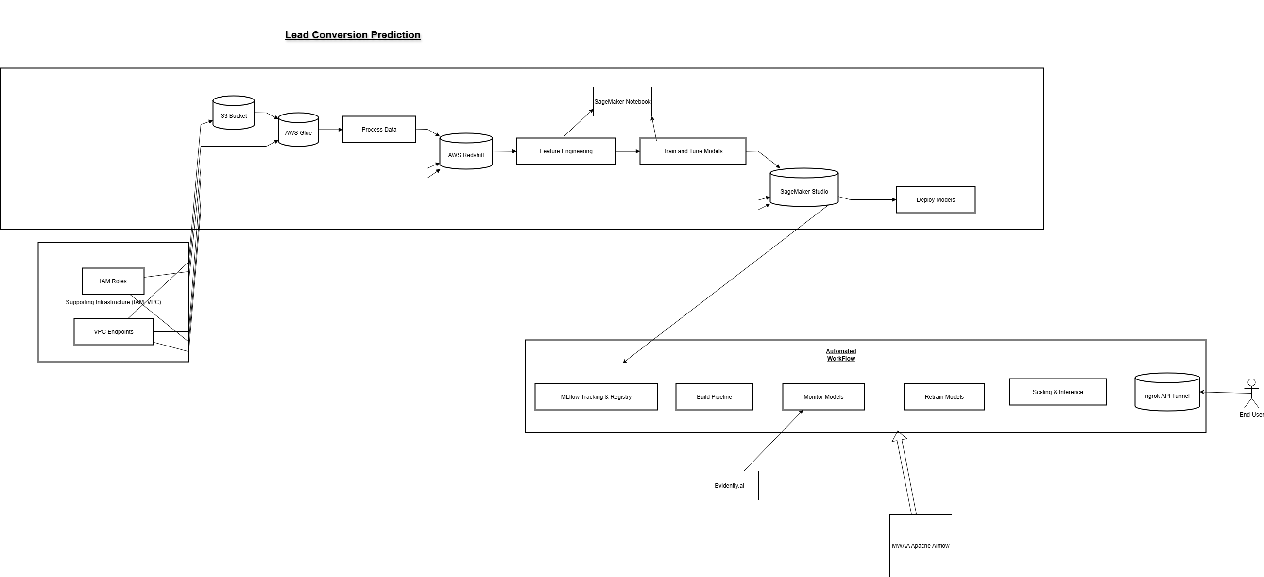
Architecture Diagram For Lead Conversion Prediction

Slide 6
Data & Features Used
Our predictive model is built upon a rich dataset, combining essential CRM information with crucial behavioral data to capture a comprehensive view of each lead.
Key Input Features
Preprocessing Pipeline
CRM Data: Lead source, industry, company size, previous interactions.
Data Cleaning: Handling missing values through imputation techniques.
Behavioral Data: Website visits, email opens, content downloads, demo requests.
Feature Engineering: Creating new features from raw data for better model performance.
Encoding: Converting categorical data into numerical formats.
Scaling: Normalizing numerical features to a standard range.

Slide 7










Modeling Approach
We explored a range of classification algorithms to determine the most effective model for predicting sales conversion likelihood.
Random Forest
Logistic Regression
An ensemble method leveraging multiple decision trees for robust predictions.
A foundational statistical model for binary classification.
Gradient Boosting
Advanced ensemble technique building models sequentially.
Hyperparameter Tuning
Optimized model parameters for peak performance.
Model Selection
Selected based on performance metrics and interpretability.

Slide 8
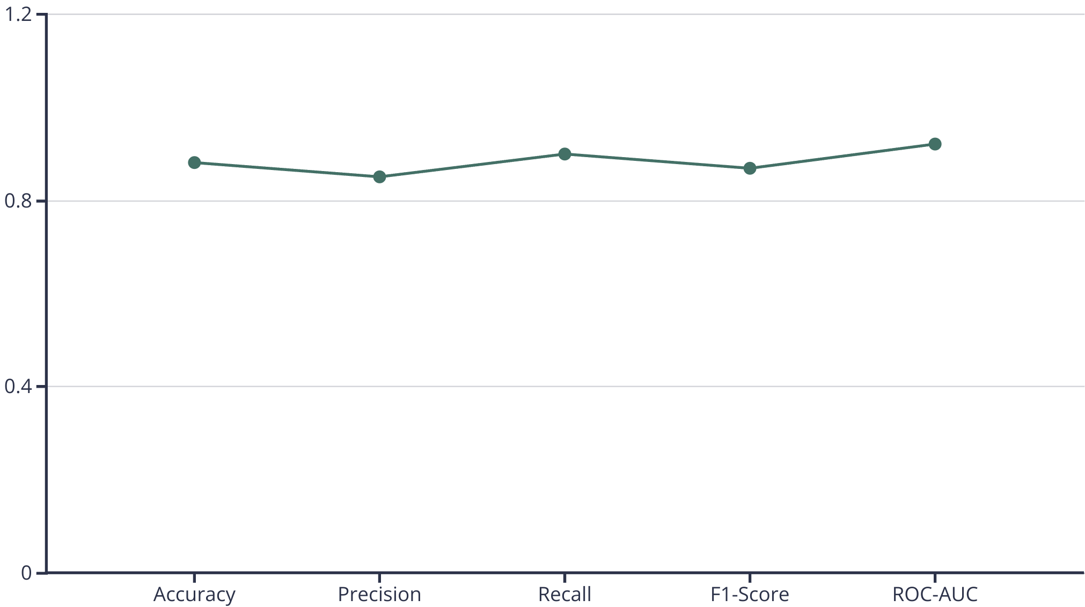
Evaluation & Metrics
Our model's performance was rigorously evaluated using key classification metrics to ensure accuracy and reliability.
Understanding Our Metrics
ROC Curve: Visualizes the true positive rate against the false positive rate, indicating model discrimination ability.
Accuracy: Overall correctness of predictions.
Precision: Proportion of true positive predictions among all positive predictions.
Recall: Proportion of true positive predictions among all actual positives.
F1-Score: Harmonic mean of precision and recall, balancing both metrics.
Confusion Matrix: Detailed breakdown of correct and incorrect classifications.

Slide 9
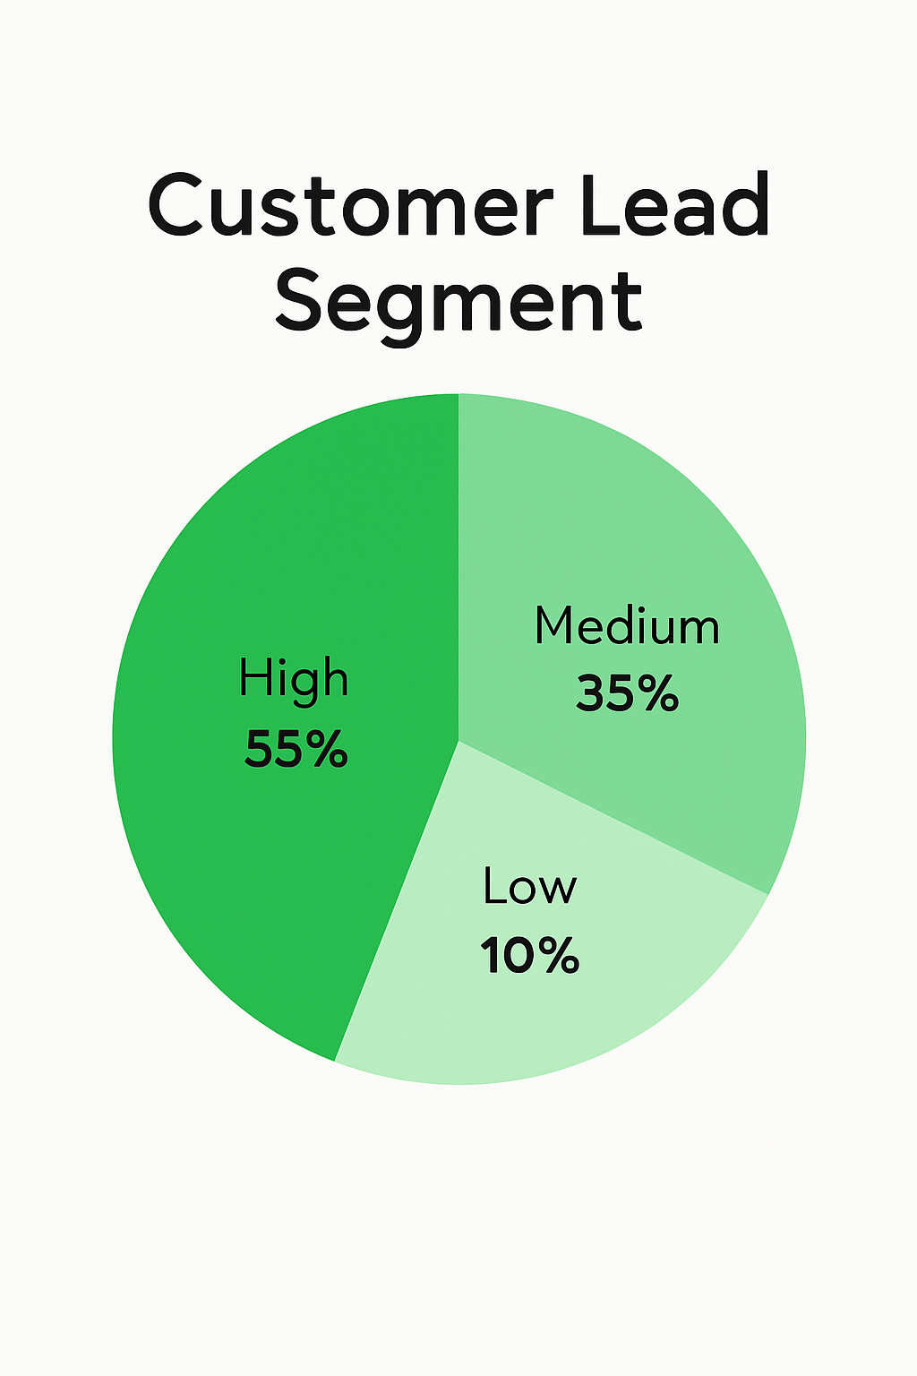
Results & Insights
Our analysis revealed key features driving conversion likelihood and enabled a strategic segmentation of leads based on predicted probability.
Feature Importance
Engagement History: High correlation with conversion.
Company Industry: Certain industries show higher conversion rates.
Lead Source: Referrals and direct inquiries perform best.
Interaction Frequency: More frequent interactions indicate higher interest.
These insights allow us to understand why certain leads are more likely to convert.
High Segment (55%)
This is the largest category, showing that over half of your leads are considered high-quality or high-potential.
Focus resources on nurturing these leads as they offer the greatest opportunity for conversion.
Medium Segment (35%)
Represents a moderate portion of your lead pool.
These leads may require additional engagement or nurturing before conversion.
Consider targeted campaigns to move them into the high segment.
Low Segment (10%)
These leads have the lowest likelihood of conversion.
While worth monitoring, fewer resources should be allocated here compared to higher tiers.

Slide 10



Business Benefits
Implementing this machine learning model translates directly into significant advantages for sales teams and overall business growth.
Improved Sales Targeting
Higher ROI
Enhanced Productivity
Sales teams can focus efforts on the most promising leads, reducing wasted time on low-potential prospects and increasing conversion rates.
Optimized outreach means better allocation of resources, leading to a higher return on investment for sales and marketing campaigns.
By streamlining the lead qualification process, sales representatives become more efficient, closing deals faster and improving overall team output.

Slide 11
Next Steps
To fully leverage the predictive power of our model, the following actions are recommended:
A/B Testing Model Impact
Integration into CRM
Conduct controlled experiments to quantitatively measure the uplift in conversion rates and sales efficiency attributed to the model.
Seamlessly embed the model's predictions directly into your existing CRM or sales platform for real-time insights.
Monitor & Refine
Ongoing Retraining
Continuously monitor model performance and gather feedback for iterative improvements and further optimization.
Regularly update and retrain the model with fresh data to ensure its accuracy and relevance in a dynamic market environment.

