Slide 1
Rugged Board
UDP-Socket
https://community.ruggedboard.com

Slide 2
UDP-Socket
Datagram sockets (SOCK_DGRAM) provide unreliable, fullduplex, packet-oriented communication channel.
Messages are transmitted and received in terms of datagrams, which is a small, fixed-length packet.
A process either reads the entire message or in case of error does not read any data.
Unreliable means there is no sequence numbering, so messages may arrive out of order, be duplicated or not arrive at all.

Slide 3
UDP-Socket
Datagram Sockets, therefore, place less load on kernel network code and on NW traffic.
Datagrams may get lost in transit, and they may arrive out of order.
For these two reasons, datagram sockets are best suited to applications in which simplicity, efficiency, and speed are more important than data integrity and consistency.
They are good choice for streams of music and video where a missing note or frame may not even be noticed
They are a bad choice for web, file or email servers. As they can be large documents.

Slide 4
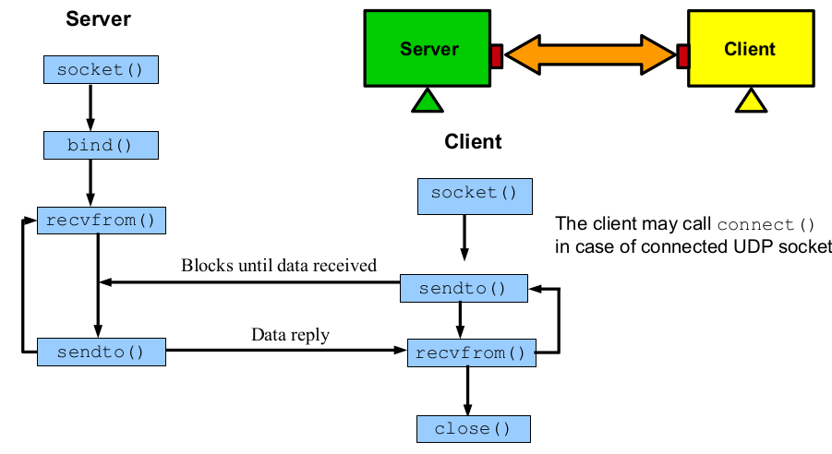
UDP-Socket

Slide 5
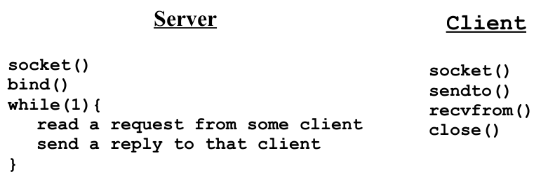
UDP-Socket
Pseudo Code

Slide 6
Open Discussions

Slide 7





Connect-us
Developer
Wiki

Slide 8
