Slide 1
Linux Internals
Linux Process
https://community.ruggedboard.com

Slide 2
Linux Process
Process in Linux
Loading Program
What is process?
Process Control Block
Process Identification (PID,PPID,SID,UID,EUID)
Process State Information(CPU Register info..)
Process Control Information(when its created?,how its create? etc)

Slide 3
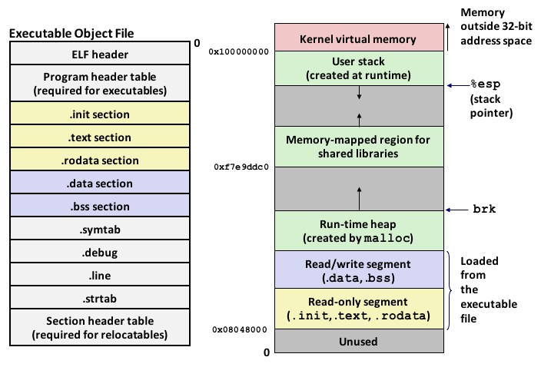
Linux Process
Pictorial View of a Process

Slide 4
Linux Process
Linux Terminal
uname –r
apt-get install linux-headers-(kernelversion)
top
ps -l
ps -u → R,S,D,T,Z
man ps → search for process state codes
echo $$

Slide 5
Linux Process
Process Creation
system()
fork()
wait()
waitpid()
exec()
clone()

Slide 6
Linux Process
Practicals

Slide 7





Connect-us
Developer
Wiki

Slide 8
Open Discussions

Slide 9
