Slide 1
Rugged Board
MQTT
https://community.ruggedboard.com

Slide 2
MQTT
What is MQTT?
MQTT is a lightweight publish/subscribe messaging protocol designed for M2M (machine to machine) telemetry in low bandwidth environments.
It was designed by Andy Stanford-Clark (IBM) and Arlen Nipper in 1999 for connecting Oil Pipeline telemetry systems over satellite.
MQTT stands for MQ Telemetry Transport but previously was known as Message Queuing Telemetry Transport.
MQTT is fast becoming one of the main protocols for IOT (internet of things) deployments.

Slide 3
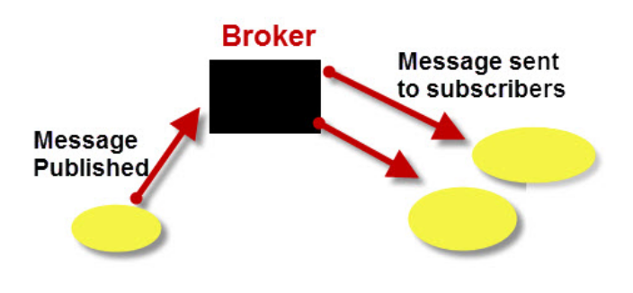
MQTT
How Does MQTT Work ?
MQTT is a messaging protocol i.e it was designed for transferring messages, and uses a publish and subscribe model.
This model makes it possible to send messages to 0,1 or multiple clients.
In MQTT a publisher publishes messages on a topic and a subscriber must subscribe to that topic to view the message.
MQTT requires the use of a central Broker

Slide 4
MQTT
Important Points to Note
Clients do not have addresses like in email systems, and messages are not sent to clients.
Messages are published to a broker on a topic.
The job of an MQTT broker is to filter messages based on topic, and then distribute them to subscribers.
A client can receive these messages by subscribing to that topic on the same broker
There is no direct connection between a publisher and subscriber.
All clients can publish (broadcast) and subscribe (receive).
MQTT brokers do not normally store messages.

Slide 5
Open Discussions

Slide 6





Connect-us
Developer
Wiki

Slide 7
