Slide 1
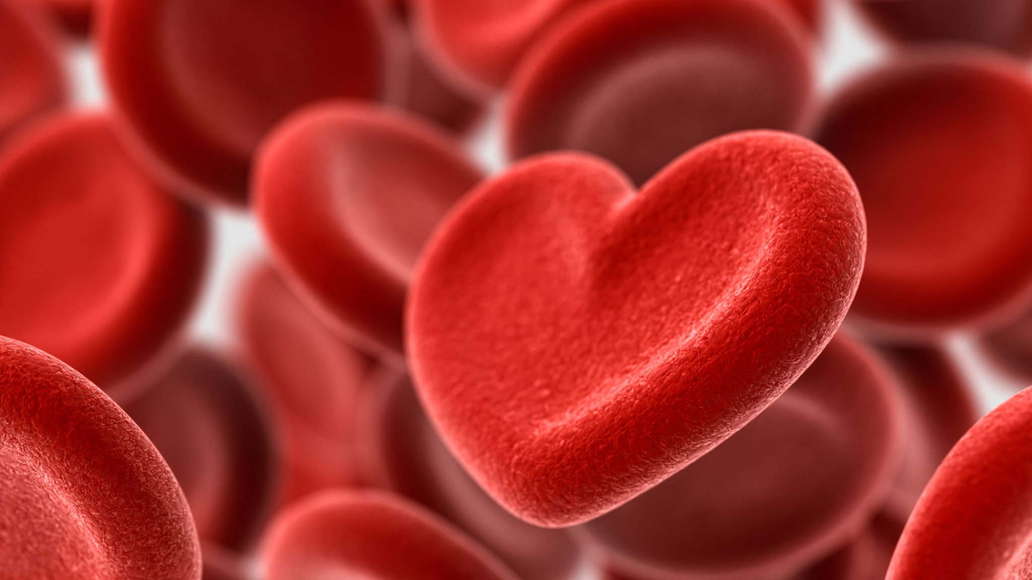
Heart Disease
DS1010 Spring 2024
Ronak Wani, Hannah Han, Aravind Sathappan

Slide 2
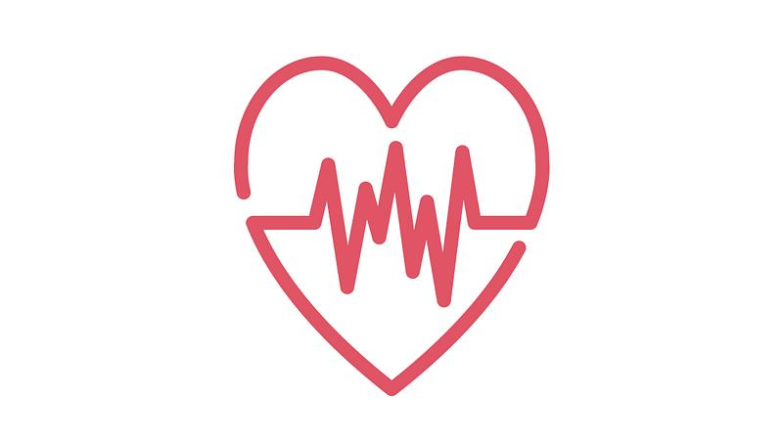
Table of Contents
The Data
Limitations & Inconsistencies
Means, Medians & Modes
Hypothesis
Target Audience
Statistical Analysis
Conclusion

Slide 3
The Data
The dataset consists of 919 people and accounts the person's age, sex, chest pain type, resting blood pressure, cholesterol, fasting blood sugar test, resting electrocardiography, max heartrate, exercise Angina, old peak, ST slope, and heart disease.
Age: 28-77
Sex: M/F
ChestPainType: ATA, NAP, ASY, TA
Resting BP: mmHg
Cholesterol: mg/dL
Fasting BP: 0/1 (low/high)
Resting ECG: Normal/ST/LVH
Max HR: per minute ​
Exercise Angina: Yes/No ​
Old Peak: millimeter of ST depression ​
ST Slope: Up/Flat/Down ​
Heart Disease: 0/1 (yes/no)

Slide 4

Chest Pain Types, Resting BP
Chest Pain Types
TA (Typical Angina)- chest pain from sharp, crushing pain in the center of the chest, often brought on by exertion.
ATA (Atypical Angina)- chest pain that doesn't have typical characteristics
NAP (Non-Anginal Pain)- chest pain that is not caused by a heart problem
ASY (Asymptomatic)- no chest pain
Resting blood pressure (BP)
high blood pressure can cause damage to your heart, kidneys and brain and increase risk of cardiovascular disease

Slide 5
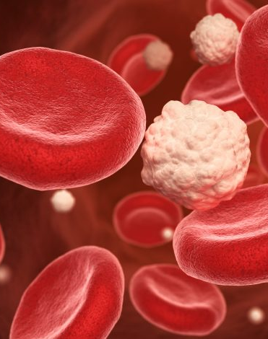
Cholesterol, Fasting BS, Resting ECG
Cholesterol
fatty foods can raise your cholesterol and high levels of cholesterol can increase your risk of heart disease
Fasting blood sugar (BS)
measures sugar in your blood after a day of fasting, usually used to diagnose diabetes
Resting electrocardiography (ECG)
records electrical activity of your heart while at rest and is used to detect abnormalities

Slide 6
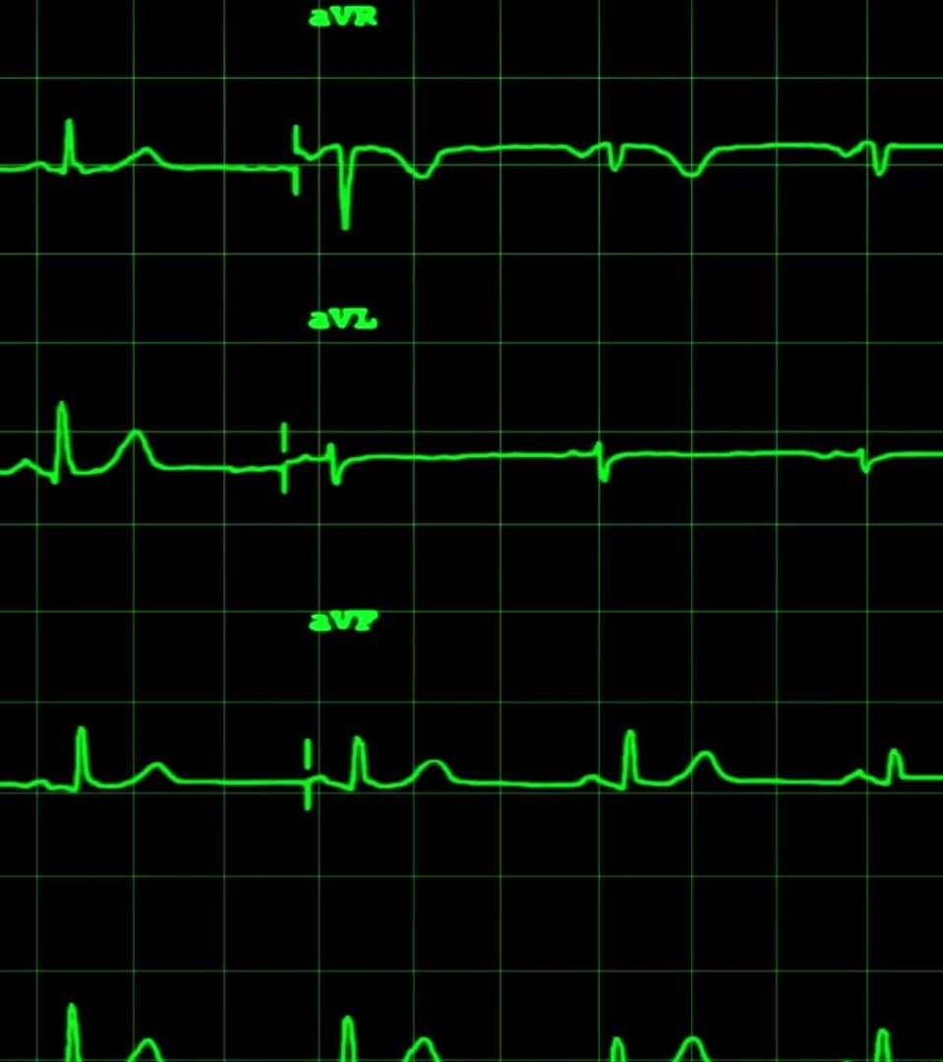
Max HR, Exercise Angina, Old Peak, ST Slope
Max heartrate (HR)
maximum number of beats per minute during exercise
Exercise angina
chest pain when exercising
Old peak
Segment (ST) depression caused by activity compared to rest
Segment (ST) slope
shift in heart rate due to exercise

Slide 7
Relevant Questions
What is the mean cholesterol, RestingBP, MaxHR for those with heart disease?
What is the mean cholesterol, RestingBP, MaxHR for those without heart disease?
What is the correlation between cholesterol and the heart disease?
What is the correlation between sex and the heart disease?
What chest pain type is the most prevelant to those with heart disease?
Which ST slope is most prevelant to those with heart disease?
Which RestingECG is most prevelant to those with heart disease?

Slide 8
Missing Features
There are no missing features (empty values)
But there are 172 "0" values for cholesterol, 117 of them are 0 for those without heart disease
We converted categorical variables to 0/1
There is a inequal ratio of females: 193, Males: 725
The youngest age is 28 and the oldest age is 77

Slide 9
Limitations & Inconsistencies
Does not specify any of the measurements for the data so we have to make assumptions
Resting BP doesn’t specify if the data is diastolic or systolic, so we assumed they are all systolic (mmHg)
Cholesterol doesn't have the measurement "mg/dl". (Unspecified category: LDL, HDL, VLDL, IDL)
Fasting BS doesn't specify what the 0/1 means so we assume 0 means low and 1 means high blood pressure
Max HR doesn’t have the measurement "per minute"
Old Peak doesn't have measurement, so we assume it is in millimeters
Heart Disease is written as 0/1 instead of "yes/no"

Slide 10
Additional Features
Family history of heart disease
BMI
Weight
Height
Exercise Activity
Diabetes

Slide 11

Target Audience
Our target audience is health-conscious individuals. Our objective is to promote awareness of heart disease, enabling people to recognize its signs before it becomes critical.

Slide 12
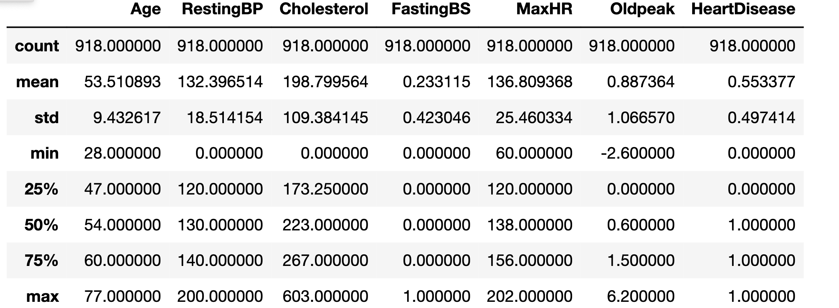
Means, Medians, & Modes

Slide 13
Cholesterol mean
Cholesterol mean (for people without heart disease): 177
Standard deviation: ± 0.209
Cholesterol mean (for people with heart disease): 217
Standard deviation: ± 0.123
Total Cholesterol mean: 198
Standard deviation: ± 0.145

Slide 14
RestingBP mean
RestingBP mean (for people without heart disease): 132
Standard deviation: ± 0.209
RestingBP mean (for people with heart disease): 133
Standard deviation: ± 0.123
Total RestingBP mean: 132
Standard deviation: ± 0.145

Slide 15
MaxHR mean
MaxHR mean (for people without heart disease): 134
Standard deviation: ± 0.209
MaxHR mean (for people with heart disease): 139
Standard deviation: ± 0.123
Total MaxHR mean: 137
Standard deviation: ± 0.145

Slide 16
Modes for heart disease
ST Slope Mode: Flat
Chest Pain Type mode: ASY
With heart disease
With heart disease
Resting ECG: Normal
With heart disease

Slide 17
Sex and heart disease
193 Total Females, 725 Total Males
321 males with heart disease
89 females with heart disease
110 females without heart disease
404 males without heart disease
46% of females had heart disease
44% of males had heart disease

Slide 20
Hypothesis
Our hypothesis is, that cholesterol will have a positive correlation to heart disease and that sex will have no influence.

Slide 21
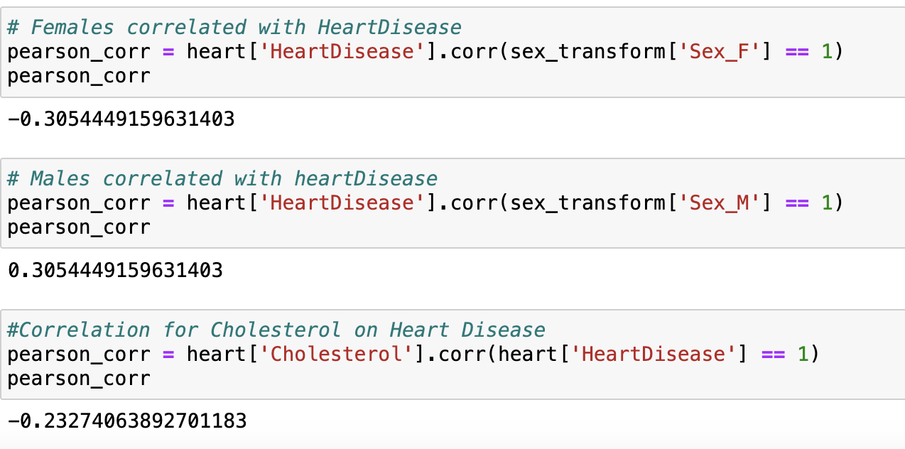
Cholesterol correlation & sex correlation
Correlation between cholesterol and heart disease: Slightly negative Correlation
Correlation between males and heart disease: slightly positive correlation
Correlation between females and heart disease: Slightly negative correlation

Slide 22
Revised Hypothesis
Our revised hypothesis is that, despite cholesterol having a negative correlation to heart disease it is not statistically relevant.

Slide 23
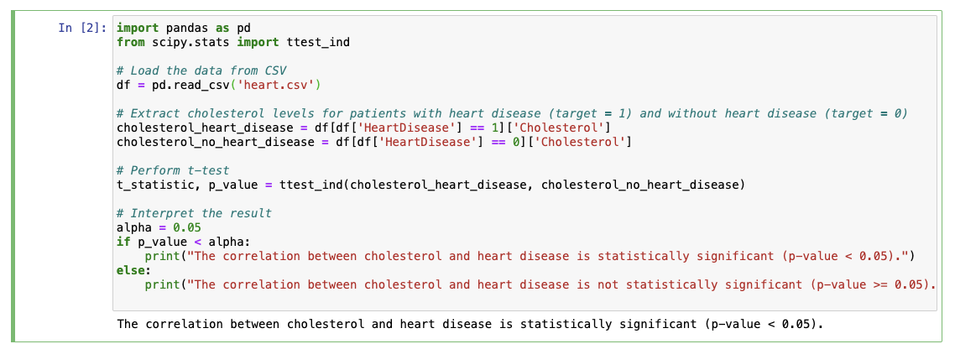
T-test for cholesterol

Slide 24
Cholesterol and Heart Disease
Our hypothesis that cholesterol will have a positive correlation was not supported by this dataset as there was a slightly negative correlation between cholesterol and heart disease.
However, many outside studies prove that high levels of cholesterol increase your risk of heart disease. And the mean cholesterol of those without heart disease was lower.
We believe the data showed a negative correlation because the dataset had 117 "0" values for people without heart disease.

Slide 25
Sex and Heart Disease
Our hypothesis that sex will have no influence was not supported by our dataset as there was a negative correlation for females and there was a positive correlation for males.
However there was a significant difference in amount of females and males in the study. (725 males and 193 females)
And 44% of the males and 46% of the females had heart disease so a relatively similar amount of females and males had heart disease

Slide 26

Conclusion
In conclusion, although the correlation between cholesterol and heart disease was statistically relevant this dataset may have been an outlier as it is not supported by previous studies done by heart disease because of the data discrepancy.
For example, for this dataset ASY (asymptomatic) was the most common for people with heart disease but typically people with heart disease will feel some sort of angina.
Confounding Variables: We assume that if the additional feature mentioned prior with family history of heart disease, BMI, or exercise activity could explain some of the discrepancies of why these people did not have the typical symptoms of heart disease.
Sample Bias: This dataset may not have been a good representative of the general population of people with heart disease as it's already shown with sex.
Statistical Artifact: This dataset may have just happened to have uncommon reports by chance.

Slide 27
Thank You
Any questions?

