Slide 1
GrAlgo
Group 5
Sahil Chandra- CS20BTECH11033
P. Ganesh Nikhil Madhav- CS20BTECH11036
Gorantla Pranav Sai- CS20BTECH11018
Suraj Telugu- CS20BTECH11050
Umesh Kalvakuntla- CS20BTECH11024
Vanga Aravind Shounik- CS20BTECH11055
Adepu Vasisht- CS20BTECH11002

Slide 2
How does a compiler work?
We are here
TOKENS
Semantic
AST
LEXER
PARSER
SEMANTIC
CHECK
CODE
GEN
Source file(.gr)
AST
LLVM IR

Slide 3
Lexical Analysis
Lexical Analysis is the first phase of compiler as seen from the flowchart above, it takes a modified source code and converts into a series of tokens.
Constants, Identifiers, Separators, Keywords and Operators are considered as tokens.
The lexer returns all valid tokens and if it finds an invalid token such as invalid operator or a character it returns an error.
It also removes comments and white spaces.

Slide 4
LEXER
We use FLEX (Fast Lexical Analyzer Generator) to generate our lexical analyzer.
FLEX takes in our tokens in a special file with a .l extension written in C language and generates a lex.yy.c file.
When the generated lex.yy.c file is compiled using the C compiler we get a file named a.out which is our lexer.
To this a.out file we give input stream and sequence of tokens is generated.

Slide 5
LEXER
As mentioned to generate the lexer we use FLEX (Fast Lexical Analyzer Generator) and we write a lex file with .l extension in C language.
Lex Compiler
(FLEX)
C Compiler
a.out file
Sequence of tokens
.l File/Lex file
Lex.yy.c
generated
Input Stream

Slide 6
Using our Lexer
The folder “Lexer” contains the following files.
lexer.l
makefile
input<number>.gr .
“make” command is used to run these files and generate the output which in this case is a sequence of tokens which will be written in a separate file named output<number>.txt .
For the detailed explanation for the commands inside the makefile see the following slides.

Slide 7
Lessons Learnt from this part of the Project
After searching through several references and documentation we finally decided to use FLEX since we already had a little bit of idea in it from Compilers-1.
Through searching we also got to learn about different methods to get lexical analyzers such as OCAML.
Since we used FLEX we developed a better understanding of how C compiler works and how operator precedence is implemented in lexer itself.

Slide 8
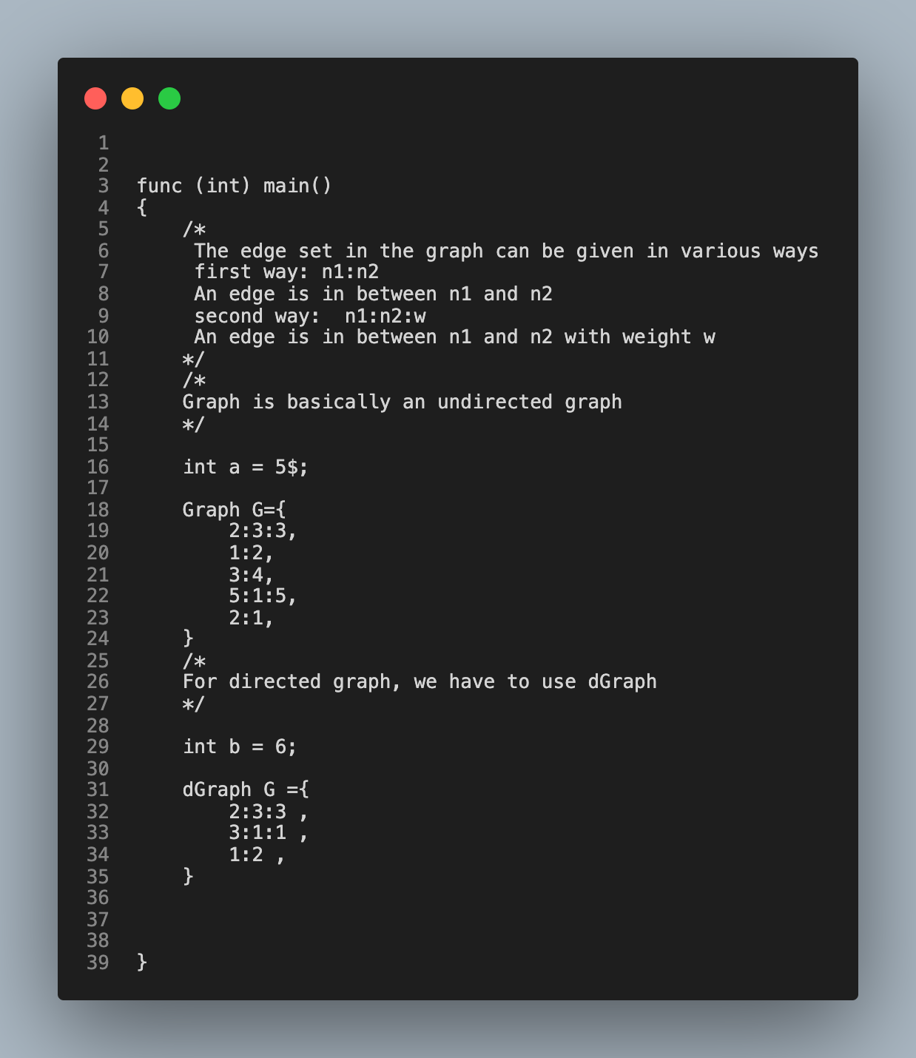
Example
Output
3 : 'FUNCTION' : 4 : 'func'
3 : 'L_PAREN' : 1 : '('
3 : 'INT' : 3 : 'int'
3 : 'R_PAREN' : 1 : ')'
3 : 'IDENTIFIER' : 4 : 'main'
3 : 'L_PAREN' : 1 : '('
3 : 'R_PAREN' : 1 : ')'
4 : 'L_BRACE' : 1 : '{'
16 : 'INT' : 3 : 'int'
16 : 'IDENTIFIER' : 1 : 'a'
16 : 'ASSIGN' : 1 : '='
16 : 'CONST' : 1 : '5'
16 : 'INVALID TOKEN' : 1 : '$'
16 : 'STM_DELIM' : 1 : ';'
18 : 'GRAPH' : 5 : 'Graph'
…

Slide 9
Thank You!!

