Slide 1

Project Title – Seasonal Agriculture Performance Analysis
[ARVA ARAVINDA SAI – TRINITY COLLEGE OF ENGINEERING AND TECHNOLOGY]
AICTE STU ID : (STU683a0c79cb5341748634745)

Slide 2

PROBLEM STATEMENT
Agricultural activities are influenced by seasonal variations in environmental conditions, farming practices, resource availability and market conditions. As a result, agricultural performance may differ from one season to another.
However, raw agricultural data does not clearly explain how agricultural performance changes across seasons or what patterns can be observed in different seasonal conditions.
The problem is to analyze the given agricultural dataset and investigate seasonal differences in agricultural performance by identifying meaningful patterns, trends, relationships and variations within the available data.

Slide 3
Project Description
This is an exploratory data analytics project built entirely in Python (Pandas, NumPy, Matplotlib, Seaborn) on a seasonal agriculture performance dataset.
The workflow covers: data cleaning (handling missing values, duplicate checks), descriptive statistics, univariate/bivariate/multivariate visual analysis, an IQR-based outlier check, and a full correlation study against yield.
Three original follow-up analyses go deeper - comparing irrigation methods across seasons, state-wise profitability, and crop-wise profit margins - leading to 8 key insights and a set of practical recommendations.
No machine learning model is built; the focus is entirely on statistical and visual data analysis to uncover seasonal patterns.

Slide 4

WHO ARE THE END USERS?
Farmers and farming cooperatives planning crop and irrigation choices by season
Agricultural extension officers and state agriculture departments
Policy makers designing seasonal support programs (e.g. pest monitoring, subsidies)
Agri-input and irrigation companies targeting regions/seasons with the most impact
Researchers and students studying seasonal agricultural trends in India

Slide 5

Technology Used
  - Python 3
  - Pandas & NumPy - data cleaning, aggregation and statistical summaries
  - Matplotlib & Seaborn - univariate, bivariate and multivariate visualizations
  - Jupyter Notebook - end-to-end analysis and documentation
  - Google Colab / local Jupyter environment for execution

Slide 6
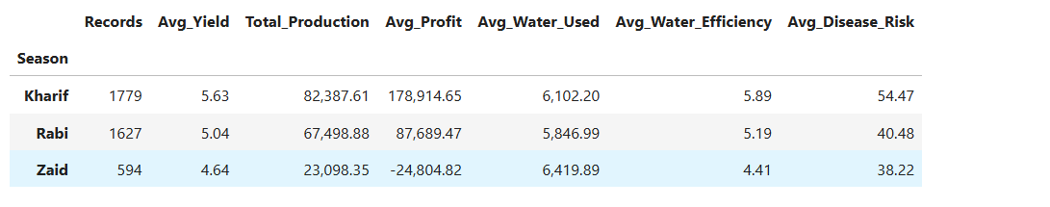
RESULTS
Putting the Seasons Side by Side
Kharif has the highest average yield (about 5.6 t/ha) and total production of the three seasons, but also the highest disease/pest risk (about 54%).
Zaid is the weakest season on yield and profit, and also has the fewest records (594 of 4,000).

Slide 7
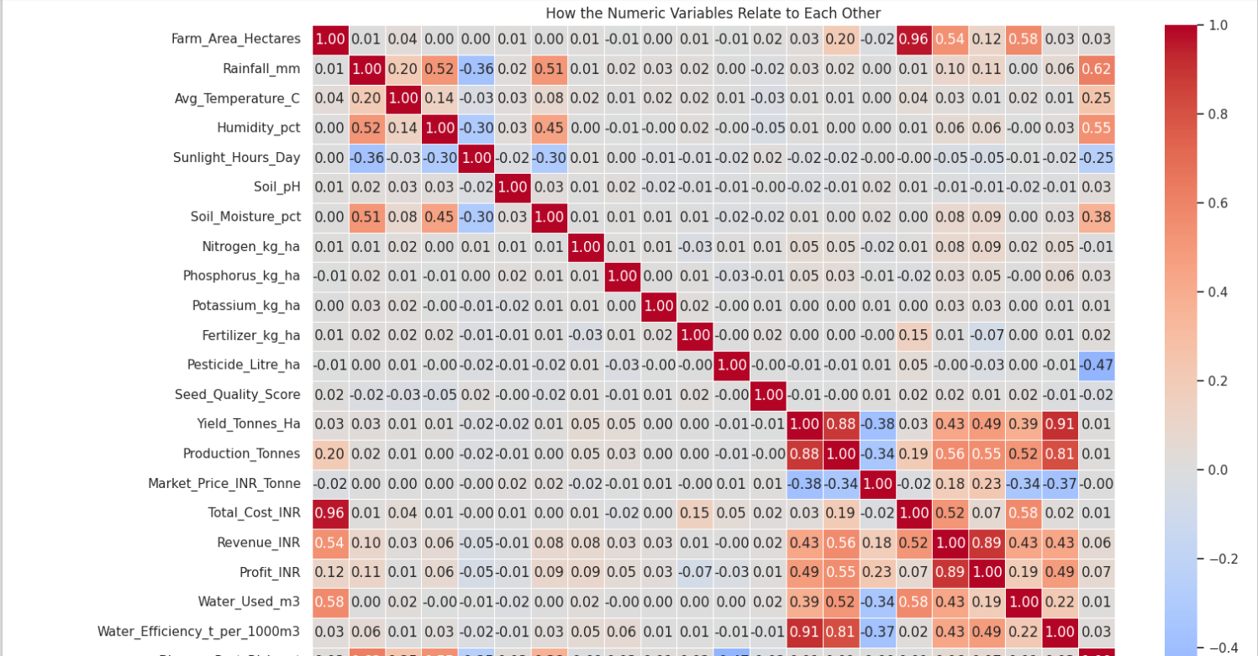
RESULTS
HEATMAP
Water_Efficiency and Production correlate most strongly with Yield (both above 0.85), while Rainfall and Farm_Area show almost no linear relationship with Yield. This shows yield is driven more by how efficiently water is used than by rainfall volume itself.

Slide 8
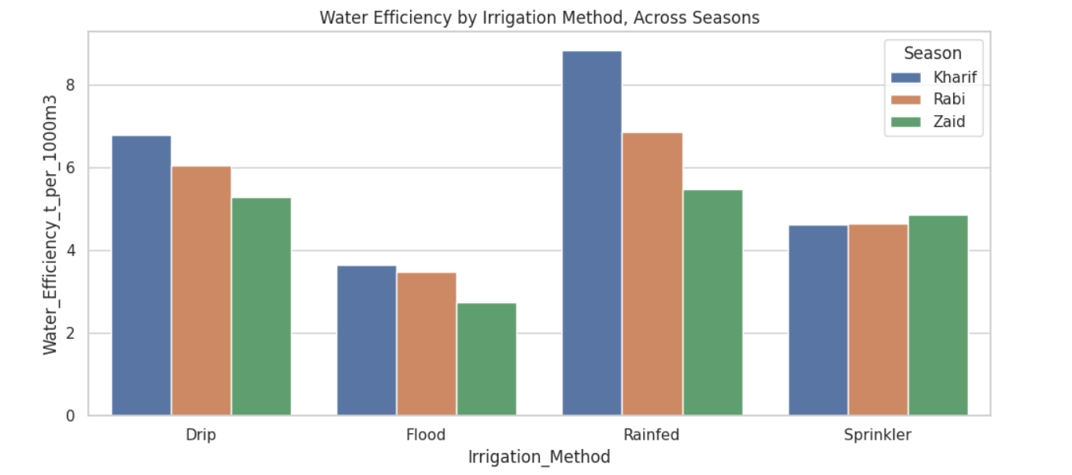
RESULTS
BARCHART
Drip irrigation delivers the best yield and water efficiency in every single season -
Kharif, Rabi and Zaid alike - never overtaken by Flood, Sprinkler or Rainfed methods.
Flood irrigation uses the most water but converts it to yield the least efficiently.

Slide 9
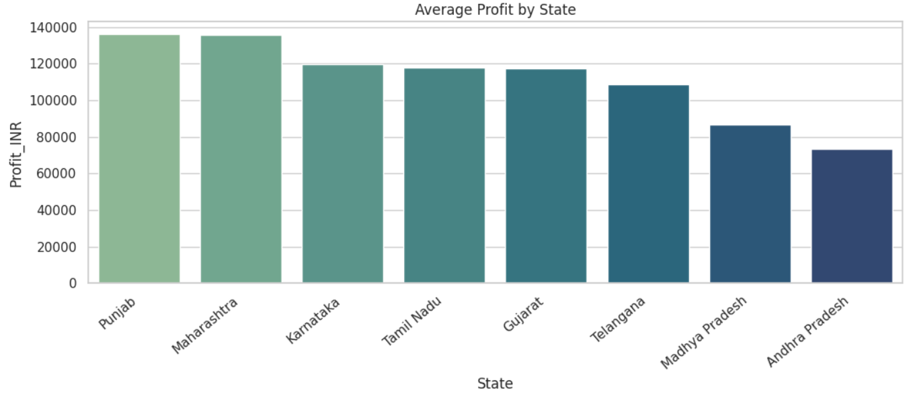
RESULTS
BAR CHART
Average profit varies clearly by state - Punjab and Maharashtra lead, while Andhra Pradesh and Madhya Pradesh trail behind - and this gap persists across all seasons, showing profitability is shaped by geography as much as by season.

Slide 10
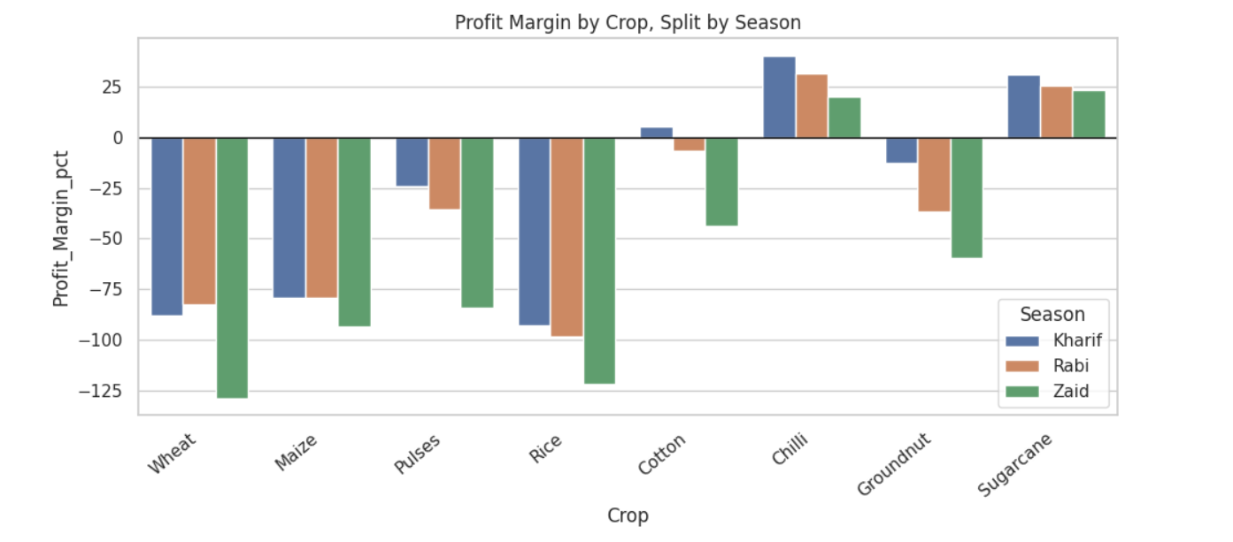
RESULTS
CROP-WISE PROFIT MARGIN CHART
High-value crops like Sugarcane and Chilli hold a positive profit margin in every season, while staple grains (Wheat, Rice, Maize) run a negative margin on average.
Crop choice affects profitability at least as much as the season does.

Slide 11
Future scope
Extend the analysis to multi-year data to separate season effects from year-to-year weather variability
Incorporate the real-world cost of switching irrigation methods to assess ROI
Validate profit-margin figures against actual market/MSP price data
Build a predictive model to forecast yield or profit for a given season, crop, state and irrigation method combination
Turn the analysis into an interactive dashboard for farmers and planners

Slide 12
GitHub Link
https://github.com/Aravinda-Sai10/Seasonal-Agriculture-Performance-Analysis

Slide 13

VOIS Course completion certificate -
Course name- Data Visualization

Slide 14
Thank you!
.

