Slide 1
Theme A — FINSWARM
Agentic Swarm · The AI Boardroom
T E A M
404 : FUNDS NOT FOUND
ARAVINDA KANNAN KS
TEAM LEAD
24BCE1290
A board that convenes
on any business problem.
TARUN KRISHNA MANIVANNAN
24BCE5460
KRISHNA PRASAD M
24BCE5519
Six mandated agents. Hard constraints
checked, not weighted.
ELUKE. SRINITHA
24BCE1639

Slide 2
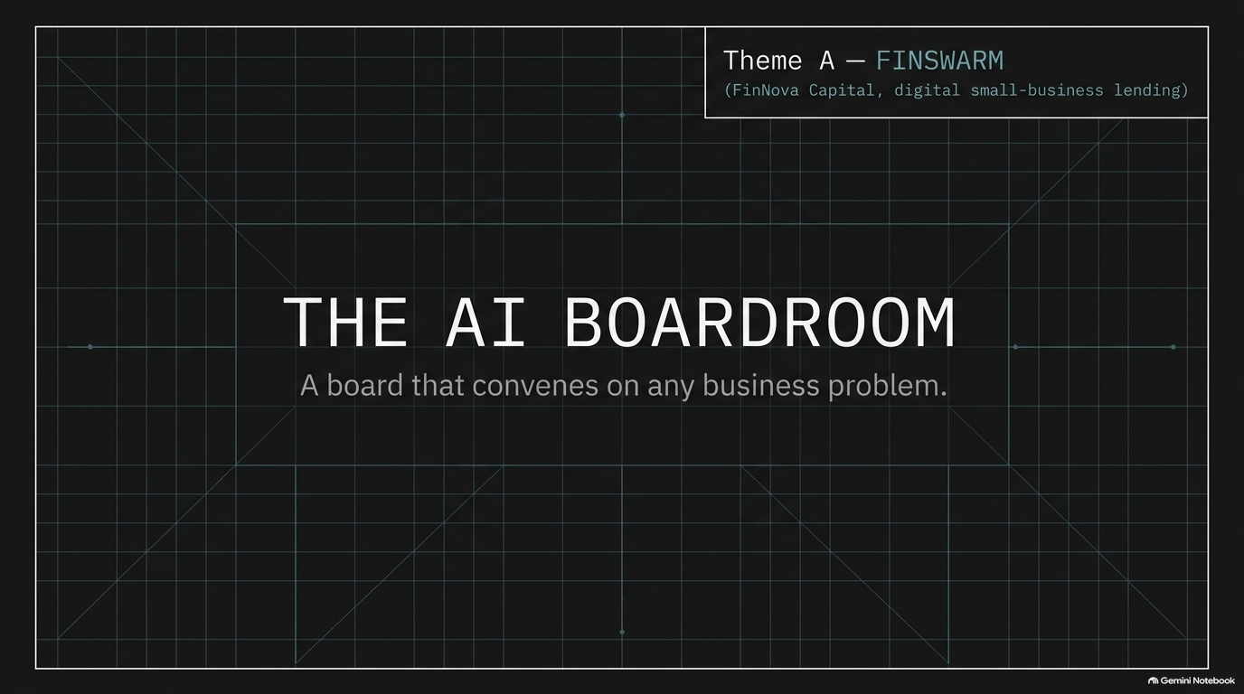

Slide 3
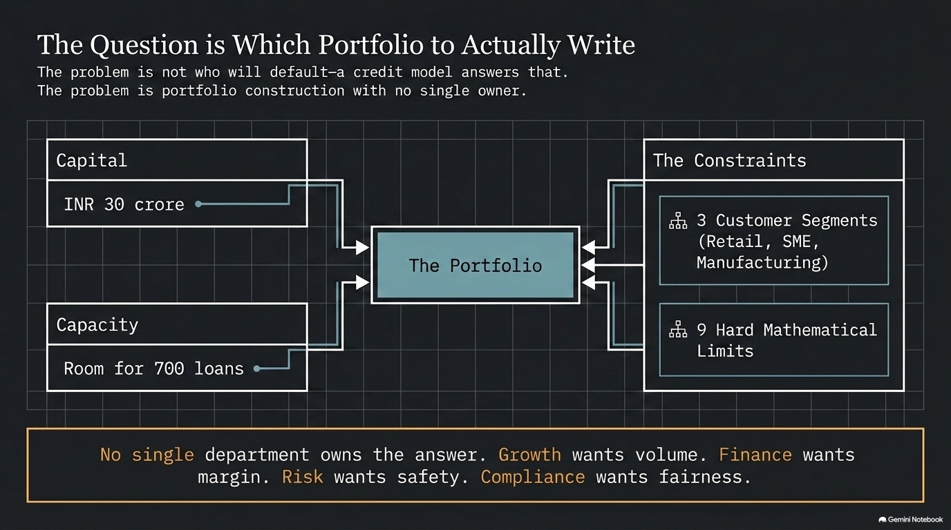

Slide 4
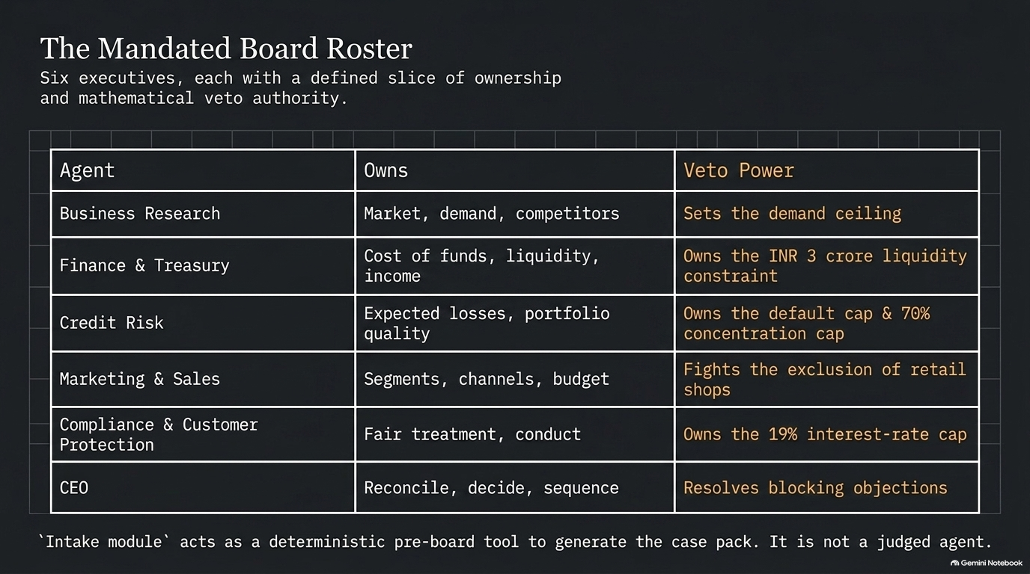

Slide 5
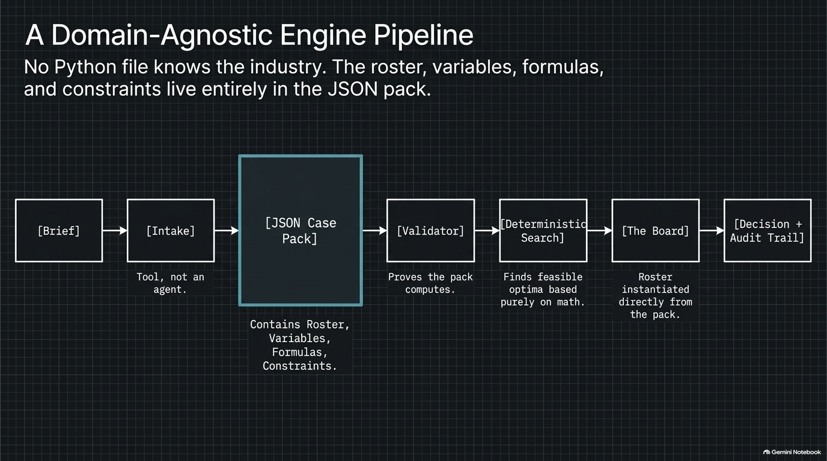

Slide 6
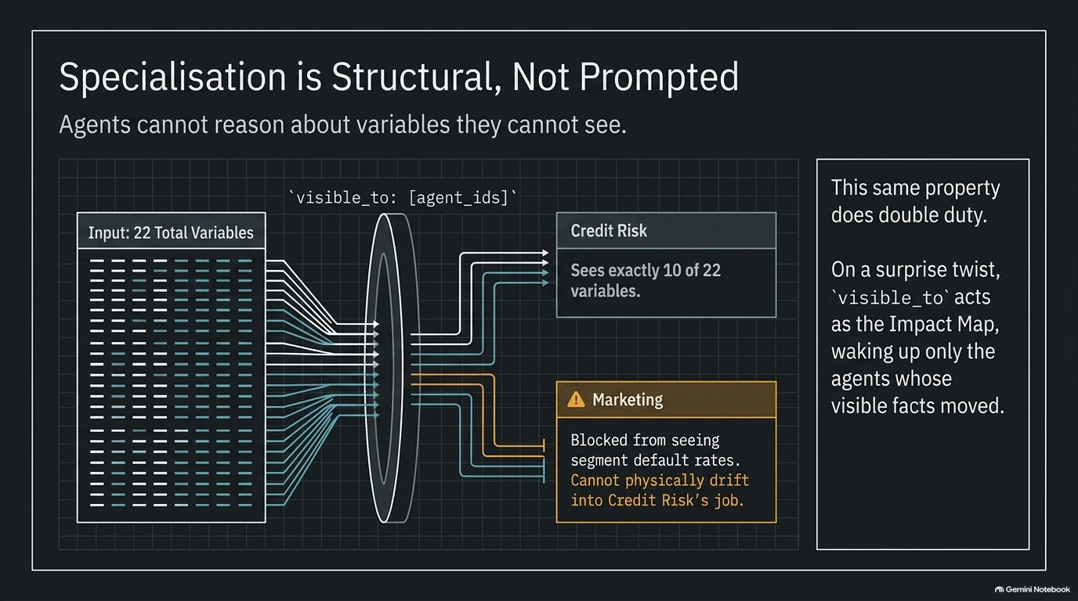

Slide 7
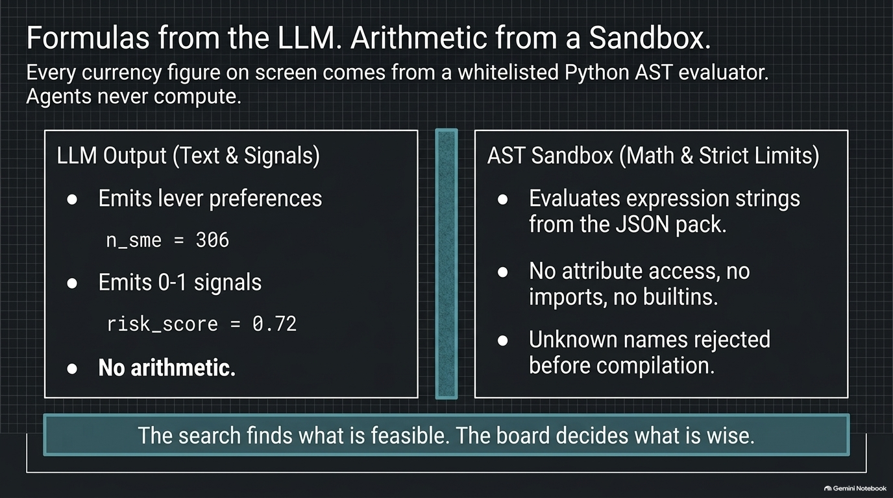

Slide 8
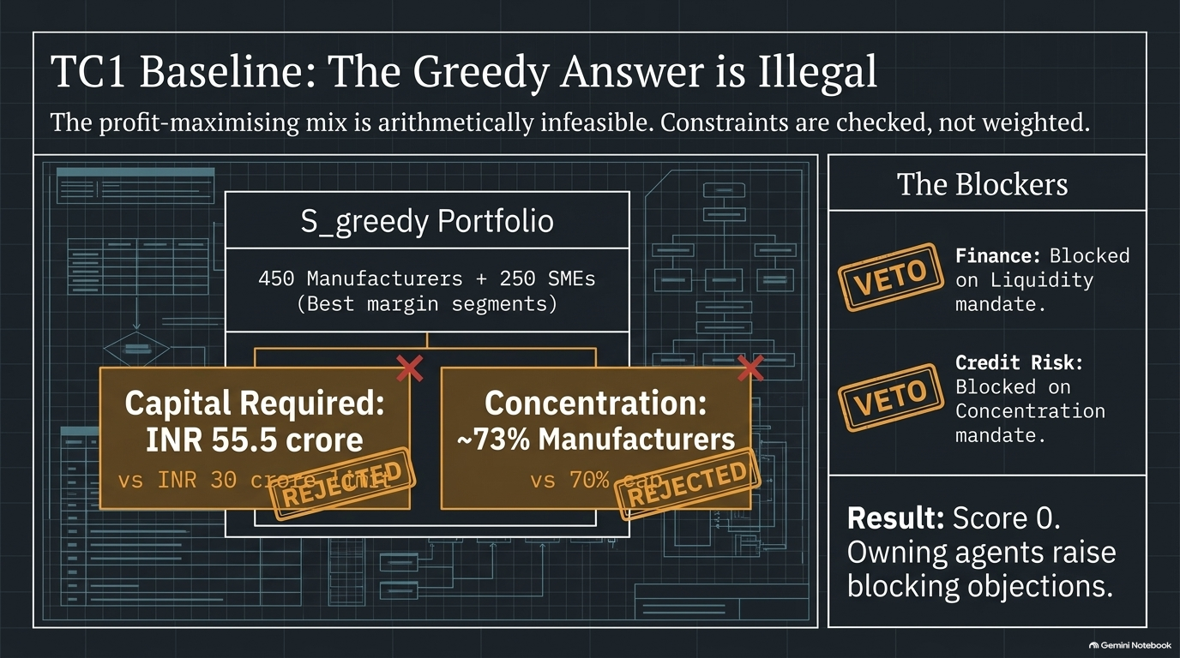

Slide 9
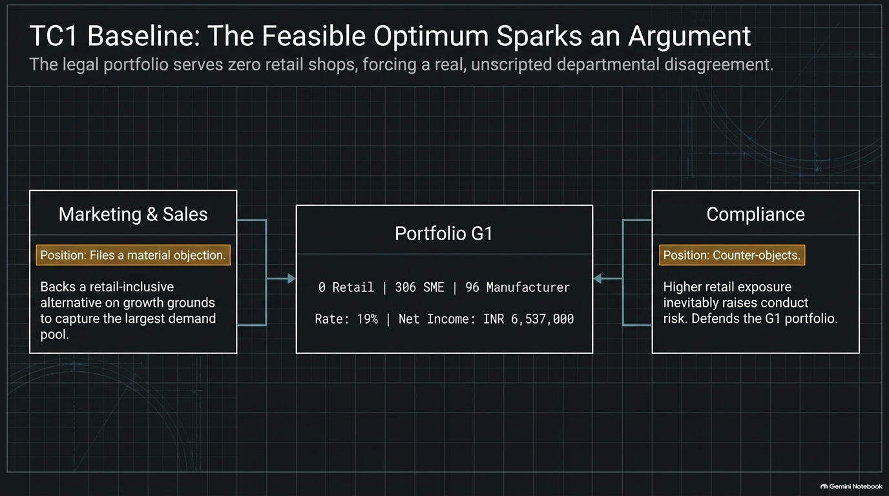

Slide 10
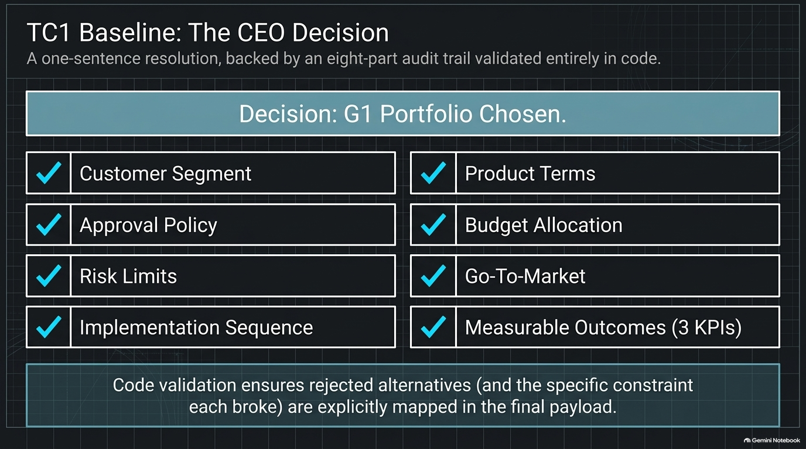

Slide 11
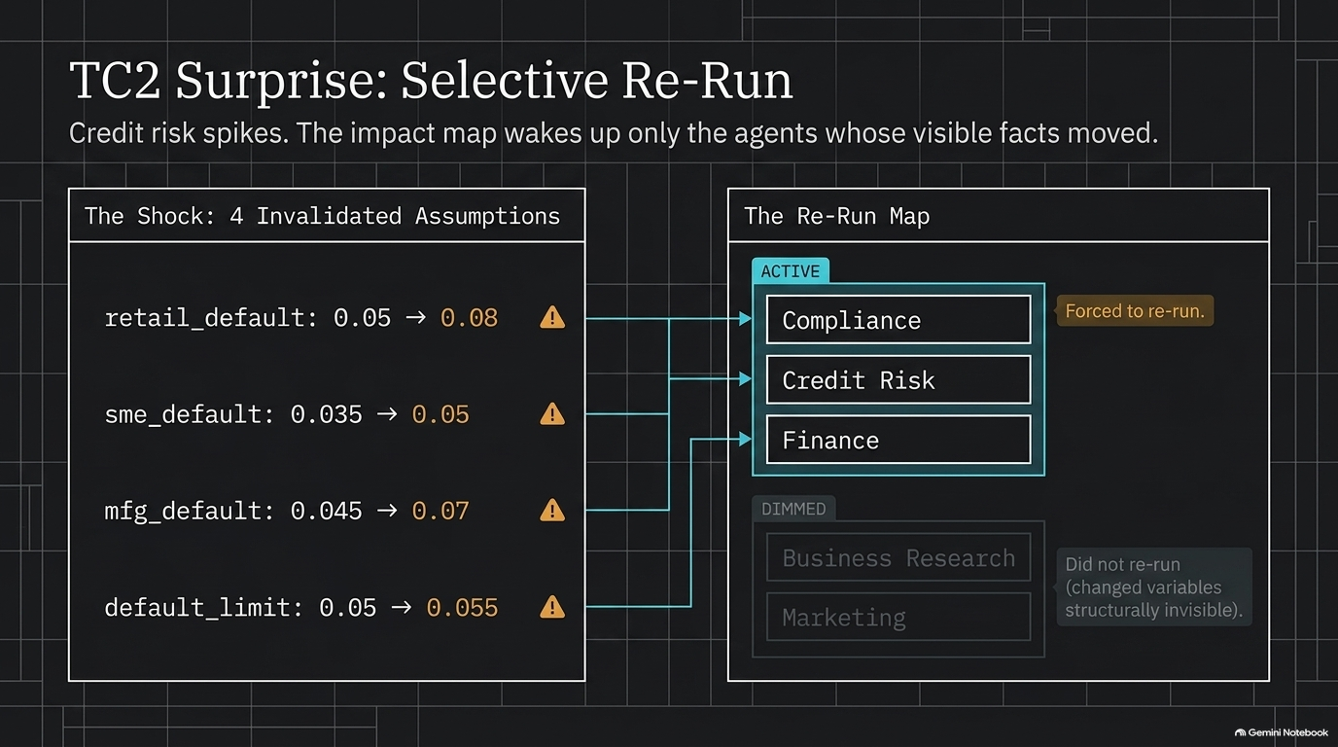

Slide 12
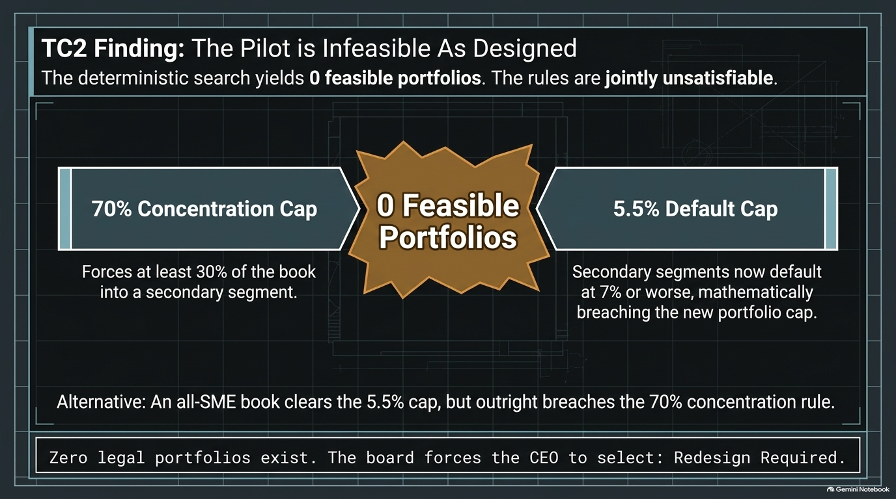

Slide 13
