Slide 1
HTML
Hyper Text Markup Language

Slide 2
HTML INTRODUCTION
What is HTML?
HTML is a language for describing web pages.
HTML stands for Hyper Text Markup Language
HTML is a markup language
A markup language is a set of markup tags
The tags describe document content
HTML documents contain HTML tags and plain text
HTML documents are also called web pages

Slide 3
HTML INTRODUCTION
HTML Tags
HTML markup tags are usually called HTML tags
HTML tags are keywords (tag names) surrounded by angle brackets like <html>
HTML tags normally come in pairs like <b> and </b>
The first tag in a pair is the start tag, the second tag is the end tag
The end tag is written like the start tag, with a forward slash before the tag name
Start and end tags are also called opening tags and closing tags
<tagname>content</tagname>

Slide 4
HTML INTRODUCTION
"HTML tags" and "HTML elements" are often used to describe the same thing.
But strictly speaking, an HTML element is everything between the start tag and the end tag, including the tags:
HTML Element:
<p>This is a paragraph.</p>

Slide 5
HTML INTRODUCTION
The purpose of a web browser (such as Google Chrome, Internet Explorer, Firefox, Safari) is to read HTML documents and display them as web pages.
The browser does not display the HTML tags, but uses the tags to determine how the content of the HTML page is to be presented/displayed to the user

Slide 6
HTML INTRODUCTION
<!DOCTYPE html>
<html>
<head>
<title>Page Title</title>
</head>
<body>
<h1>My First Heading</h1>
<p>My first paragraph.</p>
</body>
</html>

Slide 7
HTML INTRODUCTION
The <!DOCTYPE html> declaration defines that this document is an HTML5 document
The text between <html> and </html> describes the web page
The <head> element contains meta information about the HTML page
The <title> element specifies a title for the HTML page (which is shown in the browser's title bar or in the page's tab)
The text between <body> and </body> is the visible page content

Slide 8
The text between <h1> and </h1> is displayed as a heading
The text between <p> and </p> is displayed as a paragraph

Slide 9
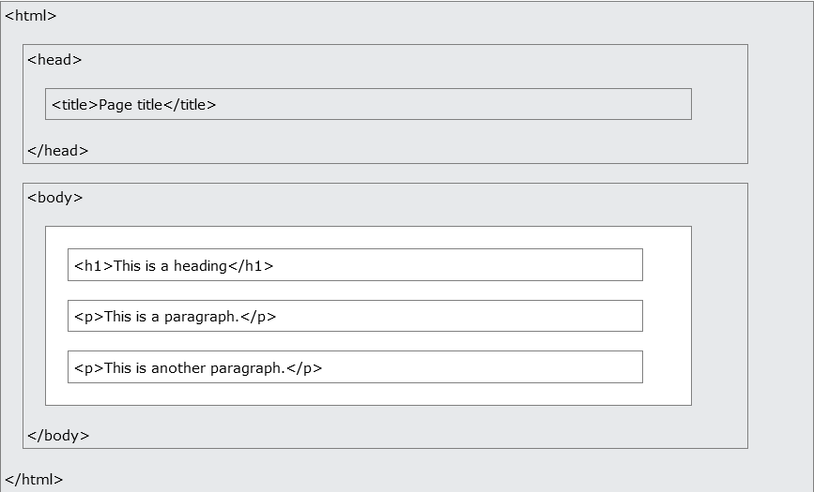
HTML INTRODUCTION

Slide 10
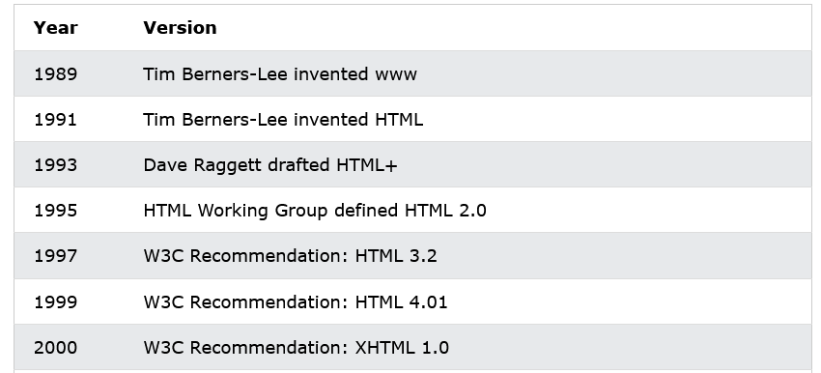
HTML INTRODUCTION - HISTORY

Slide 11
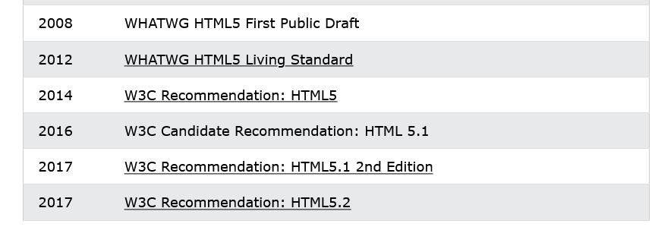

Slide 12
HTML EDITORS
Writing HTML Using Notepad or TextEdit
HTML can be edited by using a professional HTML editor like:
Adobe Dreamweaver
Microsoft Expression Web
CoffeeCup HTML Editor
However, for learning HTML it is recommended a text editor like Notepad (PC) or TextEdit (Mac). It is believed that using a simple text editor is a good way to learn HTML.

Slide 13
HTML EDITORS
Step 1: Start Notepad
Step 2: Edit Your HTML with Notepad
Step 3: Save Your HTML
Step 4: Run the HTML in Your Browser

Slide 14
HTML HEADINGS
HTML headings are defined with the <h1> to <h6> tags.
<h1>This is a heading</h1>
<h2>This is a heading</h2>
<h3>This is a heading</h3>

Slide 15
HTML TAG REFERENCE
<html> Defines an HTML document
<body> Defines the document's body
<h1> to <h6> Defines HTML headings
<hr> Defines a horizontal line
<!--> Defines a comment

Slide 16
HTML PARAGRAPHS
HTML paragraphs are defined with the <p> tag.
<p>This is a paragraph.</p>
<p>This is another paragraph.</p>

Slide 17
HTML TEXT FORMATTING
<b> Defines bold text
<em> Defines emphasized text
<i> Defines a part of text in an alternate voice or mood
<small> Defines smaller text
<strong> Defines important text
<sub> Defines subscripted text
<sup> Defines superscripted text
<ins> Defines inserted text
<del> Defines deleted text
<mark> Defines marked/highlighted text

Slide 18
HTML "COMPUTER OUTPUT" TAGS
<code> Defines computer code text
<kbd> Defines keyboard text
<samp> Defines sample computer code
<var> Defines a variable
<pre> Defines preformatted text

Slide 19
HTML CITATIONS, QUOTATIONS, AND DEFINITION TAGS
<abbr> Defines an abbreviation or acronym
<address> Defines contact information for the author/owner of a document
<bdo> Defines the text direction
<blockquote> Defines a section that is quoted from another source
<q> Defines an inline (short) quotation
<cite> Defines the title of a work
<dfn> Defines a definition term

Slide 20
HTML LINKS
HTML links are defined with the <a> tag.
<a href="http://www.abc.com">This is a link</a>

Slide 21
HTML HEAD ELEMENTS
<head> Defines information about the document
<title> Defines the title of a document
<base> Defines a default address or a default target for all links on a page
<link> Defines the relationship between a document and an external resource
<meta> Defines metadata about an HTML document
<script> Defines a client-side script
<style> Defines style information for a document

Slide 22
HTML IMAGES
HTML images are defined with the <img> tag
<img src=“xyz.jpg" width="104" height="142">

Slide 23
HTML IMAGE TAGS
<img> Defines an image
<map> Defines an image-map
<area> Defines a clickable area inside an image-map

Slide 24
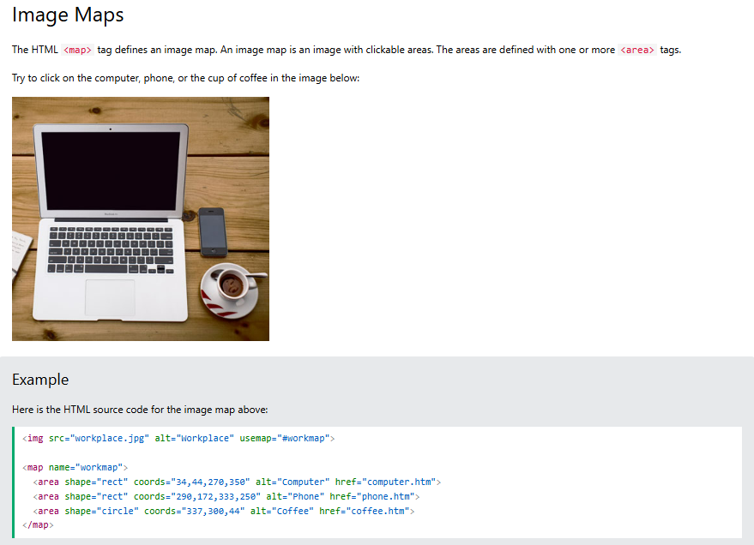

Slide 25
NESTED HTML ELEMENTS
Most HTML elements can be nested (can contain other HTML elements).
HTML documents consist of nested HTML elements.
<html>
<body>
<p>This is my first paragraph.</p>
</body>
</html>

Slide 26
EMPTY HTML ELEMENTS
HTML elements with no content are called empty elements.
<br> is an empty element without a closing tag (the <br> tag defines a line break).
Tip: In XHTML, all elements must be closed. Adding a slash inside the start tag, like <br />, is the proper way of closing empty elements in XHTML (and XML).

Slide 27
HTML BASIC
HTML Tip: Use Lowercase Tags
HTML tags are not case sensitive: <P> means the same as <p>. Many web sites use uppercase HTML tags.
It is better to use lowercase tags because the World Wide Web Consortium (W3C) recommends lowercase in HTML 4, and demands lowercase tags in XHTML.

Slide 28
HTML ATTRIBUTES REFERENCE
Below is a list of some attributes that can be used on any HTML element:
class - Specifies one or more classnames for an element (refers to a class in a style sheet)
id - Specifies a unique id for an element
style - Specifies an inline CSS style for an element
title - Specifies extra information about an element (displayed as a tool tip)

Slide 29
HTML TABLES
Tables are defined with the <table> tag.
A table is divided into rows (with the <tr> tag), and each row is divided into data cells (with the <td> tag). td stands for "table data," and holds the content of a data cell. A <td> tag can contain text, links, images, lists, forms, other tables, etc.

Slide 30
HTML TABLE HEADERS
Header information in a table are defined with the <th> tag.
All major browsers display the text in the <th> element as bold and centered

Slide 31
HTML TABLES AND THE BORDER ATTRIBUTE
If you do not specify a border attribute, the table will be displayed without borders. Sometimes this can be useful, but most of the time, we want the borders to show.

Slide 32
HTML TABLE TAGS
Tag Description
<table> Defines a table
<th> Defines a header cell in a table
<tr> Defines a row in a table
<td> Defines a cell in a table
<caption> Defines a table caption
<colgroup> Specifies a group of one or more columns in a table for formatting
<col> Specifies column properties for each column within a <colgroup> element
<thead> Groups the header content in a table
<tbody> Groups the body content in a table
<tfoot> Groups the footer content in a table

Slide 33
TABLE EXAMPLE
<table border="1">
<tr>
<th>Header 1</th>
<th>Header 2</th>
</tr>
<tr>
<td>row 1, cell 1</td>
<td>row 1, cell 2</td>
</tr>
<tr>
<td>row 2, cell 1</td>
<td>row 2, cell 2</td>
</tr>
</table>

Slide 34
HTML UNORDERED LISTS
An unordered list starts with the <ul> tag. Each list item starts with the <li> tag.
The list items are marked with bullets (typically small black circles)

Slide 35
HTML ORDERED LISTS
An ordered list starts with the <ol> tag. Each list item starts with the <li> tag.
The list items are marked with numbers.

Slide 36
HTML DESCRIPTION LISTS
A description list is a list of terms/names, with a description of each term/name.
The <dl> tag defines a description list.
The <dl> tag is used in conjunction with <dt> (defines terms/names) and <dd> (describes each term/name)

Slide 37
HTML LIST TAGS
<ol> Defines an ordered list
<ul> Defines an unordered list
<li> Defines a list item
<dl> Defines a description list
<dt> Defines a term/name in a description list
<dd> Defines a description of a term/name in a description list

Slide 38
LISTS - EXAMPLE
<ul>
<li>Coffee</li>
<li>Milk</li>
</ul>
<ol>
<li>Coffee</li>
<li>Milk</li>
</ol>
<dl>
<dt>Coffee</dt>
<dd>- black hot drink</dd>
<dt>Milk</dt>
<dd>- white cold drink</dd>
</dl>

Slide 39
HTML FORMS
HTML forms are used to pass data to a server.
An HTML form can contain input elements like text fields, checkboxes, radio-buttons, submit buttons and more. A form can also contain select lists, textarea, fieldset, legend, and label elements.
The <form> tag is used to create an HTML form:
<form>
input elements
</form>

Slide 40
FORM ATTRIBUTES
Attribute | Description
action | Backend script ready to process your passed data.
method | Method to be used to upload data. The most frequently used are GET and POST methods.
target | Specify the target window or frame where the result of the script will be displayed. It takes values like _blank, _self, _parent etc.

Slide 41
HTML FORMS - THE INPUT ELEMENT
The most important form element is the <input> element.
The <input> element is used to select user information.
An <input> element can vary in many ways, depending on the type attribute. An <input> element can be of type text field, checkbox, password, radio button, submit button, and more.

Slide 42
TEXT FIELDS
<input type="text"> defines a one-line input field that a user can enter text into:
<form>
First name: <input type="text" name="firstname"><br>
Last name: <input type="text" name="lastname">
</form>

Slide 43
ATTRIBUTES
Attribute | Description
type | Indicates the type of input control and for text input control it will be set to text.
name | Used to give a name to the control which is sent to the server to be recognized and get the value.
value | This can be used to provide an initial value inside the control.
size | Allows to specify the width of the text-input control in terms of characters.
maxlength | Allows to specify the maximum number of characters a user can enter into the text box.

Slide 44
PASSWORD FIELD
<input type="password"> defines a password field:
<form>
Password: <input type="password" name="pwd">
</form>

Slide 45
ATTRIBUTES
Attribute | Description
type | Indicates the type of input control and for password input control it will be set to password.
name | Used to give a name to the control which is sent to the server to be recognized and get the value.
value | This can be used to provide an initial value inside the control.
size | Allows to specify the width of the text-input control in terms of characters.
maxlength | Allows to specify the maximum number of characters a user can enter into the text box.

Slide 46
MULTIPLE-LINE TEXT INPUT CONTROLS
This is used when the user is required to give details that may be longer than a single sentence.
Multi-line input controls are created using HTML <textarea> tag.

Slide 47
EXAMPLE
<!DOCTYPE html>
<html>
<head>
<title>Multiple-Line Input Control</title>
</head>
<body>
<form> Description : <br />
<textarea rows="5" cols="50" name="description"> Enter description here... </textarea>
</form>
</body> </html>

Slide 48
ATTRIBUTES
Attribute | Description
name | Used to give a name to the control which is sent to the server to be recognized and get the value.
rows | Indicates the number of rows of text area box.
cols | Indicates the number of columns of text area box

Slide 49
RADIO BUTTONS
<input type="radio"> defines a radio button. Radio buttons let a user select ONLY ONE of a limited number of choices:
<form>
<input type="radio" name="sex" value="male">Male<br>
<input type="radio" name="sex" value="female">Female
</form>

Slide 50
ATTRIBUTES
Attribute | Description
type | Indicates the type of input control and for checkbox input control it will be set to radio.
name | Used to give a name to the control which is sent to the server to be recognized and get the value.
value | The value that will be used if the radio box is selected.
checked | Set to checked if you want to select it by default.

Slide 51
CHECKBOXES
<input type="checkbox"> defines a checkbox. Checkboxes let a user select ZERO or MORE options of a limited number of choices.
<form>
<input type="checkbox" name="vehicle" value="Bike">I have a bike<br>
<input type="checkbox" name="vehicle" value="Car">I have a car
</form>

Slide 52
ATTRIBUTES
Attribute | Description
type | Indicates the type of input control and for checkbox input control it will be set to checkbox.
name | Used to give a name to the control which is sent to the server to be recognized and get the value.
value | The value that will be used if the checkbox is selected.
checked | Set to checked if you want to select it by default.

Slide 53
SELECT BOX CONTROL
A select box, also called drop down box which provides option to list down various options in the form of drop down list, from where a user can select one or more options.

Slide 54
EXAMPLE
<!DOCTYPE html>
<html>
<head>
<title>Select Box Control</title>
</head>
<body>
<form> <select name="dropdown">
<option value="Maths" selected>Maths</option> <option value="Physics">Physics</option>
</select>
</form> </body> </html>

Slide 55
ATTRIBUTES - SELECT
Attribute | Description
name | Used to give a name to the control which is sent to the server to be recognized and get the value.
size | This can be used to present a scrolling list box.
multiple | If set to "multiple" then allows a user to select multiple items from the menu.

Slide 56
ATTRIBUTES - OPTION
Attribute | Description
value | The value that will be used if the radio box is selected.
selected | Specifies that this option should be the initially selected value when the page loads.
label | An alternative way of labeling options

Slide 57
FILE UPLOAD BOX
If you want to allow a user to upload a file to your web site, you will need to use a file upload box, also known as a file select box.
This is also created using the <input> element but type attribute is set to file.

Slide 58
EXAMPLE
<!DOCTYPE html>
<html>
<head>
<title>File Upload Box</title>
</head>
<body>
<form>
<input type="file" name="fileupload" accept="image/*" />
</form>
</body> </html>

Slide 59
ATTRIBUTES
Attribute | Description
name | Used to give a name to the control which is sent to the server to be recognized and get the value.
accept | Specifies the types of files that the server accepts.

Slide 60
BUTTON CONTROLS
There are various ways in HTML to create clickable buttons.
You can also create clickable button using <input> tag by setting its type attribute to button.
The type attribute can take the following values

Slide 61
Type | Description
submit | This creates a button that automatically submits a form.
reset | This creates a button that automatically resets form controls to their initial values.
button | This creates a button that is used to trigger a client-side script when the user clicks that button.
image | This creates a clickable button but we can use an image as background of the button.

Slide 62
SUBMIT BUTTON
<input type="submit"> defines a submit button.
A submit button is used to send form data to a server. The data is sent to the page specified in the form's action attribute. The file defined in the action attribute usually does something with the received input:
<form name="input" action="html_form_action.asp" method="get">
Username: <input type="text" name="user">
<input type="submit" value="Submit">
</form>

Slide 63
HIDDEN FORM CONTROLS
Hidden form controls are used to hide data inside the page which later on can be pushed to the server.
This control hides inside the code and does not appear on the actual page.
For example, following hidden form is being used to keep current page number.
When a user will click next page then the value of hidden control will be sent to the web server and there it will decide which page has be displayed next based on the passed current page.

Slide 64
EXAMPLE
<!DOCTYPE html>
<html>
<head>
<title>File Upload Box</title>
</head>
<body>
<form>
<p>This is page 10</p>

Slide 65
<input type="hidden" name="pagename" value="10" />
<input type="submit" name="submit" value="Submit" />
<input type="reset" name="reset" value="Reset" />
</form>
</body>
</html>

