Slide 1
CSS…

Slide 2
_{Position property}
The position property specifies the type of positioning method used for an element (static, relative, fixed, absolute or sticky).
There are five different position values:
          _{static}
          _{relative}
          _{fixed}
          _{absolute}
          _{sticky}
Elements are then positioned using the top, bottom, left, and right properties. However, these properties will not work unless the position property is set first.
They also work differently depending on the position value.

Slide 3

position: static (Default)
This is the default positioning for all HTML elements.
Elements appear one after another in normal document flow.
top, left, right, bottom do not work.
<div class="static-box">Static Position</div>
<style>
.static-box {
position: static;
background: lightblue;
padding: 10px;
}
</style>

Slide 4
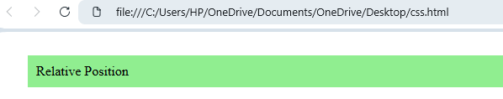
position: relative
Element is positioned relative to its original position.
Space for the element is still reserved.
Other elements are not affected.
<div class="relative-box">Relative Position</div>
<style>
.relative-box {
position: relative;
top: 20px;
left: 30px;
background: lightgreen;
padding: 10px;
}
</style>

Slide 5
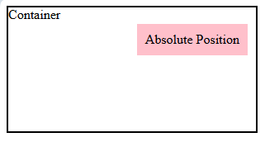
position: absolute
Element is positioned relative to the nearest positioned ancestor.
If no ancestor is positioned, it uses the viewport.
Element is removed from normal flow (no space reserved).
<div class="container">
Container
<div class="absolute-box">Absolute Position</div>
</div>
<style>
.container {
position: relative;
width: 300px;
height: 150px;
border: 2px solid black;
}
.absolute-box {
position: absolute;
top: 20px;
right: 10px;
background: pink;
padding: 10px;
}
</style>

Slide 6

position: fixed
Element is positioned relative to the browser window (viewport).
It does not move when scrolling.
Removed from normal document flow.
<div class="fixed-box">Fixed Position</div>
<style>
.fixed-box {
position: fixed;
bottom: 10px;
right: 10px;
background: orange;
padding: 10px;
}
</style>

Slide 7
position: sticky
Combines relative and fixed positioning.
Acts like relative until a scroll position is reached.
Then behaves like fixed.
<div class="sticky-box">Sticky Position</div>
<style>
.sticky-box {
position: sticky;
top: 0;
background: yellow;
padding: 10px;
}
</style>
<p style="height: 1000px;">Scroll down</p>

Slide 8
CSS Positioning Properties
Property | Description
bottom | Sets the bottom margin edge for a positioned box
clip | Clips an absolutely positioned element
left | Sets the left margin edge for a positioned box
position | Specifies the type of positioning for an element
right | Sets the right margin edge for a positioned box
top | Sets the top margin edge for a positioned box

Slide 9
CSS Overflow
The CSS overflow property controls what happens to content that is too big to fit into an area.
The overflow property specifies whether to clip the content or to add scrollbars when the content of an element is too big to fit in the specified area.
The overflow property has the following values:
visible - Default. The overflow is not clipped. The content renders outside the element's box
hidden - The overflow is clipped, and the rest of the content will be invisible
scroll - The overflow is clipped, and a scrollbar is added to see the rest of the content
auto - Similar to scroll, but it adds scrollbars only when necessary

Slide 10
Overflow
Example
Description
div.ex1 {
overflow: scroll;
}
div.ex2 {
overflow: hidden;
}
div.ex3 {
overflow: auto;
}
div.ex4 {
overflow: clip;
}
div.ex5 {
overflow: visible;
}
The overflow property specifies what should happen if content overflows an element's box.
This property specifies whether to clip content or to add scrollbars when an element's content is too big to fit in a specified area.

Slide 11
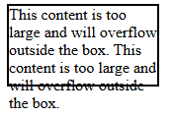
overflow: visible (Default)
Example
Description
<div class="visible-box">
This content is too large and will overflow outside the box. This content is too large and will overflow outside the box.
</div>
<style>
.visible-box {
width: 150px;
height: 80px;
border: 2px solid black;
overflow: visible;
}
</style>
Content overflows outside the container.
Container size does not change.
This is the default behavior.

Slide 12

overflow: hidden
Example
Description
<div class="hidden-box">
This content will be hidden if it exceeds the box size.
</div>
<style>
.hidden-box {
width: 150px;
height: 80px;
border: 2px solid black;
overflow: hidden;
}
</style>
Extra content is clipped and hidden.
No scrollbars are shown.
Overflowed content cannot be accessed.

Slide 13
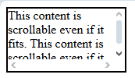
overflow: scroll
Example
Description
<div class="scroll-box">
This content is scrollable even if it fits.
</div>
<style>
.scroll-box {
width: 150px;
height: 80px;
border: 2px solid black;
overflow: scroll;
}
</style>
Scrollbars are always shown.
Allows scrolling even if content fits.

Slide 14
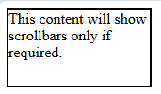
overflow: auto
Example
Description
<div class="auto-box">
This content will show scrollbars only if required.
</div>
<style>
.auto-box {
width: 150px;
height: 80px;
border: 2px solid black;
overflow: auto;
}
</style>
Scrollbars appear only when needed.
Most commonly used value.

Slide 15
Direction-Specific Overflow
Example
.box {
overflow-x: hidden; /* horizontal */
overflow-y: scroll; /* vertical */
}

Slide 16
Overflow-properties
Property | Description
overflow | Specifies what happens if content overflows an element's box
overflow-anchor | Makes it possible to turn off scroll anchoring
overflow-x | Specifies what to do with the left/right edges of the content if it overflows the element's content area
overflow-y | Specifies what to do with the top/bottom edges of the content if it overflows the element's content area
overflow-wrap | Specifies whether or not the browser can break lines with long words, if they overflow its container

Slide 17
CSS Float
The float property is used for positioning and formatting content e.g. let an image float left to the text in a container.
The float property can have one of the following values:
left - The element floats to the left of its container
right - The element floats to the right of its container
none - The element does not float (will be displayed just where it occurs in the text). This is default
inherit - The element inherits the float value of its parent
In its simplest use, the float property can be used to wrap text around images.

Slide 18
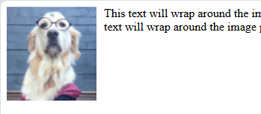
CSS Float-left
The element moves to the left side of its container.
Text and inline content wrap around the right side of the element.
<img src="image.jpg" class="left-img">
<p>
This text will wrap around the image placed on the left side.
</p>
<style>
.left-img {
float: left;
width: 120px;
margin-right: 10px;
}
</style>

Slide 19
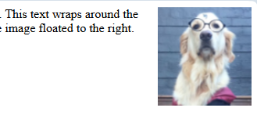
CSS Float - right
The element moves to the right side of its container.
Text wraps around the left side.
<img src="image.jpg" class="right-img">
<p>
This text wraps around the image floated to the right.
</p>
<style>
.right-img {
float: right;
width: 120px;
margin-left: 10px;
}
</style>

Slide 20
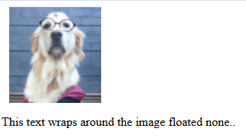
CSS none (default)
Element behaves normally.
Appears exactly where it is in the HTML flow.
<p>
This text wraps around the image floated none.
</p>
<style>
.right-img {
float: none;
width: 120px;
margin-left: 10px;
}
</style>

Slide 21


CSS inherit
The element inherits the float value from its parent.
<div class="parent">
Parent
<div class="child">Child</div>
</div>
<style>
.parent {
float: left;
width: 200px;
background: lightblue;
}
.child {
float: inherit;
background: lightgreen;
}
</style>

Slide 22
Align
Center Align Elements
To horizontally center a block element (like <div>), use margin: auto;
Setting the width of the element will prevent it from stretching out to the edges of its container.
The element will then take up the specified width, and the remaining space will be split equally between the two margins
.center {
margin: auto;
width: 50%;
border: 3px solid green;
padding: 10px;
}

Slide 23
Example:
<!DOCTYPE html>
<html>
<head>
<style>
.center {
text-align: center;
border: 3px solid green;
}
</style>
</head>
<body>
<h2>Center Text</h2>
<div class="center">
<p>This text is centered.</p>
</div>
</body>
</html>
To just center the text inside an element, use text-align: center;

Slide 24
Opacity
<!DOCTYPE html>
<html>
<head>
<style>
img {
opacity: 0.5;
}
img:hover {
opacity: 1.0;}
</style>
</head>
<body>
<h1>Image Transparency</h1>
<p>The opacity property is often used together with the :hover selector to change the opacity on mouse-over:</p>
<img src="img_forest.jpg" alt="Forest" width="170" height="100">
<img src="img_mountains.jpg" alt="Mountains" width="170" height="100">
<img src="img_5terre.jpg" alt="Italy" width="170" height="100">
</body>
</html>
The opacity property specifies the opacity/transparency of an element.
The opacity property can take a value from 0.0 - 1.0.
The lower the value, the more transparent

Slide 25
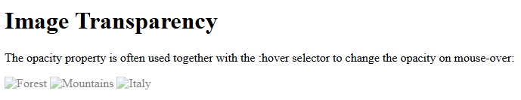
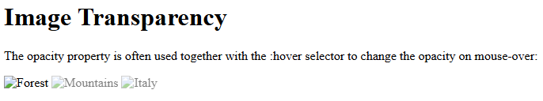

Slide 26
Border-radius
At its center, border-radius characterizes the shape of the sides of an element.
It is shorthand for border-top-left-radius, border-top-right-radius, border-bottom-right-radius, and border-bottom-left-radius.
These properties empower you to autonomously set the radius for each corner.

Slide 27
#roundedBox {
border-radius: 20px;
background-color: #7fd7e7;
}
#fancyBox {
border-radius: 15% 10%;
background-color: #ffa07a;
}
#customBox {
border-radius: 20px 30px 10px;
background-color: #98fb98;
}
Single Value:
At the point when you offer a single value, like border-radius: 30px;, it applies that radius to all corners, making consistently adjusted edges.
Two Values:
Presenting two values, similar to border-radius: 20% 10%;, empowers you to set various radii for even and vertical corners. The primary value addresses the top-left and bottom-right corners, while the subsequent value applies to the top-right and bottom-left corners.
Three and Four Values:
Things get much more intriguing with three and four values.
With border-radius: 10% 30% 20%;, the values relate to top-left, top-right, and bottom-right/bottom-left corners, separately.
For four values like border-radius: 10% 30% 20% 40%;, you take care of each corner independently.

Slide 28
The border-radius property is used to round the corners of an element.
You can use:
one value → all corners same
two values → horizontal / vertical radii
three values → top-left, top-right & bottom-left/right (CSS shorthand rule)

Slide 29
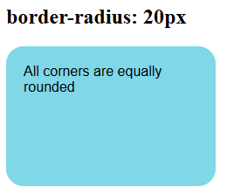
<!DOCTYPE html>
<html>
<head>
<title>Border Radius - 20px</title>
<style>
#roundedBox {
width: 200px;
height: 120px;
background-color: #7fd7e7;
border-radius: 20px;
padding: 20px;
font-family: Arial;
}
</style>
</head>
<body>
<h2>border-radius: 20px</h2>
<div id="roundedBox">
All corners are equally rounded
</div>
</body>
</html>
All four corners are equally rounded.

Slide 30
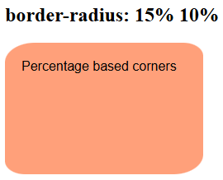
<!DOCTYPE html>
<html>
<head>
<title>Border Radius - Percentage</title>
<style>
#fancyBox {
width: 200px;
height: 120px;
background-color: #ffa07a;
border-radius: 15% 10%;
padding: 20px;
font-family: Arial;
}
</style>
</head>
<body>
<h2>border-radius: 15% 10%</h2>
<div id="fancyBox">
Percentage based corners
</div>
</body>
</html>
border-radius: 15% 10%
First value → horizontal radius
Second value → vertical radius

Slide 31
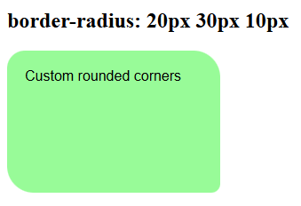
<!DOCTYPE html>
<html>
<head>
<title>Border Radius - Custom</title>
<style>
#customBox {
width: 200px;
height: 120px;
background-color: #98fb98;
border-radius: 20px 30px 10px;
padding: 20px;
font-family: Arial;
}
</style>
</head>
<body>
<h2>border-radius: 20px 30px 10px</h2>
<div id="customBox">
Custom rounded corners
</div>
</body>
</html>
border-radius: 20px 30px 10px
20px → top-left
30px → top-right & bottom-left
10px → bottom-right

Slide 32
Flex box
Flexbox is short for the Flexible Box Layout module.
Flexbox is a layout method for arranging items in rows or columns.
Flexbox makes it easier to design a flexible responsive layout structure, without using float or positioning.
A flexbox always consists of:
a Flex Container - the parent (container) <div> element
Flex Items - the items inside the container <div>

Slide 33
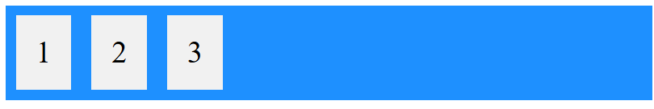
<style>
.flex-container {
display: flex;
background-color: DodgerBlue;
}
.flex-container > div {
background-color: #f1f1f1;
margin: 10px;
padding: 20px;
font-size: 30px;
}
</style>
<div class="flex-container">
<div>1</div>
<div>2</div>
<div>3</div>
</div>

Slide 34
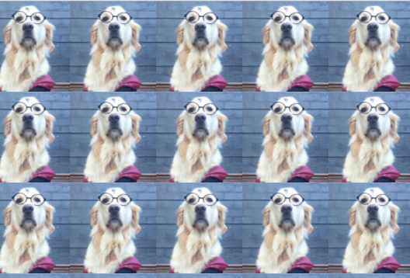
Background-attachment
The background-attachment property specifies whether the background image should scroll or be fixed (will not scroll with the rest of the page)
body {
background-image: url(“dog.png");
background-repeat: repeat;
background-position: right top;
background-attachment: fixed;
}

Slide 35
Z-Index
The z-index property specifies the stack order of an element.
An element with greater stack order is always in front of an element with a lower stack order.
Note: z-index only works on positioned elements (position: absolute, position: relative, position: fixed, or position: sticky) and flex items (elements that are direct children of display:flex elements).
Note: If two positioned elements overlap without a z-index specified, the element positioned last in the HTML code will be shown on top.
Value | Description
auto | Sets the stack order equal to its parents. This is default
number | Sets the stack order of the element. Negative numbers are allowed
initial | Sets this property to its default value. Read about initial
inherit | Inherits this property from its parent element. Read about inherit

Slide 36
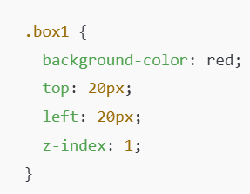
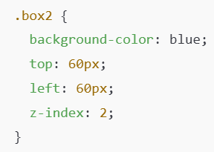
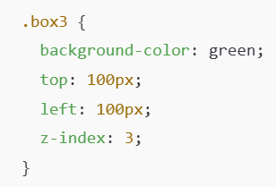
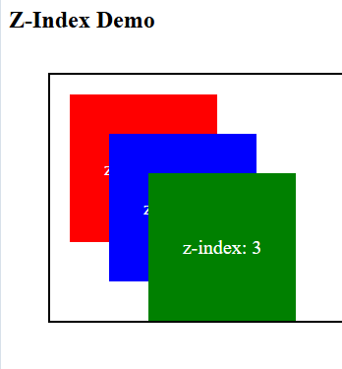
Z-Index
<!DOCTYPE html>
<html>
<head>
<title>Z-Index Example</title>
<style>
.container {
position: relative;
height: 250px;
margin: 40px;
border: 2px solid black;
}
.box {
position: absolute;
width: 150px;
height: 150px;
color: white;
font-size: 20px;
text-align: center;
line-height: 150px;
}
.box1 {
background-color: red;
top: 20px;
left: 20px;
z-index: 1;
}
.box2 {
background-color: blue;
top: 60px;
left: 60px;
z-index: 2;
}
.box3 {
background-color: green;
top: 100px;
left: 100px;
z-index: 3;
}
</style>
</head>
<body>
<h2>Z-Index Demo</h2>
<div class="container">
<div class="box box1">z-index: 1</div>
<div class="box box2">z-index: 2</div>
<div class="box box3">z-index: 3</div>
</div>
</body>
</html>
Value | Description
auto | Sets the stack order equal to its parents. This is default
number | Sets the stack order of the element. Negative numbers are allowed
initial | Sets this property to its default value. Read about initial
inherit | Inherits this property from its parent element. Read about inherit

Slide 37
Pseudo-classes
A pseudo-class is used to define a special state of an element.
For example, it can be used to:
Style an element when a user moves the mouse over it
Style visited and unvisited links differently
Style an element when it gets focus
Style valid/invalid/required/optional form elements
Syntax
The syntax of pseudo-classes:
selector:pseudo-class {
property: value;
}

Slide 38
Pseudoclass example
<style>
/* unvisited link */
a:link {
color: red;
}
/* visited link */
a:visited {
color: green;
}
/* mouse over link */
a:hover {
color: hotpink;
}
/* selected link */
a:active {
color: blue;
}
</style>

Slide 39
Hovering on div element-pseudoclass
<!DOCTYPE html>
<html>
<head>
<style>
div {
background-color: green;
color: white;
padding: 25px;
text-align: center;
}
div:hover {
background-color: blue;
}
</style>
</head>
<body>
<p>Mouse over the div element below to change its background color:</p>
<div>Mouse Over Me</div>
</body>
</html>

Slide 40
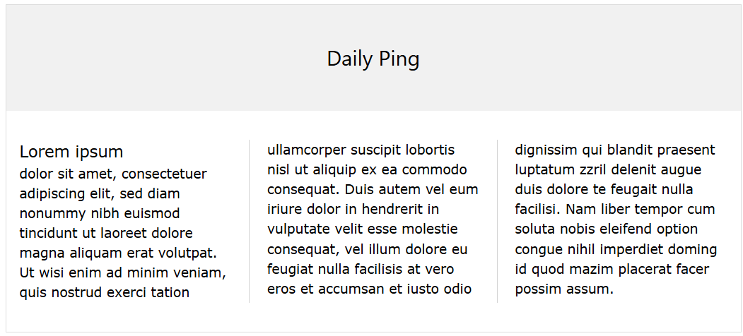
Multi-Column Properties
The CSS multi-column layout allows easy definition of multiple columns of text - just like in newspapers
column-count
column-gap
column-rule-style
column-rule-width
column-rule-color
column-rule
column-span
column-width

Slide 41
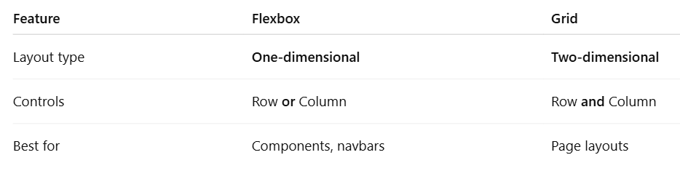
CSS Grid/Flex Layout

Slide 42
Property | Description
align-content | Vertically aligns the whole grid inside the container (when total grid size is smaller than container)
align-items | Aligns content in a grid item along the column axis
align-self | Aligns the content for a specific grid item along the column axis
display | Specifies the display behavior (the type of rendering box) of an element
column-gap | Specifies the gap between the columns
gap | A shorthand property for the row-gap and the column-gap properties
grid | A shorthand property for the grid-template-rows, grid-template-columns, grid-template-areas, grid-auto-rows, grid-auto-columns, and the grid-auto-flow properties
grid-area | Either specifies a name for the grid item, or this property is a shorthand property for the grid-row-start, grid-column-start, grid-row-end, and grid-column-end properties
grid-auto-columns | Specifies a default column size
grid-auto-flow | Specifies how auto-placed items are inserted in the grid
grid-auto-rows | Specifies a default row size
grid-column | A shorthand property for the grid-column-start and the grid-column-end properties
grid-column-end | Specifies where to end the grid item
grid-column-start | Specifies where to start the grid item
grid-row | A shorthand property for the grid-row-start and the grid-row-end properties
grid-row-end | Specifies where to end the grid item
grid-row-start | Specifies where to start the grid item
grid-template | A shorthand property for the grid-template-rows, grid-template-columns and grid-areas properties
grid-template-areas | Specifies how to display columns and rows, using named grid items
grid-template-columns | Specifies the size of the columns, and how many columns in a grid layout
grid-template-rows | Specifies the size of the rows in a grid layout
justify-content | Horizontally aligns the whole grid inside the container (when total grid size is smaller than container)
justify-self | Aligns the content for a specific grid item along the row axis
place-self | A shorthand property for the align-self and the justify-self properties
place-content | A shorthand property for the align-content and the justify-content properties
row-gap | Specifies the gap between the grid rows

Slide 43
Grid-template-columns
.grid-container {
display: grid;
grid-template-columns: auto auto auto auto;
}
grid-template-columns: none|auto|max-content|min-content|minmax()|length|percentage|fit-content()|repeat()|subgrid|initial|inherit;

Slide 44
ANIMATION
An animation lets an element gradually change from one style to another.
You can change as many CSS properties you want, as many times as you want.
To use CSS animation, you must first specify some keyframes for the animation.
Keyframes hold what styles the element will have at certain times.
@keyframes rule, the animation will gradually change from the current style to the new style at certain times.

Slide 45
CSS Animation Properties
The following table lists the @keyframes rule and all the CSS animation properties:
Property | Description
@keyframes | Specifies the animation code
animation | A shorthand property for setting all the animation properties
animation-delay | Specifies a delay for the start of an animation
animation-direction | Specifies whether an animation should be played forwards, backwards or in alternate cycles
animation-duration | Specifies how long time an animation should take to complete one cycle
animation-fill-mode | Specifies a style for the element when the animation is not playing (before it starts, after it ends, or both)
animation-iteration-count | Specifies the number of times an animation should be played
animation-name | Specifies the name of the @keyframes animation
animation-play-state | Specifies whether the animation is running or paused
animation-timing-function | Specifies the speed curve of the animation

Slide 46
Animation delay
div {
width: 100px;
height: 100px;
position: relative;
background-color: red;
animation-name: example;
animation-duration: 4s;
animation-delay: 2s;
}
The animation-delay property specifies a delay for the start of an animation.

Slide 47
Animation-iteration-count
div {
width: 100px;
height: 100px;
position: relative;
background-color: red;
animation-name: example;
animation-duration: 4s;
animation-iteration-count: 3;
}
The animation-iteration-count property specifies the number of times an animation should run.

Slide 48
Animation-direction
The animation-direction property specifies whether an animation should be played forwards, backwards or in alternate cycles.
The animation-direction property can have the following values:
normal - The animation is played as normal (forwards). This is default
reverse - The animation is played in reverse direction (backwards)
alternate - The animation is played forwards first, then backwards
alternate-reverse - The animation is played backwards first, then forwards
div {
width: 100px;
height: 100px;
position: relative;
background-color: red;
animation-name: example;
animation-duration: 4s;
animation-direction: reverse;
}

Slide 49
SVG-Animation
SVG <animate>
The <animate> element animates an attribute of an element.
The <animate> element should be nested inside the target element.
In this example, we create a red circle. We animate the cx attribute from 50 to 90%. This means that the circle will go from left to right:
SVG elements can be animated.
In SVG, we have four animation elements which sets or animates SVG graphics:
<set>
<animate>
<animateTransform>
<animateMotion>

Slide 50
The <set> element sets the value of an attribute for a specified duration.
The <animate> element animates an attribute of an element.
The <animate> element should be nested inside the target element.
The <animateMotion> element sets how an element moves along a motion path.
The <animateMotion> element should be nested inside the target element.
<svg width="200" height="100" xmlns="http://www.w3.org/2000/svg">
<circle cx="50" cy="50" r="25" style="fill:red;">
<set attributeName="r" to="50" begin="3s" />
</svg>

Slide 51
<svg width="100%" height="100" xmlns="http://www.w3.org/2000/svg">
<circle cx="50" cy="50" r="50" style="fill:red;">
<animate
attributeName="cx"
begin="0s"
dur="8s"
from="50"
to="90%"
repeatCount="indefinite" />
</circle>
</svg>
The attributeName attribute defines which attribute to animate
The begin attribute defines when the animation should start
The dur attribute defines the duration of the animation
The from attribute defines the starting value
The to attribute defines the ending value
The repeatCount attribute defines how many times the animation should play

Slide 52
To freeze
<svg width="100%" height="100" xmlns="http://www.w3.org/2000/svg">
<circle cx="50" cy="50" r="50" style="fill:red;">
<animate
attributeName="cx"
begin="0s"
dur="8s"
from="50"
to="90%"
fill="freeze" />
</circle>
</svg>

Slide 53
Animation Transform
The <animateTransform> element animates the transform attribute on the target element.
The <animateTransform> element should be nested inside the target element.
<svg width="200" height="180" xmlns="http://www.w3.org/2000/svg">
<rect x="30" y="30" height="110" width="110" style="stroke:green;fill:red">
<animateTransform
attributeName="transform"
begin="0s"
dur="10s"
type="rotate"
from="0 85 85"
to="360 85 85"
repeatCount="indefinite" />
</rect>
</svg>

Slide 54
Animate Motion
The <animateMotion> element sets how an element moves along a motion path.
The <animateMotion> element should be nested inside the target element.
In this example, we create a rectangle and a text. Both elements have an <animateMotion> element with the same path:
<svg width="100%" height="150" xmlns="http://www.w3.org/2000/svg">
<rect x="45" y="18" width="155" height="45" style="stroke:green;fill:none;">
<animateMotion
path="M0,0 q60,100 100,0 q60,-20 100,0"
begin="0s"
dur="10s"
repeatCount="indefinite" />
</rect>
<text x="50" y="50" style="font-family:Verdana;font-size:32">It's SVG!
<animateMotion
path="M0,0 q60,100 100,0 q60,-20 100,0"
begin="0s"
dur="10s"
repeatCount="indefinite" />
</text>
</svg>
The path attribute defines the path of the animation
The begin attribute defines when the animation should start
The dur attribute defines the duration of the animation
The repeatCount attribute defines how many times the animation should play

Slide 55
SVG Transformations
SVG elements can be manipulated using transform functions.
The transform attribute can be used with any SVG element.
The transform attribute defines a list of transform functions that can be applied to an element and the element's children:
translate()
scale()
rotate()
skewX()
skewY()
matrix()

Slide 56
Scale
<svg width="200" height="100" xmlns="http://www.w3.org/2000/svg">
<circle cx="25" cy="25" r="20" fill="yellow" />
<circle cx="50" cy="25" r="20" fill="red" transform="scale(2,1)" />
</svg>

Slide 57
Rotate
<svg width="200" height="100" xmlns="http://www.w3.org/2000/svg">
<rect x="50" y="5" width="40" height="40" fill="blue" transform="rotate(45)" />
</svg>

Slide 58
SkewX
<svg width="200" height="50" xmlns="http://www.w3.org/2000/svg">
<rect x="5" y="5" width="40" height="40" fill="blue" transform="skewX(30)" />
</svg>

Slide 59
SkewY
<svg width="200" height="50" xmlns="http://www.w3.org/2000/svg">
<rect x="5" y="5" width="40" height="40" fill="blue" transform="skewY(30)" />
</svg>

