Slide 1

Vision Voice: Image Captioning App with Audio
By:
Aravinda Vijayaram Kumar - G36084456
Nemi Makadia – G29362869
Nihar Domala - G34884842
Yash Doshi – G33250233

Slide 2

Objective
Generate textual descriptions for images to assist visually impaired users.
Use Pre-Trained and Custom Encoders align with LSTM based decoders for accurate captioning.
Convert captions to audio using text-to-speech (TTS) for seamless accessibility.
Leverage state-of-the-art AI to make visual content comprehensible for all.

Slide 3
Introduction of the project
What is the Project About:
Develop an accessible image captioning system using advanced deep learning techniques.
Generate textual descriptions for images with state-of-the-art models.
Integrate a text-to-speech (TTS) module to convert captions into audio.
Enhance accessibility for visually impaired users.
Importance and Uniqueness:
Combines image captioning and text-to-speech (TTS) technologies to make visual content accessible to visually impaired users.
Integrates advanced computer vision models, like Vision Transformers, with natural language processing and TTS modules.
Provides a user-friendly, end-to-end solution for translating images into meaningful audio descriptions, promoting inclusivity.

Slide 4

Data Description
COCO 2017 Dataset
Contains images with 5–7 human-generated captions per image.
Training Set: ~118,000 images
Validation Set: ~5,000 images
Preprocessing:
Image resizing (224x224)
Normalization
Caption tokenization.

Slide 5

Data Loader
Vocabulary Generation: Creates word-to-index & index-to-word mapping with special tokens like <start>, <end>, and <pad> from all the captions
Image Transformation: Transforms the images with the given transformations
resize(256) - crop(224) - normalize - toTensor

Slide 6


output word
output word
output word
output word
System Architecture
Custom Model
Transform
linear
image
feature map
embedded feature map
word
word
word
word
Layers:
CNN
linear
LSTM
W_{emb}

Slide 7

Custom Model Architecture
CNN Encoder Structure:
Three Conv2D layers
ReLU activation function for non-linearity
Average Pooling
FC Layer
RNN-based Decoder Structure:
Embedded Layer
GRU(Gated Recurrent Unit) Layer
FC Layer
The model combines convolutional layers for visual feature extraction with recurrent layers for sequential text generation.

Slide 8
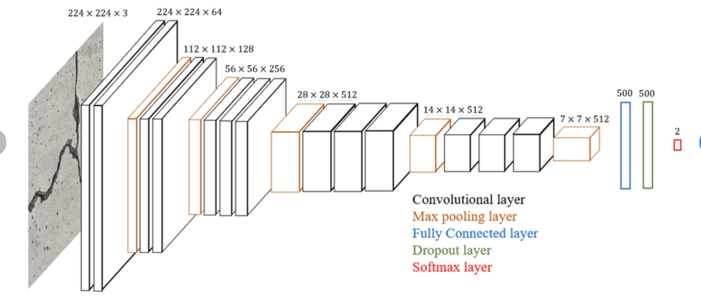
VGG-16 Architecture
VGG16 is a deep convolutional neural network with 16 layers
small 3x3 convolution filters with a stride of 1
Lower layers - basic features
Deeper layers - abstract representations
Fully connected layers - generalizes these features
Large params

Slide 9
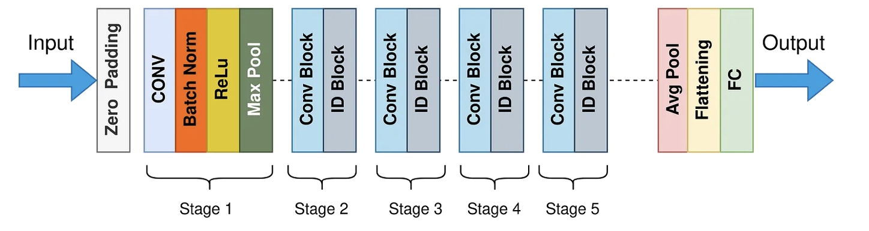
ResNet50 Model Architecture
ResNet50 is a deep convolutional neural network with 50 layers.
Uses residual connections.
connections allow the model to skip certain layers
The architecture is divided into 4 stages

Slide 10
ResNet101 Model Architecture
ResNet101 is a deeper convolutional neural network with 101 layers.
Also uses residual connections.
connections allow the model to skip certain layers
The architecture is divided into 4 stages
Higher depth

Slide 11
Aspect | VGG-16 | ResNet-101 | ResNet-50
Architecture | 16-layer CNN with simple sequential layers | 101-layer CNN with deeper residual learning | 50-layer CNN with residual connections for ease of training
Number of Parameters | ~138M | ~44.5M | ~25.6M
Inference Time | Moderate (slower due to large size) | Slower than ResNet-50 due to added depth | Fast (optimized for deeper architecture)
Feature Extraction Quality | Good, but less robust for fine-grained details | Very high quality but computationally intensive | Excellent: captures hierarchical features efficiently
Memory Usage | High (due to large parameters) | Higher than ResNet-50 | Low-to-moderate

Slide 12
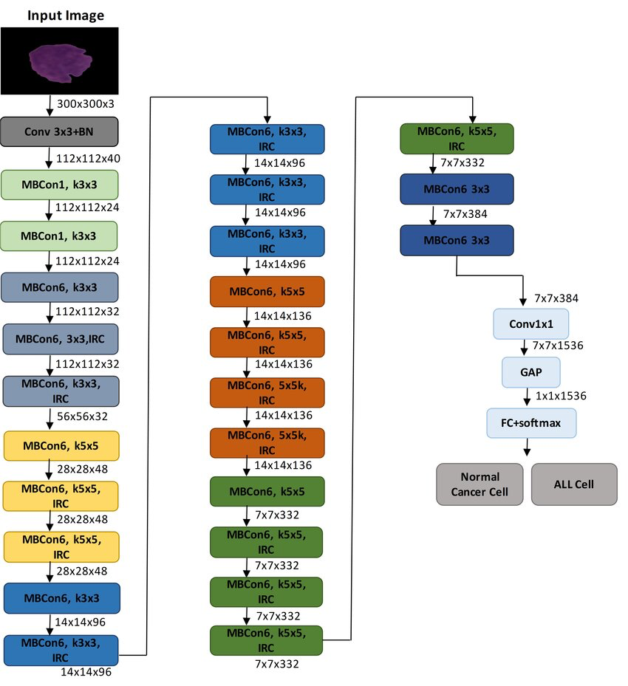
EfficientNet-B3 Model Architecture
Lightweight CNN model with ~12M parameters
Uses MBConv layers, reducing computation while maintaining accuracy
Used beam search to optimize generating captions

Slide 13
BLIP Model
BLIP (Bootstrapped Language-Image Pretraining) has two part architecture:
Encoder: Vision Transformer (ViT) for extracting visual features.
Decoder: Transformer-based text decoder for generating captions.
BLIP is trained on COCO Captions, Visual Genome, Conceptual Captions, SBU Captions and Flickr30k

Slide 14
Evaluation
Bleu Score (Bilingual Evaluation Understudy)
Measures the similarity between a generated caption and reference captions objectively
Flaw: Focuses on exact matches, missing semantic understanding
Model | Bleu Score
ResNet50 | 0.1487
Efficient Net B3 | 0.2002

Slide 15
Demo Time…

