Slide 1
ETL PROCESS OF E-COMMERCE MANAGEMENT
ARAVINDAN.B
PROJECT-0 19/08/2024

Slide 2
Contents
1. Introduction
2. Architecture
3. Schema
4. Methodology
5. Challenges
6. Summary

Slide 3
Introduction
Objective:
To extract data from JSON files.
To normalize the extracted data.
To create and populate MySQL database tables.
Scope:
Focuses on e-commerce data, including customers, products, orders and payments.

Slide 4
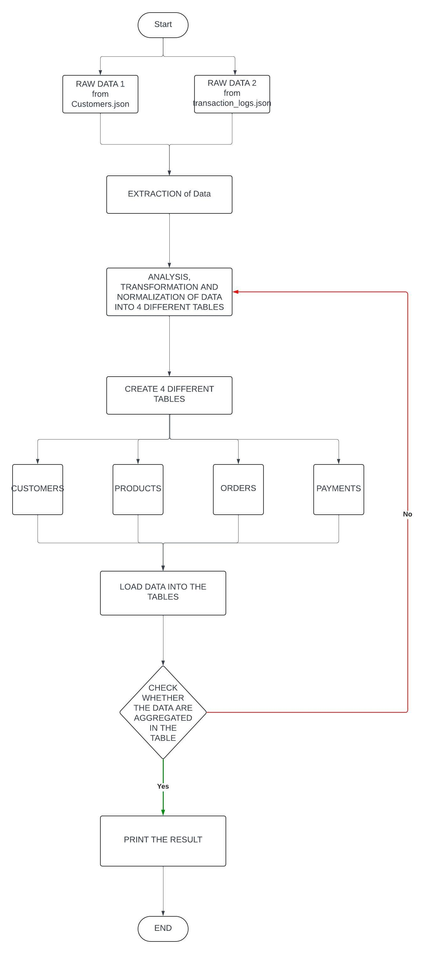
Architecture

Slide 5
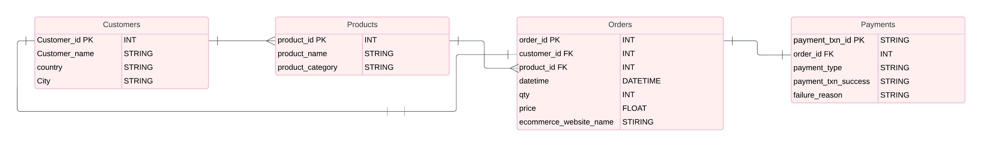
Schema

Slide 6
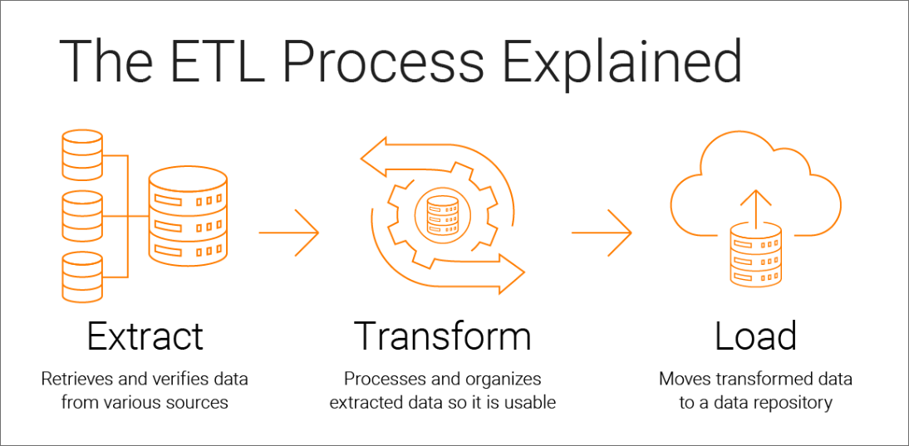
Methodology
Step 1: Extracting Data
Loading JSON files using Python.
Step 2: Data Normalization
Removing duplicates and ensuring unique records.
Step 3: MySQL Table Creation
Creating tables if they don’t already exist.
Step 4: Data Insertion
Inserting normalized data into the respective tables.

Slide 7
Challenges
Data Integrity Issues:
Handling large volumes of data efficiently.
Normalization Complexity:
Ensuring all necessary data is normalized without losing information.
Database Constraints:
Managing foreign key relationships and avoiding insertion conflicts.
Managing JSON data with nested structures.
Ensuring data integrity during transformation.

Slide 8
Summary
Project Recap:
- Successfully extracted and normalized data from JSON files.
- Created and populated MySQL tables for customers, products, orders and payments.
Future Work:
- Explore real-time data updates.
- Implement data validation and error handling mechanisms.
After the verification, close the database connection to release resources.
This methodology provides a structured approach to implementing an ETL process for JSON data normalization into a relational database, ensuring data integrity, consistency, and accuracy.

Slide 9
THANK YOU

