Slide 1

SECTION
REACT FUNDAMENTALS
LECTURE
INTRODUCTION TO REACT

Slide 2
What is REACT?
ReactJS was introduced by Facebook on May 2013. It was open sourced in March 2015.
A JavaScript library for building user interfaces.
ReactJS is concerned with the components that utilizes the expressiveness of JavaScript with a HTML – like template syntax.
It is basically the view in MVC – Model View Controller.
MVC
Model - manages the data of an application
View - a visual representation of the model
Controller - links the user and the system
Updates
Model
Manipulates
View
Controller
User
Sees
Uses

Slide 3
React Setup and Initiate Project
Node JS (Version required – 16 > and above)
Code Editor – VS Code
React up the required plugin for react.
Code formatter
After node installation –
Using Command Prompt in windows or open a Terminal in mac.
Initiate a create react app command – “npx create-react-app “project name”
Open a project on VS code.
And Open integrated - Command Prompt in windows or open a Terminal in mac.

Slide 4
SECTION
REACT LIFECYCLE
LECTURE
BABEL

Slide 5
BABEL
Babel is a JavaScript transpiler that converts edge JavaScript(ES6) into plain old ES5 JavaScript that can run in any browser even in the old ones.
What is a transpiler?
Transpilers, or source-to-source compilers, are tools that read source code written in one programming language and produce the equivalent code in another language which is in the same level.
It is a process of taking one language & convert it into another like you transpile your typescript into JavaScript and SASS into CSS.

Slide 6
SECTION
REACT FUNDAMENTALS
LECTURE
INTRODUCTION TO REACT COMPONENTS

Slide 7
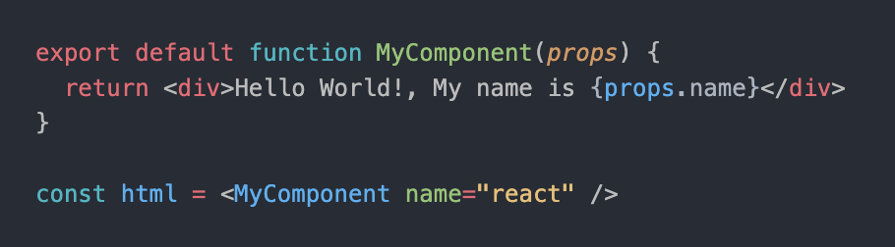
Anatomy of a REACT component
“In React, everything is a component”
The component is just a function.
Inputs are pressed through a single arguments called “props”.
The function outputs HTML.
The function is executed as if it was an HTML tag.
Inputs are pressed through a single arguments called “props”.

Slide 8
Class Component

Slide 9
Functional Component

Slide 10
SECTION
REACT FUNDAMENTALS
LECTURE
REACT STATE & PROPS

Slide 11
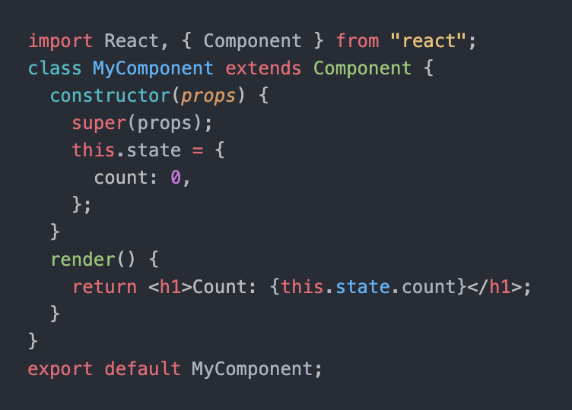
STATE & PROPS
A state is an object that holds data and information related to a React component. It can be used to store, manage, and update data within the application, which in turn allows for dynamic changes to user interfaces. For example, if a button needs to change its text based on user input, then this would be done by updating the state with new values.

Slide 12
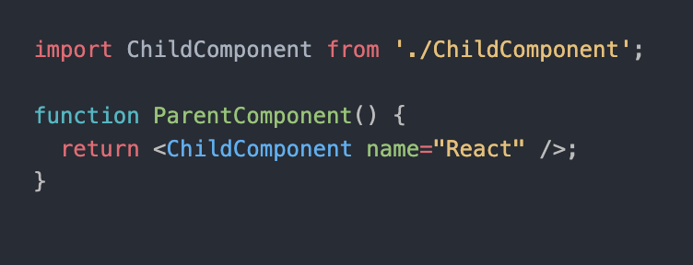
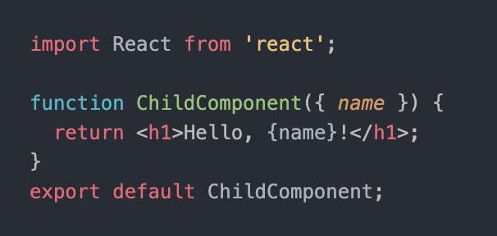
STATE & PROPS
Props, short for properties, are a way to pass data from a parent component to a child component and serve as inputs for each element’s behaviour. They are like function arguments and are used to pass data from the parent component to the child component. They can also be used for passing down states between different elements in order to keep track of changes made during user interaction with the UI.

Slide 13
SECTION
REACT LIFECYCLE

Slide 14
Mounting
Updating
Unmounting
constructor()
New Props
SetState()
forceUpdate()
getDerivedStateFromProps()
shouldComponentUpdate()
Render()
React updates DOM and refs
ComponentDidMount()
ComponentDidUpdate()
ComponentWillUnmount()

Slide 15
SECTION
REACT LIFECYCLE
LECTURE
MOUNTING PHASE

Slide 16
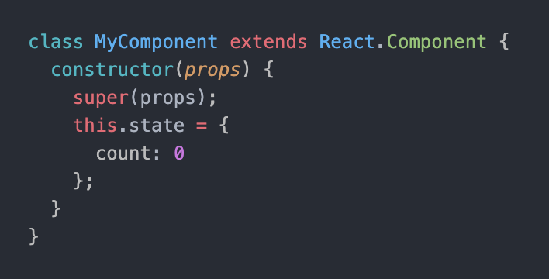
Constructor
This is the first lifecycle method called when a component is created. It is used to initialize the component’s state and bind event handlers. The constructor receives the component’s props as an argument and should always call “super(props);” before any other statements.

Slide 17
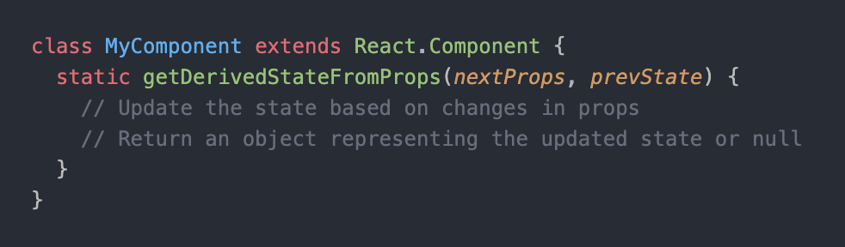
static getDerivedStateFromProps(props, state)
This static method is invoked just before rendering, both on the initial mount and on subsequent updates. It receives the component’s props and state as arguments and should return an object representing the updated state based on the props. If you don’t need to update the state, you can return null.

Slide 18
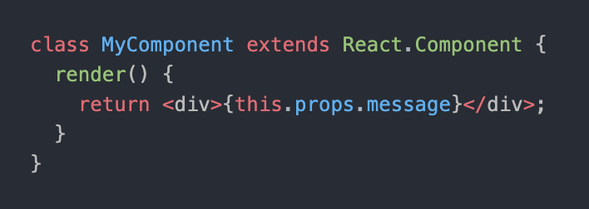
render()
The render() method is the most crucial lifecycle method and is required in every component. It is responsible for rendering the component's HTML markup and returning the React elements that make up the component's UI. The render() method should be pure, meaning it should not modify the component's state or directly interact with the browser.

Slide 19
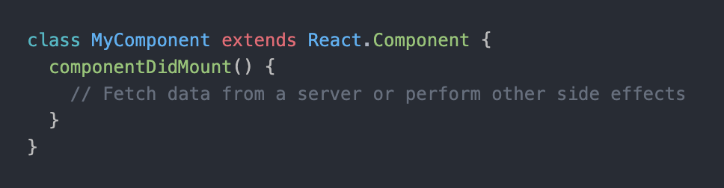
componentDidMount()
This method is called immediately after the component is mounted (i.e., inserted into the DOM). It is commonly used to perform actions that require interactions with the browser or external APIs, such as fetching data from a server. This method is an ideal place for initialization and setup.

Slide 20
SECTION
REACT LIFECYCLE
LECTURE
UPDATING PHASE

Slide 21
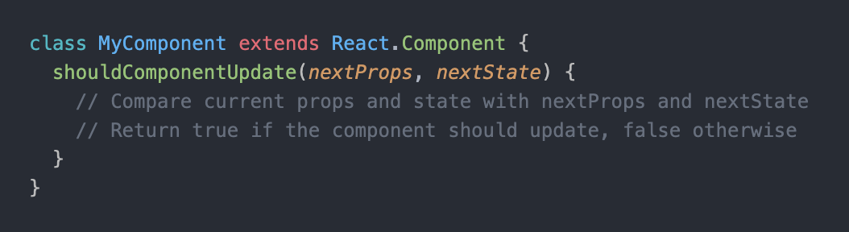
shouldComponentUpdate(nextProps, nextState)
This method is called before rendering when new props or states are received. It allows you to optimize performance by controlling whether the component should re-render or not. By default, React re-renders a component whenever its props or state change. By implementing this method, you can compare the previous and current props and state and decide if the component should update. It should return a boolean value indicating whether the component should update (true) or not (false).

Slide 22
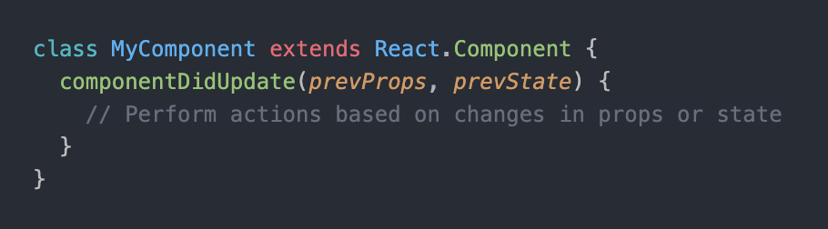
componentDidUpdate(prevProps, prevState)
This method is invoked immediately after the component’s updates are reflected in the DOM. It is useful for performing actions after a component’s state or props have changed. You can compare the previous and current props and state within this method and perform side effects or update the component as needed. However, you should be cautious when updating the component’s state within this method to avoid infinite update loops.

Slide 23
SECTION
REACT LIFECYCLE
LECTURE
UNMOUNTING PHASE

Slide 24
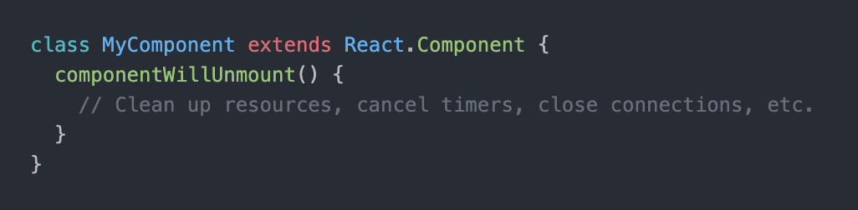
componentWillUnmount()
This method is called just before the component is unmounted and removed from the DOM. It is used to perform necessary clean-up actions, such as cancelling timers, closing connections, or releasing resources that were set up in componentDidMount(). This method is crucial for avoiding memory leaks and ensuring proper clean-up.

Slide 25
SECTION
REACT LIFECYCLE
LECTURE
REACT HOOKS

Slide 26
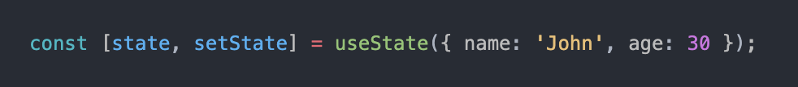
useState
The React useState Hook allows you to have state variables in functional components. You pass the initial state to this function, and it returns a variable with the current state value (not necessarily the initial state) and another function to update this value.

Slide 27
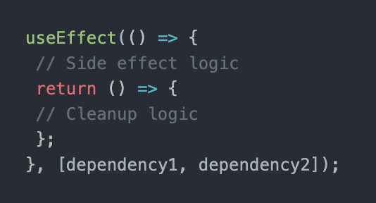
useEffect
The useEffect hook is part of React’s Hooks API. The core principle of this hook is to let you perform side effects in your functional components. The useEffect hook is a smooth combination of React’s lifecycle methods like componentDidMount, componentDidUpdate and componentWillUnmount.

Slide 28
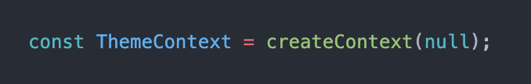
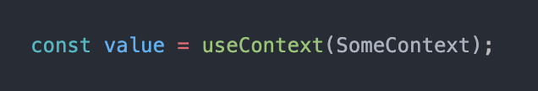
useContext
Context provides a way to pass data through the component tree without having to pass props down manually at every level.
Context is designed to share data that can be considered “global” for a tree of React components, such as the current authenticated user, theme, or preferred language. For example, in the code below we manually thread through a “theme” prop to style the Button component

Slide 29
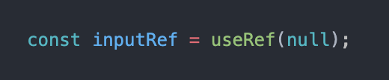
useRef
The useRef is a hook that allows you to create a mutable reference to an element or a value. Unlike the useState hook, updating a useRef does not trigger a re-render of the component. It's commonly used for accessing and managing DOM elements directly, storing persistent values, or working with values that should not trigger a re-render.

Slide 30
useReducer
This method is called immediately after the component is mounted (i.e., inserted into the DOM). It is commonly used to perform actions that require interactions with the browser or external APIs, such as fetching data from a server. This method is an ideal place for initialization and setup.

Slide 31
useCallback
The useCallback hook is used when you have a component in which the child is rerendering again and again without need. Pass an inline callback and an array of dependencies. useCallback will return a memoized version of the callback that only changes if one of the dependencies has changed. This is useful when passing callbacks to optimized child components that rely on reference equality to prevent unnecessary renders..

Slide 32
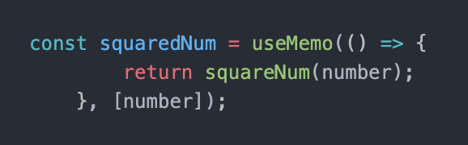
useMemo
The useMemo is a hook used in the functional component of react that returns a memoized value. Memoization is a concept used in general when we don’t need to recompute the function with a given argument for the next time as it returns the cached result. A memoized function remembers the results of output for a given set of inputs. In React also, we use this concept, whenever in the React component, the state and props do not change the component and the component does not re-render, it shows the same output.

Slide 33
SECTION
REACT LIFECYCLE
LECTURE
REACT ROUTER

Slide 34
ROUTER
React Router is a standard library for routing in React. It enables the navigation among views of various components in a React Application, allows changing the browser URL, and keeps the UI in sync with the URL. Let us create a simple application to React to understand how the React Router works.
Steps to include the Router package in project:
Run this command in integrated terminal in IDE to include this package -
> npm i react-router-dom

Slide 35
SECTION
REACT LIFECYCLE
LECTURE
REACT REDUX & FLUX

