Slide 1


SECTION
JAVASCRIPT FUNDAMENTALS
LECTURE
INTRODUCTION TO
JAVASCRIPT

Slide 2
What is JavaScript ?
JavaScript…
JavaScript is a High-Level, object-oriented programming language.
JavaScript is a scripting language that enables you to create dynamically updating content, control multimedia, animate images and etc..

Slide 3

What is ECMAScript ?
ECMAScript…
ECMAScript is a scripting-language specification that was developed by ECMA International to create a standardized JavaScript implementation across all web browsers.
ECMAScript 1
ECMAScript 3
ECMAScript 5
1997
1998
1999
2009
2015
ECMAScript 2
ECMAScript 4
ECMAScript 6

Slide 4
What is Data Type ?
Data Types in JavaScript define the data type that a variable can store. JavaScript includes primitive and non-primitive data (Reference) types.
Primitive
String
Number
Boolean
Undefined
Null
Reference
Object
Array
Functions

Slide 5
SECTION
JAVASCRIPT FUNDAMENTALS
LECTURE
REFERENCE DATA TYPE

Slide 6
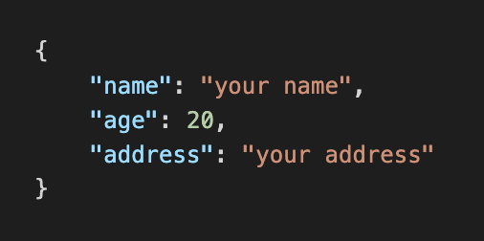
JAVASCRIPT OBJECT NOTATION - JSON
It is a format for structuring data. This format is used by different web applications to communicate with each other.
It supports data structures like arrays and objects and the JSON documents that are rapidly executed on the server.
Syntax
The keys and a values are added with double quotes. Except numbers, undefined, null.
Curly braces holds data.

Slide 7
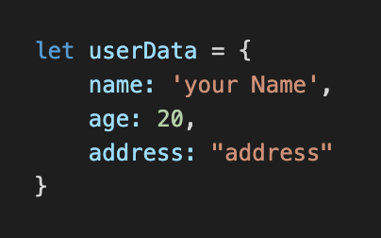
OBJECT
An object is a collection of properties, and a property is an association between a name (or key) and a value. A property's value can be a function, in which case the property is known as a method.
Syntax
The values are added with single or a double quotes. Except numbers, undefined, null
Curly braces holds data.

Slide 8
ARRAY
The array is a data structure where values or items are placed in a linear order.
Arrays are resizable and can contain a mix of different data types. Arrays are zero-indexed
Array Elements/ Values
3
12
4
7
2
0
1
2
3
4
Array Index

Slide 9


What is Variables
A variable is a container for a value, like a number we might use in a sum, or a string that we might use as part of a sentence.
“hello world”
35
true

Slide 10
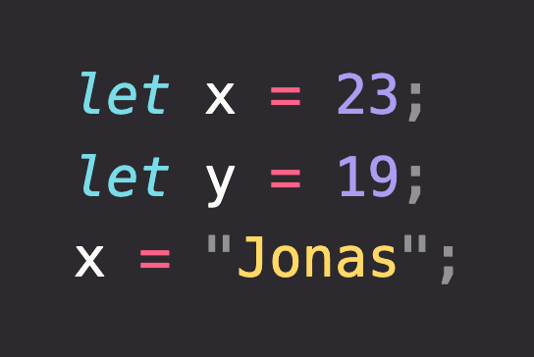
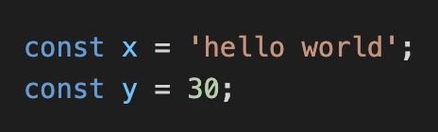
THE Variables
The let declaration declares re-assignable, block-scoped local variables, optionally initializing each to a value.
The const declaration declares block-scoped local variables. The value of a constant can't be changed through reassignment using the assignment operator, but if a constant is an object, its properties can be added, updated, or removed.

Slide 11
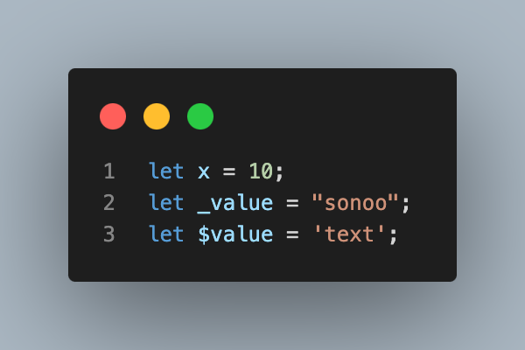
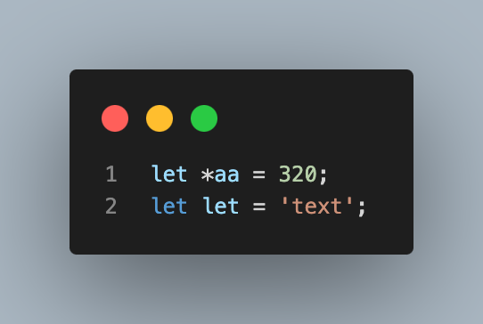


The Variable Rules
There are some rules while declaring a JavaScript variable (also known as identifiers).
Name must start with a letter (a to z or A to Z), underscore( _ ), or dollar( $ ) sign.
After first letter we can use digits (0 to 9), for example value1.
JavaScript variables are case sensitive, for example x and X are different variables.

Slide 12
SECTION
JAVASCRIPT FUNDAMENTALS
LECTURE
OPERATORS

Slide 13
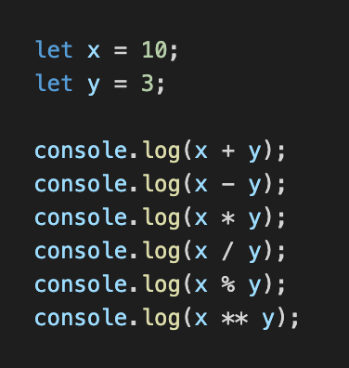
ARITHMETIC

Slide 14
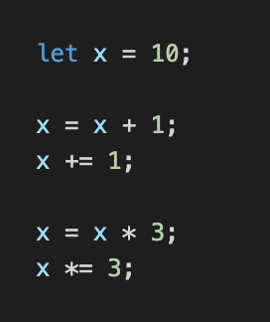
ASSIGNMENT

Slide 15
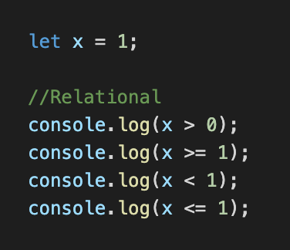
COMPARISON

Slide 16
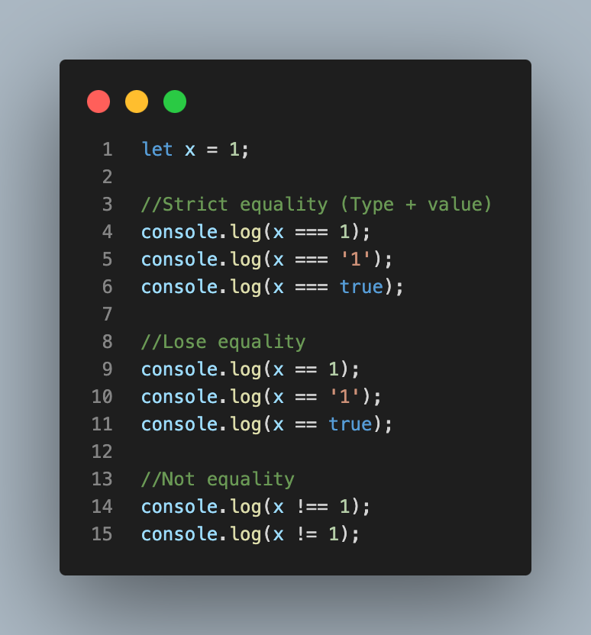
EQUALITY

Slide 17
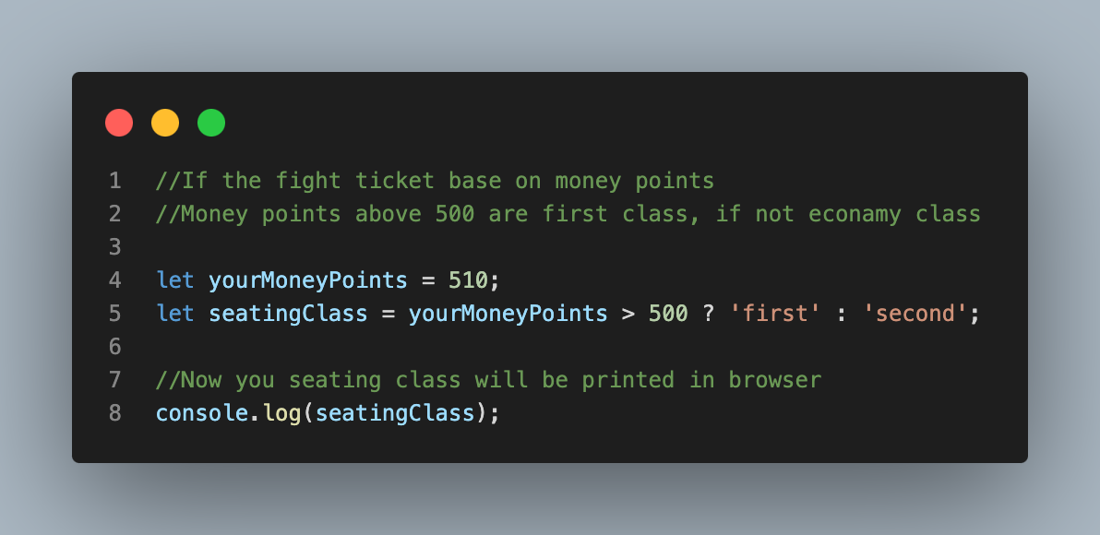
TERNARY

Slide 18
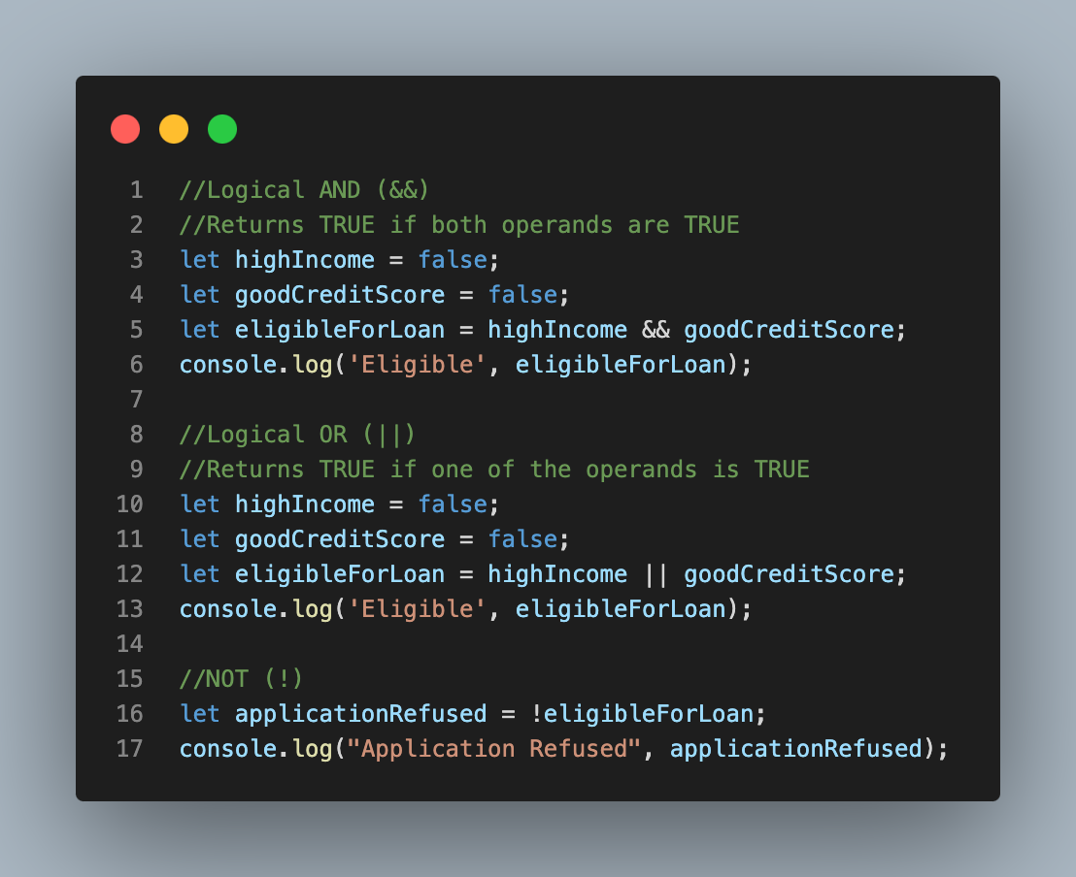
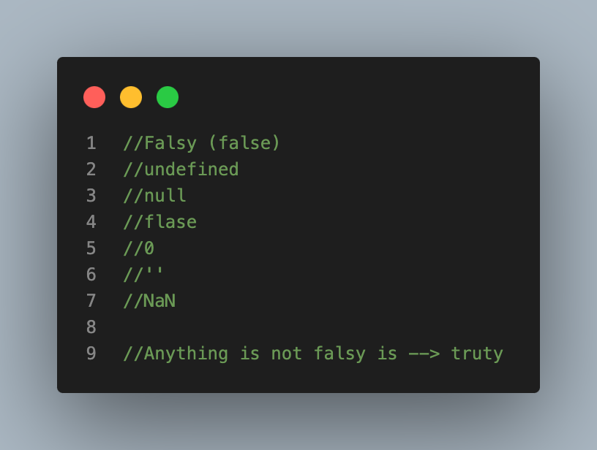
LOGICAL

Slide 19
SECTION
JAVASCRIPT FUNDAMENTALS
LECTURE
CONDITIONAL STATEMENTS

Slide 20
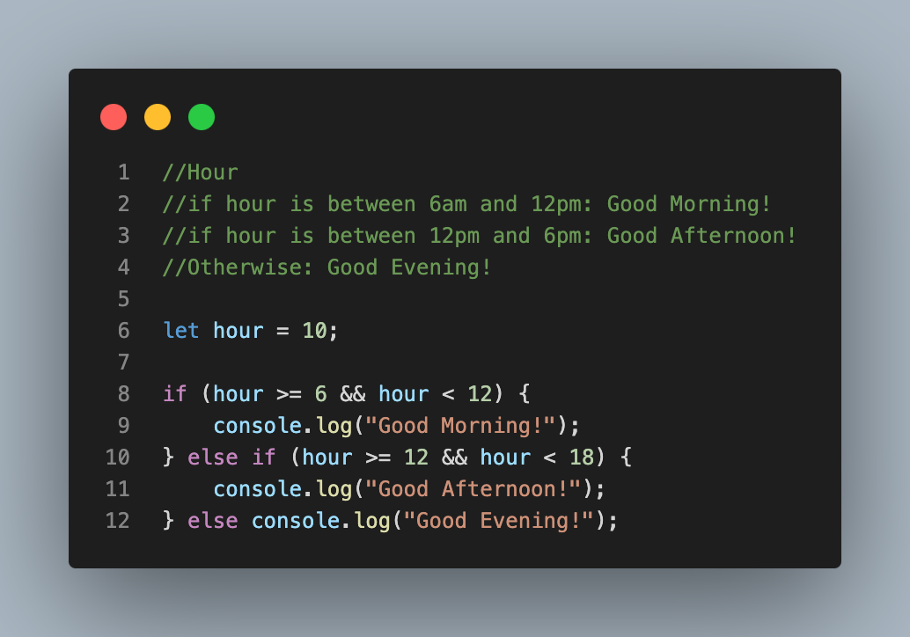
If…else

Slide 21
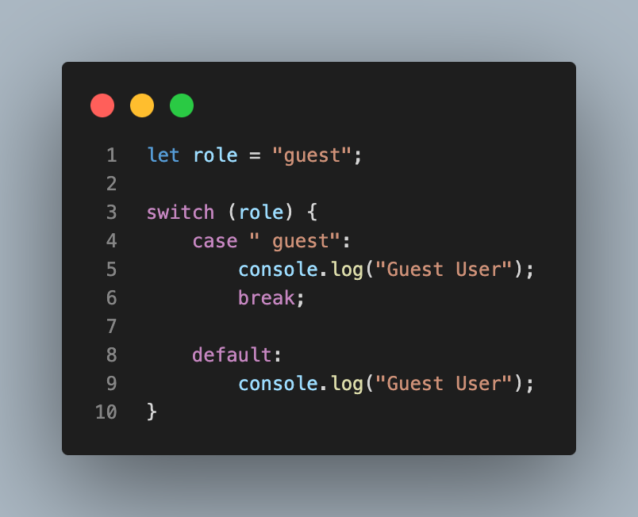
switch…case

Slide 22
SECTION
JAVASCRIPT FUNDAMENTALS
LECTURE
LOOPS

Slide 23
Loops..
Loops are used in JavaScript to perform repeated tasks based on a condition. Conditions typically return true or false. A loop will continue running until the defined condition returns false.

Slide 24
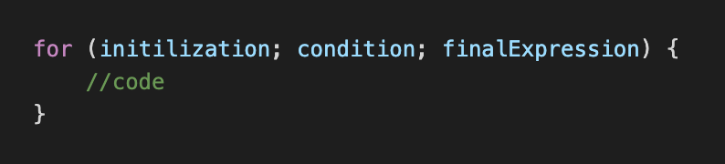
for Loop
initialization - This expression runs before the execution of the first loop and is usually used to create a counter.
condition - This expression is checked each time before the loop runs. If it evaluates to true, the statement or code in the loop is executed. If it evaluates to false, the loop stops. And if this expression is omitted, it automatically evaluates to true.
finalExpression - This expression is executed after each iteration of the loop. This is usually used to increment a counter but can be used to decrement a counter instead.

Slide 25
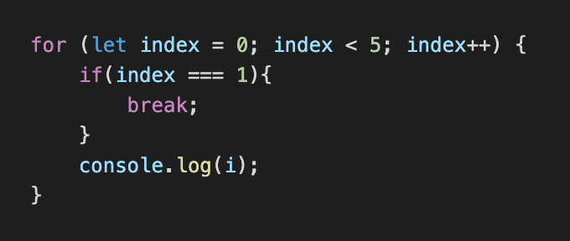
for Loop
for loops are commonly used to run code a set number of times. Also, you can use break to exit the loop early, before the condition expression evaluates too false.

Slide 26
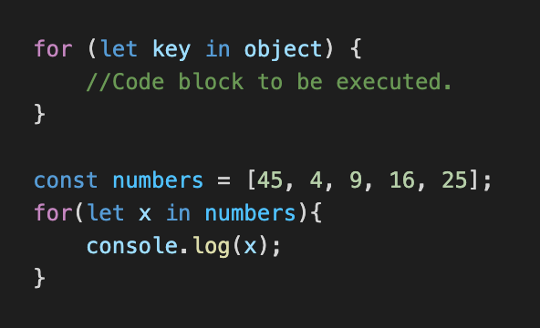
for in Loop
The x returns position.

Slide 27
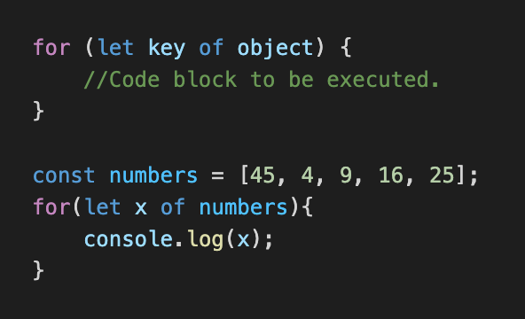
for of Loop
The x returns value.

Slide 28
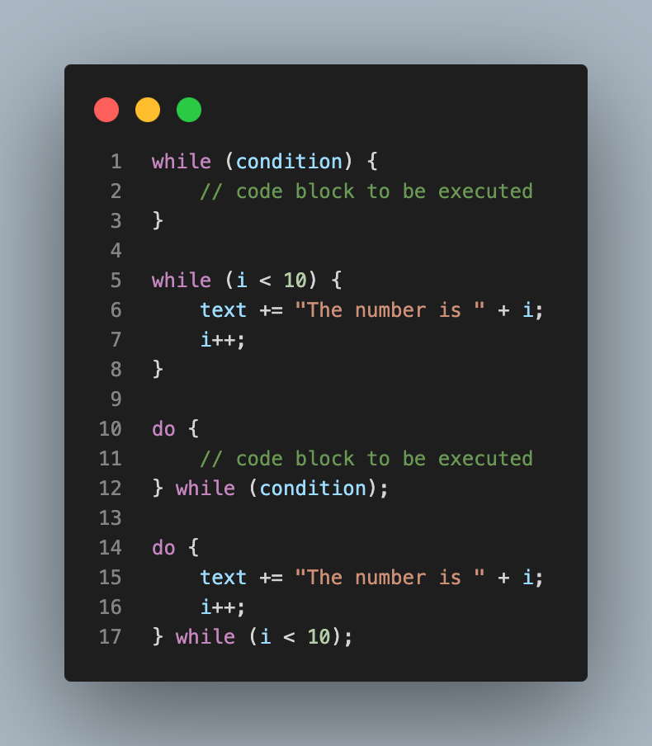
while & do while Loop

Slide 29
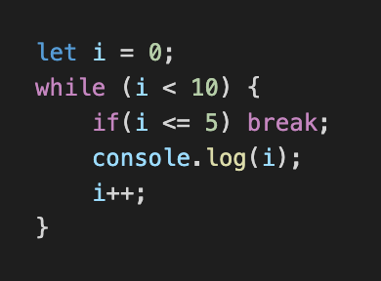
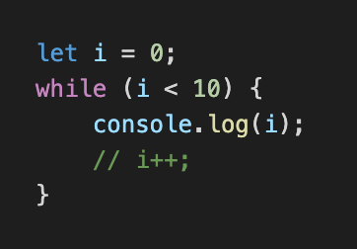
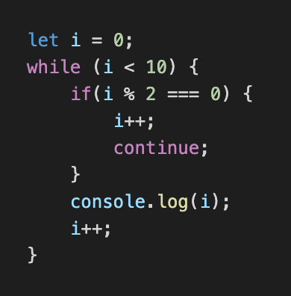
Break, Continue, and Infinite in the Loop
this to break the loop.
Without this expression, the loop goes into infinity.
this to break the flow and continue from the beginning.

Slide 30
SECTION
JAVASCRIPT FUNDAMENTALS
LECTURE
FUNCTIONS

Slide 31
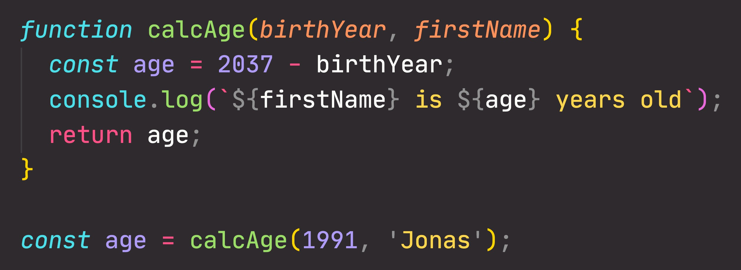
FUNCTIONS REVIEW: ANATOMY OF A FUNCTION
Parameters: placeholders to receive input
values. Like local variables of a function
Function body: block of code that we want to reuse. Processes the function’s input data
Function name
return statement to output a value from the function and terminate execution
Calling, running or invoking the function, using ()
Variable to save returned value (function output)
Arguments: actual values of function parameters, to input data

Slide 32
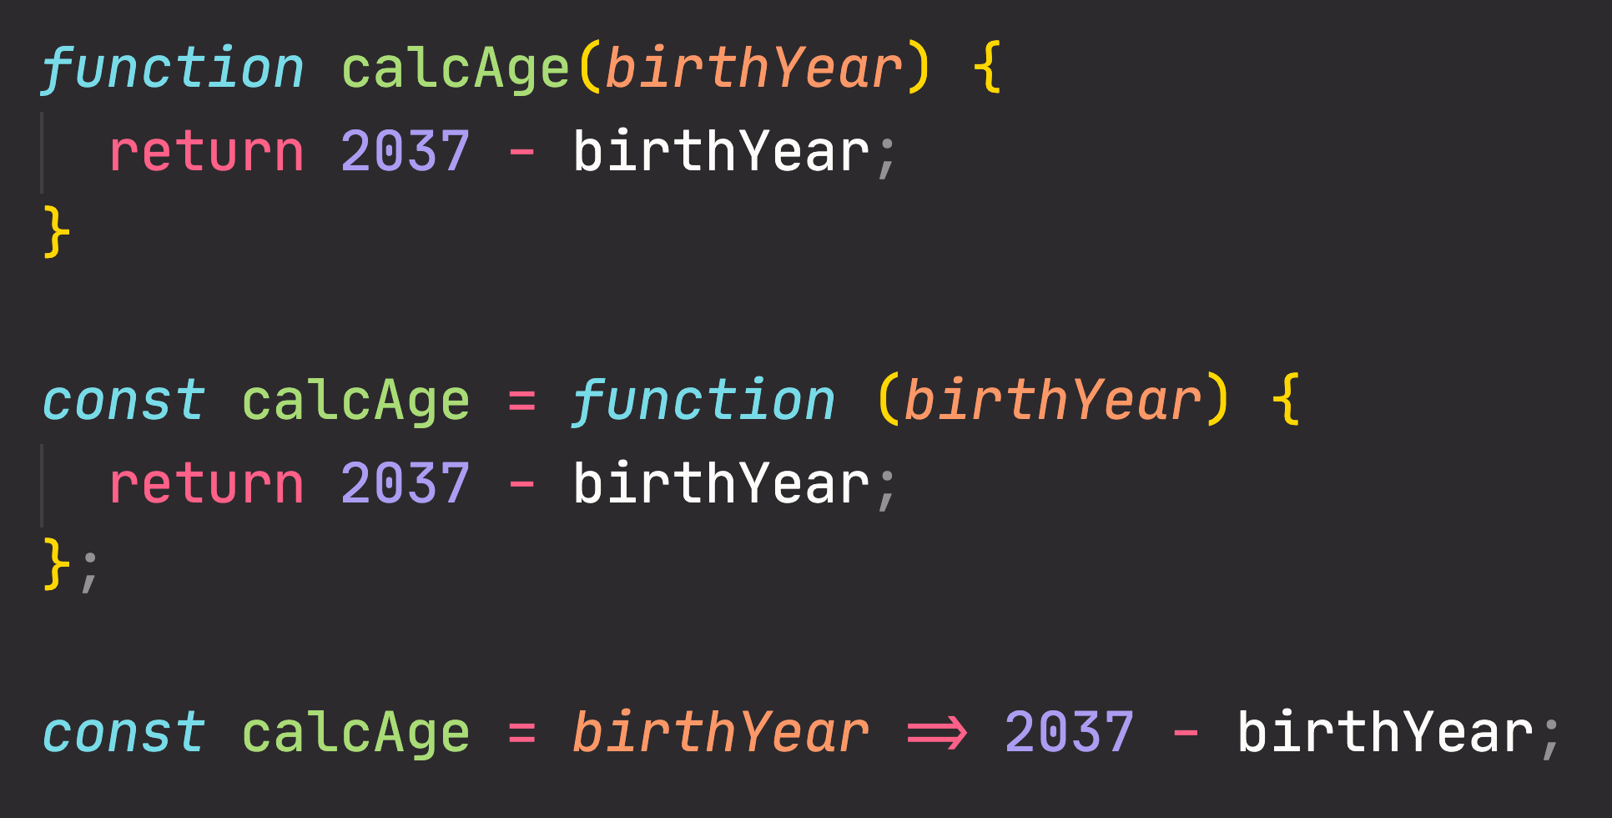
FUNCTIONS REVIEW: 3 DIFFERENT FUNCTION TYPES
Function declaration
Function that can be used before it’s declared
Function expression
Essentially a function
value stored in a variable
Arrow function
Great for a quick one-line functions. Has no this keyword (more later...)

Slide 33
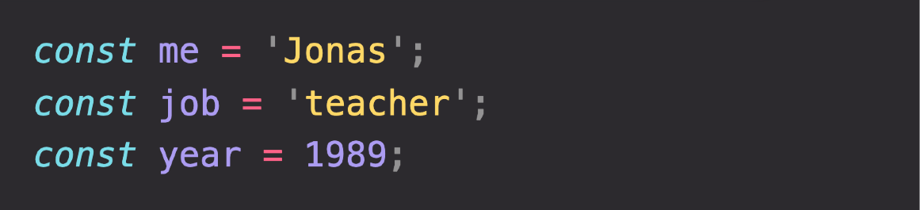
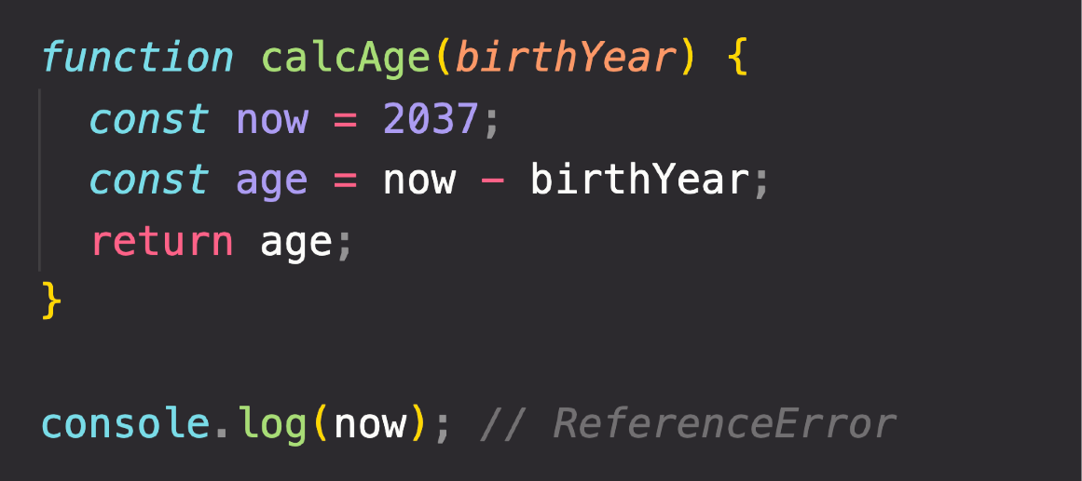
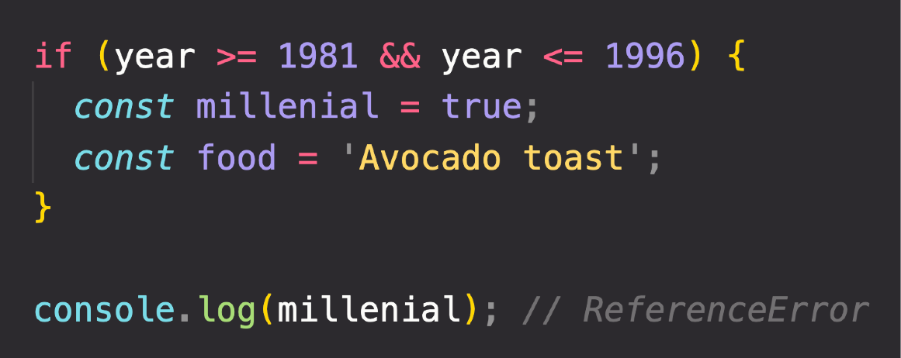
THE 3 TYPES OF SCOPE
FUNCTION SCOPE
Variables are accessible only
inside function, NOT outside
Also called local scope
Global Scope
Function Scope
Block Scope (ES6)
GLOBAL SCOPE
Example: if block, for loop block, etc.
Outside of any function or block
Variables declared in global scope are accessible everywhere
Variables are accessible only
inside block (block scoped)
HOWEVER, this only applies to
let and const variables!
Functions are also block scoped
(only in strict mode)

Slide 34
SECTION
JAVASCRIPT FUNDAMENTALS
LECTURE
DOM DOCUMENT

Slide 35
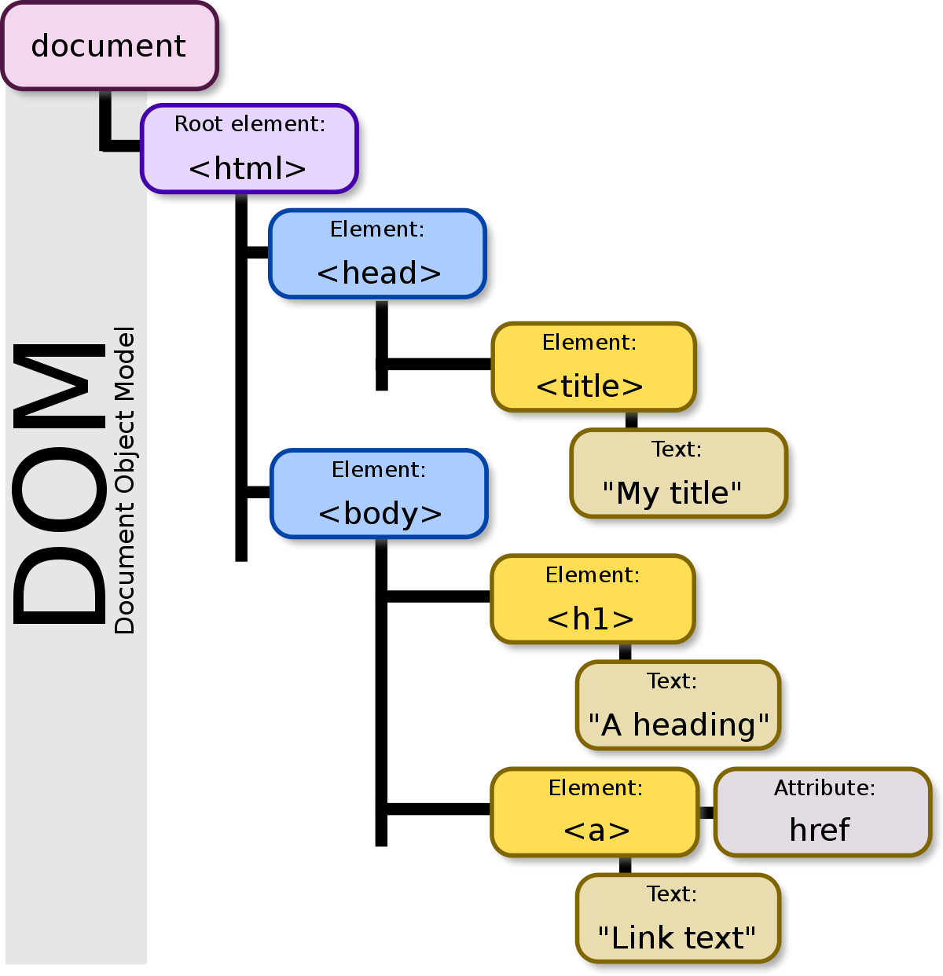
DOM Document Object
DOM - Stands for Document Object Model. It is a programming interface that allows us to create, change, or remove elements from the document. We can also add events to these elements to make our page more dynamic. The DOM views an HTML document as a tree of nodes. A node represents an HTML element.

Slide 36
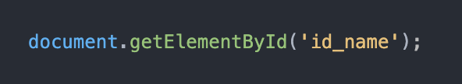
DOM Document Object and How to access DOM
JavaScript Document object is an object that provides access to all HTML elements of a document. When an HTML document is loaded into a browser window, then it becomes a document object
Accessing elements in the DOM means finding specific parts of a website and changing or manipulating them. To access an element on a website, you need to know the specific element you want to access. JavaScript provides different methods to access the elements in the DOM, such as getElementById, getElementsByTagName, querySelector, and querySelectorAll.

Slide 37
SECTION
JAVASCRIPT FUNDAMENTALS
LECTURE
HTML WINDOW

Slide 38
SECTION
TYPESCRIPT FUNDAMENTALS
LECTURE
INTRODUCTION JQUERY

Slide 39
What is jQuery?
jQuery
jQuery is a JavaScript framework.
It facilitates the readability and the manipulation of HTML DOM elements, event handling, animations, and AJAX calls.
Advantages
Simplified syntax: jQuery has a simplified syntax that makes it easy to manipulate HTML documents, handle events, and perform AJAX requests.
Cross-browser compatibility: jQuery handles browser differences in a transparent way, making it easier to write code that works across different browsers.

Slide 40
jQuery Traversing
Ancestors
$(“selector”).parent();
$(“selector”).parents();
$(“selector”).parentsUntil("div");
Descendants
$(“selector”).children();
$(“selector”).find(“span”);

Slide 41
JQuery Traversing
Siblings
$(“selector”).siblings();
$(“selector”).next();
$(“selector”).nextAll();
$(“selector”).nextUntill();
Filtering
$(“selector”).first();
$(“selector”).last();
$(“selector”).filter();
$(“selector”).not();

Slide 42

SECTION
TYPESCRIPT FUNDAMENTALS
LECTURE
INTRODUCTION

Slide 43
What is TypeScript?
TypeScript is a strongly typed, object-oriented, compiled programming language that builds on JavaScript. It is a superset of the JavaScript language, designed to give you better tooling at any scale.
Components of TypeScript
Language: the syntax, and type annotations.
The TypeScript Compiler (TSC): converts the instructions written in TypeScript to its JavaScript equivalent.
The TypeScript Language Service: an additional layer of editor-like applications, such as statement completion, signature help, code formatting, and colorization, among other things.

Slide 44
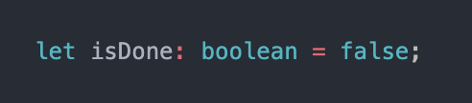
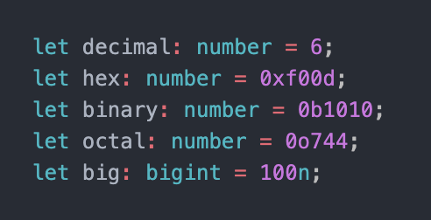
Basic Type of TypeScript
Boolean - The most basic datatype is the simple true/false value, which JavaScript and TypeScript call a Boolean value.
Number - As in JavaScript, all numbers in TypeScript are either floating point values or BigIntegers. These floating point numbers get the type number, while BigIntegers get the type bigint. In addition to hexadecimal and decimal literals, TypeScript also supports binary and octal literals introduced in ECMAScript 2015.

Slide 45
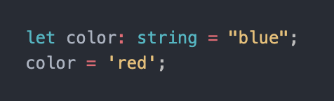
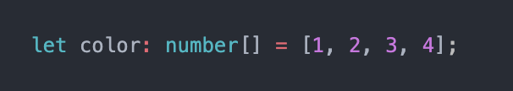
Basic Type of TypeScript
String - Another fundamental part of creating programs in JavaScript for webpages and servers alike is working with textual data. As in other languages, we use the type string to refer to these textual datatypes. Just like JavaScript, TypeScript also uses double quotes (") or single quotes (') to surround string data.
Array - TypeScript, like JavaScript, allows you to work with arrays of values. Array types can be written in one of two ways. In the first, you use the type of the elements followed by [] to denote an array of that element type.

Slide 46
Basic Type of TypeScript
String - Another fundamental part of creating programs in JavaScript for webpages and servers alike is working with textual data. As in other languages, we use the type string to refer to these textual datatypes. Just like JavaScript, TypeScript also uses double quotes (") or single quotes (') to surround string data.
Array - TypeScript, like JavaScript, allows you to work with arrays of values. Array types can be written in one of two ways. In the first, you use the type of the elements followed by [] to denote an array of that element type.

Slide 47
SECTION
WEB FUNDAMENTALS
LECTURE
AJAX

Slide 48
What is AJAX?
AJAX - Asynchronous JavaScript And XML.
Asynchronous JavaScript and XML (AJAX) is a combination of web application development technologies that make web applications more responsive to user interaction. Whenever your users interact with a web application, such as when they click buttons or checkmark boxes, the browser exchanges data with the remote server. Data exchange can cause pages to reload and interrupt the user experience. With AJAX, web applications can send and receive data in the background so that only small portions of the page refresh as required.
Async - Asynchronous is a non-blocking architecture, so the execution of one task isn't dependent on another.
XML stands for Extensible Markup Language. It's a markup language used to describe the structure and content of data in a document.

Slide 49
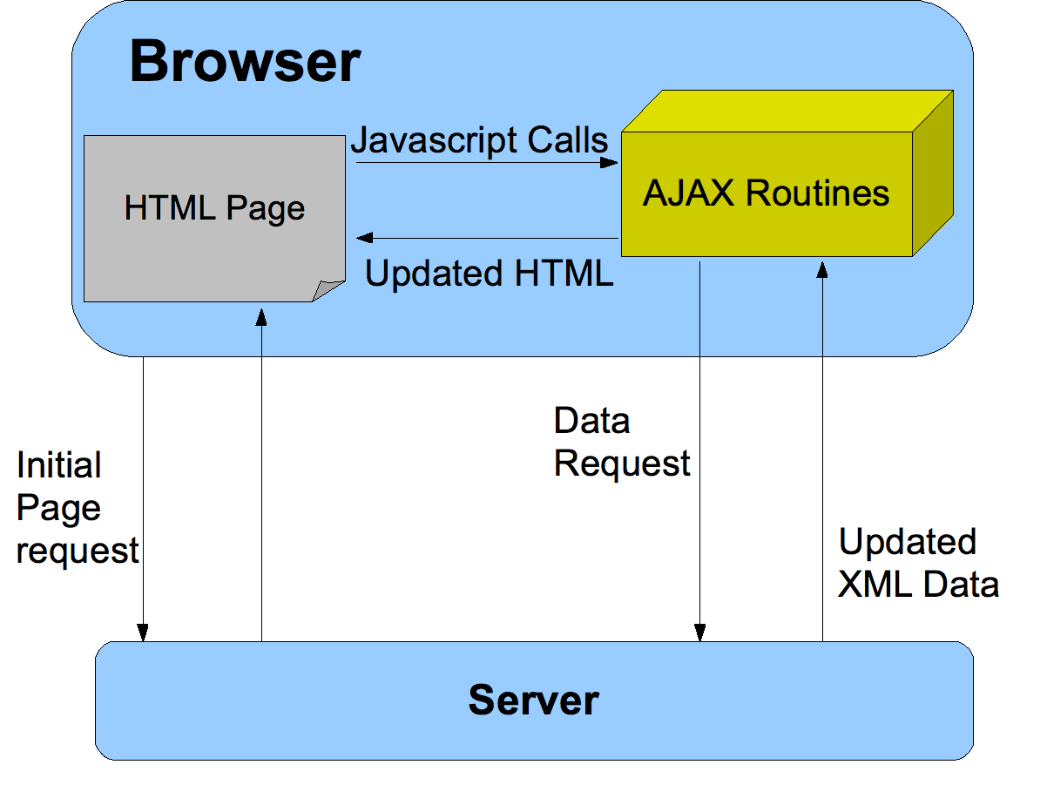
AJAX

Slide 50
SECTION
JS FUNDAMENTALS
LECTURE
OOPS..

Slide 51
Object-Oriented Programming
OOPS - Object-Oriented Programming (OOP) is a programming paradigm in computer science that relies on the concept of classes and objects. It is used to structure a software program into simple, reusable pieces of code blueprints (usually called classes), which are used to create individual instances of objects

Slide 52
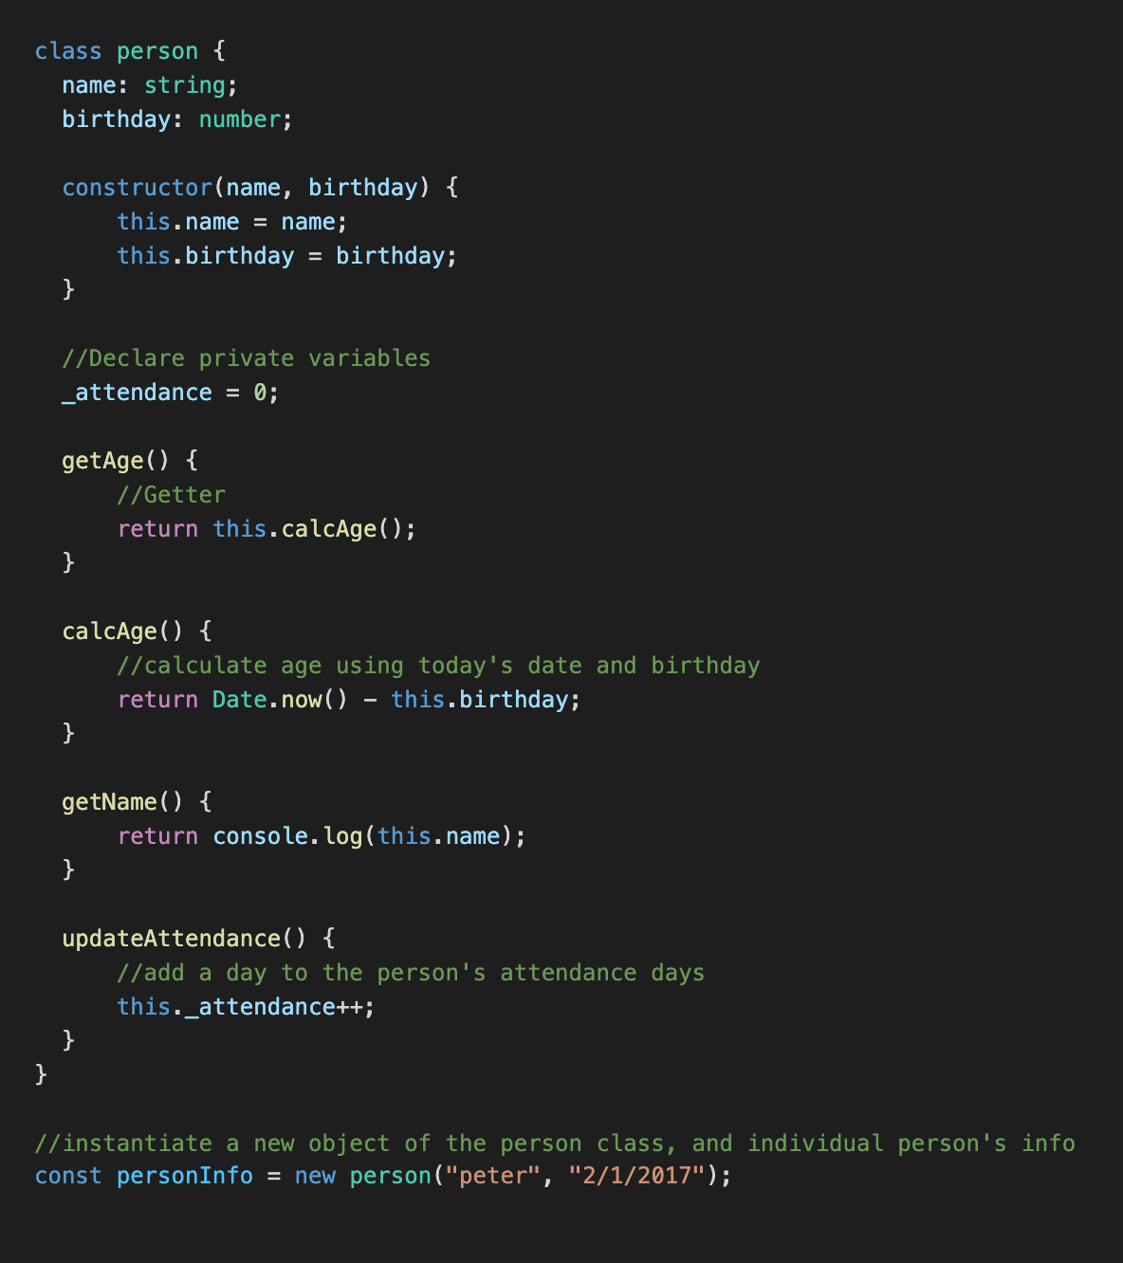
CLASS
A class is a blueprint used to create an instance of an object. It is made up of variables (called instance variables) and methods. Every object instantiated from a class will have all the properties of the class that instantiated it.
Constructor Function - A constructor function is a class function responsible for initializing a class’s instance variables. Constructors in TypeScript are defined using the constructor keyword. The constructor function takes all class’s instance variables as parameters, initializes them, and assigns their values in its body.

Slide 53
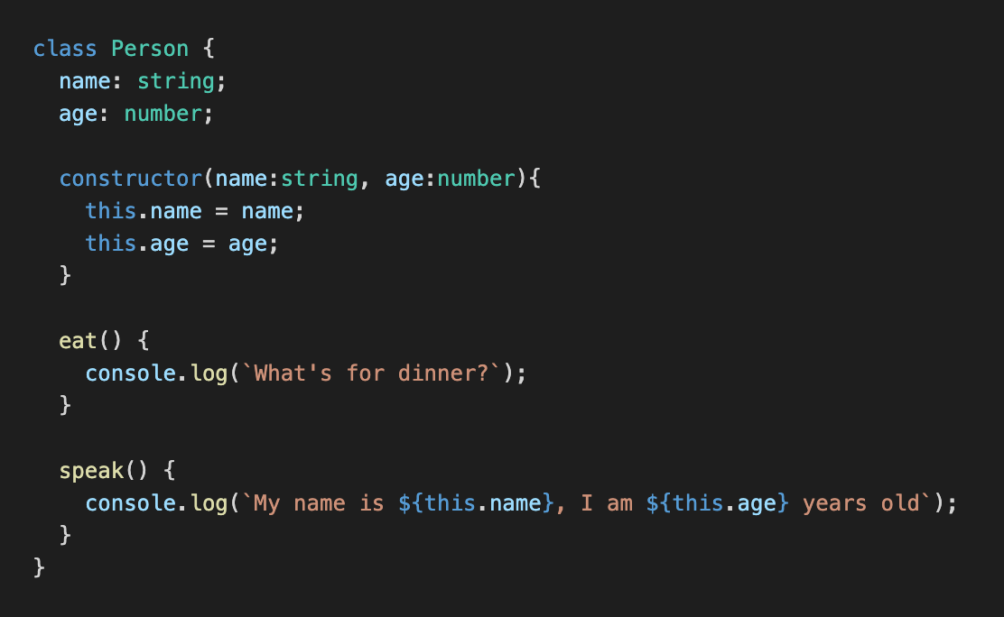
INHERITANCE
Inheritance in object-oriented programming refers to a mechanism where a class (subclass) inherits properties from an existing class (superclass). The subclass can also extend functionality by adding new properties or methods. For example, consider the class below as the super class:

Slide 54
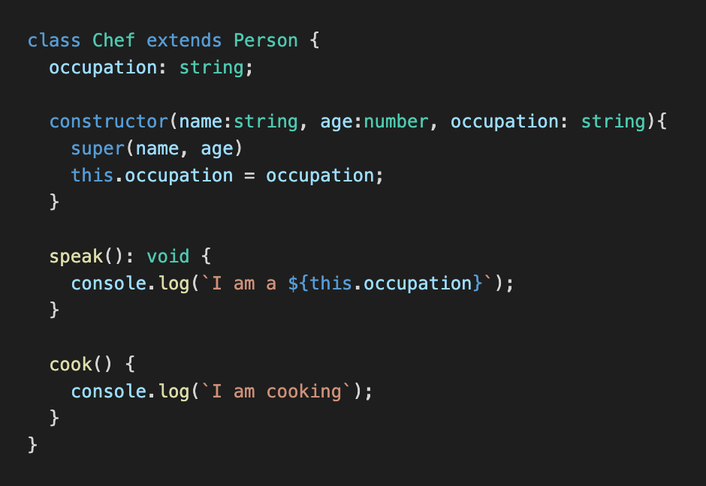
INHERITANCE
Note that if the superclass has properties defined in its constructor, the subclass has to initialize these properties in its constructor using the super keyword. The super keyword is used to reference a superclass’ properties in a subclass.

Slide 55
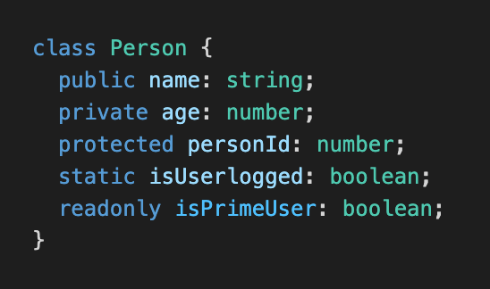
ACCESS MODIFIERS
An access modifier is a keyword that changes the accessibility of a property or method in a class.
public: This is the default visibility of every class property. A public property is accessible outside the class.
private: A property prefixed with the private keyword can’t be accessed anywhere outside the class and cannot be inherited by a subclass.
protected: The protected access modifier is very similar to the private access modifier with one key difference. Properties marked with the protected keyword are visible and can be inherited by a subclass.
static: Properties or methods prefixed with static can only be accessed directly on the class and not on an object instantiated from the class. They also can’t be inherited.
readonly: Properties prefixed with readonly can’t be modified; their values can only be read. Since read-only properties cannot be modified, they must be set at the class declaration or inside a constructor function.

