Slide 1


SECTION
JAVASCRIPT FUNDAMENTALS
LECTURE
INTRODUCTION TO
JAVASCRIPT

Slide 2
What is JavaScript ?
JavaScript…
JavaScript is a High-Level, object-oriented programming language.
JavaScript is a scripting language that enables you to create dynamically updating content, control multimedia, animate images and etc..

Slide 3

What is ECMAScript ?
ECMAScript…
ECMAScript is a scripting-language specification that was developed by ECMA International to create a standardized JavaScript implementation across all web browsers.
ECMAScript 1
ECMAScript 3
ECMAScript 5
1997
1998
1999
2009
2015
ECMAScript 2
ECMAScript 4
ECMAScript 6

Slide 4
What is Data Type ?
Data Types in JavaScript define the data type that a variable can store. JavaScript includes primitive and non-primitive data (Reference) types.
Primitive
String
Number
Boolean
Undefined
Null
Reference
Object
Array
Functions

Slide 5


What is Variables
A variable is a container for a value, like a number we might use in a sum, or a string that we might use as part of a sentence.
“hello world”
35
true

Slide 6
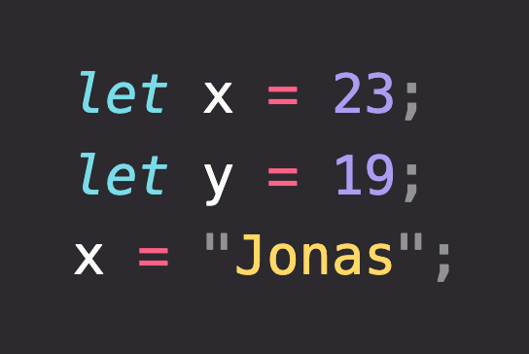
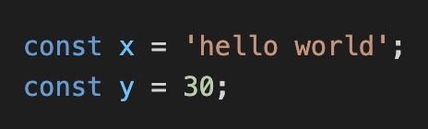
THE Variables
The let declaration declares re-assignable, block-scoped local variables, optionally initializing each to a value.
The const declaration declares block-scoped local variables. The value of a constant can't be changed through reassignment using the assignment operator, but if a constant is an object, its properties can be added, updated, or removed.

Slide 7
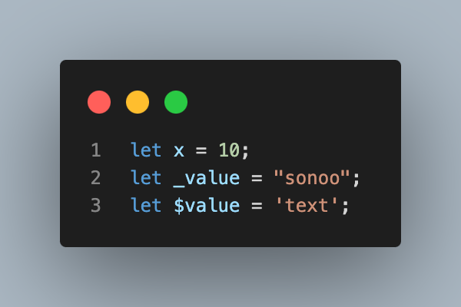
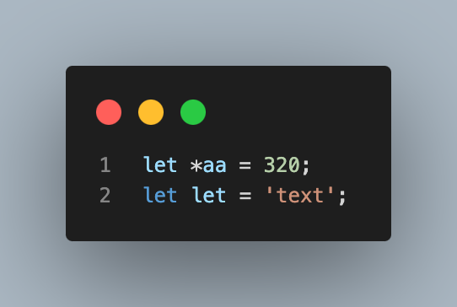


The Variable Rules
There are some rules while declaring a JavaScript variable (also known as identifiers).
Name must start with a letter (a to z or A to Z), underscore( _ ), or dollar( $ ) sign.
After first letter we can use digits (0 to 9), for example value1.
JavaScript variables are case sensitive, for example x and X are different variables.

Slide 8
SECTION
JAVASCRIPT FUNDAMENTALS
LECTURE
OPERATORS

Slide 9
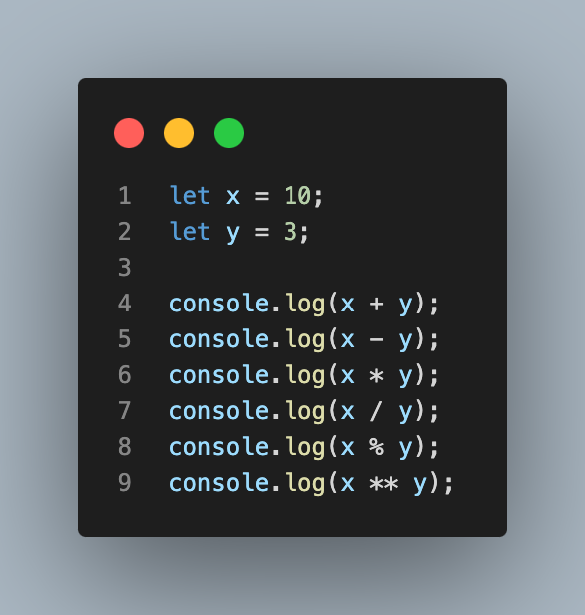
ARITHMETIC

Slide 10
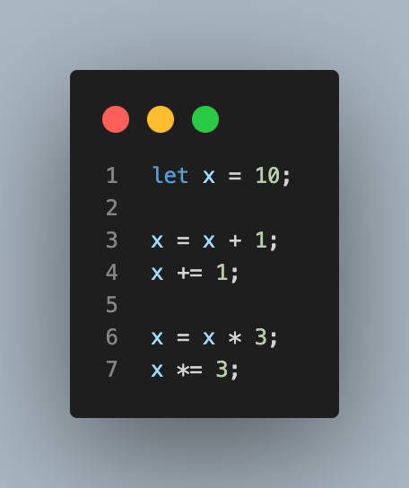
ASSIGNMENT

Slide 11
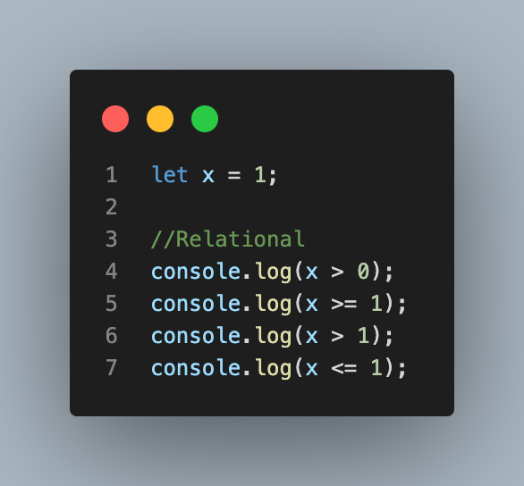
COMPARISON

Slide 12
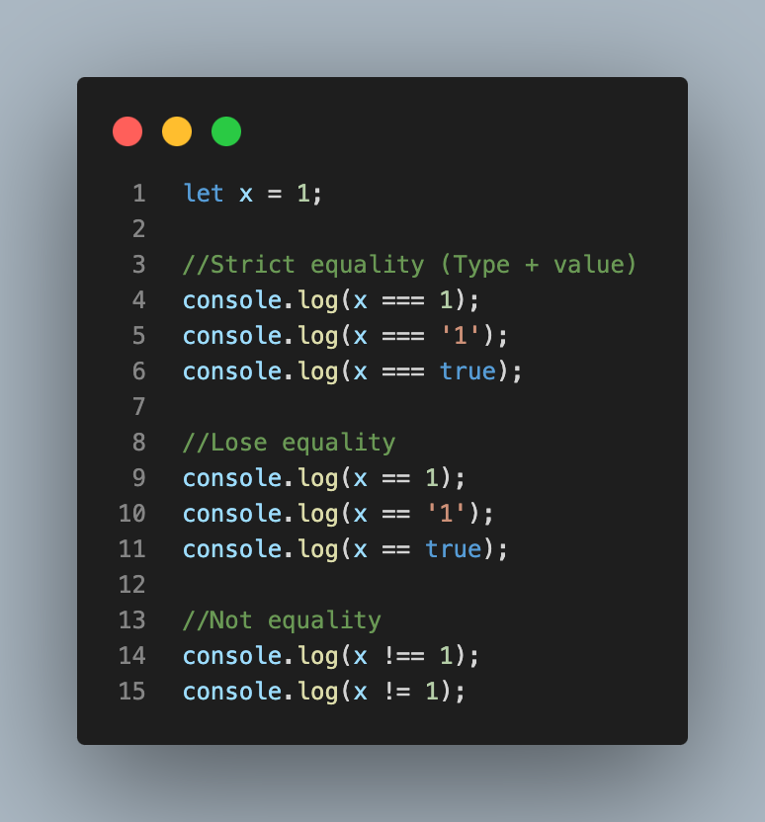
EQUALITY

Slide 13
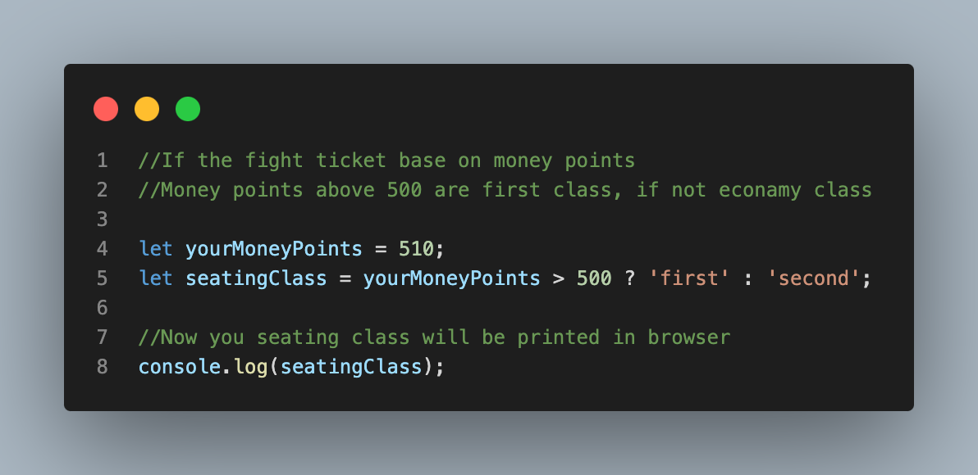
TERNARY

Slide 14
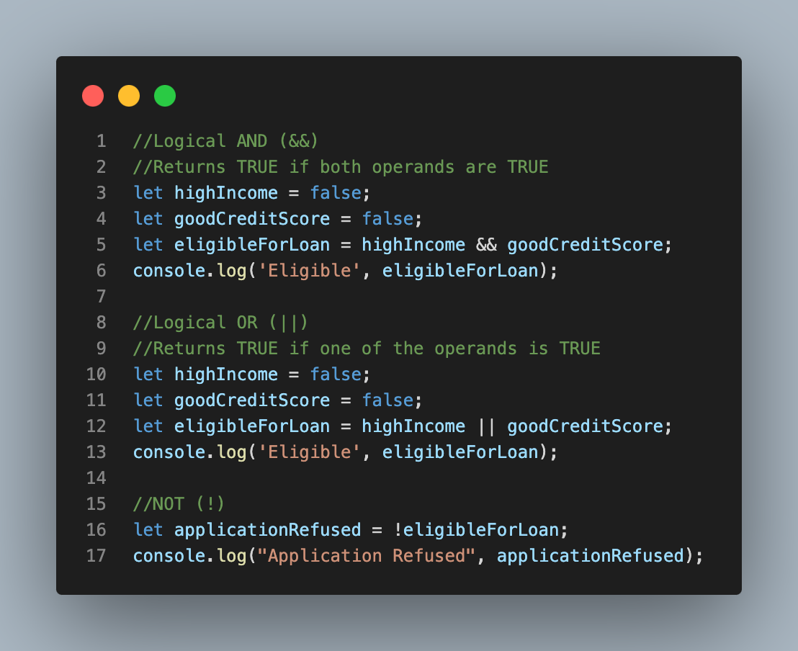
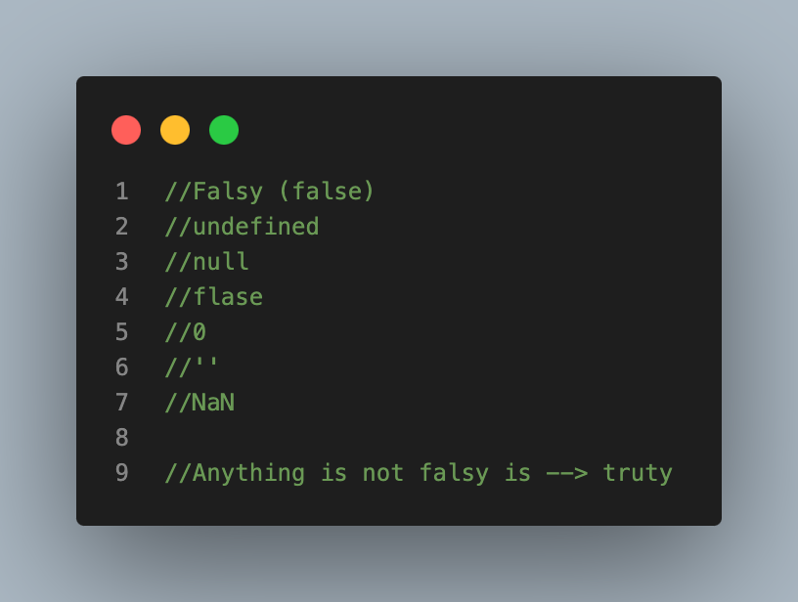
LOGICAL

Slide 15
SECTION
JAVASCRIPT FUNDAMENTALS
LECTURE
CONDITIONAL STATEMENTS

Slide 16
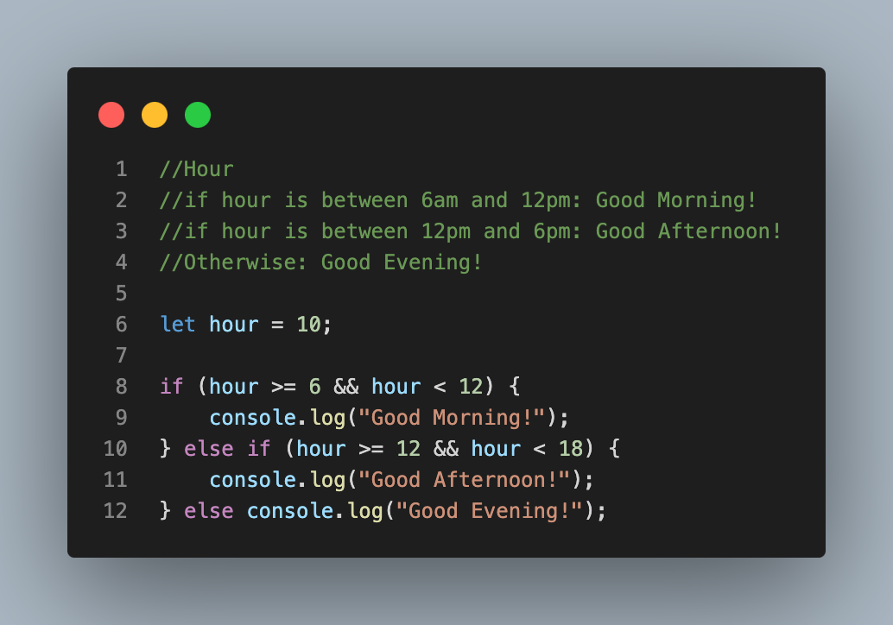
If…else

Slide 17
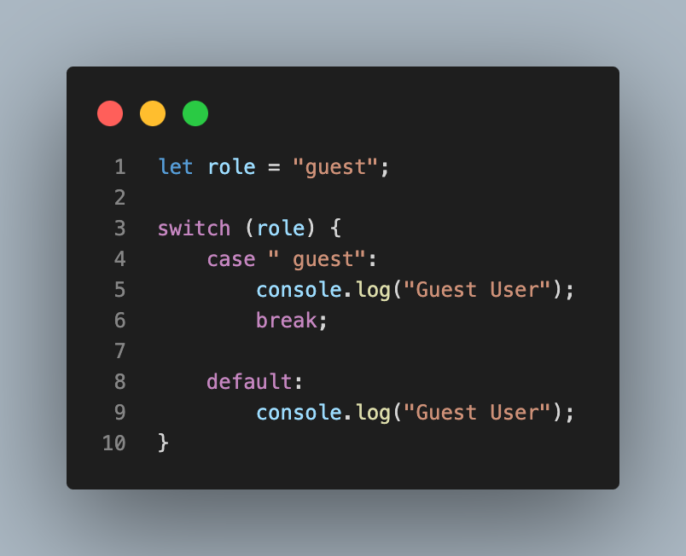
switch…case

Slide 18
SECTION
JAVASCRIPT FUNDAMENTALS
LECTURE
LOOPS

Slide 19
Loops..
Loops are used in JavaScript to perform repeated tasks based on a condition. Conditions typically return true or false. A loop will continue running until the defined condition returns false.

Slide 20
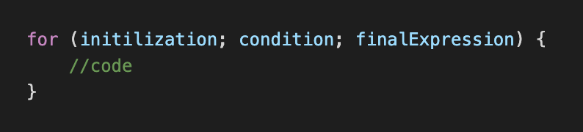
for Loop
initialization - This expression runs before the execution of the first loop and is usually used to create a counter.
condition - This expression is checked each time before the loop runs. If it evaluates to true, the statement or code in the loop is executed. If it evaluates to false, the loop stops. And if this expression is omitted, it automatically evaluates to true.
finalExpression - This expression is executed after each iteration of the loop. This is usually used to increment a counter but can be used to decrement a counter instead.

Slide 21
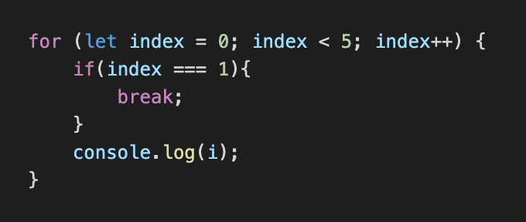
for Loop
for loops are commonly used to run code a set number of times. Also, you can use break to exit the loop early, before the condition expression evaluates too false.

Slide 22
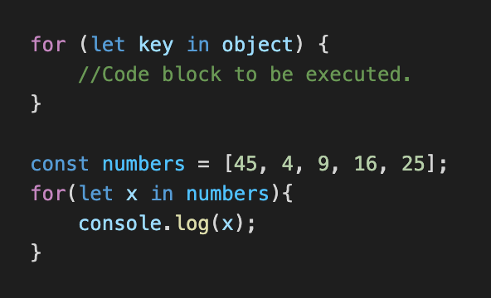
for in Loop
The x returns position.

Slide 23
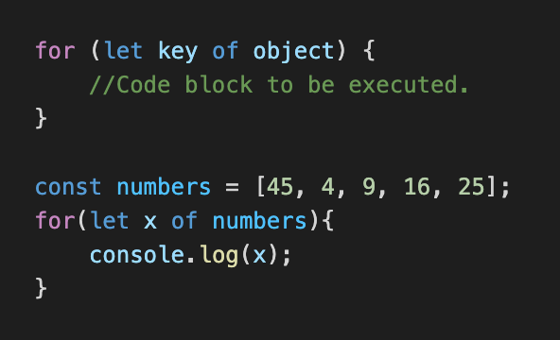
for of Loop
The x returns value.

Slide 24
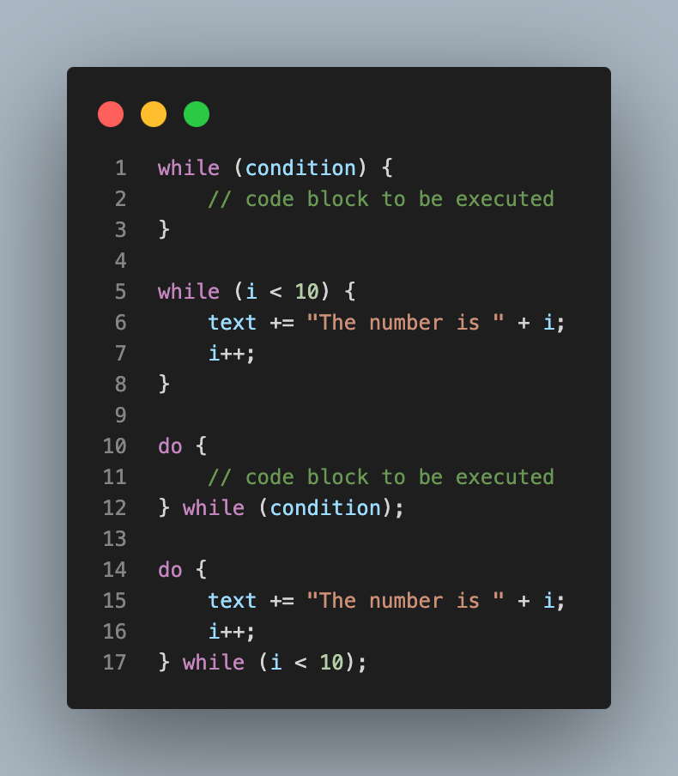
while & do while Loop

Slide 25
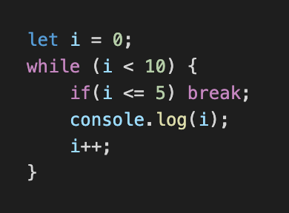
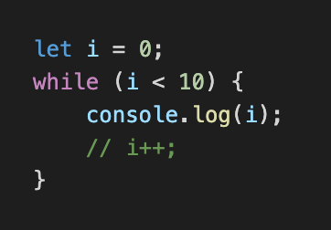
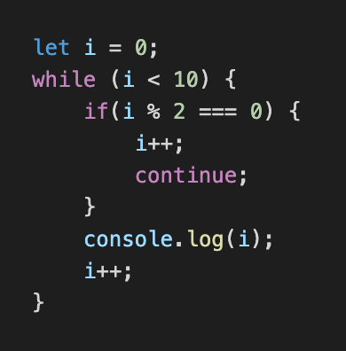
Break, Continue, and Infinite in the Loop
this to break the loop.
Without this expression, the loop goes into infinity.
this to break the flow and continue from the beginning.

Slide 26
SECTION
JAVASCRIPT FUNDAMENTALS
LECTURE
FUNCTIONS

Slide 27
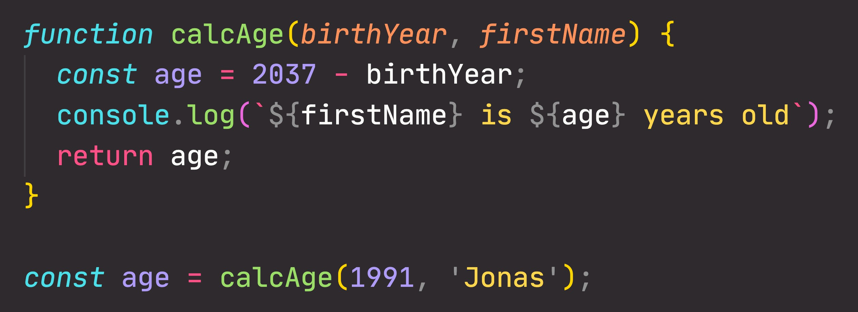
FUNCTIONS REVIEW: ANATOMY OF A FUNCTION
Parameters: placeholders to receive input
values. Like local variables of a function
Function body: block of code that we want to reuse. Processes the function’s input data
Function name
return statement to output a value from the function and terminate execution
Calling, running or invoking the function, using ()
Variable to save returned value (function output)
Arguments: actual values of function parameters, to input data

Slide 28
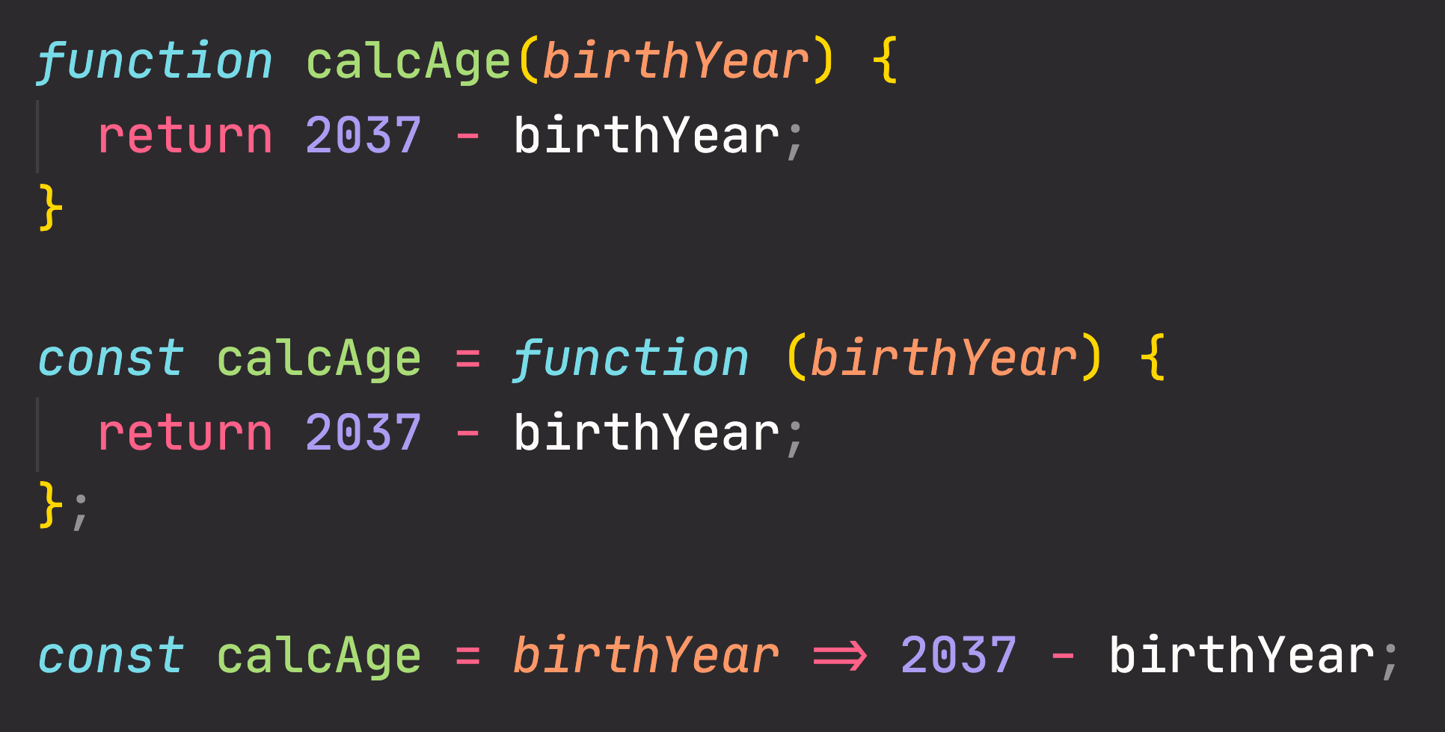
FUNCTIONS REVIEW: 3 DIFFERENT FUNCTION TYPES
Function declaration
Function that can be used before it’s declared
Function expression
Essentially a function
value stored in a variable
Cognizant values
Arrow function
Great for a quick one-line functions. Has no this keyword (more later...)

Slide 29
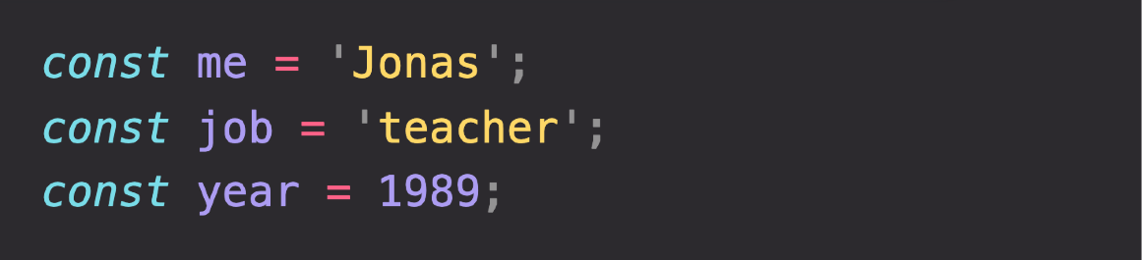
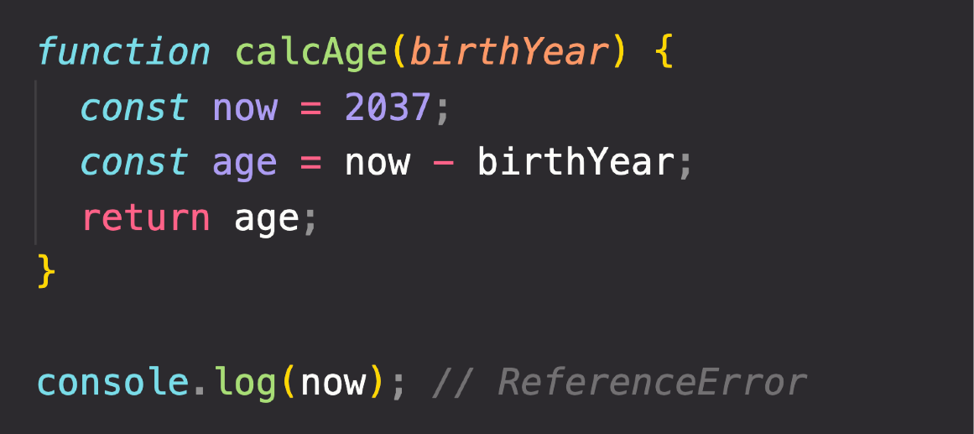
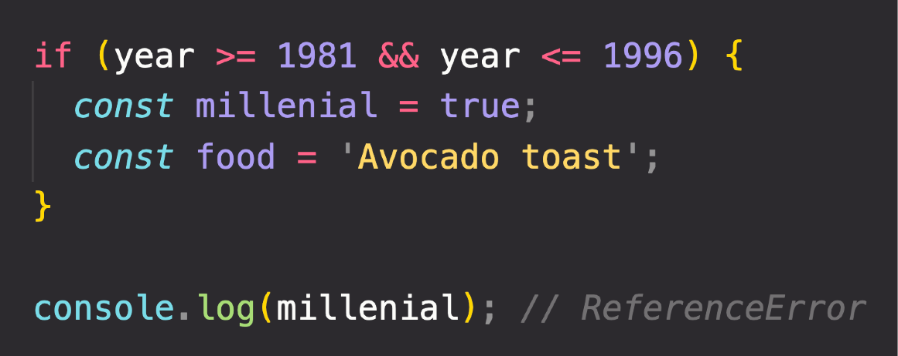
THE 3 TYPES OF SCOPE
FUNCTION SCOPE
Variables are accessible only
inside function, NOT outside
Also called local scope
Global Scope
Function Scope
Block Scope (ES6)
GLOBAL SCOPE
Example: if block, for loop block, etc.
Outside of any function or block
Variables declared in global scope are accessible everywhere
Variables are accessible only
inside block (block scoped)
HOWEVER, this only applies to
let and const variables!
Functions are also block scoped
(only in strict mode)

Slide 30
SECTION
JAVASCRIPT FUNDAMENTALS
LECTURE
DOM DOCUMENT

Slide 31
DOM Document Object

Slide 32

SECTION
TYPESCRIPT FUNDAMENTALS
LECTURE
INTRODUCTION

