Slide 1



SECTION
WEB DEVELOPMENT
LECTURE
HTML & CSS

Slide 2
Learning…
Tools of Web development.
Basic Website Concepts. (eg URL, HTTP, DOM, etc)
Basic of Web Servers and Web Hosting
Working of Website and inspect network using DevTools.
HTML 5
Element and Tags usages.

Slide 3
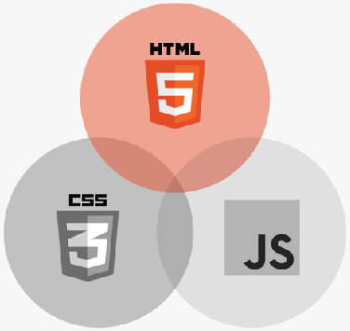
WHAT IS HTML?
Hyper Text Markup Language
HTML is a markup language that web developers use to structure and describe the content of a webpage (not a programming language)
HTML consists of elements that describe different types of content: paragraphs, links, headings, images, video, etc.
Web browsers understand HTML and render HTML code as websites

Slide 4
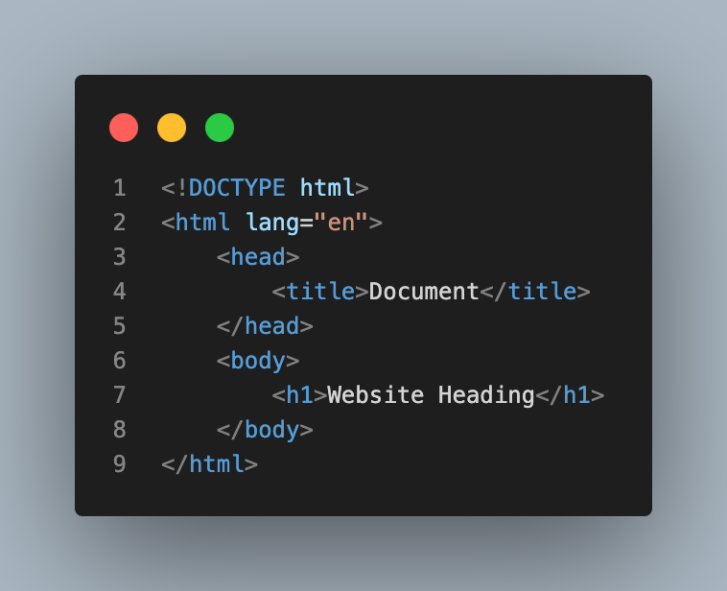
HTML CODE STRUCTURE
HTML Code Structure
The essential tags that are required to create a HTML document are:
<!DOCTYPE html>
<html>
<head>
<style>..</style>
</head>
<body>..</body>
</html>

Slide 5

ANATOMY OF AN HTML ELEMENT
Element
<p>HTML is a markup language</p>
Opening tag: Name of the element, wrapped in < and >
Content: Content of the element, in this example text. But it might be another element (child element). Some elements have no content (e.g. <img>)
Closing tag: Same as opening tag, but with a /. When element has no content, it’s omitted

Slide 6
Create an HTML
Choose IDE:
HTML file:
Create a new file using IDE the file extension should be with learninghtml.html
Viewing document in web browser open a file with any of browser to view our changes.
Note:
Make sure the selected/ installed IDE should support any React requirements.

Slide 7
HTML TAG <html>..</html>
<html> tag: Encloses all other HTML tags and associated text within your document. It is an optional tag.
But it is always a good form to include an opening tag and closing tag. The closing tag is the same as the opening tag, except for the slash mark e.g. </html>.
The slash mark is always used in closing tags.
The format is:
<html>
Your Title and Document (contains text with HTML tags) goes here
</html>

Slide 8
HEAD TAG <head>..</head>
<head> tag: The element contains meta information about the HTML page.
Tags that are associated with head tags are:
<title>, <style>, <base>, <link>, <meta>, <script>
The format is:
<head>
<base href=”https://baseurl.com" target="_blank">
<link rel=“stylesheet” heref=”main.css”>
<title>
page title
</title>
</head>

Slide 9
LINK TAG <link>
The tag defines the relationship between the current document and an external resource.
Most often used to link to external style sheets or to add a favicon to your website.
The format is:
<link rel="stylesheet" type="text/css" href="theme.css">
Attribute | Value | Description
rel | stylesheet, Alternate, author, dns-prefetch, help, icon, license, next, pingback, preconnect, prefetch, preload, prerender, prev, search | Required. Specifies the relationship between the current document and the linked document
href | URL | Specifies the location of the linked document
type | media_type | Specifies the media type of the linked document

Slide 10
BODY TAG <body>..</body>
<body> tag: the Tag contains all the text and graphics of the document with all the HTML tags that are used for control and formatting of the page.
The format is:
<body>
Web page content and elements goes here
</body>

Slide 11
STYLE TAG <style>..</style>
<style> tag: Tag contains all the text and graphics of the document with all the HTML tags that are used for control and formatting of the page.
CSS Properties are added.
The format is:
<style>
.h1 {
font-size: larger;
}
</style>

Slide 12
Handling Text and Content
Headings and paragraphs are some common HTML elements that we see on all websites. In HTML, <h1> to <h6> tags represent headings and are used to describe the contents below them. The paragraph or the <p> tag in HTML helps users define a paragraph.
Lets code…

Slide 13
Handling Image
Img tag is used to display image on the web page. HTML img tag is an empty tag that contains attributes only, closing tags are not used in HTML image element.
Lets code…

Slide 14
Handling Order and Unorder List
Unorder List: An unordered list starts with the <ul> tag. Each list item starts with the <li> tag.
Order List: An ordered list starts with the <ol> tag. Each list item starts with the <li> tag.
Lets code…

Slide 15
SECTION
CSS FUNDAMENTALS
LECTURE
INTRODUCTION TO CSS

Slide 16
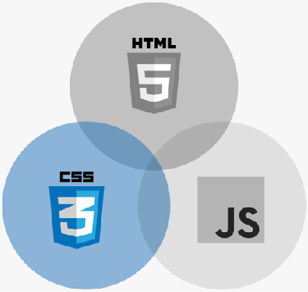
WHAT IS CSS?
CSS
Cascading Style Sheets
CSS describes the visual style and presentation of the content written in HTML
CSS consists of countless properties that developers use to format the content: properties about font, text, spacing, layout, etc.

Slide 17
HOW WE SELECT AND STYLE ELEMENTS
A CSS RULE
Selector
Declaration block
h1
{
color: blue;
text-align: center;
font-size: 20px;
Declaration / Style
}
Property
Value

Slide 18
SECTION
CSS FUNDAMENTALS
LECTURE
CONFLICTS BETWEEN SELECTORS

Slide 19
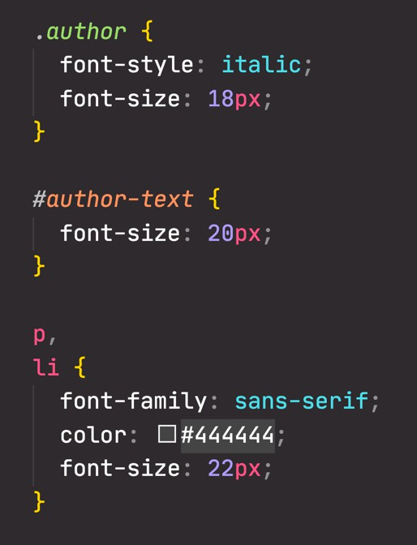

RESOLVING CONFLICTING DECLARATIONS
Highest priority
5
Declarations marked !important
No important! ?
4
Inline style (style attribute in HTML)
No inline style?
Last selector in code applies *
3
ID (#) selector
Multiple?
No # selector?
2
Class (.) or pseudo-class (:) selector
Multiple?
No . or : selector?
1
Element selector (p, div, li, etc.)
Multiple?
No element selector?
There is an ID selector (#author-text), so for the
conflicting font-size property, this is the selector that applies
Lowest priority
0
Universal selector (*)
* It’s a bit more complicated in reality

