Slide 1



SECTION
WEB DEVELOPMENT
LECTURE
HTML & CSS

Slide 2
Learning…
Tools of Web development.
Basic Website Concepts. (eg URL, HTTP, DOM, etc)
Basic of Web Servers and Web Hosting
Working of Website and inspect network using DevTools.
HTML 5
Element and Tags usages.

Slide 3
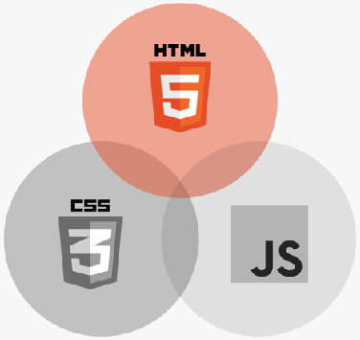
WHAT IS HTML?
Hyper Text Markup Language
HTML is a markup language that web developers use to structure and describe the content of a webpage (not a programming language)
HTML consists of elements that describe different types of content: paragraphs, links, headings, images, video, etc.
Web browsers understand HTML and render HTML code as websites

Slide 4
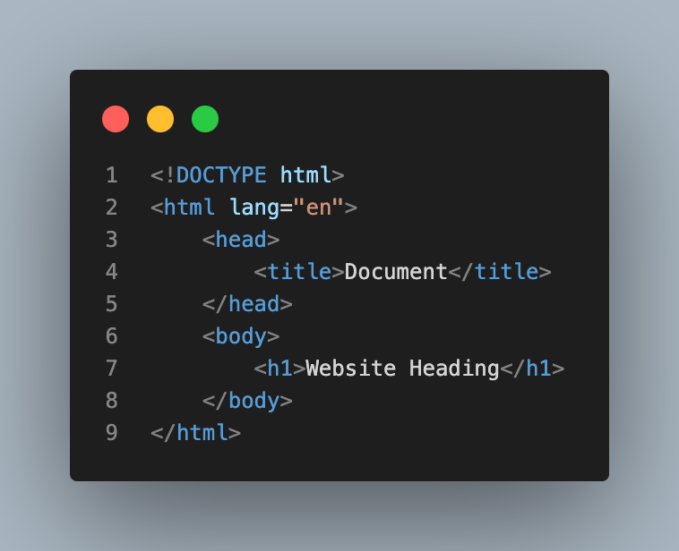
HTML CODE STRUCTURE
HTML Code Structure
The essential tags that are required to create a HTML document are:
<!DOCTYPE html>
<html>
<head>
<title>..</title>
<style>..</style>
<script>..</script>
</head>
<body>..</body>
</html>

Slide 5

ANATOMY OF AN HTML ELEMENT
Element
<p>HTML is a markup language</p>
Opening tag: Name of the element, wrapped in < and >
Content: Content of the element, in this example text. But it might be another element (child element). Some elements have no content (e.g. <img>)
Closing tag: Same as opening tag, but with a /. When element has no content, it’s omitted

Slide 6

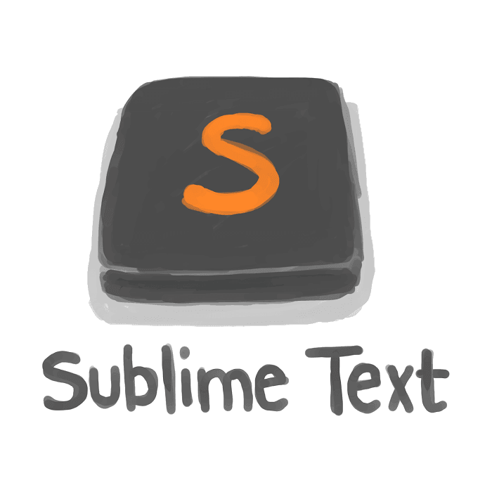

Create an HTML
Choose IDE:
HTML file:
Create a new file using IDE the file extension should be with learninghtml.html
Viewing document in web browser open a file with any of browser to view our changes.
Note:
Make sure the selected/ installed IDE should support any React requirements.

Slide 7
HTML TAG <html>..</html>
<html> tag: Encloses all other HTML tags and associated text within your document. It is an optional tag.
But it is always a good form to include an opening tag and closing tag. The closing tag is the same as the opening tag, except for the slash mark e.g. </html>.
The slash mark is always used in closing tags.
The format is:
<html>
Your Title and Document (contains text with HTML tags) goes here
</html>

Slide 8
HEAD TAG <head>..</head>
<head> tag: The element contains meta information about the HTML page.
Tags that are associated with head tags are:
<title>, <style>, <base>, <link>, <meta>, <script>
The format is:
<head>
<base href=”https://baseurl.com" target="_blank">
<link rel=“stylesheet” heref=”main.css”>
<title>
page title
</title>
</head>

Slide 9
LINK TAG <link>
The tag defines the relationship between the current document and an external resource.
Most often used to link to external style sheets or to add a favicon to your website.
The format is:
<link rel="stylesheet" type="text/css" href="theme.css">
Attribute | Value | Description
rel | stylesheet, Alternate, author, dns-prefetch, help, icon, license, next, pingback, preconnect, prefetch, preload, prerender, prev, search | Required. Specifies the relationship between the current document and the linked document
href | URL | Specifies the location of the linked document
type | media_type | Specifies the media type of the linked document

Slide 10
BODY TAG <body>..</body>
<body> tag: the Tag contains all the text and graphics of the document with all the HTML tags that are used for control and formatting of the page.
The format is:
<body>
Web page content and elements goes here
</body>

Slide 11
STYLE TAG <style>..</style>
<style> tag: Tag contains all the text and graphics of the document with all the HTML tags that are used for control and formatting of the page.
CSS Properties are added.
The format is:
<style>
.h1 {
font-size: larger;
}
</style>

Slide 12
Handling Text and Content
Headings and paragraphs are some common HTML elements that we see on all websites. In HTML, <h1> to <h6> tags represent headings and are used to describe the contents below them. The paragraph or the <p> tag in HTML helps users define a paragraph.
Lets code…

Slide 13
Handling Image
Img tag is used to display image on the web page. HTML img tag is an empty tag that contains attributes only, closing tags are not used in HTML image element.
Lets code…

Slide 14
Handling Order and Unorder List
Unorder List: An unordered list starts with the <ul> tag. Each list item starts with the <li> tag.
Order List: An ordered list starts with the <ol> tag. Each list item starts with the <li> tag.
Lets code…

Slide 15
Handling Table
Table Tags: A table in HTML consists of table cells inside rows and columns.
Tags: <table>, <thead>, <tbody>, <tfoot>, <tr>, <th>, <td>
Lets code…

Slide 16
Handling Forms
Form Tags: Are used to create an HTML form for user input.
Tags: <form> <input>, <textarea>, <button>, <select>, <option>, <optgroup>, <fieldset>, <label>, <output>
Lets code…

Slide 17
SECTION
CSS FUNDAMENTALS
LECTURE
INTRODUCTION TO CSS

Slide 18
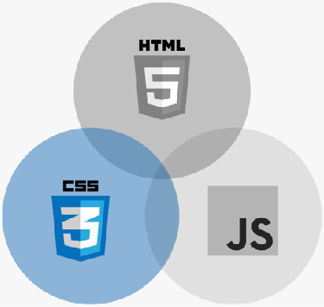
WHAT IS CSS?
CSS
Cascading Style Sheets
CSS describes the visual style and presentation of the content written in HTML
CSS consists of countless properties that developers use to format the content: properties about font, text, spacing, layout, etc.

Slide 19
HOW WE SELECT AND STYLE ELEMENTS
A CSS RULE
Selector
Declaration block
h1
{
color: blue;
text-align: center;
font-size: 20px;
Declaration / Style
}
Property
Value

Slide 20
SECTION
CSS FUNDAMENTALS
LECTURE
WORKING WITH COLORS

Slide 21
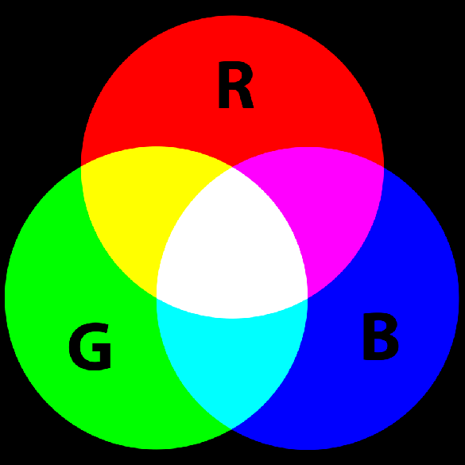



THE RGB MODEL
R G B
255 0 0
RGB Model: Every color can be represented by a combination of RED, GREEN and BLUE
R G B
255 255 0
R G B
255 0 255
Each of the 3 base colors can take a value between 0 and 255, which leads to 16.8 million different colors
R G B
255 255 255
R G B
0 0 0
0 | 255
0 | 255
0 | 255
R G B
0 255 0
R G B
0 0 255
R G B
0 255 255

Slide 22


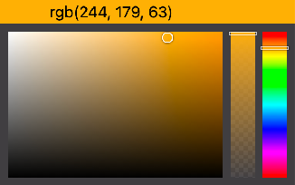
DEFINING COLORS IN CSS
1
RGB / RGBA NOTATION
Regular RGB model
2 HEXADECIMAL NOTATION
Instead of using a scale from 0 to 255, we go from 0 to ff (255 in hexadecimal numbers)
rgb(0, 255, 255)
#00ffff
RGB with transparency (“alpha”)
rgba(0, 255, 255, 0.3)
Shorthand, when all colors are identical pairs
#0ff
In practice, we mostly use hexadecimal
colors, and rgba when we need transparency
#f4b33f
rgb(244, 179, 63)
rgba(244, 179, 63, 0.7)
Color picker in VS Code

Slide 23
SECTION
CSS FUNDAMENTALS
LECTURE
CONFLICTS BETWEEN SELECTORS

Slide 24
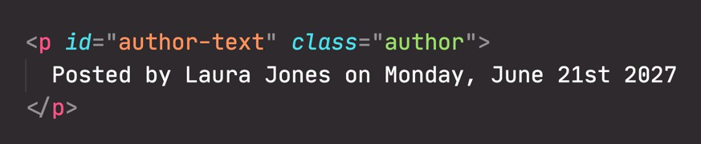
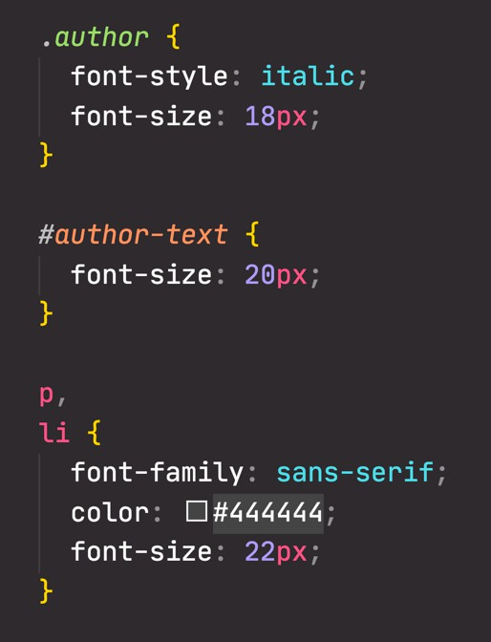


CONFLICTING SELECTORS AND DECLARATIONS
There are multiple selectors selecting the same element. Which one of them applies?
All of them. All rules and properties are applied!
But there are conflicting font-size
declarations! Is it 18px, or 20px, or 22px?
Let’s see how it works...

Slide 25

RESOLVING CONFLICTING DECLARATIONS
Highest priority
5
Declarations marked !important – Don’t use
No important! ?
4
Inline style (style attribute in HTML)
No inline style?
Last selector in code applies *
3
ID (#) selector
Multiple?
No # selector?
2
Class (.) or pseudo-class (:) selector
Multiple?
No . or : selector?
1
Element selector (p, div, li, etc.)
Multiple?
No element selector?
There is an ID selector (#author-text), so for the
conflicting font-size property, this is the selector that applies
Lowest priority
0
Universal selector (*)
* It’s a bit more complicated in reality

Slide 26
SECTION
CSS FUNDAMENTALS
LECTURE
INHERITANCE AND THE UNIVERSAL SELECTOR

Slide 27
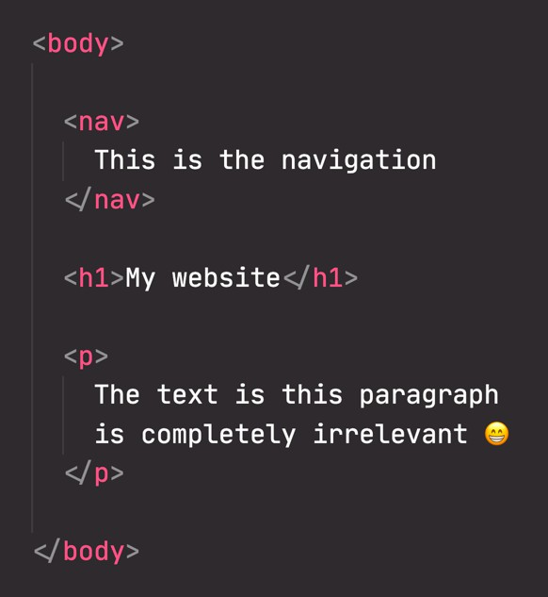
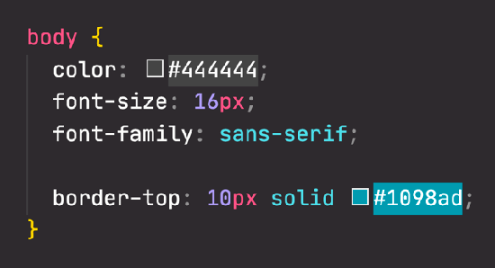

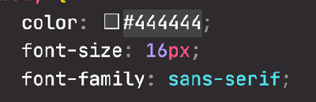
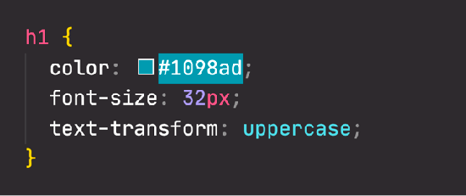
HOW INHERITANCE WORKS
Parent element
The border property does NOT get inherited
OVERRIDING INHERITED STYLES
Not all properties get inherited. It’s mostly ones related to text: font-family, font-size, font-weight, font- style, color, line-height, letter-spacing, text-align, text-transform, text-shadow, list-style, etc.

Slide 28
SECTION
CSS FUNDAMENTALS
LECTURE
THE CSS BOX MODEL

Slide 29
THE CSS BOX MODEL
Visible part of element on the page
Content: Text, images, etc.
Border: A line around the element, still inside of the element
Padding: Invisible space around the content, inside of the element
Margin: Space outside of the element, between elements
Fill area: Area that gets filled with background color or background image
margin
padding
width
CONTENT
height
FILL AREA
border

Slide 30

ANALOGY FOR THE CSS BOX MODEL
border
Content area
margin
padding

Slide 31
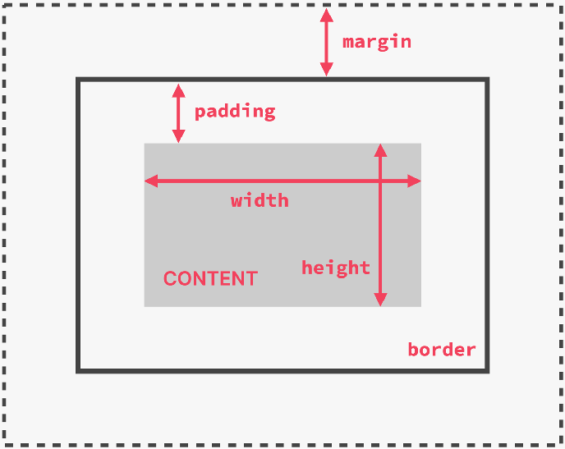
ELEMENT HEIGHT AND WIDTH CALCULATION
Final element width = left border + left padding + width + right padding + right border
Final element height = top border + top padding
+ height + bottom padding + bottom border
We can specify all these values using CSS properties This is the default behavior, but we can change it

Slide 32
SECTION
CSS FUNDAMENTALS
LECTURE
TYPES OF BOXES

Slide 33

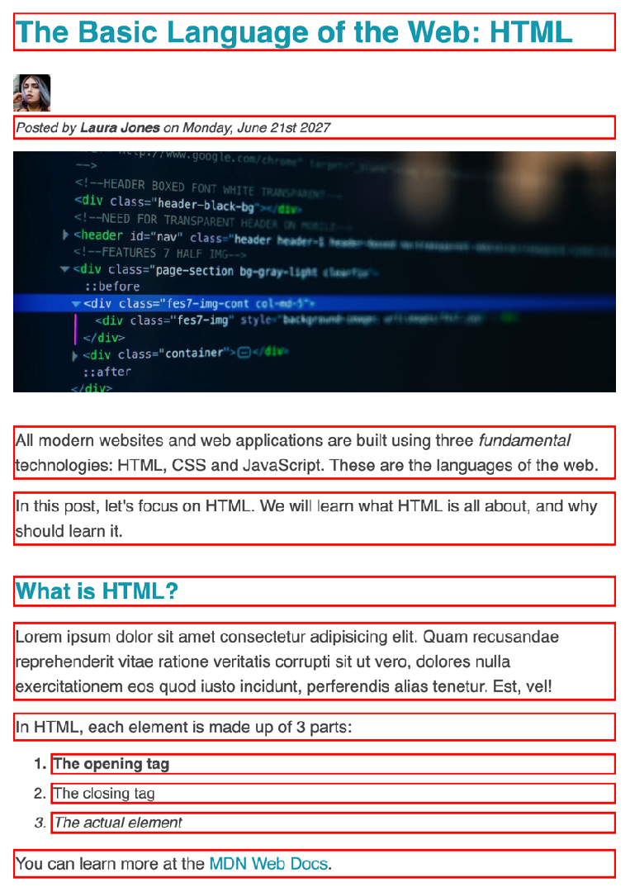
BLOCK-LEVEL ELEMENTS
Elements are formatted visually as blocks
Elements occupy 100% of parent element’s width, no matter the content
Elements are stacked vertically by default, one after another
The box-model applies as showed earlier
Default elements: body, main, header, footer, section, nav, aside, div, h1-h6, p, ul, ol, li, etc.
With CSS: display: block

Slide 34

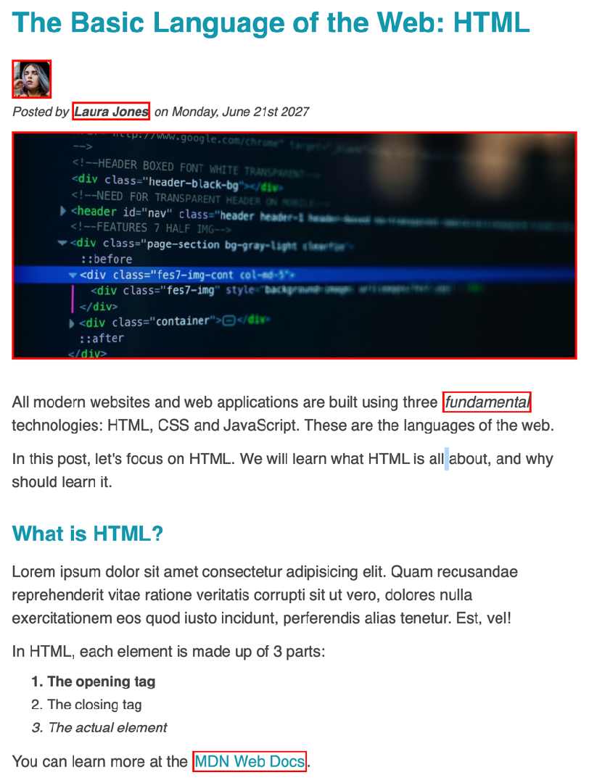
INLINE ELEMENTS
Occupies only the space necessary for its content
Causes no line-breaks after or before the element
Box model applies in a different way: heights and widths do not apply
Paddings and margins are applied only horizontally (left and right)
Default elements: a, img, strong, em, button, etc.
With CSS: display: inline

Slide 35
SUMMARY: INLINE, BLOCK-LEVEL AND INLINE-BLOCK BOXES
BLOCK-LEVEL BOXES
INLINE-BLOCK BOXES
INLINE BOXES
Elements formatted visually as blocks
Looks like inline from the outside, behaves like block- level on the inside
Occupies only content’s space
Causes no line-breaks
100% of parent’s width
Occupies only content’s space
Box model is different: heights and widths do not apply
Vertically, one after another
Causes no line-breaks
Box-model applies as showed
Paddings and margins only horizontal (left and right)
Box-model applies as showed
display: inline-block

Slide 36
SECTION
CSS FUNDAMENTALS
LECTURE
ABSOLUTE POSITIONING

Slide 37
NORMAL FLOW VS. ABSOLUTE POSITIONING
Element is removed from the normal flow: “out of flow”
No impact on surrounding elements, might overlap them
We use top, bottom, left, or right to offset the element from its relatively positioned container
NORMAL FLOW
ABSOLUTE POSITIONING
Default positioning
Element is “in flow”
Elements are simply laid out according to their order in the HTML code
Default positioning
position: relative
position: absolute

Slide 38
UNDERSTANDING ABSOLUTE POSITIONING
100px
200px
.container {
position: relative;
background-color: #f7e6c1;
}
.el {
position: absolute; top: 100px;
left: 200px;
background-color: #f4b33f;
}

Slide 39
SECTION
LAYOUTS: FLOATS, FLEXBOX, AND CSS GRID FUNDAMENTALS
LECTURE
THE 3 WAYS OF BUILDING LAYOUTS

Slide 40





WHAT DOES “LAYOUT” MEAN?
LAYOUT
Layout is the way text, images and other content is placed and arranged on a webpage
Layout gives the page a visual structure, into which we place our content
Building a layout: arranging page elements into a visual structure, instead of simply having them placed one after another (normal flow)

Slide 41
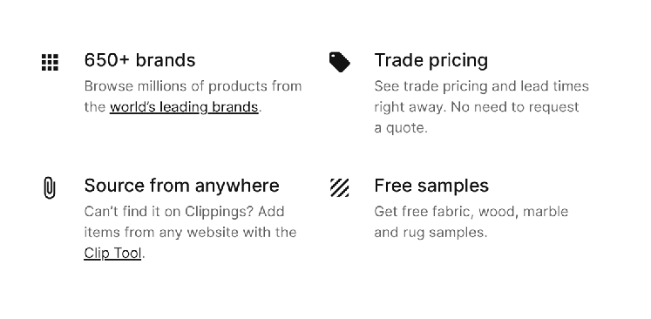

PAGE LAYOUT VS. COMPONENT LAYOUT
PAGE LAYOUT
COMPONENT LAYOUT

Slide 42




THE 3 WAYS OF BUILDING LAYOUTS WITH CSS
1
2
3
FLOAT LAYOUTS
The old way of building layouts of all sizes, using the float CSS property. Still used, but getting outdated fast.
FLEXBOX
Modern way of laying out elements in a 1-dimensional row without using floats.
Perfect for component layouts.
CSS GRID
For laying out element in a fully-fledged 2-dimensional grid. Perfect for page layouts and complex components.

Slide 43
SECTION
LAYOUTS: FLOATS, FLEXBOX, AND CSS GRID FUNDAMENTALS
LECTURE
USING FLOATS

Slide 44
ABSOLUTE POSITIONING VS. FLOATS
NORMAL FLOW
ABSOLUTE POSITIONING
FLOATS
Element is removed from the normal flow: “out of flow”
=
Element is removed from the normal flow: “out of flow”
Default positioning
Element is “in flow”
≠
No impact on surrounding elements, might overlap them
Text and inline elements will wrap around the floated element
Elements are simply laid out according to their order in the HTML code
We use top, bottom, left, or right to offset the element from its relatively positioned container
The container will not adjust its height to the element
Default positioning
position: relative
float: left float: right
position: absolute

Slide 45
SECTION
LAYOUTS: FLOATS, FLEXBOX, AND CSS GRID FUNDAMENTALS
LECTURE
BOX-SIZING: BORDER-BOX

Slide 46
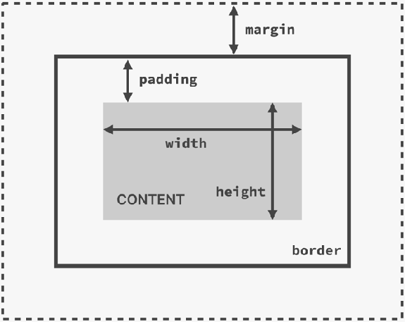
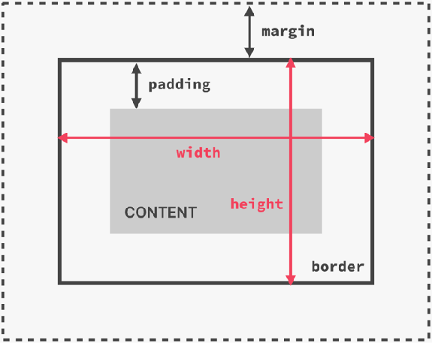
THE BOX MODEL WITH BOX-SIZING: BORDER-BOX
box-sizing: border-box
Final element width = right border + right padding + width + left padding + left border
Final element height = top border + top padding + height + bottom padding + bottom border

Slide 47
SECTION
LAYOUTS: FLOATS, FLEXBOX, AND CSS GRID FUNDAMENTALS
LECTURE
A FLEXBOX OVERVIEW

Slide 48

WHAT IS FLEXBOX?
FLEXBOX
Flexbox is a set of related CSS properties for building 1-dimensional layouts
The main idea behind flexbox is that empty space inside a container element can be automatically divided by its child elements
Flexbox makes it easy to automatically align items to one another inside a parent container, both horizontally and vertically
Flexbox solves common problems such as vertical centering and creating
equal-height columns
Flexbox is perfect for replacing floats, allowing us to write fewer and cleaner HTML and CSS code

Slide 49
FLEXBOX TERMINOLOGY
Flex items
Flex container
MAIN AXIS
CROSS AXIS
display: flex

Slide 50

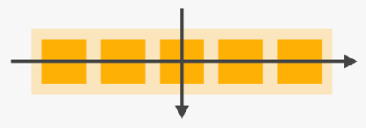
FLEX CONTAINER
MAIN AXIS
FLEX ITEMS
CROSS AXIS
1 gap: 0 | <length>
1
align-self: auto | stretch | flex-start | flex- end | center | baseline
To create space between items, without using margin
To overwrite align-items for individual flex items
2
justify-content: flex-start | flex-end | center | space-between | space-around | space-evenly
2 flex-grow: 0 | <integer>
To align items along main axis (horizontally, by default)
To allow an element to grow (0 means no, 1+ means yes)
align-items: stretch | flex-start | flex-end | center | baseline
3
3 flex-shrink: 1 | <integer>
To align items along cross axis (vertically, by default)
To allow an element to shrink (0 means no, 1+ means yes)
flex-direction: row | row-reverse | column | column-reverse
4 flex-basis: auto | <length>
4
To define an item’s width, instead of the width property
To define which is the main axis
5 flex-wrap: nowrap | wrap | wrap-reverse
5 flex: 0 1 auto | <int> <int> <len>
To allow items to wrap into a new line if they are too large
Recommended shorthand for flex-grow, -shrink, -basis.
align-content: stretch | flex-start | flex-end | center | space-between | space-around
6 order: 0 | <integer>
6
Controls order of items. -1 makes item first, 1 makes it last
Only applies when there are multiple lines (flex-wrap: wrap)

Slide 51
SECTION
LAYOUTS: FLOATS, FLEXBOX, AND CSS GRID FUNDAMENTALS
LECTURE
A CSS GRID OVERVIEW

Slide 52
WHAT IS CSS GRID?
CSS GRID
CSS Grid is a set of CSS properties for building 2-dimensional layouts
The main idea behind CSS Grid is that we divide a container element into rows and columns that can be filled with its child elements
In two-dimensional contexts, CSS Grid allows us to write less nested HTML
and easier-to-read CSS
CSS Grid is not meant to replace flexbox! Instead, they work perfectly together. Need a 1D layout? Use flexbox. Need a 2D layout? Use CSS Grid.

Slide 53
BASIC CSS GRID TERMINOLOGY
Grid container
COLUMN AXIS
Grid items
display: grid
ROW AXIS

Slide 54
MORE CSS GRID TERMINOLOGY
1
2
3
4
1
Grid track/row
COLUMN AXIS
Grid lines
2
Gutters (gaps)
3
Grid track/column
Grid cell (might be filled by a grid item or not)
ROW AXIS

Slide 55

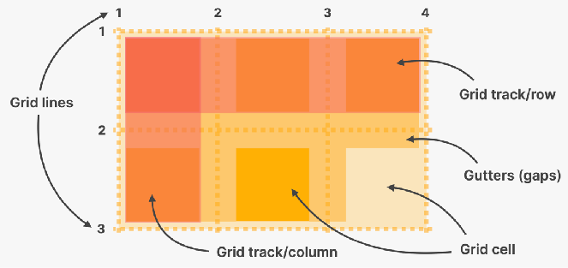
GRID CONTAINER
GRID ITEMS
grid-template-rows: <track size>*
grid-template-columns: <track size>*
grid-column: <start line> / <end line> | span <number>
grid-row: <start line> / <end line> | span <number>
1
1
To establish the grid row and column tracks. One length unit for each track. Any unit can be used, new fr fills unused space
To place a grid item into a specific cell, based on line numbers.
span keyword can be used to span an item across more cells
row-gap: 0 | <length>
column-gap: 0 | <length>
gap: 0 | <length>
justify-self: stretch | start | center | end
align-self: stretch | start | center | end
2
2
To create empty space between tracks
To overwrite justify-items / align-items for single items
justify-items: stretch | start | center | end
align-items: stretch | start | center | end
3
To align items inside rows / columns (horizontally / vertically)
justify-content: start | start | center | end | ...
align-content: start | start | center | end | ...
4
To align entire grid inside grid container. Only applies if container is larger than the grid
This list of CSS Grid properties is not exhaustive, but enough to get started.

