Slide 1
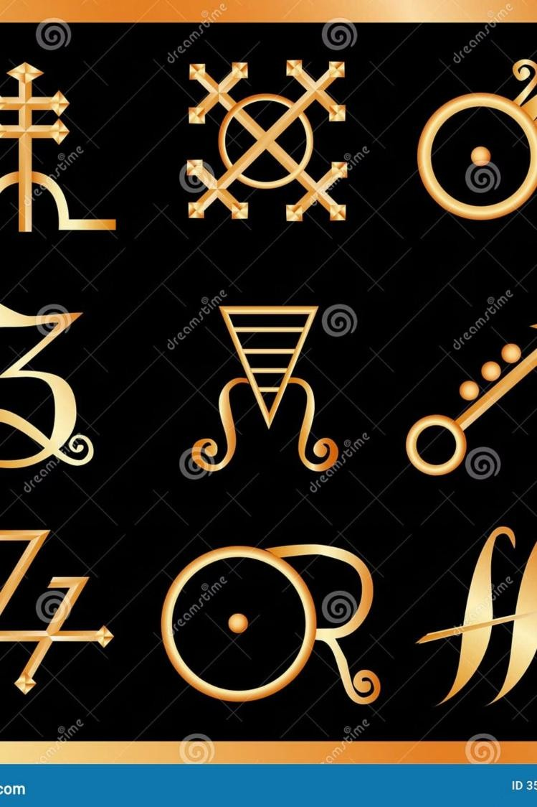
From Caesar to Vigenère: Evolution of Substitution
Ciphers
Cryptography and Network Security (CSA5112)
SUBMITTED BY
CH Aravind (192325093)

Slide 2
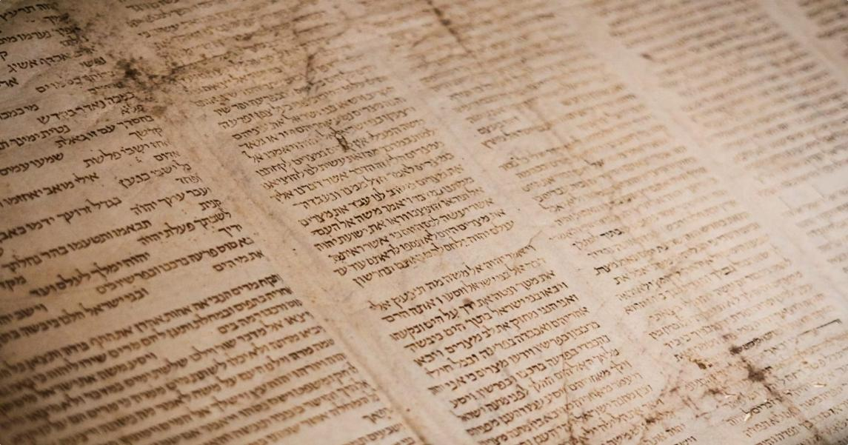

What Are Substitution Ciphers?
Definition
A substitution cipher replaces each letter of plaintext with another letter, symbol, or number based on a fixed rule or key.
Key Characteristics
One of the oldest encryption techniques
Uses a key for both encryption and
decryption
Provides message confidentiality
Foundation for modern cryptography

Slide 3
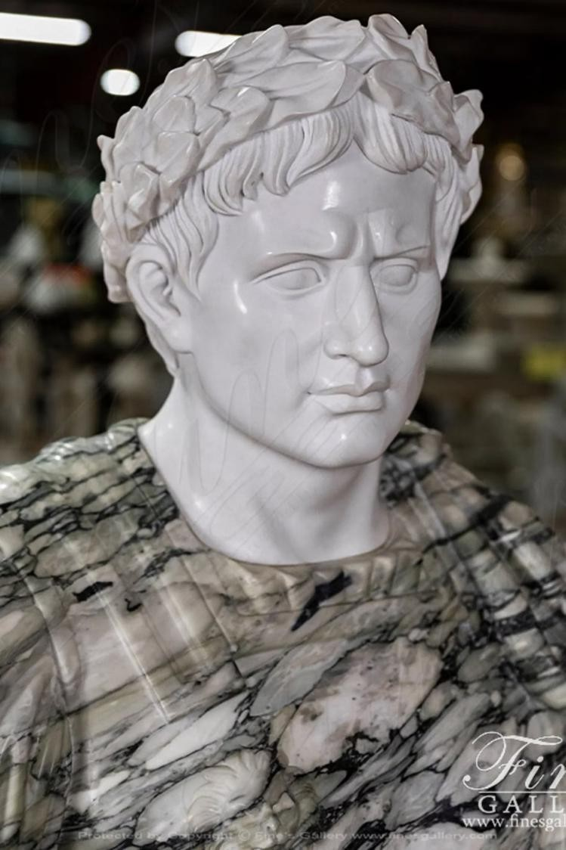
Caesar Cipher
Developed by Julius Caesar around 50 BC for secure military communication. Each letter is shifted forward by a fixed number of positions in the alphabet.
How It Works
Advantages
Shift = 3:
F…
A → D, B → E, C →
Simple to understand and
implement
Fast encryption and decryption
HELLO → KHOOR
Limitations
Only 26 possible keys
Easily broken by brute force

Slide 4
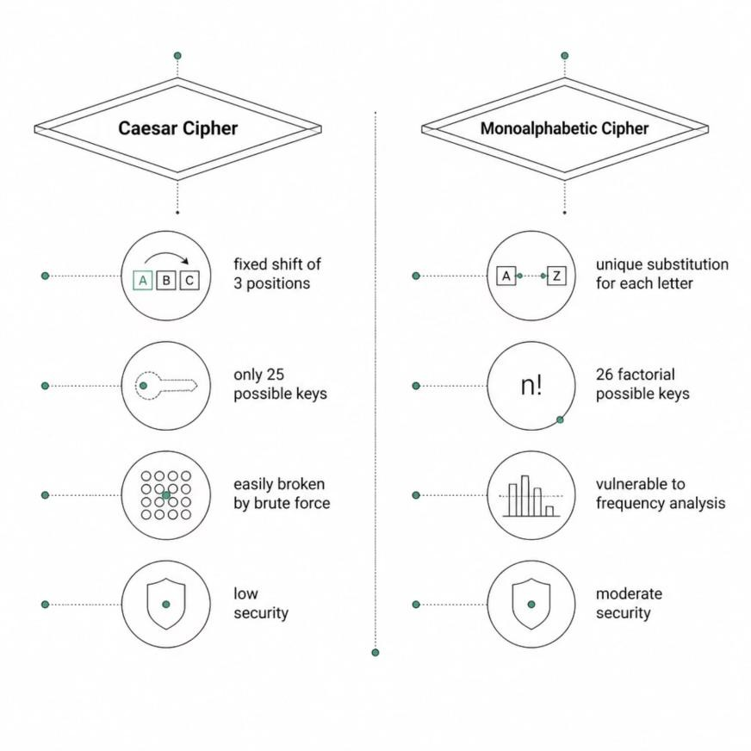
Monoalphabetic Cipher
Rather than a fixed shift, each letter maps to a unique substitute from a scrambled alphabet — dramatically expanding the key space.
Example Substitution
Plain: ABCDEFGHIJKLMNOPQRSTUVWXYZ
Cipher: QWERTYUIOPASDFGHJKLZXCVBNM
Advantages
Vastly larger key space than Caesar
Brute force attacks become impractical
Limitations
Vulnerable to frequency analysis
Letter patterns remain statistically visible

Slide 5
Vigenère Cipher
POLYALPHABETIC SUBSTITUTION
Invented by Blaise de Vigenère in the 16th century. A keyword determines which shift to apply at each position — multiple alphabets in one cipher.
Working Principle
Each letter of the keyword specifies a different Caesar shift. The
keyword repeats across the message length.
Why It's Stronger
Multiple Shift Patterns
The same plaintext letter encrypts differently depending on its position.
Plainte xt | H | E | L | L | O
Keywo rd | K | E | Y | K | E
Ciphert ext | R | I | J | V | S
Resists Frequency Analysis
Letter frequencies are flattened across the ciphertext.
Very Large Key Space
Keyword length and content create enormous combinations.

Slide 6

Comparison of Ciphers
Each cipher represents a leap in cryptographic strength — more complex keys, larger key spaces, and better resistance to attack.
Feature | Caesar Cipher | Monoalphabetic | Vigenère Cipher
Key Type | Fixed Shift | Substitution Table | Keyword
Complexity | Low | Medium | High
Security Level | Low | Moderate | High
Frequency Analysis | Poor resistance | Poor resistance | Better resistance
Key Space | 25 keys | 26! ≈ 4×10²⁶ | Very Large
Caesar Cipher
Monoalphabetic
Vigenère Cipher
Security improved at each stage by increasing key complexity and reducing statistical predictability.

Slide 7
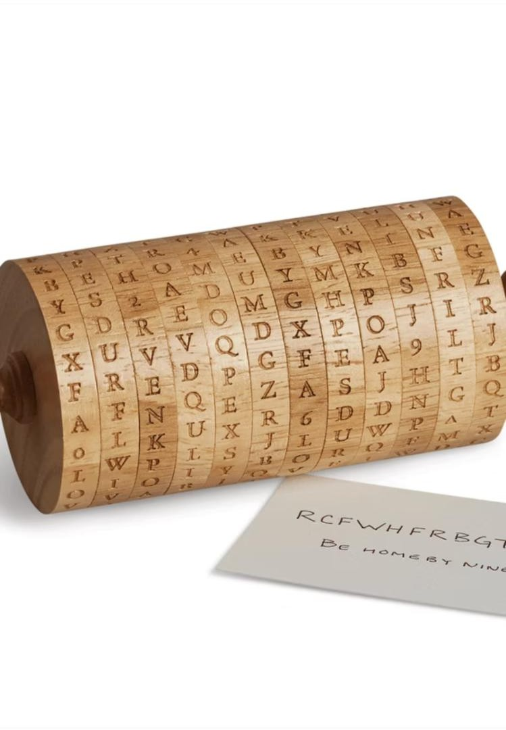
Conclusion & Key Takeaways
01
Caesar Cipher
Introduced substitution encryption with a fixed shift — simple but historically significant.
02
Monoalphabetic Cipher
Expanded key complexity with unique letter mappings, though frequency analysis remained a threat.
03
Vigenère Cipher
Introduced polyalphabetic substitution via a keyword, resisting simple statistical attacks.
04
Foundation for Modern Crypto
These ciphers established principles that underpin today's cryptographic systems.
Key Takeaway: As cryptographic techniques evolved, security improved by
increasing key complexity and reducing predictability.

