Slide 1
Analyzing trends and patterns of terror attacks
A data-driven approach for law of enforcement and other stakeholders to prevent or mitigate future incidents.

Slide 2
BY
Dasari aravind
MS.Pooja Govindsing Rajarwal
Rama Krishna Padhy
Arun Kumar Chiguruppa
Mr. Pasala Nuthan Vara Kishore
Mr. MUHAMMED SHIYAN C K
Mr. Nimish Ranade under the guidance of
mr.iftekar patel(mentor)
ms.c.anavadhya(co-mentor)

Slide 3
Table of contents
Project Objective.
Introduction.
Data Cleaning.
HeatMap Of Null Values.
EDA.
Global Attacks
Year wise Attacks.
Hour wise Attacks.
Types of Major Targets.
Analyzing Major Perpetrators.

Slide 4
Table of contents
Types of Attacks.
Weapons Used.
Associations.
Feature Selection.
Data Pre-Processing.
Model Building.
Model Evaluation.
Model Deployment.
Result.
Software Used.

Slide 5
Table of contents
Advantages and Disadvantages.
Applications.
Future Enhancements.
Conclusion.
.

Slide 6
project objective
to understand the patterns and trends of terrorist/violent activities in certain locations over time, the methods they employ, their potential reasons, and the groups involved, in order to help law enforcement and other stakeholders to prevent or mitigate future incidents.

Slide 7
introduction
“Analyzing trends and patterns of Terror Attacks” Project was made by us to understand patterns in terror attacks in some of the locations over time and make a prediction model to prevent or mitigate future incidents.
Project was Started from Data Cleaning as it is the first most important process in making model or analysis.
Data Cleaning included correction of spelling mistakes and filling null values.
EDA played a key role in this process as EDA had given major solution to the given project objective.
A Model was built using regularization techniques so as overcome the problem of overfitting and deployed on stream lit.

Slide 8
Data cleaning
Data Cleaning is the first most important process in building a model.
In our Project also Firstly, we had done Data Cleaning.
Earlier we saw how to impute median/mode in null values but we had never seen how to correct spelling mistakes, which was our first challenge.
We had explored many ways to solve this challenge, explored how SpellCheckers work.
Later we found the solution which was creating a dictionary and created a new dataset without any spelling mistakes.
Later on we found null values in the dataset, for categorical columns we used mode imputation technique and for numerical columns median imputation technique as mean is sensitive to outliers and data is not following non-normal distribution.

Slide 9
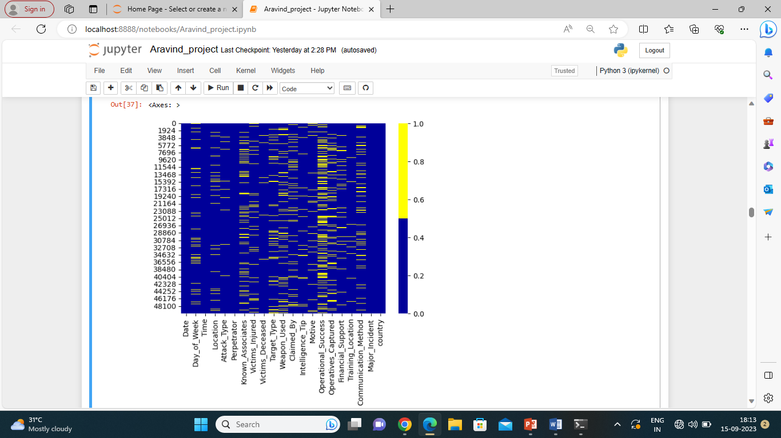
Heatmap of null values
A Heat map was created so as to check for the null values where the null values are coloured with yellow colour and blue colour represents the non-null values. These null values are filled using imputation techniques.

Slide 10
EDA
EDA played a Major Role in our project as EDA gives major solution to the Project Objective.
Doing a proper EDA gives out a solution to meet project requirements.
So a Proper EDA was made by us where EDA was done manually putting code in jupyter notebook, Auto EDA was made and we also did EDA using Tableau Software.
As we had made EDA in three ways we had made more analysis.
According to the analysis that we had made we came to conclusion only some features are important for making a model.
We also came to a conclusion that Logical approach is most important in this project scenario besides domain knowledge.
A Picture is Worth than million words so Visualizations are made clearly for the Project.

Slide 11
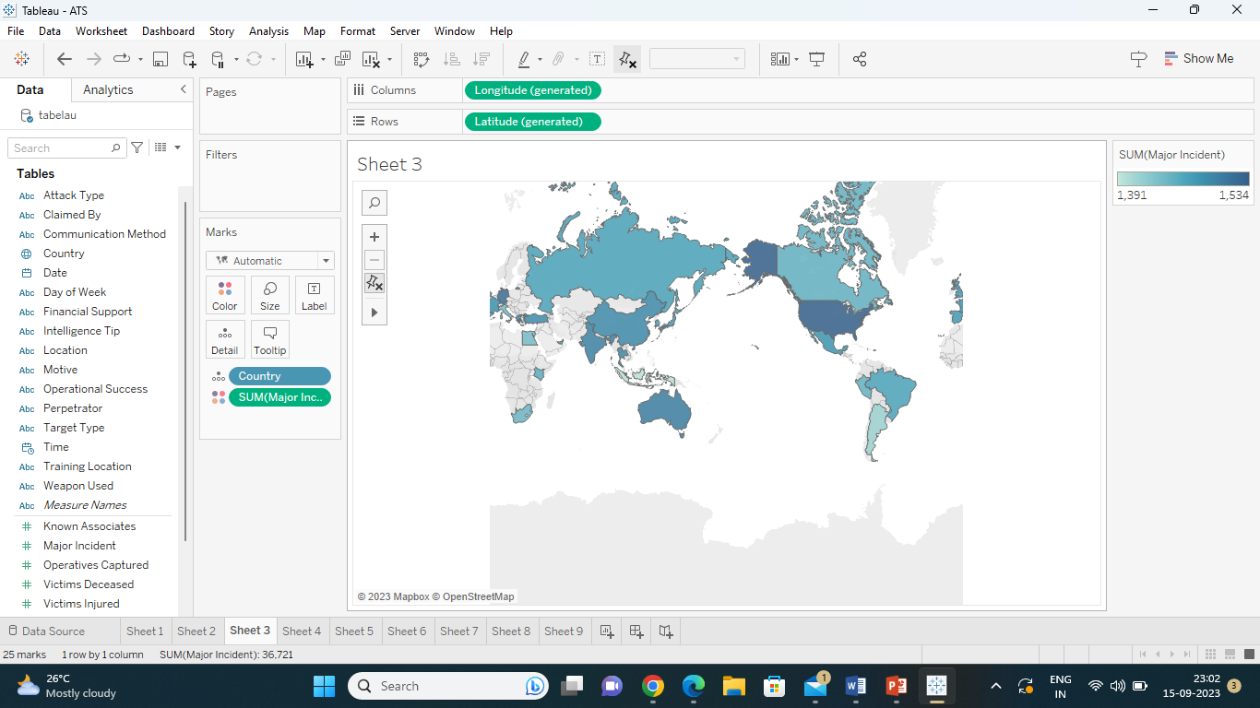
Global attacks

Slide 12
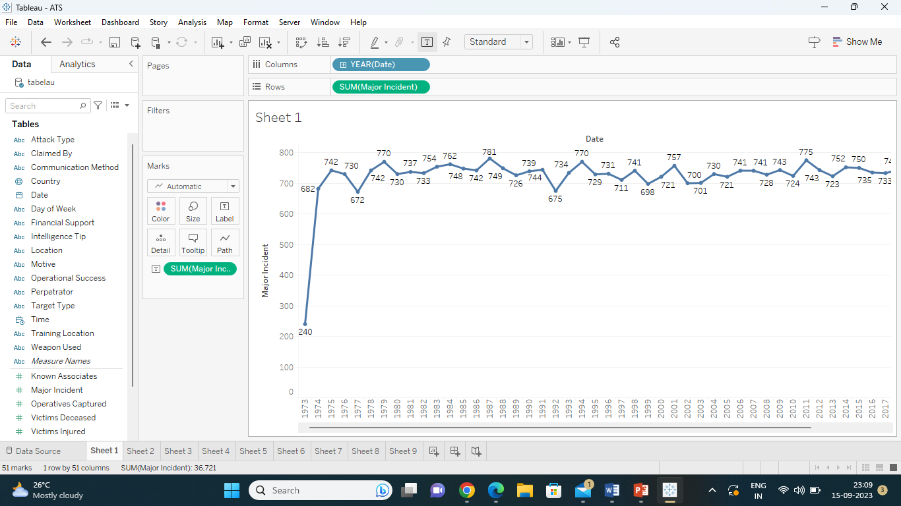
Year wise attacks

Slide 13
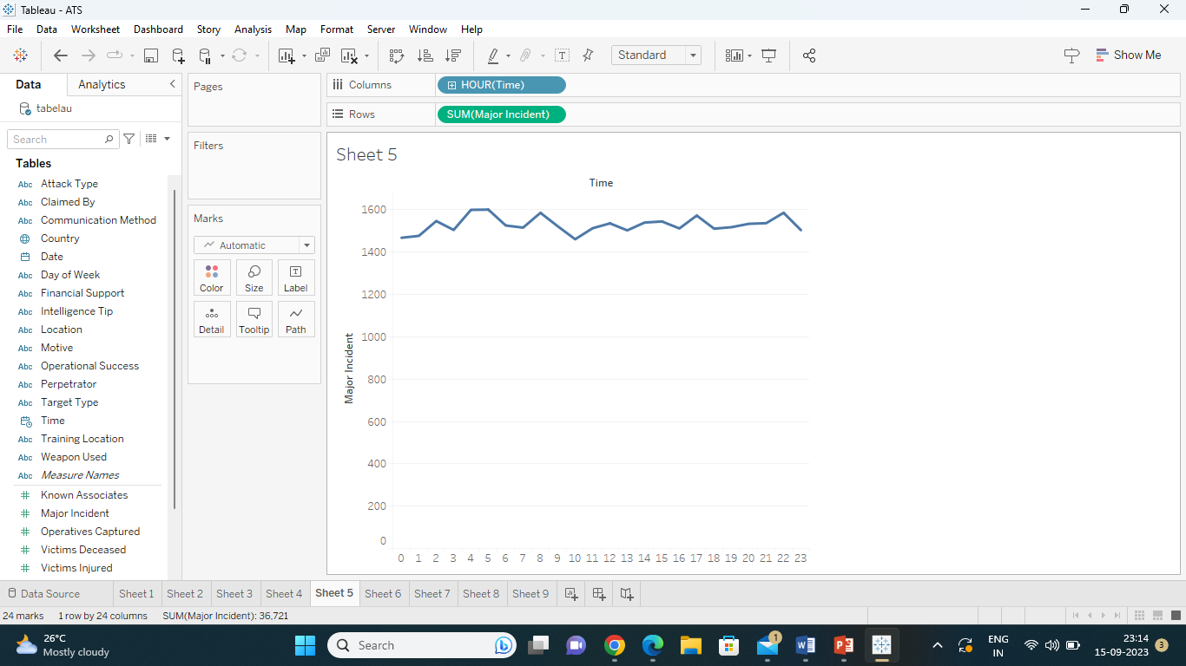
Hour wise attacks

Slide 14
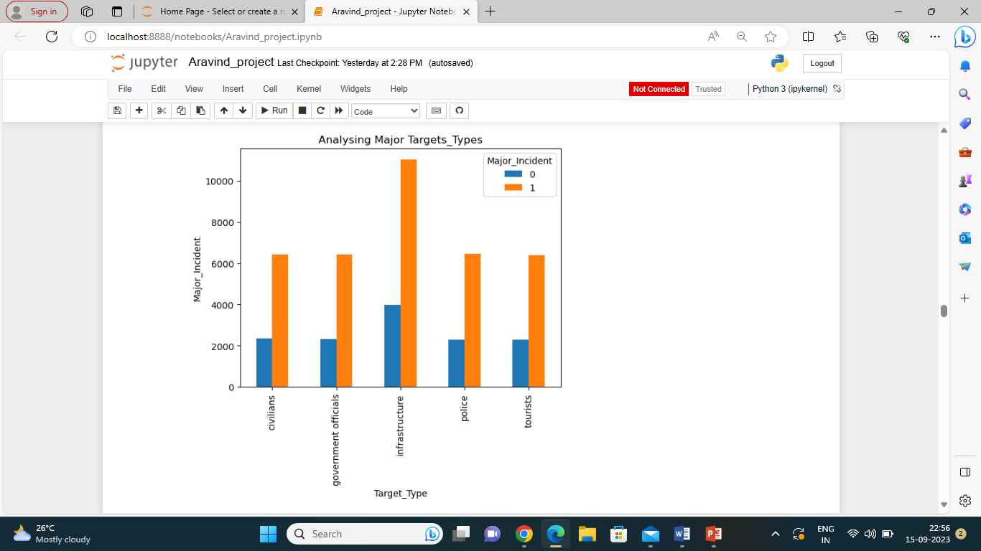
Types of major targets

Slide 15
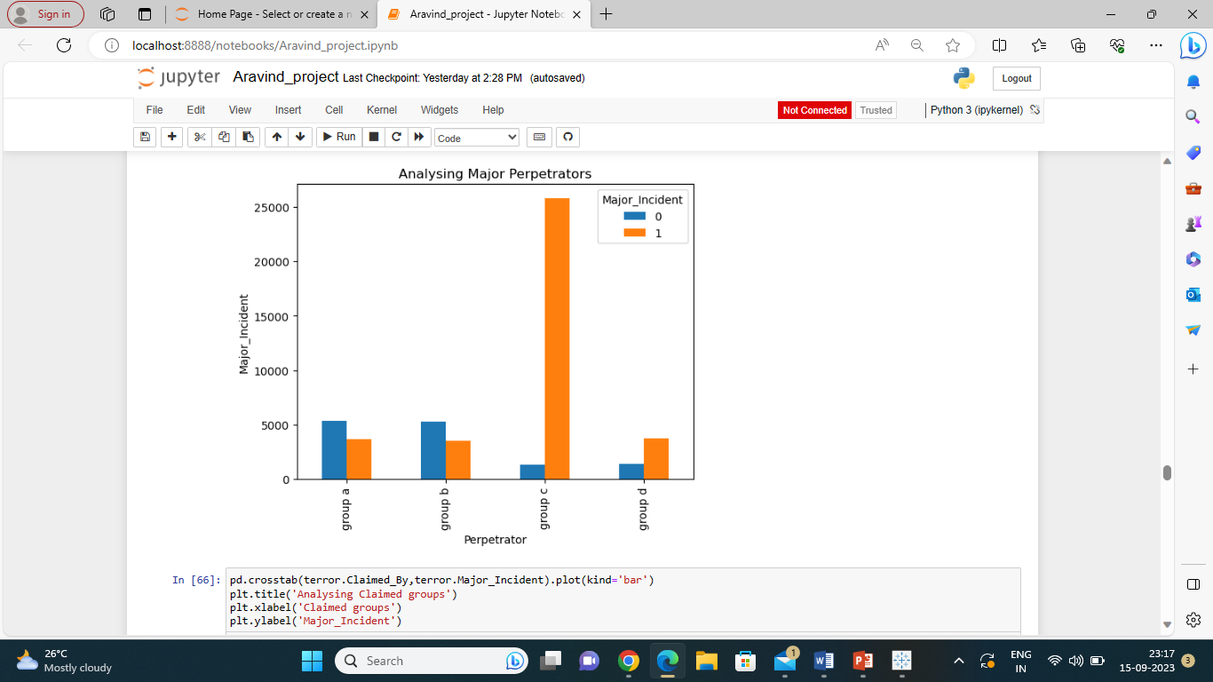
Analyzing major perpetrators

Slide 16
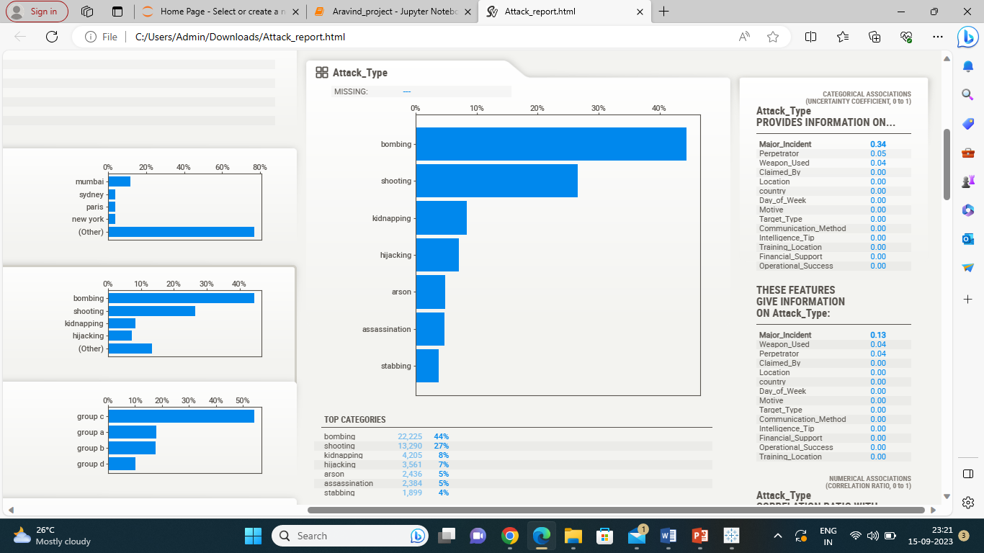
Types of Attacks

Slide 17
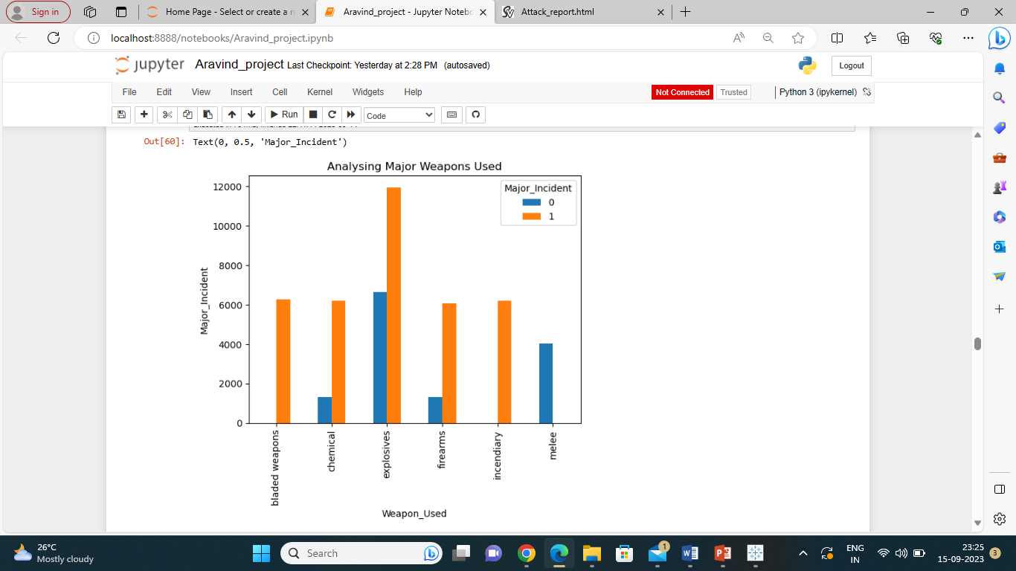
Weapons used

Slide 18
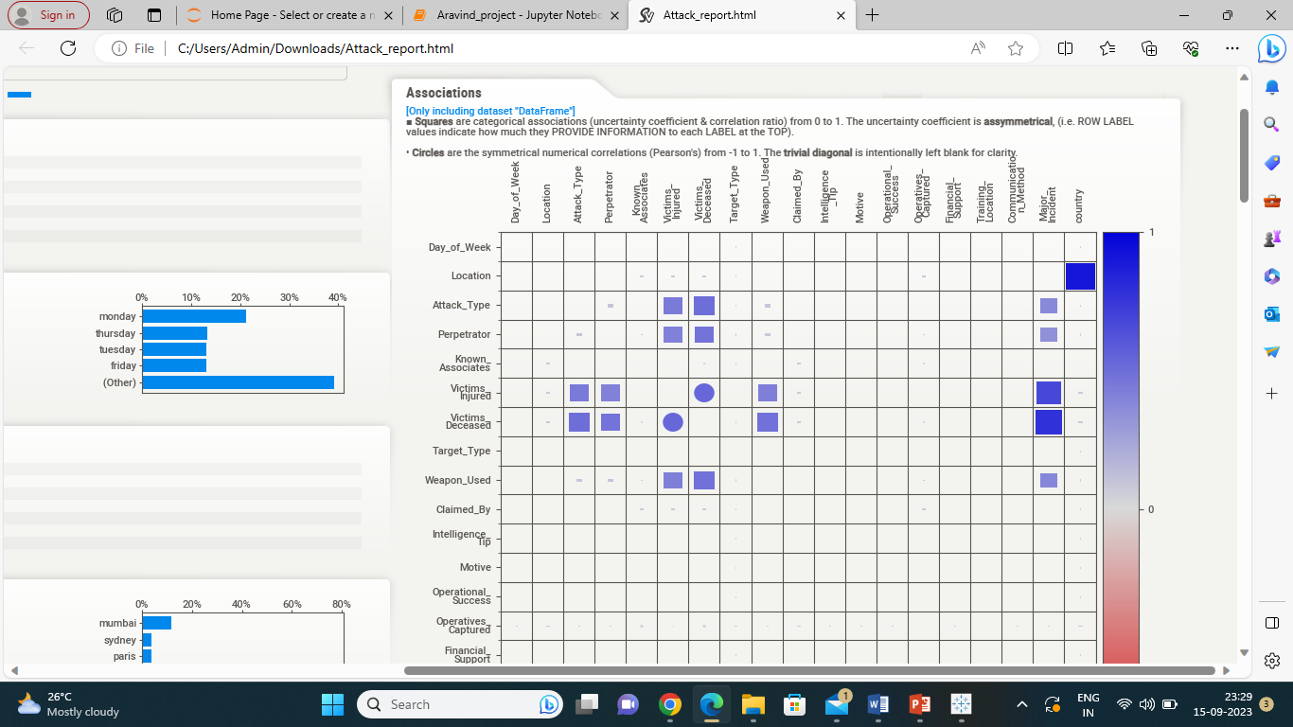
Associations

Slide 19
Feature selection
Feature selection is also important in building a model.
If every feature is selected and given to the model the model may learn the patterns from the data, which may lead to overfitting.
Overfitting is a condition where model training accuracy is high, but testing accuracy decreases.
In order to prevent overfitting we used feature selection.
After completion of EDA we came to conclusion that only few features are important for model building.
We found that Perpetrator,Attack_Type,Weapons_Used,Victims_Deceased,Victims_Injured are the important features for the model to predict incidents which are Minor or Major.
So only those features are fed to the model.

Slide 20
Data Pre-Processing
A Model can’t be built without undergoing data pre-processing.
Model can’t understand the categorical data so the data should be pre-processed.
For our dataset with selected features we can’t use pre-processing technique called Label encoder as there is no kind of levels in the data(kind of bigger to smaller levels).
If we had used label encoder then the data could have been manipulated.
So we had used one hot encoding technique for Pre Processing of data.
This technique labelled data in the form of 1’s and 0’s.
We also downloaded the one hot encoder in a .pkl format in order to give it to the model at deployment stage.

Slide 21
Model building
Model Building gives out a proper prediction to the input features.
We also completed model building, but we faced a problem of overfitting.
As we had used mode imputation technique for filling null values, there existed a problem called overfitting.
Solving a problem of overfitting became a challenge in model building.
We tried many techniques like SMOTE, Hyper Parameter tuning , but those techniques didn’t work.
As data is in such a way that any model learns the patterns we used L1 Regularization to overcome overfitting which in turn reduced model accuracy.
In this Case of project we didn’t use many models because as per requirements we need only one model without any overfitting which has Low Accuracy than Expected.

Slide 22
Model evaluation
After building a model, a model needs to be evaluated to check model performance.
We also did model evaluation, checked for model’s Training and Testing accuracy.
Surprisingly the model testing accuracy is found to more than training accuracy.
We also made a classification Report.
We Observed Good Precision and Recall.
We didn’t find any overfitting in the model.
After model evaluation we came to conclusion to use this model for deployment,
After model evaluation we went for deployment.

Slide 23
Model deployment
Model Deployment is the final stage of the Project.
We had written a code in the .py format for the purpose of deployment.
The model was saved in loaded_model_format.
OnehotEncoder.pkl was saved in order to recall in model deployed.
We also wrote a code for stream lit background colour.
All the codes and files were uploaded in GitHub.
We had made Stream lit as a third party app and connected GitHub with StreamLit.
Finally Model was Deployed on StreamLit Globally as we created a Global API for the Project.

Slide 24
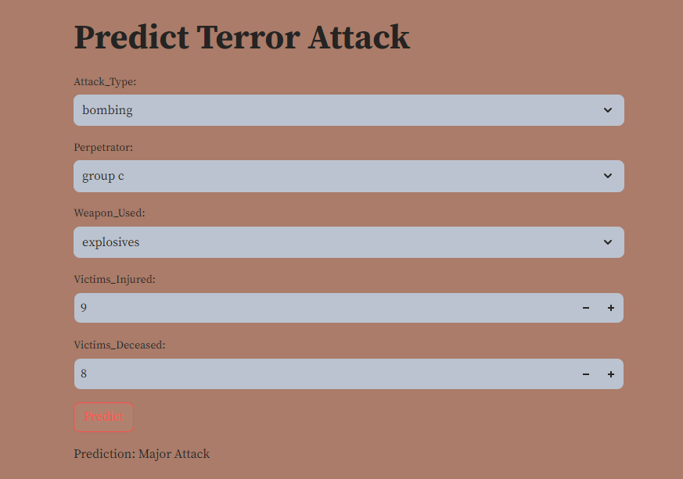
Result

Slide 25
Software used
Jupyter notebook
Google colab
Tableau
Anaconda
Github
streamlit

Slide 26
Advantages and disadvantages
Advantages:
From this model we can know what are major attack types and major groups involved.
We can know whether a incident is Major or Minor from this model.
We can mitigate/prevent future incidents using this model for law of enforcement or other stakeholders.
Disadvantages:
Model can’t be used in real-time situations.
If Terrorists are using this Model that could create more dangerous scenarios.
Model has limited features and cannot use other features as of now.

Slide 27
Applications
Military Based Applications.
For Controlling Terrorist Attacks.
In Anti terror Squad Applications.
For Controlling Rural or Urban Crimes.
Can be used in Global attacks.

Slide 28
Future enhancements
The Model can be enhanced as per the future requirements.
If there is dataset which is designed for military attacks then a model a can be built for military attacks.
If the features are according to rural or urban crimes then model can deployed which can be used to control crimes in rural or urban areas.
Even a app can be made for Anti Terror Squad but where security plays a key role.
According to Data the model can be used for Global attacks also.
A Good Enhancement, With Proper Authorization and Security could result in a App for Law of Enforcement and other Stakeholders.

Slide 29
conclusion
We had completed the Project With Proper Guidance from the Mentor and Co-Mentor.
EDA played important role in our project.
More than Domain Knowledge, Logical Approach towards the Real-time Scenario made us to solve the problem and meet Project Requirements.
The time Period for this project was 2-3 weeks.
From End to End i.e. Starting from Problem Statement to Deployment Communication Played a Key Role in our Project.
From Project we enhanced Ourselves in part of EDA and model building.
We also faced challenges like Overfitting, As a team we completed the challenges.
We also gained Domain Knowledge by exploring techniques like SMOTE.

Slide 30
Thank you

