Slide 1
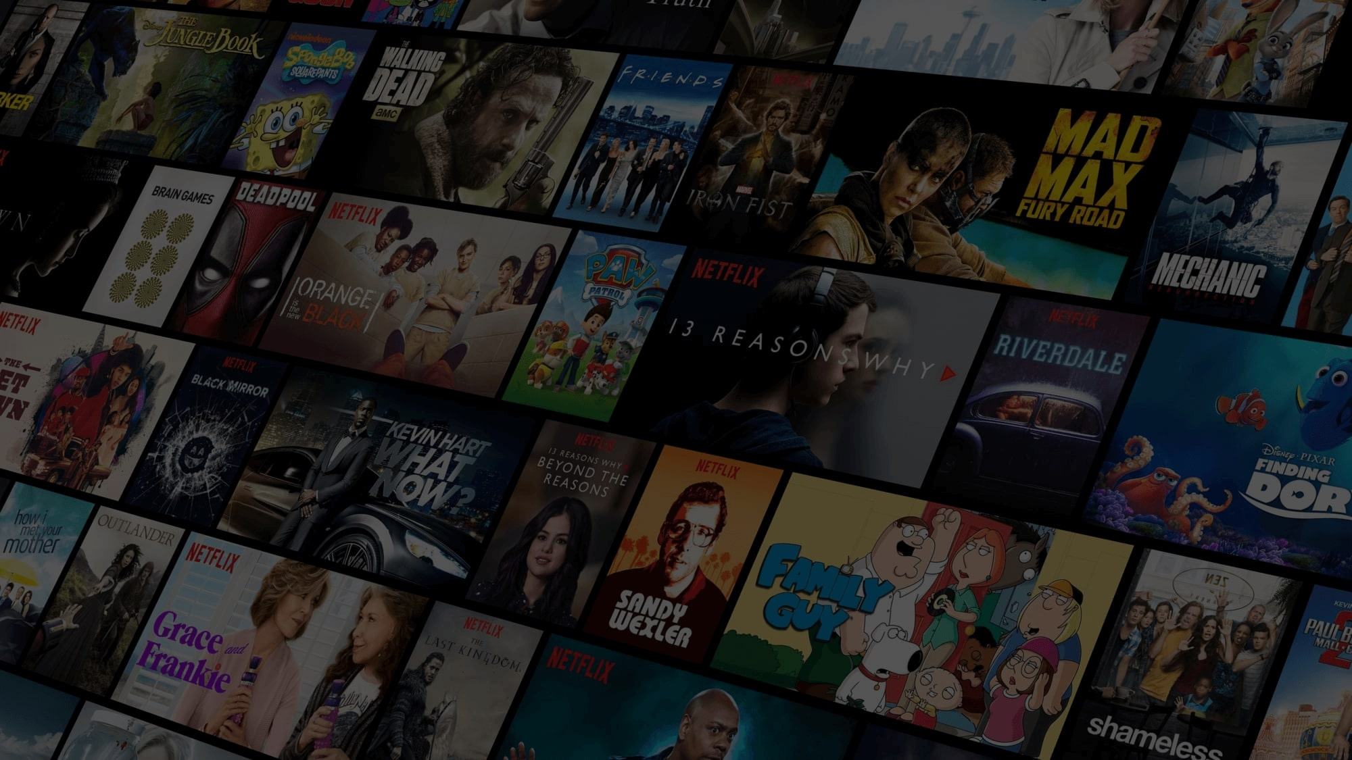
MoviE RecOmmendation System Using NLP and KNN
Enhancing Personalized Film Recommendations By OUR CUTTING-EDGE ALGORITHM

Slide 2

Submitted By:
Mr Battini Vijay
Dasari Aravind
MS Pooja Govindsing Rajarwal
Miss Sindhu M J
Ms Vidhita Arun Sabale
Ms Shruti Jaiswal
Ms Shruti Shankar Molawade
UNDER THE GUIDANCE OF:
Mr.Iftekar Patel(Mentor)
Ms.C.Anavadhya(Co-Mentor)

Slide 3
Table of contents:
Project Objective.
Introduction.
Data Collection.
EDA.
Observed Distributions Using Python.
Auto EDA.

Slide 4
Table of contents:
Dashboards.
Data Pre-Processing.
Embedding Space.
Model Building.
Model Deployment.
Conclusion.

Slide 5

Project objective:
Scrape Movie dataset from IMDB, perform analysis for deeper insights and build a recommendation system.

Slide 6
INTRODUCTION:
Recommendation Systems are Playing a wide role in the current scenario as they are used in Many applications like Youtube, Netflix, Amazon etc..
There are many Recommendation systems like Music recommendation System which suggest according to the user inputs.
Recommendation Systems are of three types:
Content Based
Collaborative
Hybrid

Slide 7
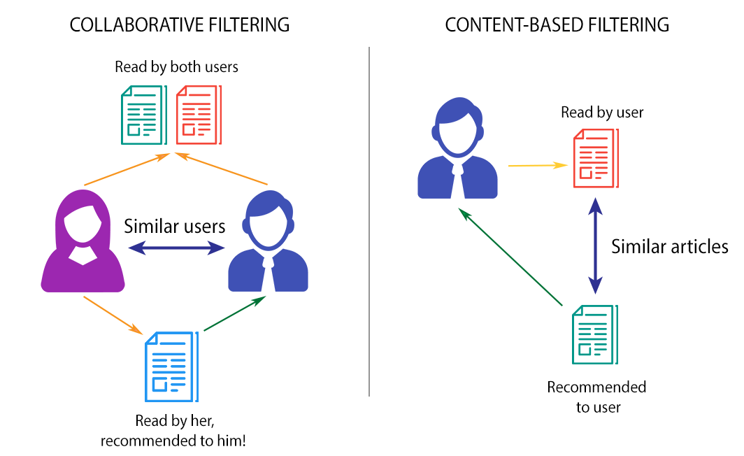

Slide 8
Content Based Recommendation System recommends according to content and user preferences.
Collaborative Recommendation System gives recommendations based on similar user preferences.
Whereas Hybrid is a combination of both.
In our Project the Recommendation System we used is Content Based Recommendation system.
Actually Business Scenario is to recommend movies based on the content.
So as to meet Business Requirement we built model but the way of building the model is different.
Pure NLP is used for the purpose of Encoding the Description.
KNN is Used for the Purpose of Recommendations.

Slide 9

Data collection:
The Business Objective is to Scrape data from IMDB and build Recommendation System to Recommend Movies based on User Input.
To meet the requirements of business objective we scrapped data from IMDB.
To Scrape data from IMDB we used Beautiful Soup Library.
We collected 10000 movies data includes a variety of attributes such as movie name, release year, rating, metascore, gross income, votes, runtime, genre, certificate, description, directors, and stars.
We also Scrapped Posters of the movie for enhancing user experience with our model.

Slide 10

EDA
To make deep analysis and give more insights as per the business objective we made Exploratory Data Analysis.
To check for Null Values, Duplicates and Observe Distribution we used python and had written codes so as to visualize data.
Filtering Data played a role here for Visualizations as we had 10000 data with different kind of attributes.
For Filtering Data and Visualizing Data we used Tableau, where we also created Dashboards.
We also used a Auto EDA Library called sweetviz and generated a html report so as visualize total data in one report.

Slide 11
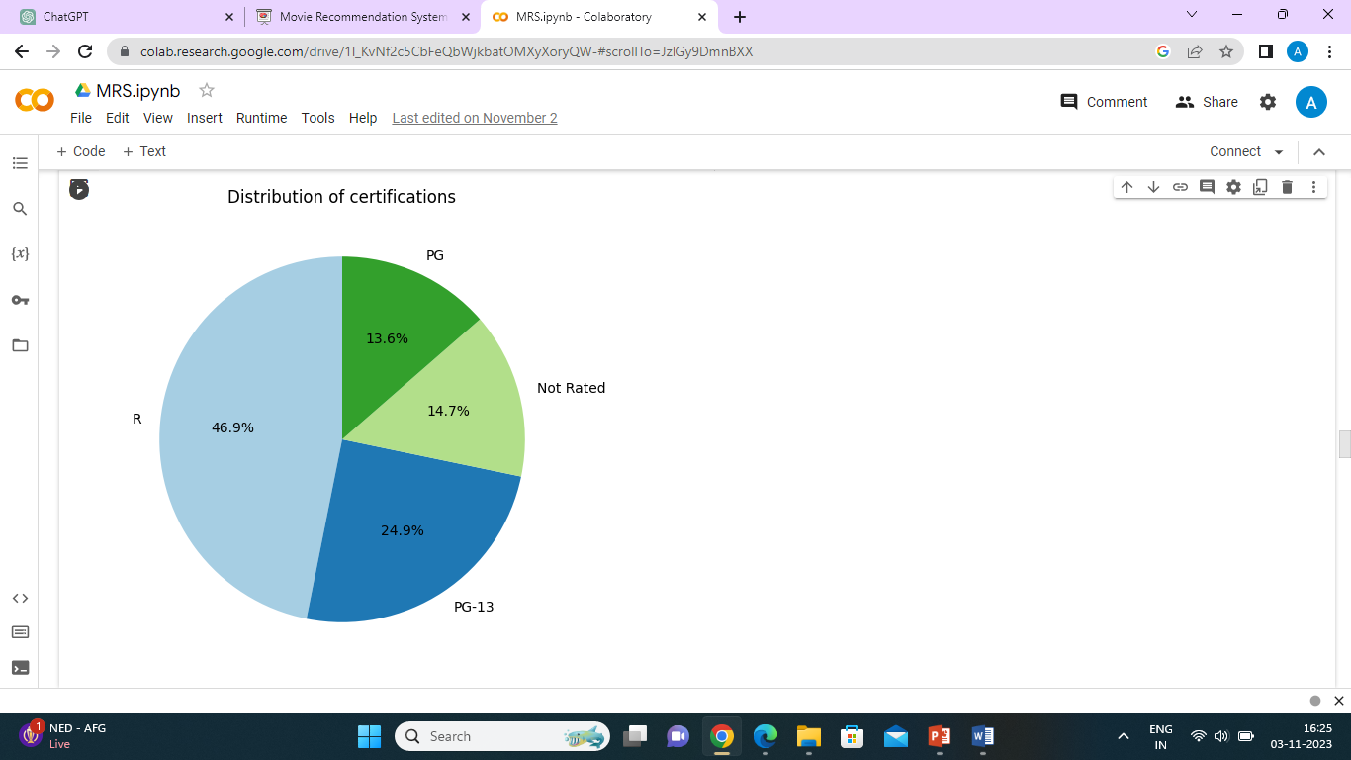
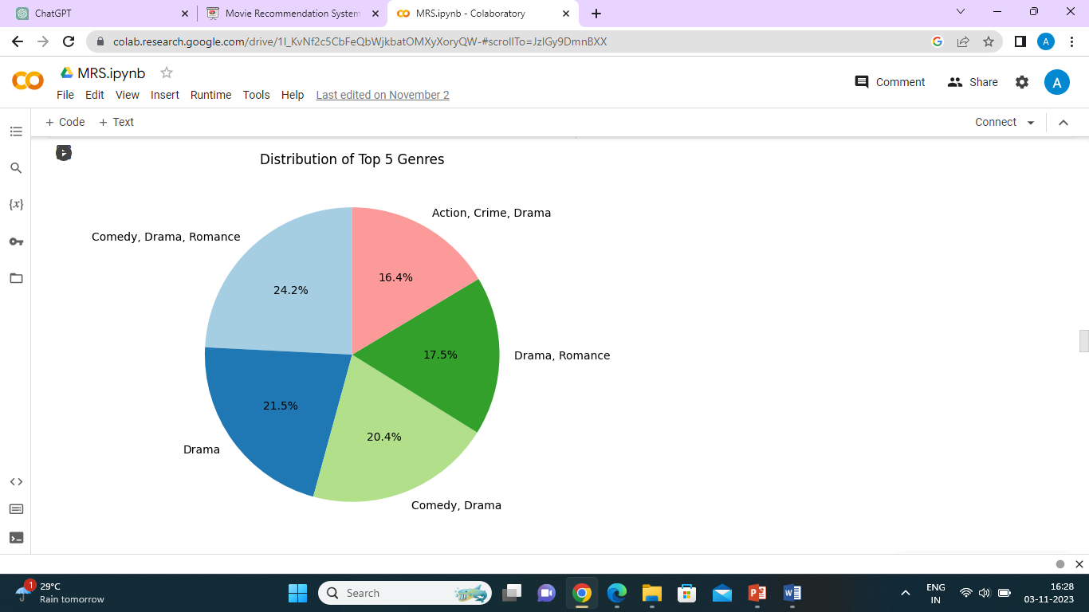
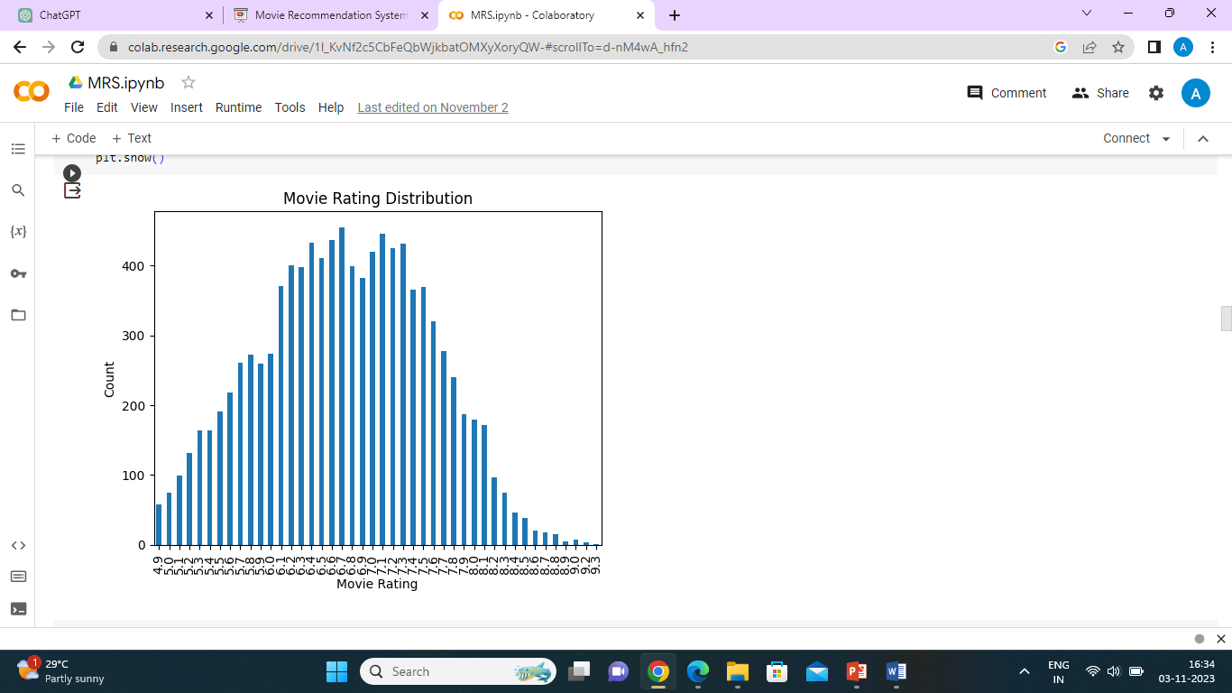
Observed distributions using python

Slide 12
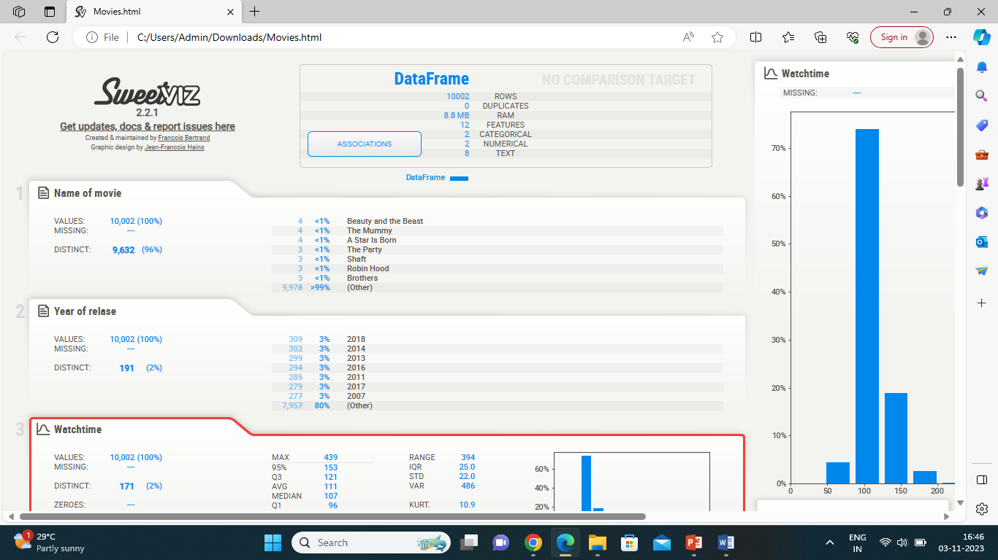
AUTO-EDA

Slide 13
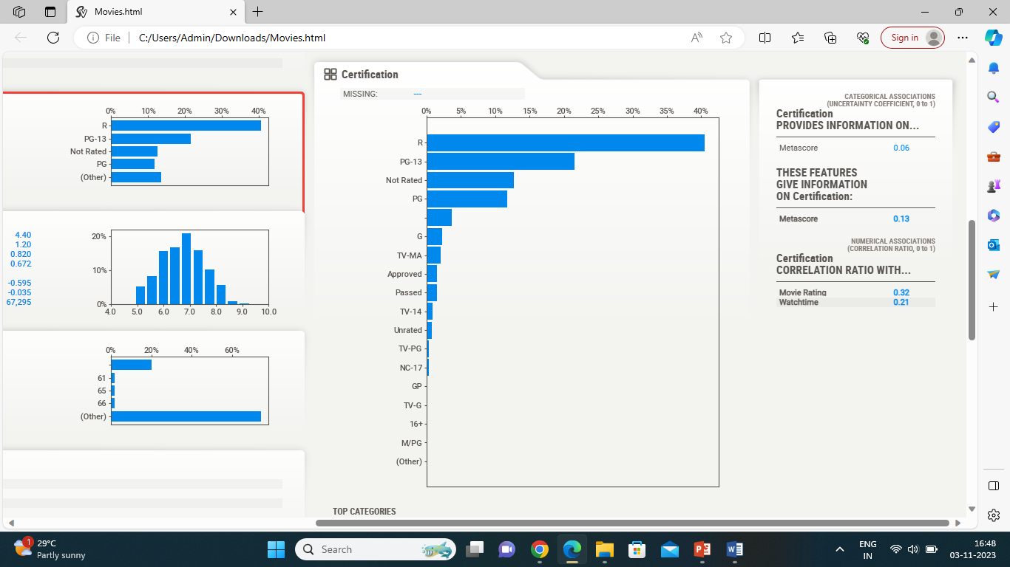

Slide 14
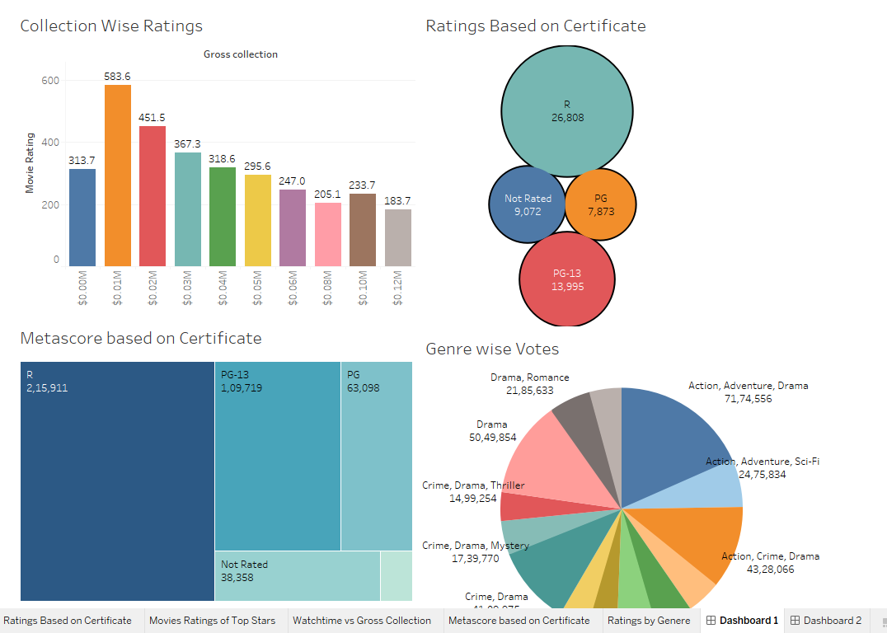
Dashboards:

Slide 15
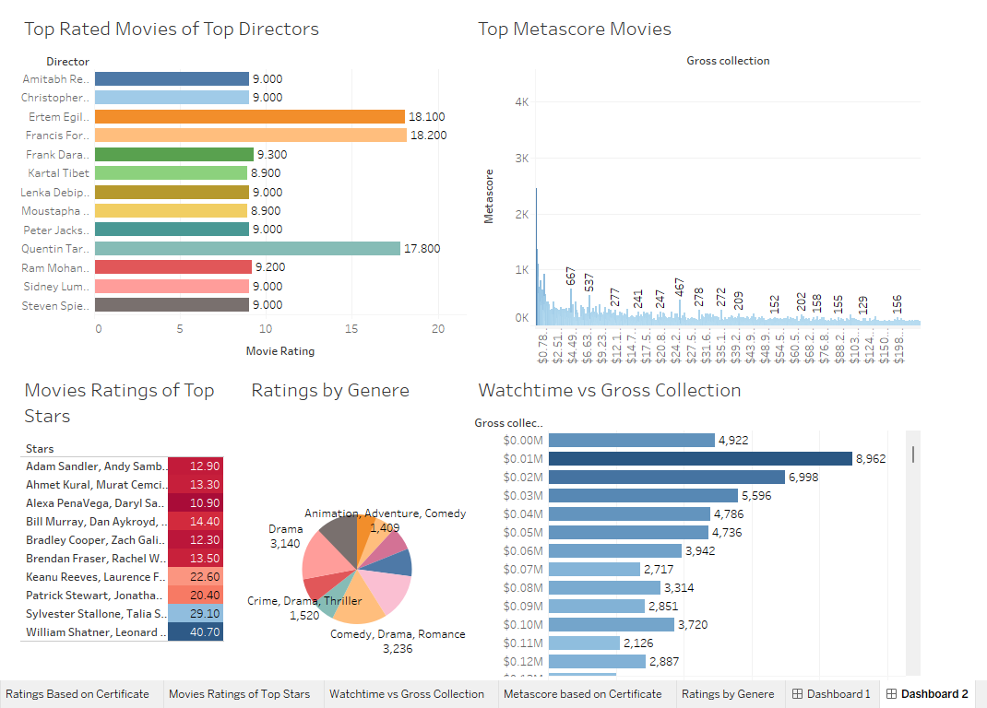

Slide 16
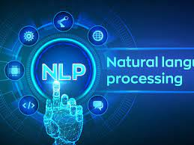
Data PRE-PROCESSING
For the Pre-Processing we had used purely NLP.
We had loaded a model for creating embeddings by using Universal Sentence Encoder.
The Universal Sentence Encoder encodes text into vectors that can be used for text classification, semantic similarity, clustering and other natural language tasks.
Universal Sentence Encoder is readily available and trained on tons of data so as to perform NLP tasks.
We used link of universal sentence encoder and hub from tensorflow for creating embeddings.

Slide 17
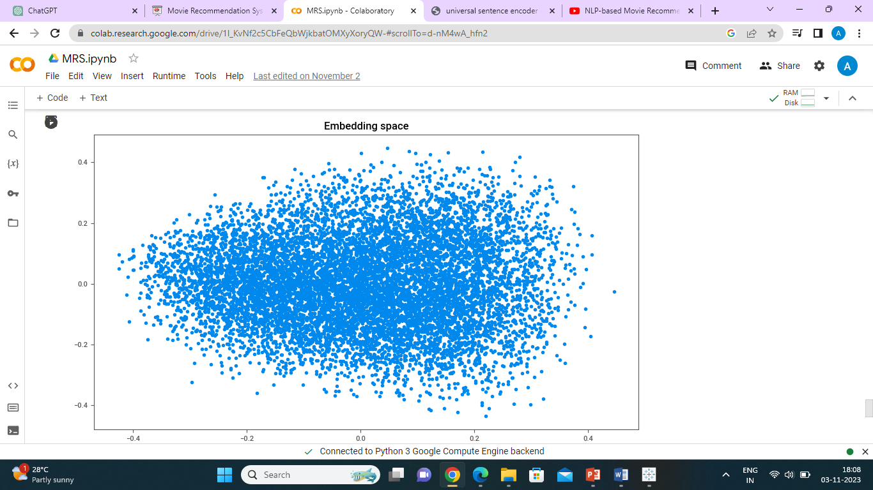
EMBEDDING SPACE
Universal Sentence Encoder generates embeddings.
To visualize embedding space we used PCA.
Embeddings are the vector form of representing the description.
Embeddings considers the sentiment of the sentence.
So the descriptions which are similar to each other will be considered for recommendation which leads to a content based Movie Recommendation system.

Slide 18
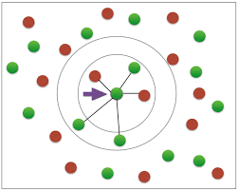
Model Building
In Some Projects EDA plays a key role to meet business requirement.
But here Model Building played a key role in meeting business requirements.
We used Nearest Neighbors Algorithm so recommending movies.
Already embeddings and embedding space is created, considering the sentiment similarity is also established.
So we didn’t use cosine similarity and Nearest neighbors was used to find similar context by fitting NN on embeddings which in turn gave recommendation for movies.
We also gave no of recommendations to be given by giving a value to n_neighbors.

Slide 19
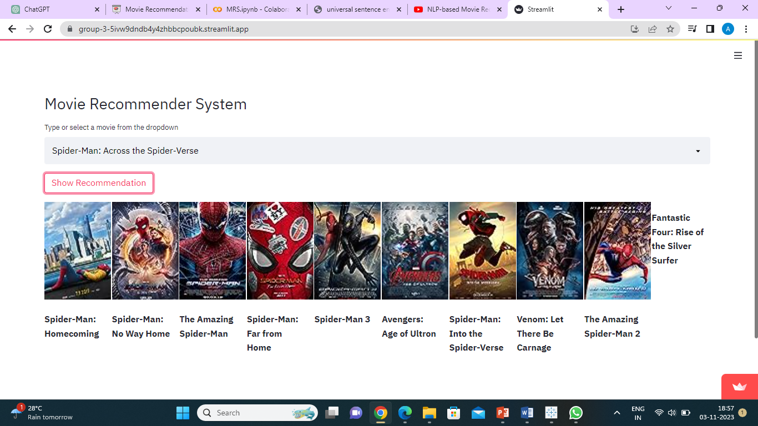
Model Deployment:
We deployed the model using streamlit.
Deployment is the ultimate goal of the Project.
We met the business requirements of the project and created a global api.
For user personalization we also included the posters of the movie.

Slide 20

Conclusion:
There are many recommendation system which we come across our daily life.
Recommending Books, Music, Movies can be seen in many applications.
Here we built a Recommendation system for Recommending Movies.
There are many deployed API’s, apps for recommending movies we made our project in a different way, using different approach, using different algorithms, softwares and many libraries so as to built recommendation system according to the user personalisation.

Slide 21

Thank you

