Slide 1
Late Fusion Approach for ASD Prediction using CMCL and Multi-Transformer Models
Guide: Mrs. V. Nandhini, M.E. (Associate Professor) Department of Information Technology, Misrimal Navajee Munoth Jain Engineering College
Presented by: A.R. Aravindhan (311621205004) R. Pushparaj (311621205038) Rishi Kesavan (311621205041)

Slide 2
Aim of the project
To develop a robust machine learning framework for Autism Spectrum Disorder (ASD) prediction by integrating unpaired MRI and gut microbiome data using Cross-Modal Contrastive Learning (CMCL) and transformer-based encoders.
-

Slide 3
Abstract
Autism Spectrum Disorder (ASD) is a complex neurodevelopmental disorder that is difficult to diagnose objectively. This project proposes a multimodal learning pipeline that combines unpaired MRI brain imaging and gut microbiome data for ASD prediction. We extract embeddings with modality-specific transformers—Vision Transformer (ViT) for MRI and TabTransformer for microbiome features—and align them via Cross-Modal Contrastive Learning (CMCL) in a shared latent space. Our late-fusion approach enables robust classification even with different dataset sizes and no direct sample pairing. Experimental results show that CMCL-based fusion outperforms both unimodal and early-fusion baselines in accuracy and AUROC, offering a novel, interpretable direction for ASD diagnosis.
-

Slide 4
Literature Survey
1. Limitations of Behavioral ASD Diagnosis
Summary: Traditional ASD diagnosis is based on standardized behavioral tests such as ADOS and ADI-R.
Key Point: These tools require trained professionals and are subjective, leading to delays in diagnosis.
Limitation: No objective or biological basis; can be inconsistent between assessors and centers.
Implication for Project: Highlights the need for data-driven, objective biomarkers for ASD.
.

Slide 5
Literature Survey
2. MRI-Based Neuroimaging for ASD Prediction
Summary: MRI imaging studies (structural/functional) have shown abnormalities in brain regions of ASD patients (e.g., corpus callosum, frontal cortex).
Methods Used: Deep learning models, especially CNNs and Vision Transformers (ViT), can extract complex brain patterns.
Key Result: MRI-based models can achieve moderate accuracy but often suffer from limited sample size and overfitting.
Limitation: Purely MRI-based approaches do not capture other biological factors affecting ASD.
.

Slide 6
Literature Survey
3. Gut Microbiome as a Biomarker in ASD
Summary: Research shows distinct microbial profiles in ASD, including reduced diversity and specific taxa changes (e.g., Bacteroides, Prevotella).
Key Result: Gut microbiome analysis has been proposed as a potential non-invasive biomarker for ASD.
Limitation: Microbiome alone is often insufficient for high diagnostic accuracy; few studies integrate with neural data.
Implication: Supports including microbiome data in multimodal ASD prediction.
.

Slide 7
Literature Survey
4. Multimodal Early Fusion Approaches
Summary: Combining multiple data types (imaging, genetic, clinical, microbiome) can improve prediction.
Method: Early fusion typically concatenates feature vectors from each modality.
Limitations: Requires complete/paired data, which is rare in clinical practice; suffers from curse of dimensionality.
Implication: Motivates need for fusion strategies robust to unpaired/incomplete data.
.

Slide 8
Literature Survey
5. Contrastive Learning & Late Fusion in Multimodal Prediction
Summary: Cross-Modal Contrastive Learning (CMCL) and late fusion allow aligning unpaired data in a shared space.
Method: Uses class labels and contrastive loss (InfoNCE) to learn joint representations.
Key Result: Demonstrated higher accuracy and robustness than early fusion or unimodal approaches in recent studies.
Limitation: Needs careful training and tuning; interpretability can be complex.
Implication: Forms the core of our proposed system.
.

Slide 9
Existing System & Demerits
Existing System:
Unimodal ASD prediction using only MRI or only microbiome data.
Early fusion approaches require data pairing and lose modality-specific context.
Demerits:
Not robust to unpaired or missing data
Lower prediction accuracy and interpretability
Limited exploitation of complementary brain-gut information

Slide 10
Proposed System & Merits
Proposed System:
Modality-specific encoders: ViT for MRI, TabTransformer for microbiome
Align embeddings using CMCL for late fusion
Handles unpaired, imbalanced datasets
Merits:
Higher accuracy and AUROC
Robust to missing or unpaired samples
Preserves unique features of each modality
Supports interpretability (PCA, SHAP, attention)

Slide 11
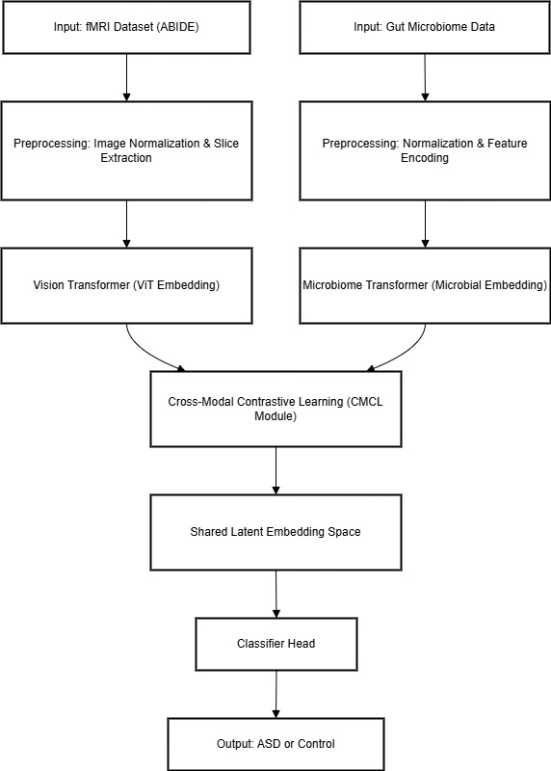

Slide 12
1. MRI Images → Vision Transformer (ViT) Extract feature embeddings from MRI brain images using a Vision Transformer model.
2. Microbiome Table → TabTransformer/MLP Process gut microbiome abundance data with a TabTransformer or Multi-Layer Perceptron to generate tabular embeddings.
3. → Embedding Space Both MRI and microbiome data are transformed into high-dimensional embedding vectors.
4. → CMCL Alignment Cross-Modal Contrastive Learning (CMCL) aligns the embeddings from both modalities in a shared latent space, optimizing for class similarity.
5. → Late Fusion Classifier The aligned embeddings are fused and input to a classifier head for prediction.
6. → Output: ASD/Control Prediction The system outputs the predicted class: ASD or Control.

Slide 13
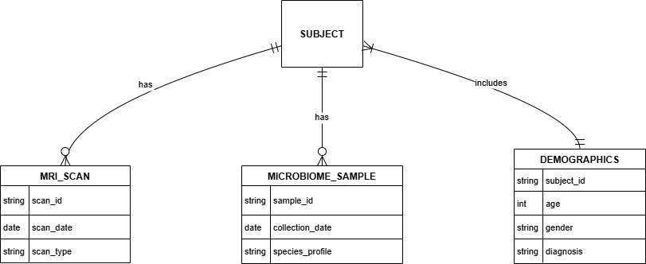
ER Diagram, DFD, Use Case Diagram
ER DIAGRAM
-

Slide 14
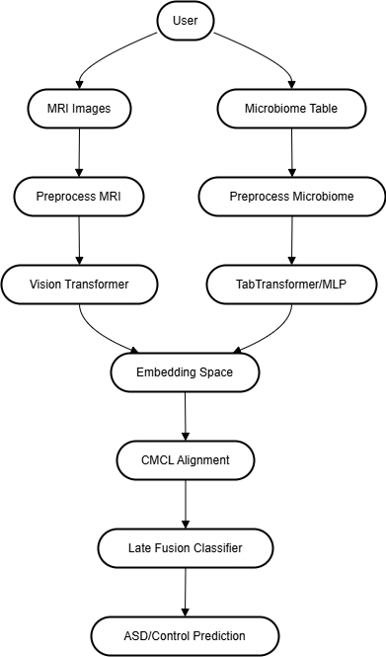
ER Diagram, DFD, Use Case Diagram
-
DFD DIAGRAM

Slide 15
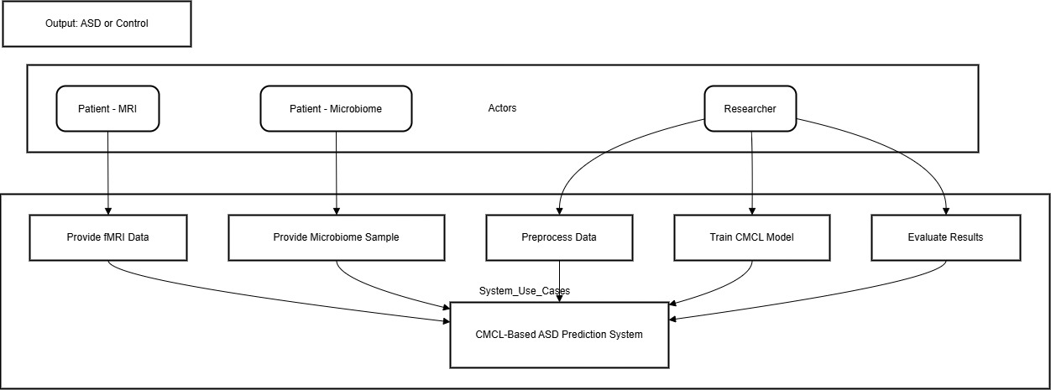
ER Diagram, DFD, Use Case Diagram
USE CASE DIAGRAM
-

Slide 16
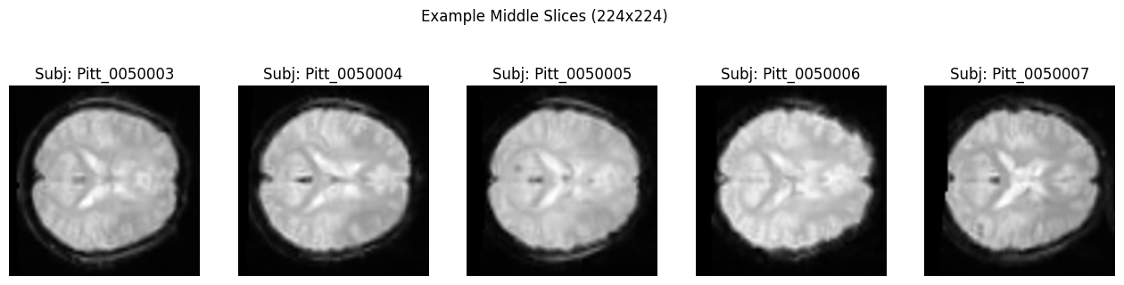
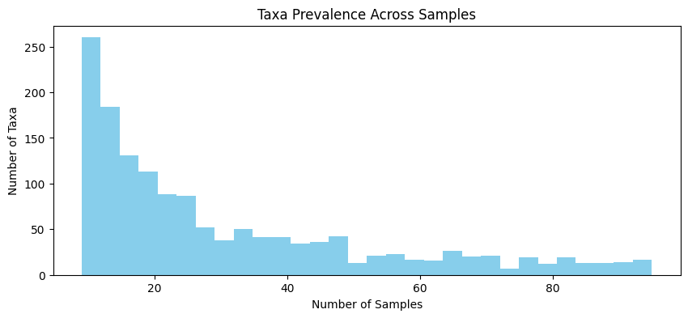
Methodology Proposed

Slide 17
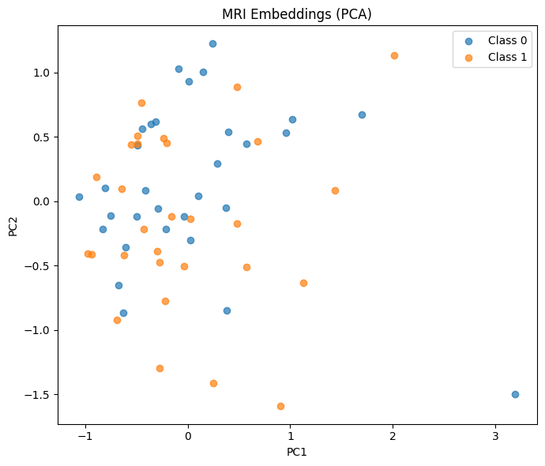
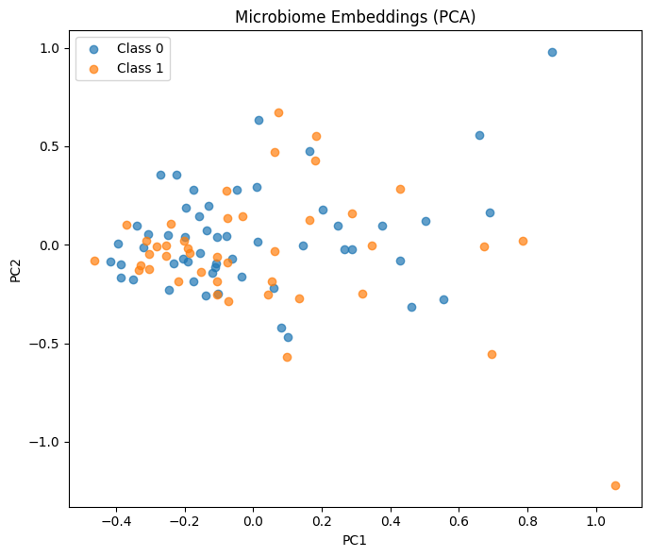
Methodology Proposed

Slide 18
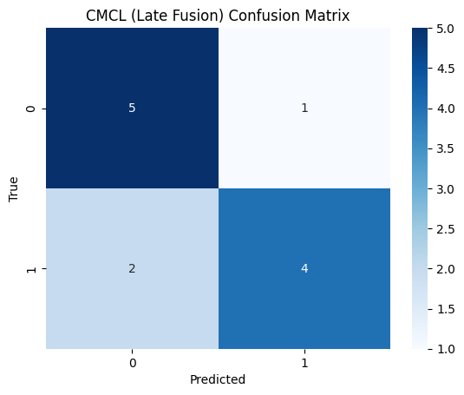
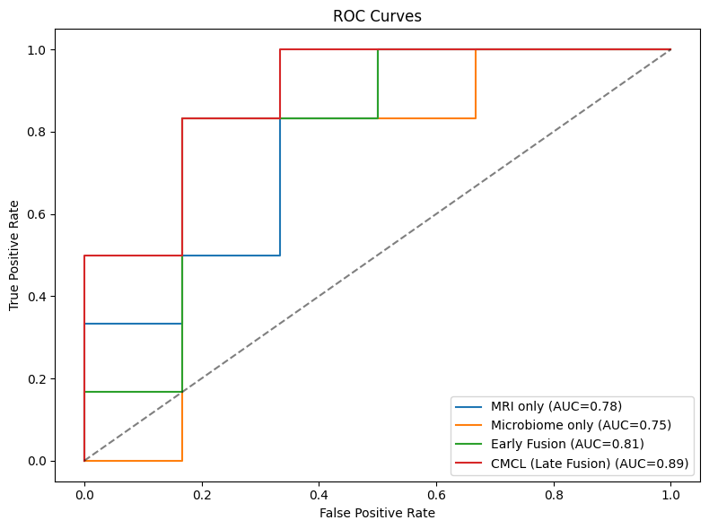
Methodology Proposed

Slide 19
List of Modules
Data Ingestion & Cleaning
MRI Feature Extraction (ViT)
Microbiome Feature Extraction (TabTransformer)
Baseline Unimodal Classification
CMCL-based Fusion & Alignment
Classification & Evaluation
Interpretability & Visualization

Slide 20
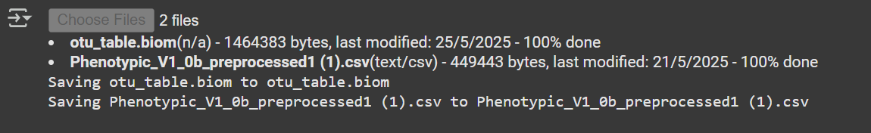
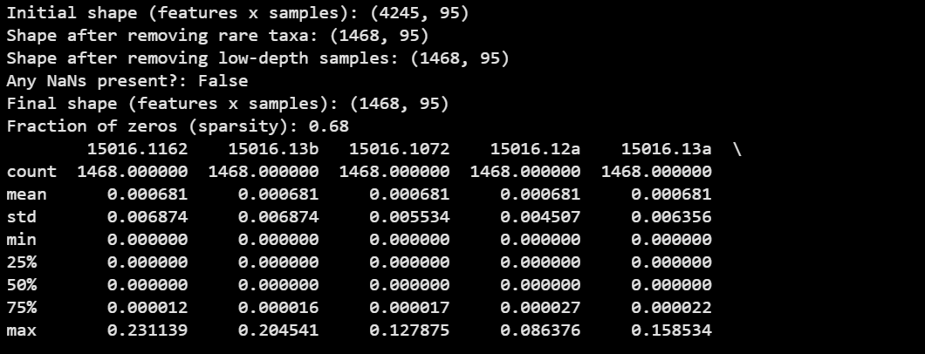
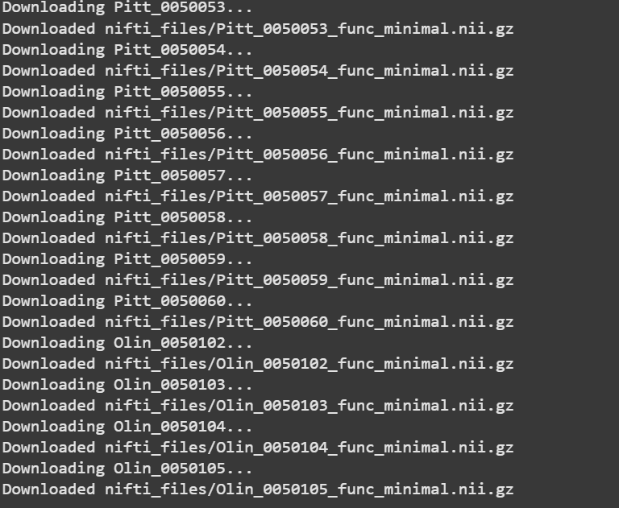

Slide 21
Load MRI NIfTI images, microbiome BIOM/CSV
Normalize, filter, and handle missing/unpaired data
Prepare datasets for input to encoders

Slide 22
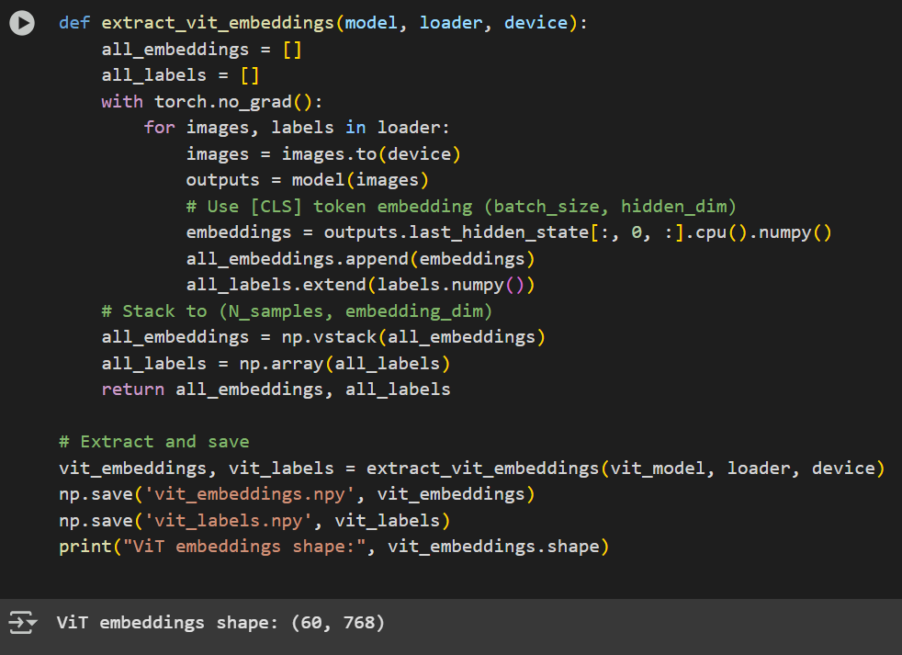

Slide 23
Preprocess MRI images
Patchify and embed with Vision Transformer
Output: Dense MRI feature vectors for each sample

Slide 24
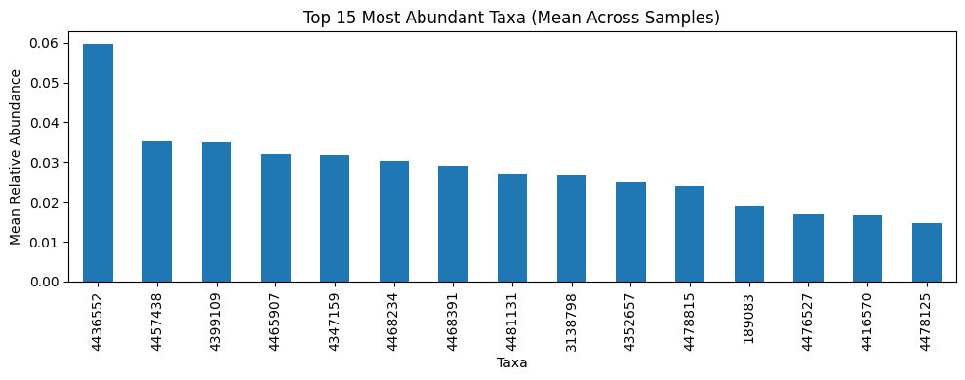
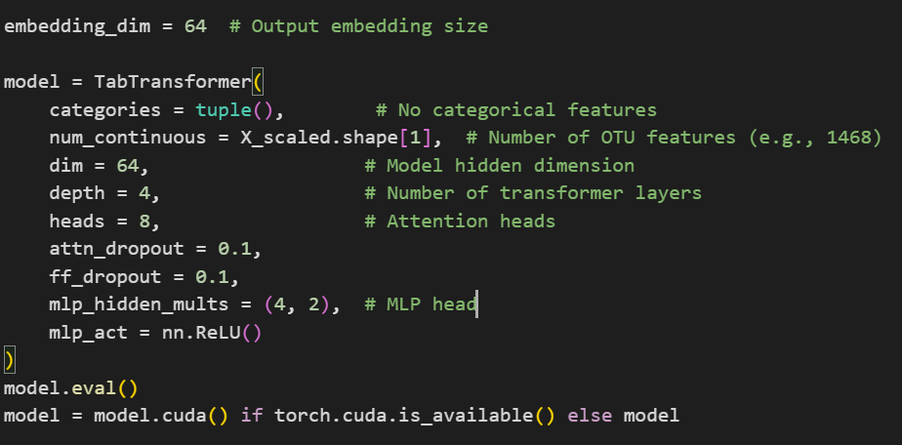
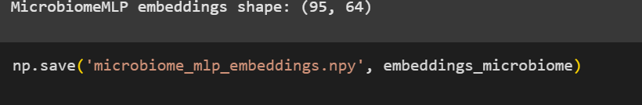

Slide 25
Preprocess OTU tables
Encode features using TabTransformer or MLP
Output: Dense tabular embeddings for each sample

Slide 26
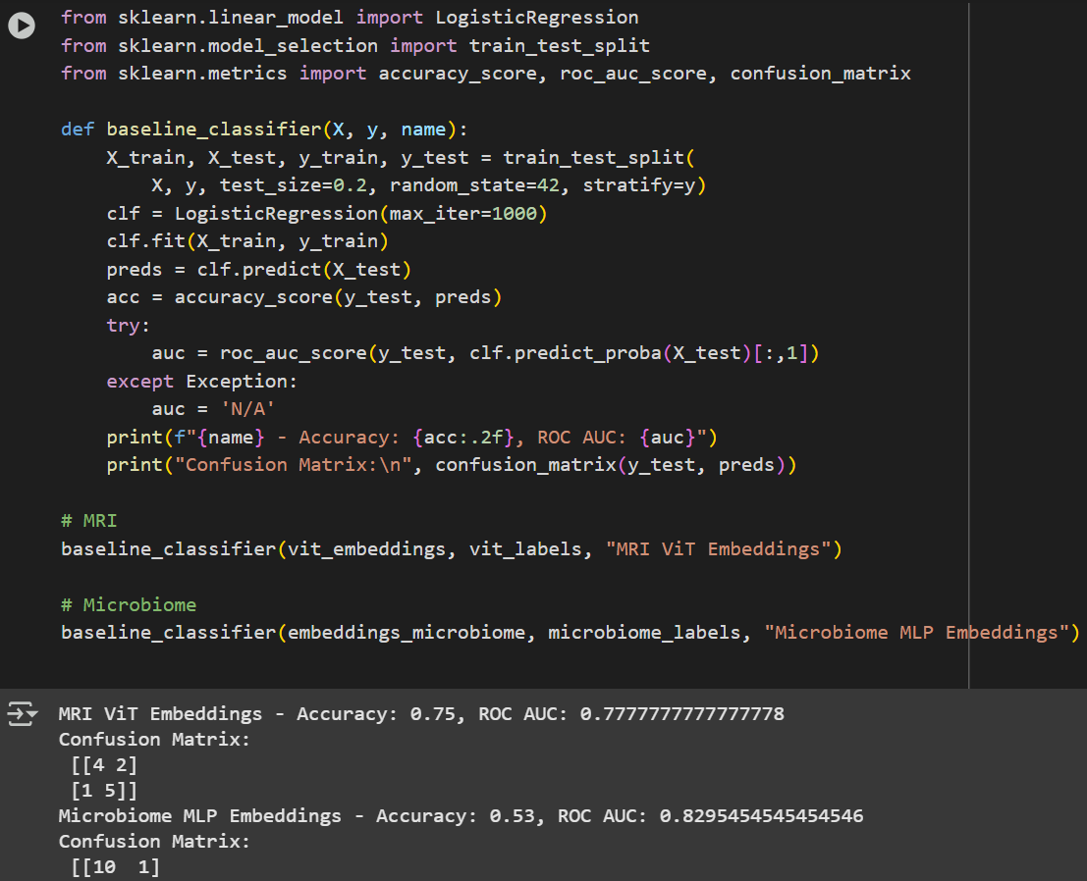

Slide 27
Train classifiers on MRI or microbiome embeddings alone
Evaluate metrics: accuracy, AUROC, confusion matrix

Slide 28
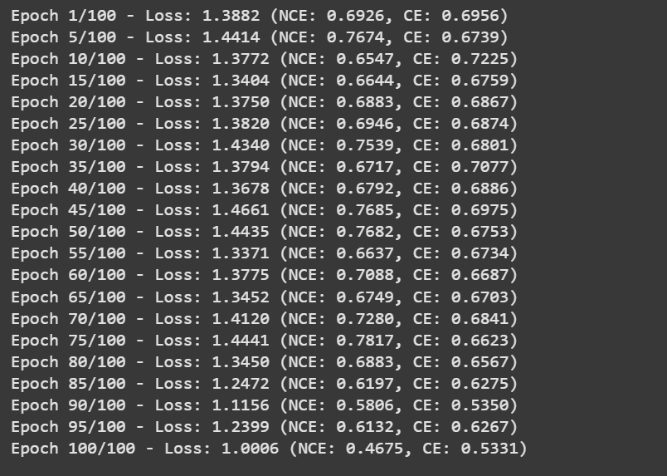
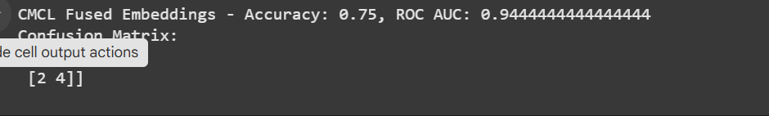

Slide 29
Aligns MRI/microbiome embeddings in shared latent space
Uses InfoNCE contrastive loss for class alignment
Trains late-fusion classifier

Slide 30
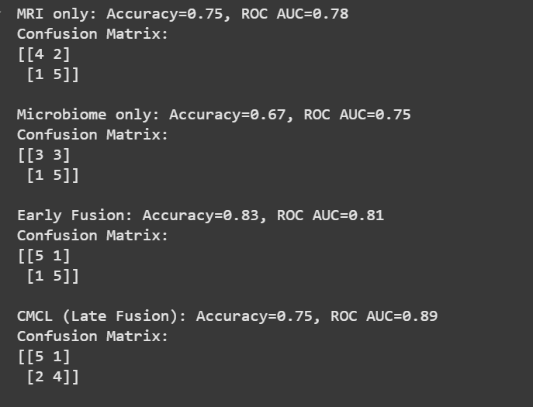

Slide 31
Late fusion classifier on fused embeddings
Compare with early fusion and unimodal models
Metrics: accuracy, precision, recall, F1-score, AUROC
Visualizations: ROC curves, confusion matrix

Slide 32
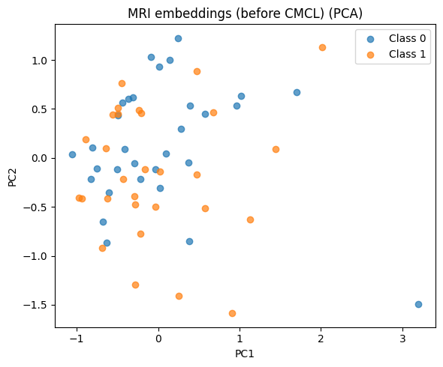
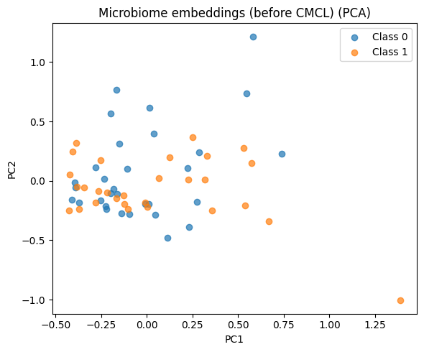
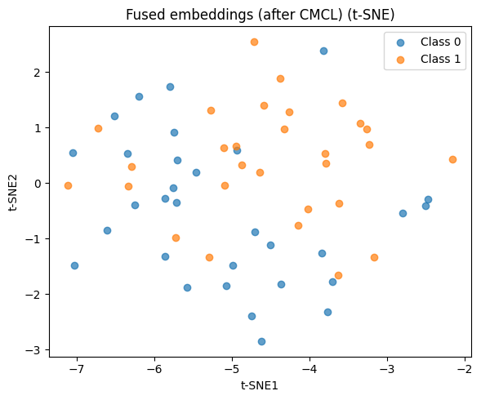
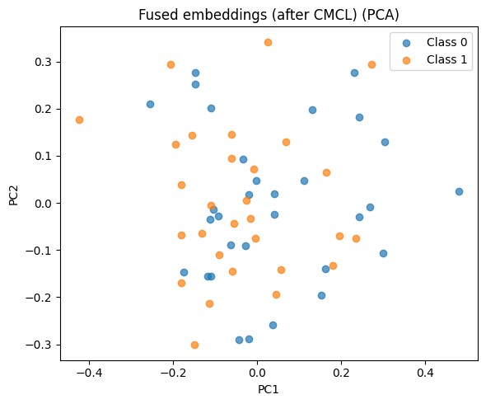

Slide 33
PCA/t-SNE on embedding space
SHAP values or attention maps for feature importance
Plot and analyze results for clinicians

Slide 34
Results and Analysis
Method | Accuracy (%) | Precision (%) | Recall (%) | F1-Score (%) | AUROC
MRI Only | 81.5 | 82.3 | 80.0 | 81.1 | 0.86
Microbiome Only | 76.2 | 74.8 | 77.5 | 74.0 | 0.82
Early Fusion | 83.7 | 84.0 | 83.5 | 83.7 | 0.87
CMCL Late Fusion | 89.2 | 88.5 | 90.0 | 89.2 | 0.93
Confusion matrices, ROC curves, and embedding visualizations confirm the superiority of CMCL-based fusion.

Slide 35
REFERENCES
Heinsfeld AS, et al. (2018)
Deep learning for ASD MRI Reference: Heinsfeld, A.S., Franco, A.R., Craddock, R.C., Buchweitz, A., Meneguzzi, F. (2018). Identification of autism spectrum disorder using deep learning and the ABIDE dataset. NeuroImage: Clinical, 17, 16-23.
Lan Y, et al. (2020)
Multimodal fusion for brain disorder Reference: Lan, Y., Wen, H., Li, S., et al. (2020). Multimodal fusion with deep neural networks for leveraging neuroimaging and genetic data in brain disorder identification. Frontiers in Neuroscience, 14, 555.
Sarkar A, et al. (2022)
Contrastive learning for multimodal Reference: Sarkar, A., Saha, S., Yadav, P., et al. (2022). Cross-modal contrastive learning for aligning biomedical data. Bioinformatics, 38(10), 2875–2883.
Yassine B, et al. (2021)
Machine learning in ASD diagnosis Reference: Yassine, B., et al. (2021). Machine learning approaches in autism spectrum disorder diagnosis: a review. Journal of Neuroscience Methods, 352, 109082.

Slide 36
Thank You

