Slide 1
Driver Anti Sleep Device
TEAM : 02
PRESENTED By:
ARAVINDHAN A (22AI002)
HARISH S S (22AI017)
VELUSAMY G (22AI056)
Guided By :
Mrs: LALITHA K

Slide 2
Abstract
The Drowsiness Detection System with Buzzer Alert and SMS Alert via GSM is an innovative and potentially life-saving project designed to enhance road safety by addressing the issue of driver drowsiness.
This project integrates advanced technologies to detect signs of driver fatigue and alert the driver through both auditory and mobile communication methods.

Slide 3
Objectives:
Develop a real-time drowsiness detection system using image processing and machine learning algorithms. Analyze captured images to monitor drowsiness levels in individuals, particularly drivers. Trigger alerts when signs of drowsiness are detected to prevent accidents. Integrate GSM technology to send SMS notifications to alert the individual or concerned parties. Provide an innovative and cost-effective solution to enhance safety, especially in critical situations like driving. Ensure the system is adaptable for various safety contexts beyond driving.

Slide 4
Components Required:
HARDWARE DWARE COMPONENTS
1.RASPBERRY Pi 2.ARDUINO 3.CAMERA 4.BUZZER 5.GSM MODULE 6.POWER SUPPLY 7.JUMPER WIRES
SOFTWARE COMPONENTS
1.ARDUINO IDE 2.EMBEDDED C 3.RASPBERRY PI OPERATING SYSTEM 4.ANYDESK 5.PHONE FOR RECEIVED SMS ALERTS
Notes:
Transparent glasses

Slide 5
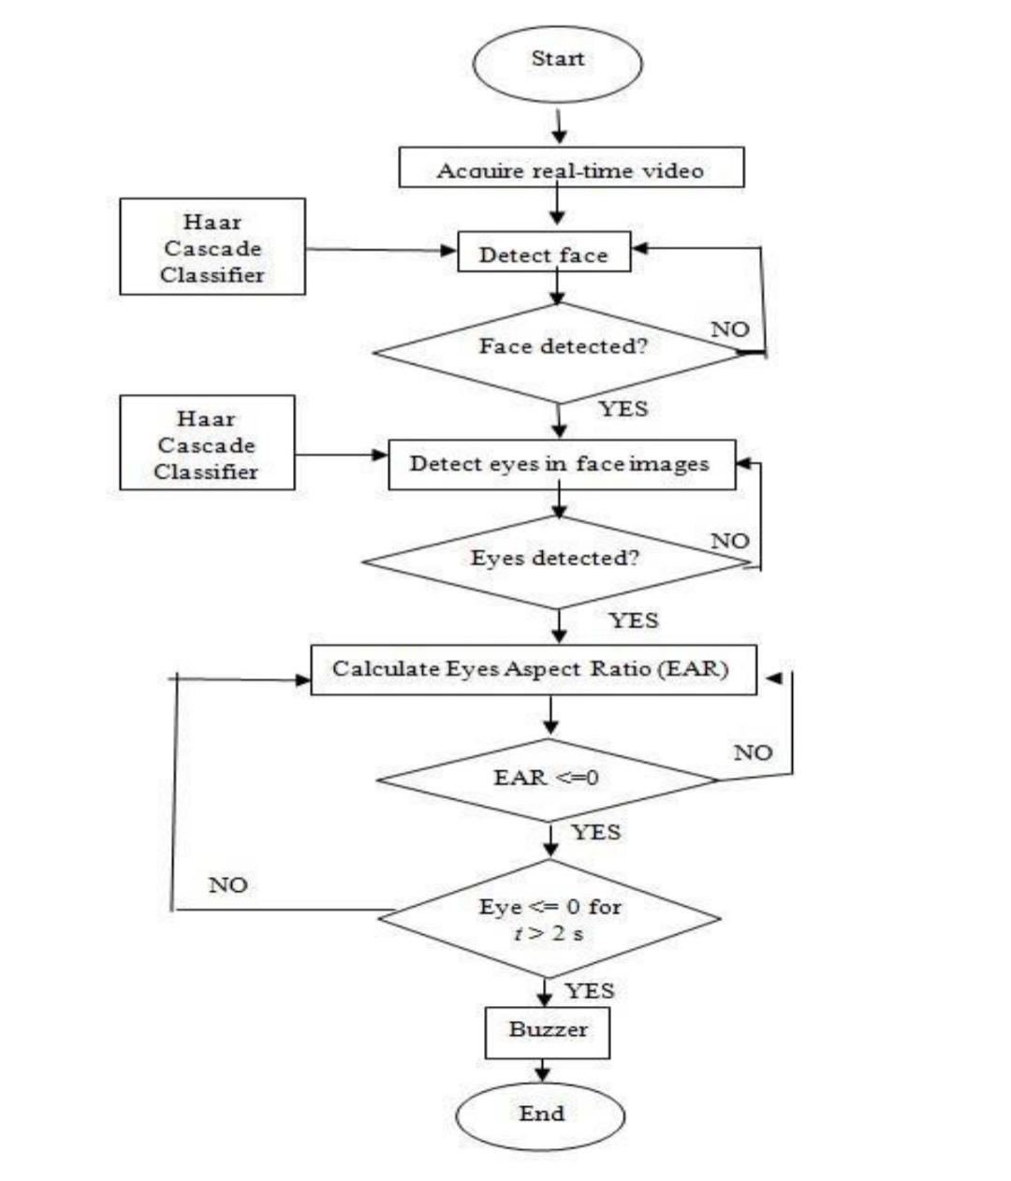
Flow Diagram:
VIBRATOR ON

Slide 6
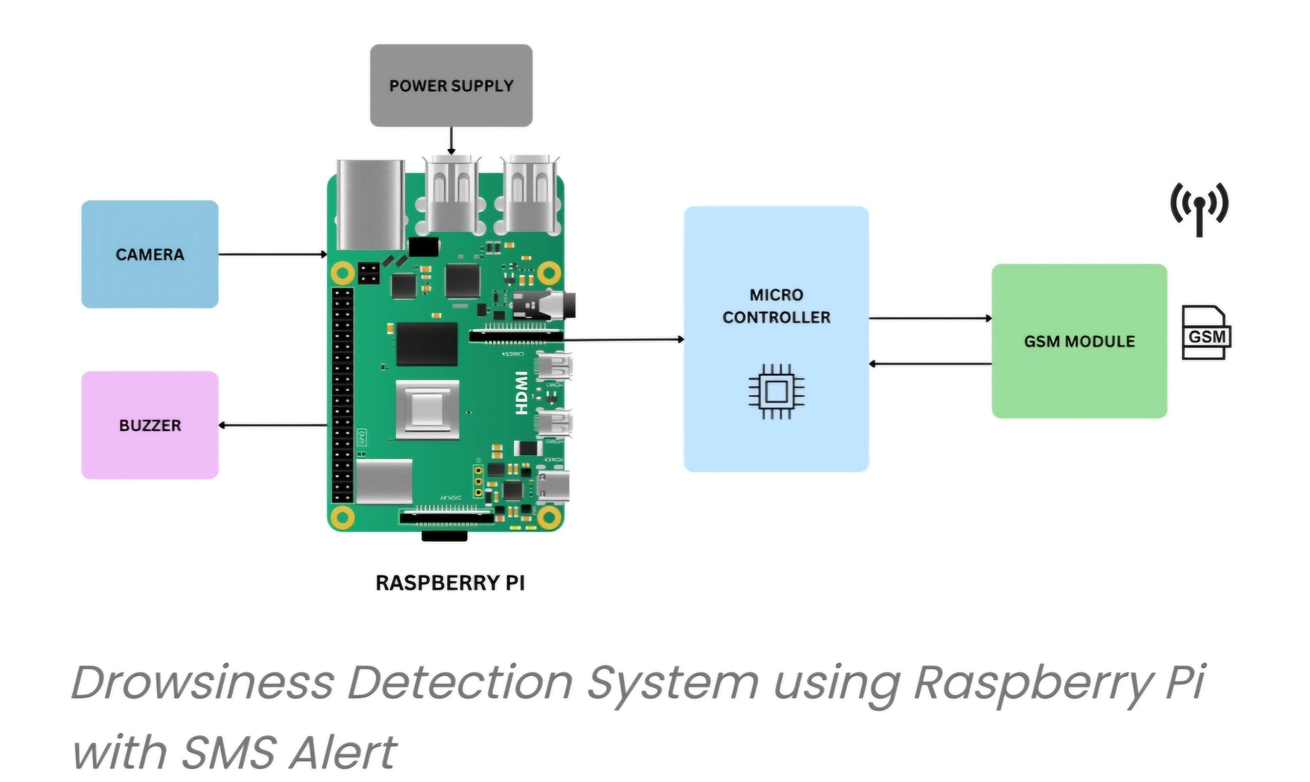
Circuit Diagram:

Slide 7
Implementation: (Hardware or software)
1. Hardware Requirements: ●Camera (Webcam or built-in camera) to capture real-time images of the user. ●GSM module for sending SMS notifications. ●Microcontroller (if using GSM module with hardware integration) or a software-based GSM gateway API for SMS alerts. 2. Software Requirements: ●Programming Languages: Python (for image processing and machine learning) ●Libraries: 1.OpenCV (for image processing) 2.Dlib (for facial landmark detection) 3.TensorFlow/Keras or scikit-learn (for machine learning model training) 4.Twilio API or PySerial (for SMS through GSM module) ●Machine learning algorithms like SVM or deep learning models such as CNN can be used to classify drowsiness.

Slide 8
THANK YOU

