Slide 1
Employee Attrition Analysis
Analysing workforce attrition, performance, engagement and wellbeing using Power BI

Slide 2
Project Overview
This project was designed to demonstrate analytical reporting, Power BI dashboard development, and stakeholder-focused insight generation, all directly aligned with the competencies required for the HMRC Evaluation Technician Support role.
Analytical Reporting
Transforming raw data into structured, meaningful reports
Power BI Development
Building interactive, insight-rich dashboards
Stakeholder Focus
Delivering clear, actionable insights for decision-makers

Slide 3
Business Objective
The core aim was to transform raw HR data into clear, actionable business insights, enabling informed workforce decision-making across four critical areas.
The dashboard was designed to support data-driven HR decision-making by transforming workforce data into clear analytical insights.
Identify turnover patterns and at-risk employee groups
Measure satisfaction, wellbeing, and work-life balance
Analyse ratings, training impact, and role-level output
Monitor burnout risk and environment satisfaction
Attrition
Engagement
Performance
Wellbeing

Slide 4






Tools & Skills Used
A comprehensive toolkit was applied to deliver end-to-end analytical reporting, from data extraction and transformation through to insight generation and stakeholder-ready presentation.
Power BI
Interactive dashboard development and visualisation
Power Query
Data extraction, cleaning, and transformation
DAX Measures
Custom calculations and advanced analytical logic
Data Modelling
Relational schema design and data integrity
Dashboard Design
UX-focused, stakeholder-ready report layouts
Data Storytelling
Translating metrics into clear business narratives

Slide 5
Technical Approach
Data cleaned and transformed using Power Query
Date formatting corrected using locale conversion (UK format)
Relationships created between employee and performance tables
Date table developed for trend and time-intelligence reporting
DAX measures created for attrition rate, burnout risk, satisfaction scores and performance KPIs
Interactive slicers and drill-down visuals implemented for stakeholder usability

Slide 6
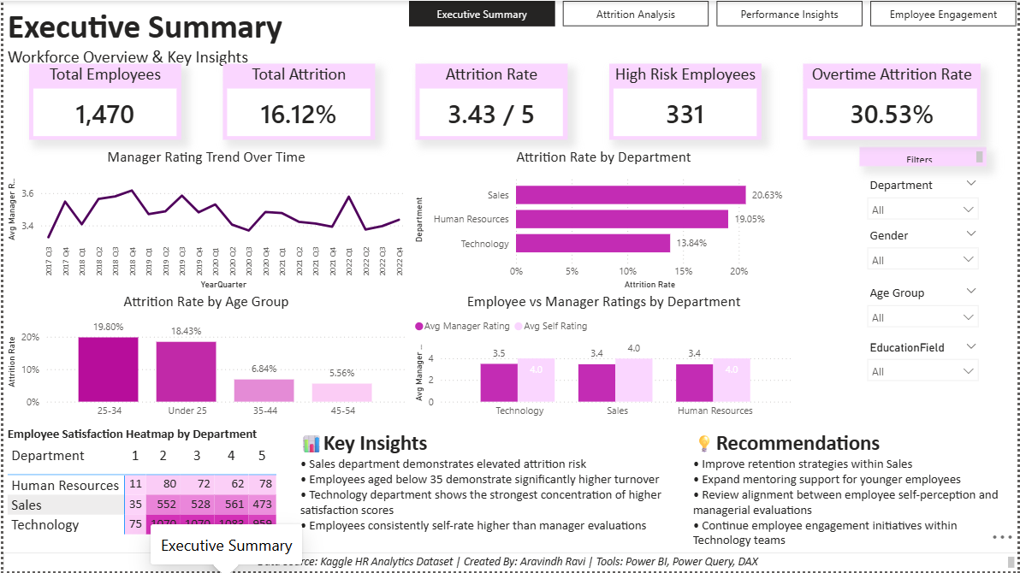
Executive Summary Dashboard
The Executive Summary Dashboard provides a high-level workforce overview at a glance, surfacing the most critical HR metrics for senior stakeholders without requiring deep technical navigation.
Attrition Overview
Organisation-wide turnover rates and trends
Manager Ratings
Aggregate performance scoring by department
Employee Satisfaction
Key wellbeing and engagement indicators

Slide 7
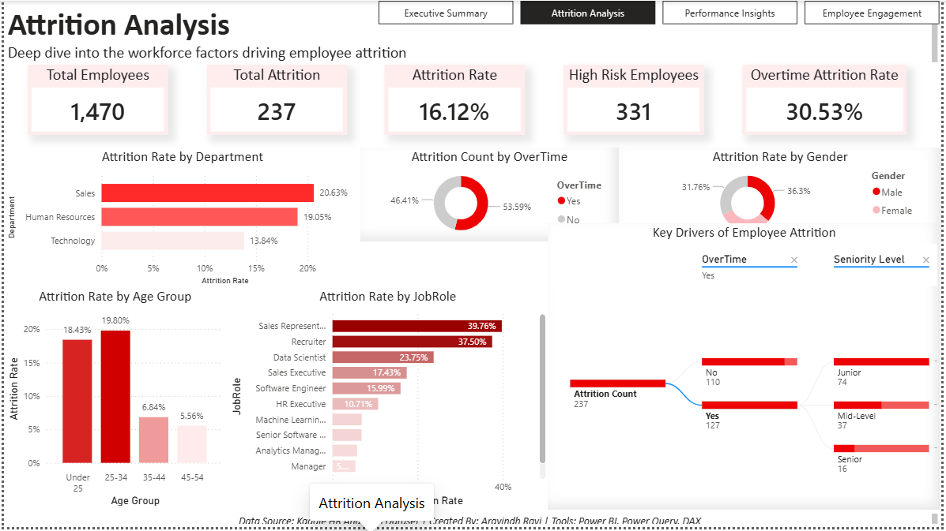
Attrition Analysis Dashboard
This dashboard focuses on identifying turnover patterns and isolating the employee segments most at risk of leaving, enabling proactive retention strategies.
Overtime Risk
Correlation between overtime hours and attrition likelihood
High-Risk Employees
Profiles flagged for elevated turnover probability
Age-Group Attrition
Turnover rates segmented by employee age bands
Root Cause Analysis
Primary factors influencing employee departure decisions

Slide 8
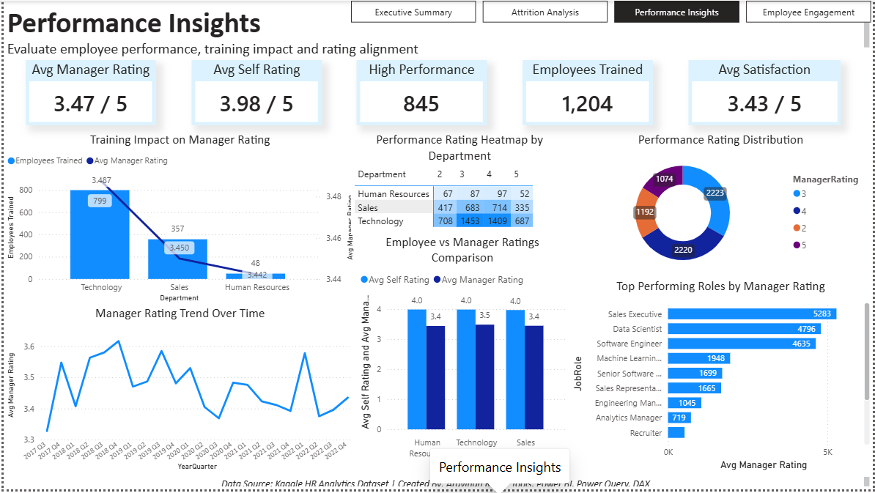
Performance Insights Dashboard
The Performance Insights Dashboard analyses employee output, training effectiveness, and rating discrepancies, providing a multi-dimensional view of workforce capability.
Employee Performance
Role-level and departmental performance distribution
Training Impact
Measuring the effect of training on performance scores
Manager vs Self-Ratings
Identifying perception gaps between employees and managers
Top-Performing Roles
Job functions with the strongest aggregate performance

Slide 9
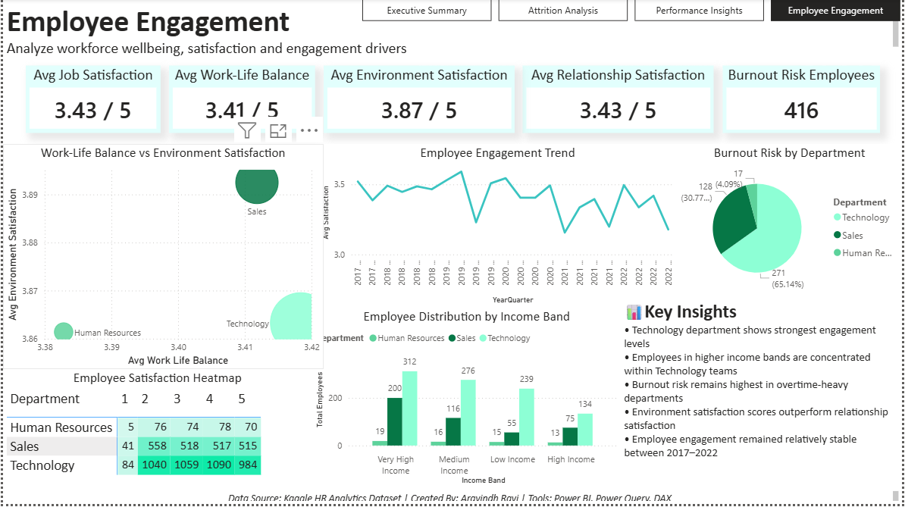
Employee Engagement Dashboard
This dashboard focuses on the human side of workforce analytics - measuring wellbeing, burnout risk, and the environmental factors that drive or diminish engagement.
Burnout Risk
Employees flagged for elevated stress and fatigue levels
Work-Life Balance
Satisfaction scores across working hours and flexibility
Environment Satisfaction
Workplace conditions and cultural sentiment analysis

Slide 10
Key Business Insights
Analysis across all four dashboards revealed consistent, actionable patterns, each directly informing workforce strategy and retention priorities.
The Sales function recorded the highest turnover, signalling a need for targeted retention interventions.
Younger age bands demonstrated higher attrition rates, pointing to career development and onboarding gaps.
Technology employees showed higher engagement scores, reflecting positive team culture and role satisfaction.
Employees consistently rated themselves higher than managers, highlighting a potential calibration gap.
Burnout risk was strongly correlated with overtime hours, identifying a clear wellbeing intervention target.
Requires targeted retention strategies
Younger Employees - Elevated Turnover Risk
Technology Teams - Stronger Engagement
Self-Ratings Exceed Manager Ratings
Burnout Concentrated in Overtime Groups

Slide 11
Conclusion
This project demonstrates the ability to combine analytical thinking, Power BI reporting, and stakeholder-focused storytelling to support evidence-based workforce decision-making.

