Slide 1
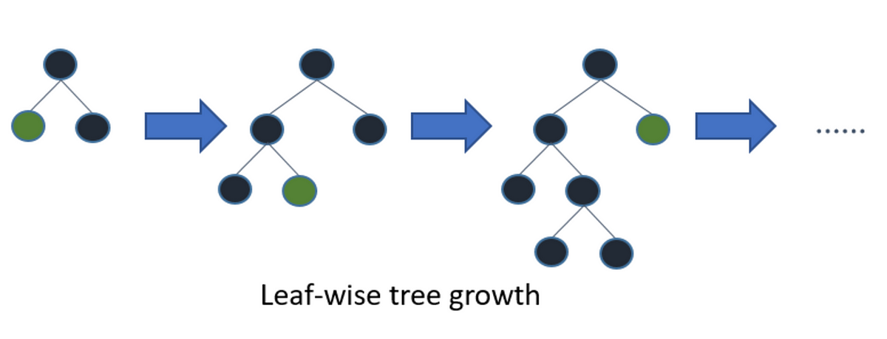
LGboosting

Slide 2
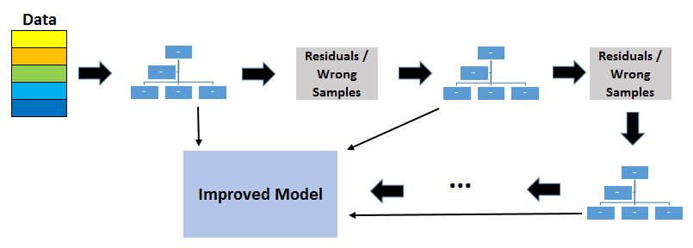
LGboosting

Slide 3
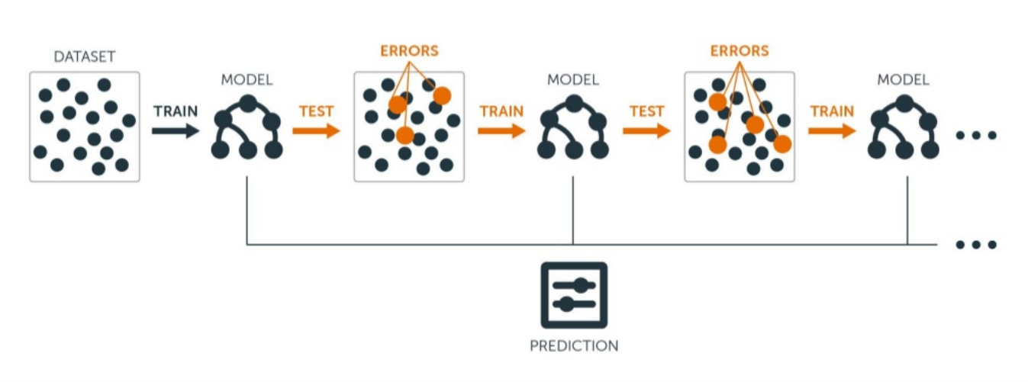
LGboosting

Slide 4

LGboosting

Slide 5
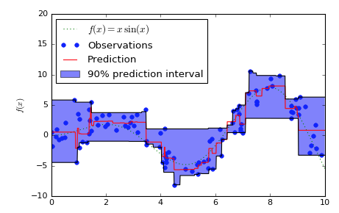
LGboosting

