Slide 1

Tabu Search Applications
Outlines:
Application of Tabu Search
Our Project with Tabu Search: EACIIT analytics

Slide 2
The Classical Vehicle Routing Problem
Vehicle Routing Problem is important for distribution management.
Classical Vehicle Routing Problem is a basic variant of this class of problem.
Formally defined as follow:
Given graph G = (V,E): V = set of vertices and E = set of edges
One vertex will serve as depot with a fleet of m vehicles of capacity Q and all other will be customers needed to be serviced.
Each customer v_{i} need q_{i} at time t_{i}. Each edge (vi, vj) in E is associated with cost c_{ij} and travel time t_{ij}.

Slide 3
The Classical Vehicle Routing Problem
We want to find a solution such that:
Each route begins and ends at the depot;
Each customer is visited exactly once by exactly one route;
The total demand of the customers assigned to each route does not exceed Q;
The total duration of each route (including travel and service times) does not exceed a specified value L;
The total cost of the routes is minimized.

Slide 4
The Classical Vehicle Routing Problem
Using Tabu Search:
There are many ways to define a search space. One of them is a set of feasible solutions where each element is a set of vehicle routes satisfying all the constraints.
Similarly, there are also various method of choosing a neighborhood structures. An example of a complex neighborhood structure is the λ-interchange of Osman (1993), are obtained by allowing simultaneously the movement of customers to different routes and the swapping of customers between routes.
And tabus can be defined as followed: if customer v₁ has just been moved from route R₁ to route R₂, one could declare tabu moving back v₁ from R₂ to R₁ for some number of iterations (this number is called the tabu tenure of the move).

Slide 5
Other Notable Application of Tabu Search
Scheduling in Manufacturing System:
Job Shop Problem, Flow Shop Problem, Flow Shop with Parallel Machines
Nowicki and Smutnicki (1993, 1994, 1995) have developed effective tabu search methods that optimize the makespan criterion.
They employ a classical insertion neighborhood with a candidate list strategy for removing useless moves, in order to concentrate on "the most promising part" of the neighborhood.
The proposed algorithms employ a short-term memory tabu list which stores attributes of visited solutions, represented by selected pairs of adjacent jobs on a machine.

Slide 6
Other Notable Application of Tabu Search
Telecommunication (Hub Facilities Location):
Communication Networks, Traffic Networks (airlines flow)
Determining optimal locations of hub nodes and allocations of non-hub nodes to those hubs is an NP-hard combinatorial problem.
Skorin-Kapov and Skorin-Kapov (1994) provide an efficient tabu search heuristic for the single allocation p-hub median problem, which models the situation when n nodes can interact only via a set of fully interconnected hubs.

Slide 7
Our project: EACIIT
Data analytics company headquartered in Singapore
Serve a variety of clients across industries
No methodology behind scheduling clients
First-come first-serve
Minimizing 1 | r_{j} | Σw_{j}C_{j}
Neighborhood: swapping adjacent jobs
Tabu size = 5

Slide 8
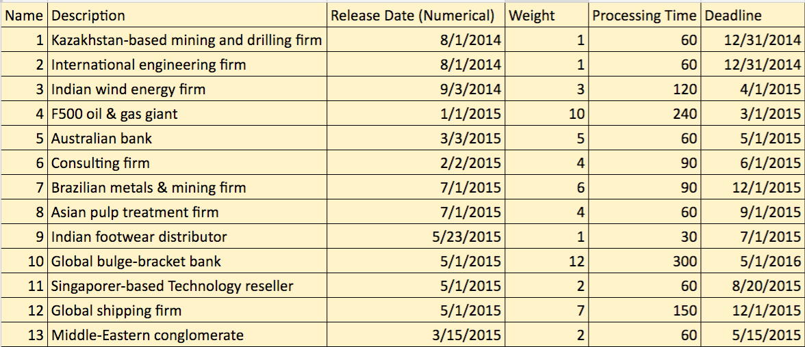
Our data

Slide 9
Tabu search results
List schedule:
[1, 2, 3, 4, 5, 6, 7, 8, 9, 10, 11, 12, 13]
Objective function value: 24170
Company schedule:
[1, 2, 4, 3, 5, 7, 6, 9, 10, 8, 11, 12, 13]
Objective function value: 19991
Tabu search after 10 iterations:
[1, 4, 3, 5, 2, 10, 7, 6, 12, 8, 9, 11, 13]
Objective function value: 14936
Tabu search after 15+ iterations:
[4, 1, 5, 3, 2, 10, 12, 7, 6, 8, 11, 13, 9]
Objective function value: 14252

