Slide 1
Cert Exam Prep: Exam 70-475: Big Data and Analytics Solutions
BRK3259
James Herring
Big Data Architect
Global Black Belt Team

Slide 2
Let’s Start at 40,000 feet
Who:
This certification exam is targeted towards data management professionals, data architects, data scientists, and data developers who design big data analytics solutions on Microsoft Azure. Candidates for this exam will have relevant work experience in big data analytics solutions.
Architects
Consultants
PFEs
TAMS
TSPs
CSAs

Slide 3
Data Platform: 70-473 & 70-475
70-473 Designing and implementing Cloud Data Platform Solutions | 70-475 Designing and Implementing Big Data Analytics Solutions
Design & implement DB solutions | Big data batch and interactive processing
Manage DBMS security | Big data real-time processing
Design for HA, DR and Scale | Implement Machine Learning
Monitor and Manage implementations | Operationalize these end-to-end

Slide 4
Exam Basics
50-60 questions
~2 - 3 hours to complete exam
Can review questions
3-4 case studies
Cannot move between case studies
No longer a Beta Exam!
Qualifies for the Second Shot offer.
Exam TIP: Mark what you want to review!

Slide 5
https://www.mssqltips.com/sqlservertip/4914/exam-material-for-microsoft-70475-designing-and-implementing-big-data-analytics-solutions/
https://www.youtube.com/watch?v=4j2txHfBqzE
https://borntolearn.mslearn.net/forums/f/573/t/329277
Processing Big Data with Hadoop in Azure HDInsight
www.edx.org/.../processing-big-data-hadoop-azure-microsoft-dat202-1x-0
Implementing Predictive Solutions with Spark in Azure HDInsight
www.edx.org/.../implementing-predictive-solutions-spark-microsoft-dat202-3x-2
Implementing Real-Time Analysis with Hadoop in Azure HDInsight
www.edx.org/.../implementing-real-time-analysis-hadoop-microsoft-dat202-2x-2
Processing Big Data with Azure Data Lake Analytics
www.edx.org/.../processing-big-data-azure-data-lake-microsoft-dat223-1x

Slide 6
Exam Scoring
Each exam has a "cut score"
Each question is worth one point
Questions are not designed to ‘Trick’ you
No partial credit
No points deducted for wrong answers
Exam TIP: Answer ALL questions!

Slide 7
Major Areas of the Test
Design big data batch processing & interactive solutions (20-25%)
Design machine
learning
solutions (25-30%)
Design big data
real-time processing
solutions (20 - 25%)
Operationalize
end-to-end cloud analytics solutions (25-30%)

Slide 8
Design big data batch processing & interactive solutions

Slide 9
Where will you land the big data
https://msdn.microsoft.com/en-us/library/azure/gg433040.aspx
https://msdn.microsoft.com/en-us/library/dn749874.aspx#sec4
Azure Storage
Blob – Table – File – Queue
HDInsight
Azure SQL
SQL Server IaaS on Azure VM
Document DB

Slide 10
Data Ingestion
Streaming Data
Stream Insight
Reactive extensions (RX)
Storm
Custom/ 3rd Party
Automation
ADF
SSIS
PowerShell
Custom (Azure SDK)
Interactive
PowerShell
AZ Copy
X-plat CLI
Visual Studio
Hadoop Command Line
Log Files
Flume
SSIS
Relational
Scoop
SSIS
Polybase (APS)
How I want to handle a one time bulk data load
On-Premises vs. Cloud considerations
How would I deal with small routine writes on a continual basis
What is an appropriate directory structure for processing?

Slide 11
Scenarios
Ingesting data
Device Management
Ingestion Components
Considerations with ADF
Target Solutions

Slide 12
Data Access & Authorization
Data Management Gateway
Installation
Configuration
Considerations with ADF
Storage Key Management
Shared Access Services (SAS)

Slide 13

HDInsight Clusters
Hadoop
Apache Spark
Apache Hbase
Apache Storm
R Server on Spark (preview)

Slide 14
Spark
In-memory computing
Easy ingestion from Azure Blob
Interactive reporting (Jupyter, Zeppelin)
Concurrent user processing
Caching
In memory (best performance)
SSDs (helps reduce cluster size)
Integration
Event Hub, Kafka
Aoo

Slide 15
HBase
NoSQL database (like Google BigTable)
Random Access for un/semi-structured data
‘Schema on Read’
Stores data directly in Azure Blob Storage
Good for Scale out (sharding tables)
In-memory caching reads
Scenarios:
Key-value store (messaging)
Sensor data
Real-time query
Data store for apps

Slide 16
Know components and utilities
Scoop – data integration between RDBMS & HDFS
Ambari – Cluster provision/manage/monitor
Oozie – Workflow management
Hcatalog (Templeton)
Zookeeper - Coordination

Slide 17
Know the technologies, frameworks & use
Pig
Hive
Python
Flume
Mahout
Spark SQL
Map Reduce
PowerShell

Slide 18
Think Solutions & Scenarios
Event Hub +
Storm Cluster +
D3.js
“I have a large volume of historical sensor data. It is semi structured and I want to look at data from each system, isolate inconsistencies and view that data visually”
“I have sensor data coming in near real time from a number of different locations. It needs to be monitored via a dashboard type of application”
Azure SQL
SSIS
SSRS
Hadoop+
Hive+
Microsoft Excel

Slide 19
Think Solutions & Scenarios
“Company X is a large Microsoft shop and are looking to reduce their costs. They have a legacy SQL Server database that they would like to take off premises. The database is approximately 230 Gb and will double every year, and users need five years of data. It has less than 2500 users are authorized access the server though about 50 Active Directory roles. What is the better solution. ”
Azure SQL Database
Azure VM with SQL Server
X - Size
X - Authentication
√ - Size
√ - Authentication

Slide 20
Design big data real-time processing solutions

Slide 21
Storm
‘Real-time’ Analytics
Streaming
Queues (Kafka, Azure Service Bus queues, Event Hub)
Scenarios:
IoT
Fraud Detection
Social analytics
ETL
Network Monitoring
Mobile

Slide 22
Design and Provision Compute Resources
Stream analytics, storm, event hub
RT Event processing
RT Event storage
Configuring Cluster Size
Resource Assignment

Slide 23
Lambda architecture
Key Principles of the Lambda Architecture
Complexity is hard to scale, keep things simple and easy to reason about
Human fault tolerance
Following slides are taken from a Cloud Platform University deck on azure analytics presented by Felipe Andrade, TSP

Slide 24
Lambda Architecture
Architecture that is meant to be generic, fault tolerant and outwardly scalable to support a wide range of workloads and use cases.
Batch Layer
Serving Layer
Master dataset
Data
Speed Layer

Slide 25
Lambda architecture
Key Principles of Storage
Store all the data in the rawest form possible, this set is the master data set.
The master data set is immutable..
The master data set is fully normalized.
Each piece of data is true in perpetuity—each piece should have timestamp.
Data follows a fact-based model, where each data piece is atomic and timestamped.
Each fact data piece must be distinguishable, adding “nonce” random #’s as need.

Slide 26
Lambda architecture
Key Principles of Speed
Incremental updating constrained to the Speed Layer—complex implementation.
The Speed Layer trades accuracy for low latency.
The Speed Layer only looks at recent data.
The Speed Layer allows random writes and the results are transient.

Slide 27
Lambda architecture
Key Principles of Batch
The Batch Layer looks at all data at once.
The Batch Layer will eventually correct the Speed Layer.
The Serving Layer provides denormalized views that are continually produced from the Batch Layer and intended to support random access reads.
The Batch and Serving Layers are Available, but not Consistent in the face of a network Partition (CAP Theorem).
Avoid online compaction (restricted to Speed Layer) and random writes (also restricted to the Speed Layer) to optimize for the read path.
All this enables human fault tolerance- any mistake in generating a view or updating the Speed Layer can be corrected in the next batch run.

Slide 28
Lambda architecture
Functional Summary
Batch View = function (all data)
Real-time View = function (current real-time view, new data)
Query = function (batch view, real-time view)

Slide 29
Lambda Architecture on Azure
Analytics Clients
Azure provides many options for each layer:
Power BI
Speed Layer
Excel
SQL DB
DocDB
Azure ML
Ingest
Stream Processing
Event Hubs
Azure Stream Analytics
Redis
Custom Apps
Import/Export Service
HDInsight Storm
Command Line
Azure Data Factory
HDInsight Spark Streaming
Batch Processing
HDInsight (MapReduce, Pig, Tez, Spark)
Batch Layer
Batch View Serving Layer
HDInsight Sqoop
Azure Data Lake
Azure Batch
Azure SQL DW
Azure Search
HDFS
Azure SQL DW
HBase + Phoenix
Blob Storage
Azure ML
Azure Data Factory

Slide 30
Lambda Architecture
Architecture that is meant to be generic, fault tolerant and outwardly scalable to support a wide range of workloads and use cases.
Batch Layer
Serving Layer
Azure HDInsight
Azure Blob Storage
MapReduce, Pig, Hive, Oozie, SSIS
Azure Storage Explorer, Excel, Power Query/pivot/map/view
Reporting Services, Linq to Hive, SSAS
Master dataset
Data
Speed Layer
StreamInsight, Spark
Azure SQL DB
Azure Tables
MemCache MongoDB

Slide 31
Design Machine Learning solutions

Slide 32
Key Areas of Machine Learning
ML Studio
Setting up the experiment
ADF and other utilities
Monitoring and Alerting
Modules & what they do
Datasets
Split
Profiling and cleansing
Publishing as a Service

Slide 33
Basic Steps for ML
Apply pre- processing to data
Apply ML Algorithm
Deploy chosen model
Candidate
Model
Chosen
Model
Applications
Applications
Data Processing Modules
ML Algorithms
from “Introducing Azure Machine Learning” by David Chappell & Associates

Slide 34
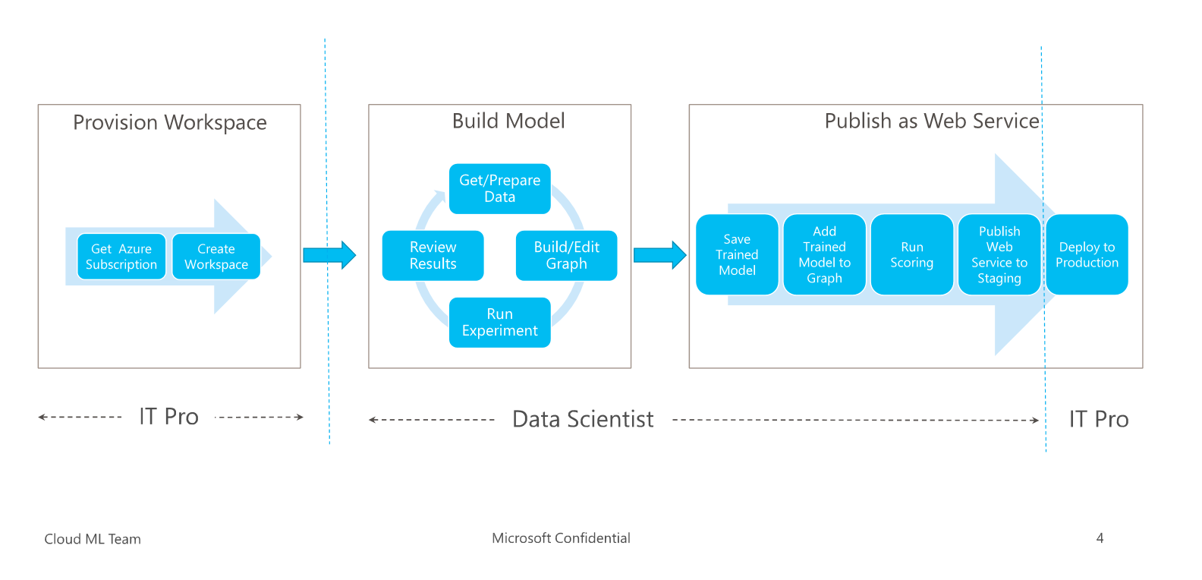
Publishing an ML API Web Service

Slide 35
Definitions
Regression – A model for predicting a continuous value based on independent variables, such as predicting the price of a car based on its year and make.
Anomaly detection is a common algorithm for fraud detection.
Clustering algorithm is used aggregate unlabeled data into potential.
Classification – A model for organizing data points into categories based on a data set for which category groupings are already known.
Binary Classification - Binary classification is the act of discriminating an item into one of two groups based on specified measures or variables
Multi-Class Classification – Classification into more than two groups.

Slide 36
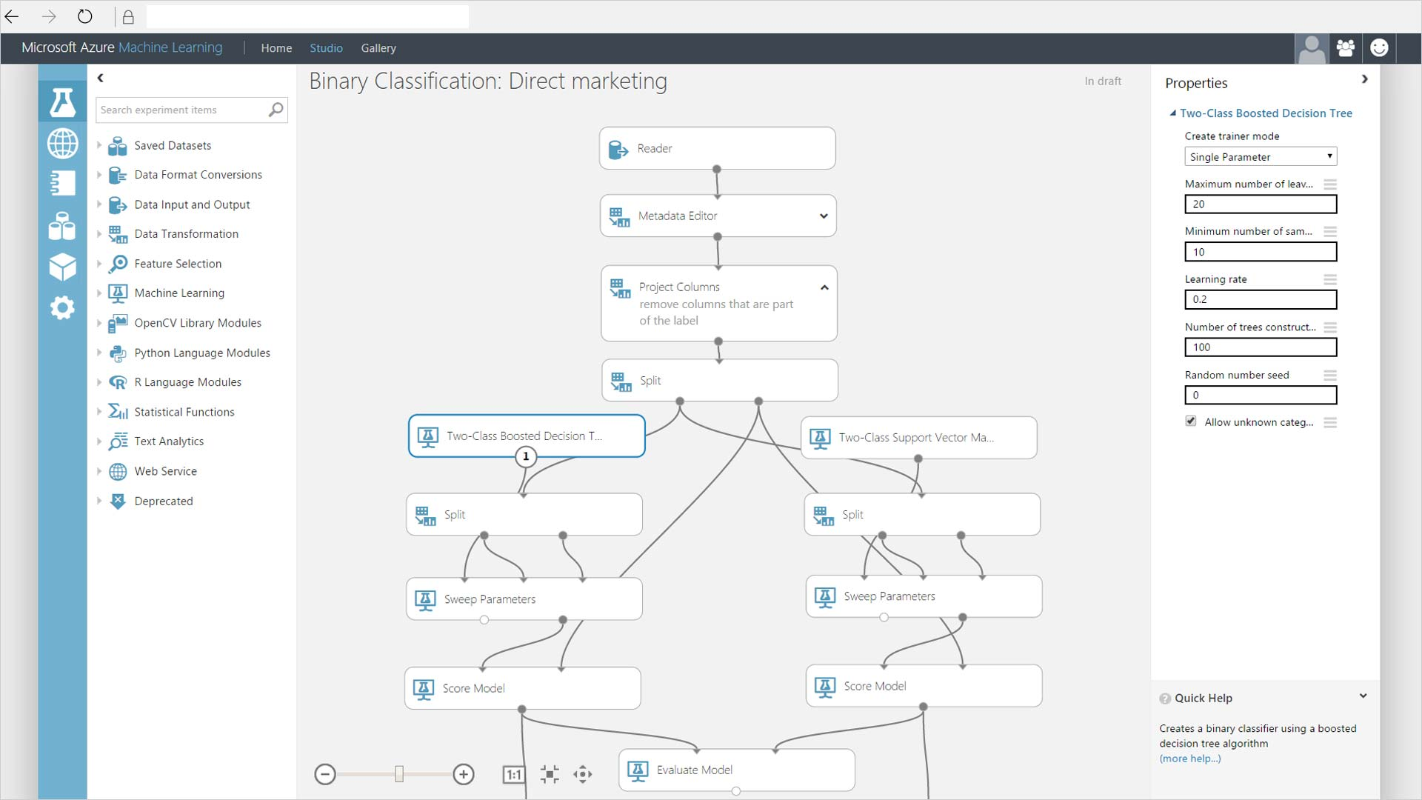

Slide 37
Operationalize end-to-end cloud analytics solutions

Slide 38
Key aspects of operating a solution
Data Movement
ADF and other utilities
Monitoring and Alerting
Monitoring & Managing
Maintenance
Regenerating Storage Keys

Slide 39
Azure Data Factory
Setting up hybrid environment
DMG
Monitoring and Managing
Job Scheduling
Setting up Pipeline Errors
Alerts
ADF Event Monitoring

Slide 40
Don’t worry about
SQL 2016
Not a lot of syntax (some)
Data Lake, SQL DW

Slide 41
Parting thoughts
“‘I don’t know’ has become ‘I don’t know yet’.”
- Bill gates

Slide 42
What to do
Eat a good meal
Read questions carefully
Think it through
Relax
It’s just a test
If at first you don’t succeed - retake it
Good Luck!

Slide 43
In review: session objectives and takeaways
Session Objective(s):
Session Objective 1: Help YOU prepare Exam 70-475 (Design and Implement Big Data Analytics Solutions
Session Objective 2: Know the areas you will need to be familiar with
Session Objective 3: Learn how to study the right material, and some tips and tricks
Key Takeaway 1
Preparation is reading and doing
Key Takeaway 2
You can prepare and pass the exam

Slide 44
Related content
Breakout sessions/Chalk Talks/Theater sessions
CRT306: Cert Exam Prep: Exam 70-473: Cloud Data Platform Solutions (Neil McIsaac)
Thursday, July 28 12:45-14:00 in (WSCC) 400
CRT310 Cert Exam Prep: Exam 70-534: Architecting Azure Solutions (Mark Grimes)
Wednesday, July 27 14:45-16:00 or Friday, July 29 08:30-09:45 in (WSCC) 620
AZR322 Learning Machine Learning Friday, July 29 13:15-14:30 Sheraton) Grand Ballroom C
Earlier this TR:
AZR202 The fundamentals of Azure Machine Learning
TR22 & earlier sessions on ML, ADF, Hadoop.

Slide 45
Q&A
If you have questions please proceed to the Q&A MICROPHONE located in your session room.

