Slide 1


Slide 2
The Hadoop Ecosystem
HDFS – distributed, fault tolerant file system
MapReduce – framework for writing/executing distributed, fault tolerant algorithms
Hive – SQL-like declarative languages
Pig – Scripting language
Sqoop – package for moving data between HDFS and relational DB systems
BI
Reporting
ETL
Tools
RDBMS
Hive & Pig
Sqoop
Map/
Reduce
HBase
HDFS

Slide 3
Talk Outline
(Visually…)
3
Hive & Pig
Sqoop
4
Map/
Reduce
2
HDFS
1

Slide 4
HDFS – Hadoop Distributed File System
Underpinnings of the entire Hadoop ecosystem
HDFS design goals:
Scalable to 1000s of nodes
Assume failures (hardware and software) are common
Targeted towards small numbers of very large files
Write once, read multiple times
Traditional hierarchical file organization of directories and files
Highly portable
Hive & Pig
Sqoop
Map/
Reduce
HDFS

Slide 5
File Splits
Example:
Large File
1100101010011100101010011100101010011100101010011100110010101001110010101001110010101001110010101001110010101001
1100101010011100101010011100101010011100101010011100110010101001110010101001110010101001110010101001110010101001
1100101010011100101010011100101010011100101010011100110010101001110010101001110010101001110010101001110010101001
1100101010011100101010011100101010011100101010011100110010101001110010101001110010101001110010101001110010101001
1100101010011100101010011100101010011100101010011100110010101001110010101001110010101001110010101001110010101001
1100101010011100101010011100101010011100101010011100110010101001110010101001110010101001110010101001110010101001
1100101010011100101010011100101010011100101010011100110010101001110010101001110010101001110010101001110010101001
1100101010011100101010011100101010011100101010011100110010101001110010101001110010101001110010101001110010101001
…
6440MB
Let’s color-code them
Block
1
Block
1
Block
2
Block
2
Block
3
Block
3
Block
4
Block
4
Block
5
Block
5
Block
6
Block
6
…
Block
100
Block
100
Block
101
Block
101
64MB
64MB
64MB
64MB
64MB
64MB
64MB
40MB
Files are composed of set of blocks
Typically 64MB in size
Each block is stored as a separate file
e.g., Block Size = 64MB

Slide 6
Block Placement
Example:
Block
1
Block
2
Block
3
Block
2
Block
2
Block
3
Block
1
Block
3
Objectives: load balancing, fast access, fault tolerance
Block
1
Node 1
Node 2
Node 3
Node 4
Node 5
e.g., Replication factor = 3
Default placement policy:
First copy is written to the node creating the file (write affinity)
Second copy is written to a data node within the same rack
(to minimize cross-rack network traffic)
Third copy is written to a data node in a different rack(to tolerate switch failures)

Slide 7
HDFS Node Types
NameNode – one instance per cluster
Responsible for filesystem metadata operations on cluster, replication and locations of file blocks
Backup Node – responsible for backup of NameNode
DataNodes – one instance on each node of the cluster
Responsible for storage of file blocks
Serving actual file data to client
NameNode
Master
CheckpointNode
or
BackupNode
(backups)
DataNode
DataNode
DataNode
DataNode
Slaves

Slide 8
HDFS Architecture
NameNode
BackupNode
namespace backups
(heartbeat, balancing, replication, etc.)
DataNode
DataNode
DataNode
DataNode
DataNode
nodes write to local disk

Slide 9
Putting Files On HDFS
Giant File
110010101001
010100101010
011001010100
101010010101
001100101010
010101001010
100110010101
001010100101
{node1, node2, node 3}
{node2, node4, node 5}
{node2, node3, node 4}
{node1, node3, node 5}
HDFS
Client
(based on “replication factor”) (3 by default)
Name node tells client where to store each block of the file
NameNode
BackupNode
Client transfers block directly
to assigned data nodes
and so on…
DataNode
DataNode
DataNode
DataNode
DataNode

Slide 10
Getting Files From HDFS
Giant File
110010101001
010100101010
011001010100
101010010101
001100101010
010101001010
100110010101
001010100101
HDFS
Client
return locations
of blocks of file
NameNode
BackupNode
stream blocks from data nodes
DataNode
DataNode
DataNode
DataNode
DataNode

Slide 11
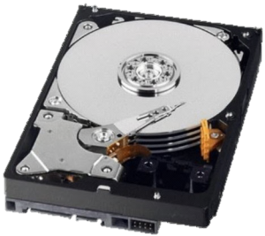
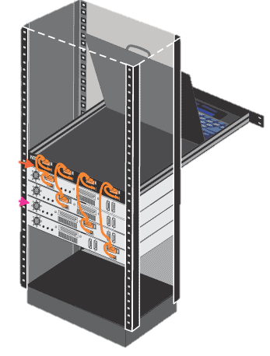
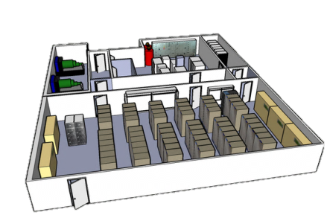
Failures, Failures, Failures
HDFS was designed with the expectation that failures (both hardware and software) would occur frequently
DataNode
Failure types:
Disk errors and failures
DataNode failures
Switch/Rack failures
NameNode failures
Datacenter failures
NameNode

Slide 12
Fault Tolerance (DataNode Failure)
NameNode
BackupNode
Blocks are auto-replicated on remaining
nodes to satisfy replication factor
NameNode detects DataNode loss
DataNode
DataNode
DataNode
DataNode
DataNode
DataNode
DataNode
DataNode

Slide 13
Fault Tolerance (NameNode Failure)
NameNode loss requires
manual intervention
Automatic failover is
in the works
NameNode
BackupNode
Not an epic failure, because you
have the BackupNode
DataNode
DataNode
DataNode
DataNode
DataNode

Slide 14
Live Horizontal Scaling and Rebalancing
NameNode
BackupNode
Blocks are re-balanced
and re-distributed
NameNode detects new DataNode
is added to cluster
DataNode
DataNode
DataNode
DataNode
DataNode
DataNode
DataNode
DataNode

Slide 15




HDFS Summary
Highly scalable
1000s of nodes and massive (100s of TB) files
Large block sizes to maximize sequential I/O performance
No use of mirroring or RAID.
Reduce cost
Use one mechanism (triply replicated blocks) to deal with a wide variety of failure types rather than multiple different mechanisms
Negatives
Block locations and record placement is invisible to higher level software
→ Makes it impossible to employ many optimizations successfully employed by parallel DB systems
Why?

Slide 16
Outline
(Visually…)
3
Hive & Pig
Sqoop
4
Relational
Databases
Map/
Reduce
2
5
HDFS
1

Slide 17
Hadoop MapReduce (MR)
Programming framework (library and runtime) for analyzing data sets stored in HDFS
MapReduce jobs are composed of two functions:
User only writes the Map and Reduce functions
MR framework provides all the “glue” and coordinates the execution of the Map and Reduce jobs on the cluster.
Fault tolerant
Scalable
map() → reduce()
sub-divide &
conquer
combine & reduce
cardinality

Slide 18
MapReduce
Essentially, it’s…
Take a large problem and divide it into sub-problems
Perform the same function on all sub-problems
Combine the output from all sub-problems
…
MAP
…
DoWork()
DoWork()
DoWork()
REDUCE
…
Output

Slide 19
MapReduce Visualized (in More Detail)
<key_{A}, value_{a}>
<key_{B}, value_{b}>
<key_{C}, value_{c}>
…
<key_{i}, value_{i}>
Mapper
DataNode
<key_{A}, list(value_{a}, value_{b}, value_{c}, …)>
Reducer
Sort
and
group
by
key
<key_{A}, value_{a}>
<key_{B}, value_{b}>
<key_{C}, value_{c}>
…
<key_{i}, value_{i}>
Mapper
DataNode
<key_{B}, list(value_{a}, value_{b}, value_{c}, …)>
Reducer
Output
<key_{A}, value_{a}>
<key_{B}, value_{b}>
<key_{C}, value_{c}>
…
<key_{i}, value_{i}>
Mapper
DataNode
<key_{C}, list(value_{a}, value_{b}, value_{c}, …)>
Reducer
<key_{A}, value_{a}>
<key_{B}, value_{b}>
<key_{C}, value_{c}>
…
<key_{i}, value_{i}>
Mapper

Slide 20
MapReduce Components
How Does This All Fit With HDFS?
Master
hadoop-namenode
- Coordinates all M/R tasks & events
- Manages job queues and scheduling
- Maintains and Controls TaskTrackers
- Moves/restarts map/reduce tasks if needed
- Uses “checkpointing” to combat single points of failure
JobTracker
MapReduce
Layer
NameNode
HDFS
Layer
JobTracker controls and
heartbeats TaskTracker nodes
hadoop-
datanode1
hadoop-
datanode2
hadoop-
datanode3
hadoop-
datanode4
Execute individual map and reduce tasks as assigned by JobTracker (in separate JVM)
Slaves
TaskTracker
TaskTracker
TaskTracker
TaskTracker
MapReduce
Layer
HDFS
Layer
TaskTrackers store temp data
DataNode
DataNode
DataNode
DataNode
Temporary data stored to local file system

Slide 21
Job Submission
Submit jobs to JobTracker
MR
Client
JobTracker
jobs get queued
map()’s are assigned to TaskTrackers (HDFS DataNode locality aware)
reduce phase begins
TaskTracker
TaskTracker
TaskTracker
TaskTracker
mappers spawned in separate JVM and execute
Mapper
Mapper
Mapper
Mapper
Reducer
Reducer
Reducer
Reducer
mappers store temp results
Temporary data stored to local file system

Slide 22
MapReduce Visualized: Map Phase
Get sum sales grouped by zipCode
(custId, zipCode, amount)
54235
$75
4
54235
$75
54235
$22
Blocks
of the
Sales
file in
HDFS
7
10025
$60
DataNode3
10025
$60
2
53705
$30
4
54235
$75
10025
$95
5
53705
$65
1
02115
$15
7
10025
$60
44313
$55
3
0
54235
$22
10025
$95
Group
By
Mapper
53705
$65
8
44313
$55
5
53705
$65
One output bucket per reduce task
0
54235
$22
DataNode2
2
53705
$30
5
53705
$15
53705
$30
6
44313
$10
1
02115
$15
53705
$15
Mapper
Group
By
02115
$15
3
10025
$95
5
53705
$15
02115
$15
6
44313
6
44313
$25
8
44313
$55
$10
DataNode1
9
02115
$15
44313
$10
6
44313
$25
9
02115
$15
Map tasks
44313
$25

Slide 23
Reduce Phase
Reducer
53705
$65
53705
$65
54235
$75
53705
$30
Sort
53705
$30
SUM
53705
$110
54235
$22
53705
$15
53705
$15
Mapper
10025
$60
10025
$95
Reducer
Done!
44313
$55
44313
$10
10025
$60
53705
$65
10025
$95
44313
$25
10025
$60
Sort
44313
$10
SUM
10025
$155
Shuffle
10025
$95
44313
$25
44313
$90
44313
$55
44313
$55
53705
$30
53705
$15
Reduce tasks
Reducer
Mapper
02115
$15
54235
$75
02115
$15
02115
$15
54235
$22
Sort
02115
$15
02115
$30
44313
$10
SUM
02115
$15
54235
$75
54235
$97
44313
$25
02115
$15
54235
$22

Slide 24
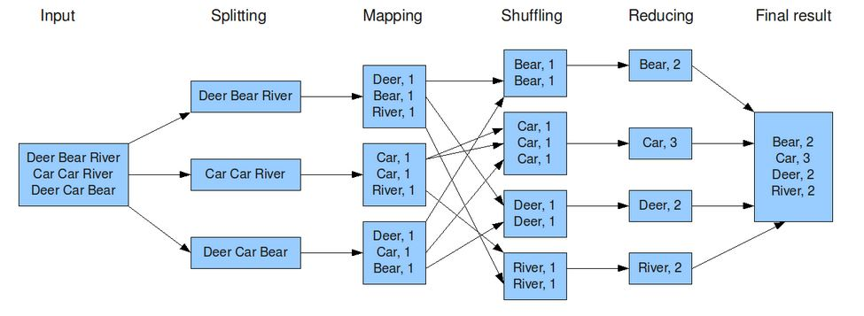
Word count Example

Slide 25
A Few More Details
Actual number of Map tasks M is generally made much larger than the number of nodes used.
Why?
Helps deal with data skew and failure
Example: Say M = 10,000 and
W = 100 (W is number of Map workers)
Each worker does (10,000 / 100) = 100 Map tasks
If it suffers from skew or fails the uncompleted work can
easily be shifted to another worker
Skew with Reducers is still a problem
Example: In a query = “get sales by zipcodes”, some zipCodes (e.g. 10025) may have many more sales records than others

Slide 26
Dealing With Failures
Like HDFS, MapReduce framework designed to be highly fault tolerant
Worker (Map or Reduce) failures
Detected by periodic Master pings
Map or Reduce jobs that fail are reset and then given to a different node
If a node failure occurs after the Map job has completed, the job is redone and all Reduce jobs are notified
Master failure
If the master fails for any reason the entire computation is redone

Slide 27

Highly fault tolerant
Relatively easy to write “arbitrary” distributed computations over very large amounts of data
MR framework removes burden of dealing with failures from programmer
Schema embedded in application code
A lack of shared schema
Makes sharing data between applications difficult
Makes lots of DBMS “goodies” such as indices, integrity constraints, views, … impossible
No declarative query language

Slide 28
Talk Outline
(Visually…)
3
Hive & Pig
Sqoop
4
Relational
Databases
Map/
Reduce
2
5
HDFS
1

Slide 29


Slide 30
Hadoop InteractiVE(HIVE)
A data warehouse infrastructure built on top of Hadoop for providing data summarization using Ad-hoc querying on large volumes of data.
ETL.
Access to different storage.
SQL like query language.
Query execution via MapReduce.

Slide 31
Applications Of Hive
Works on immutable data.
Log processing
Daily Report
User Activity Measurement
Data/Text mining
Machine learning (Training Data)
Business intelligence

Slide 32
Configuring Hive
Unpack the tarball in a suitable place on your workplace
$ tar xzf hive-x.y.z.tar.gz
Put Hive on your class path
$ export HIVE_HOME=/home/hive_install_path/hive-x.y.z
$ export PATH=$PATH:$HIVE_HOME/bin
Type hive to launch the shell
$ bin/hive
hive>

Slide 33
Configuring Hive
For batch processing in hive.
$ bin/hive -f '/home/hadoop/Desktop/hivescr.q'
To stop the common messages such as time taken to run a query.(Silent mode)
$ bin/hive -S -e 'show tables'

Slide 34
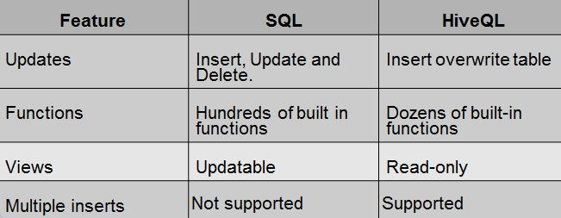
HiveQL
HiveQL is hive's SQL dialect
It does not provide the full features of SQL_92 language constructs
The main differences between HiveQL and SQL are

Slide 35
Data Types
Primitive Data Types
Type Size Example
TINYINT 1-byte signed integer 20
SMALLINT 2-byte signed integer 20
INT 4-byte signed integer 20
BIGINT 8-byte signed integer 20
BOOLEAN TRUE | FALSE TRUE
FLOAT 4-byte single precision 3.14159
DOUBLE 8-byte double precision 3.14159
STRING Sequence of characters usf
TIMESTAMP Unix epoch seconds '2014-02-03:12:34:56.123456789’

Slide 36
Data Types
Complex Data Types
Type Syntax Examples
STRUCT struct<id:int,name:string>
MAP map(string,string)
Array array(string)

Slide 37
Hive Data Model
Data in hive is organized into :
Tables
Managed Tables
External Tables

Slide 38
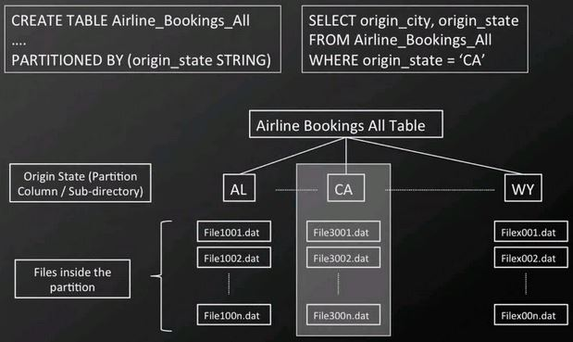
Partition
Dividing the table into coarse-grained parts based on the value of partition column
Partition makes queries faster to do queries on slices of data

Slide 39
Buckets
To enable more efficient queries
Makes sampling efficient
CREATE TABLE bucketed_users (id INT, name STRING)
CLUSTERED BY (id) INTO 4 BUCKETS;
Select * from users
TABLESAMPLE(BUCKET 1 OUT OF 4 ON rand());

Slide 40
External Table
External table : Hive refers to the data that is at an existing location outside the warehouse directory
hive> Create EXTERNAL table
ext_table(dummyString) location '/user/tom/ext_table';
hive> load data inpath '/user/text' into table
ext_table;
When an external table is dropped hive will leave the data untouched and delete only the metadata.

Slide 41
Queries
Table Creation
hive> create table <tablename> (<columnname datatype,..>)
row format delimited fields terminated by ‘<character>';
Alter Table
hive> alter table<tablename>
addcolumn(<columnname><datatype>);
Drop Table
hive> drop table <tablename>;
Load Data
hive> load data inpath <filepath> into table <tablename>

Slide 42
Queries
VIEWS:
A view is a sort of “virtual table” that is defined by a SELECT statement
Views in hive are read-only.
Syntax :
hive> create view <tablename>
as select *from <tablename>
where <condition>;

Slide 43
Queries
Insert Overwrite Table
hive> insert overwrite table <table_name>
select col1, col2
from <table>;
Multi-Table Insert
hive> from table
insert overwrite table table1
select col1, col2
insert overwrite table table2
select col1, count(col3) group by col1
insert overwrite table table3
select col1, col4 where <condition>;

Slide 44
Subquery
Hive supports subqueries only in the FROM clause.
The columns in the subquery select list are available in the outer query just like columns of a table.
Example :
Select col1,col2 from
(select col3+col4 as col1, col5+col6 as col2
from <table1>) <table2>;

Slide 45
Join in Hive
Hive supports only equi joins.
hive> SELECT table1.*, table2.*
FROM table1 JOIN table2
ON (table1.col1 = table2.col1) ;
More than two tables can be joined in Hive
hive> SELECT a.val, b.val, c.val
FROM a JOIN b ON (a.key = b.key1)
JOIN c ON (c.key = b.key1);
Map join
hive> SELECT /*+ MAPJOIN(things) */ sales.*, things.*
FROM sales JOIN things ON (sales.id = things.id);

Slide 46
Storage Formats
There are two kinds of storage formats
Row Format
The row format dictates how rows, and the fields in a particular row, are stored.
The row format is defined by a SerDe(Serializer-Deserializer).
File Format
Text Format(Default)
Sequence File Format

Slide 47
User Defined Functions
UDFs have to be written in Java
Three Types:
Regular UDFs.
UDAFs - user-defined aggregate functions.
UDTFs - user-defined table-generating functions

Slide 48
Implementation of UDFs
If you have a custom UDF implemented in Java,
Add jar to hadoop classpath.
hive> ADD JAR sample.jar;
Create a “temporary” function that calls to your UDF
hive> CREATE TEMPORARY FUNCTION Strip AS
'com.example.sample';
Run the query.
hive> SELECT Strip(Column_Name) FROM table;

Slide 49
Regular UDFs
User Defined Functions (UDFs) take a row (which could be a single value) and return a new row (or value). UDFs are one-to-one mappings.
The following dividends query uses the year() and month() UDFs to extract the year and month from a trading day date stamp, respectively.
hive> SELECT ymd, year(ymd), month(ymd) FROM dividends LIMIT 20;
OK
2006-01-25 2006 1
2009-11-09 2009 11
2009-08-10 2009 8

Slide 50
UDAFs
User Defined Aggregate Functions (UDAFs) take multiple rows and return an aggregate of them as a new row. UDAFs are many-to-one mappings.
hive> SELECT avg(dividend), count(dividend) FROM dividends WHERE symbol = 'AAPL';
OK
0.027142856695822306 35

Slide 51
UDTFs
User Defined Table-Generating Functions (UDTFs) are the least well known. They take a single row and return multiple new rows, effectively generating a new table.
UDTFs are one-to-many mappings.
hive> SELECT explode(subordinates) as subs FROM employees;
OK
Mary Smith
Todd Jones
Bill King
John Doe

Slide 52

Pig Latin

Slide 53
Agenda
Introduction to Pig
Features of Pig
Pig Usage Scenarios
Getting started with Pig
Working with Pig

Slide 54
Introduction to Pig
Pig is a scripting language used for exploring large data sets. Pig Latin is a Hadoop extension that simplifies hadoop programming by giving a high-level data processing language.
Components of Pig
Pig Latin — a language used to express data flows
Pig Engine — an engine over hadoop
Grunt — an interactive shell for Pig scripts
Advantages of using Pig
• Insulates users from changes in Hadoop interfaces.
• Increases productivity. In one test
10 lines of Pig Latin ≈ 200 lines of Java
What takes 4 hours to write in Java takes about 15 minutes in Pig Latin
Opens the system to non-Java programmers

Slide 55
Features of Pig
Pig Latin is a data flow language
Provides support for data types – long, float, chararray, schemas and functions
Is extensible and supports User Defined Functions
Operates on files in HDFS
Provides common operations like JOIN, GROUP, FILTER, SORT
Pig Usage Scenario
Web log processing
Transforming data according to business needs
Data processing for web search platforms
Ad hoc queries across large data sets
Rapid prototyping of algorithms for processing large data sets

Slide 56
Getting started with Pig
Running Pig scripts
Data Types
Pig Latin Statements
Examples

Slide 57
Running Pig Programs
There are two modes for running Pig programs
1. Local mode - Pig accesses local filesystem and suitable for trying pig.
2. MapReduce mode - Pig translates queries into MapReduce jobs and runs them
on a Hadoop cluster.
There are three ways of executing Pig programs, all of which work in both local and
MapReduce mode:
Script
Pig can run a script file that contains Pig commands. For example, pig Script. Pig runs the commands in the local file script.pig. Alternatively, for very short scripts,
you can use the -e option to run a script specified as a string on the command line.

Slide 58
Grunt
Grunt is an interactive shell for running Pig commands. Grunt is started when no file is specified for Pig to run, and the -e option is not used. It is also possible to run Pig scripts from within Grunt using run and exec.
Embedded
You can run Pig programs from Java using the PigServer class, much like you can use
JDBC to run SQL programs from Java. Gives you more control than pig script provides.

Slide 59

Introducing Data Types
Data type is a a data storage format that can contain a specific type or range of values.
PIG supports two types of data type:
1. Scalar types
Sample: int, long, float, double, chararray, bytearray
2. Complex types
Sample: i. map – is a set of key value pairs
ii. tuple – is an ordered set of fields
iii. bag – is a collection of tuples

Slide 60
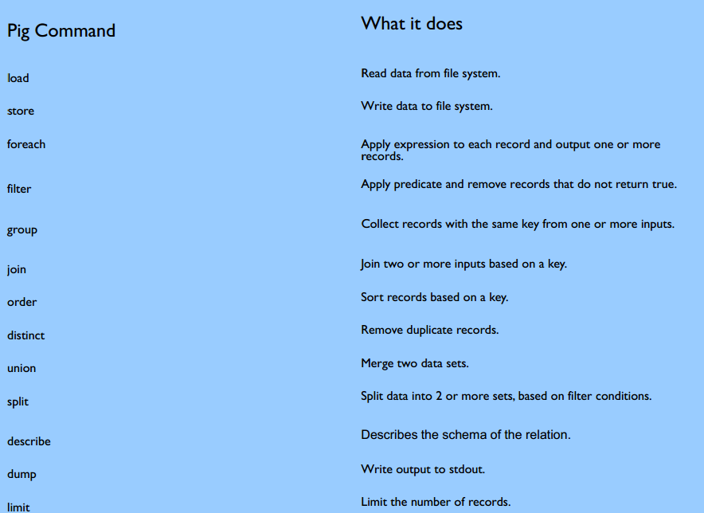
Pig Commands

Slide 61
Pig Latin Statements
A Pig Latin statement is an operator that takes a relation as input and produces another relation as output. This definition applies to all Pig Latin operators except LOAD and STORE which read data from and write data to the file system.
Pig Latin statements can span multiple lines and must end with a semi-colon.
Pig Latin statements are generally organized in the following manner:
1. A LOAD statement reads data from the file system.
2. A series of "transformation" statements processing the data.
3. A STORE statement writes output to the file system or,
a DUMP statement displays output to the screen.
Ex - log = LOAD ‘/home/user/pig-0.8.1/tutorial/data/excite-small.log’ AS
(user,time,query);
limit = LIMIT log 4;
STORE lmt into ‘/home/user/dir1’;

Slide 62
Sqoop

Slide 63
Introduction
Sqoop is a tool designed to transfer data between Hadoop and relational databases.
Import data from a relational database such as SQL or MySQL or Oracle into the Hadoop Distributed File System.
Uses MapReduce to import and export the data which provides parallel operation as well as fault tolerance.
Export data back into relational databases.

Slide 64
How does Sqoop works?
Data sliced into partitions
Mappers transfer data
Data types determined via meta data
Many data transfer formats supported i.e. CSV
Can import into
Hive
Hbase

Slide 65

Sqoop - Interfaces
Get data from
-Relational databases
-Data warehouses
-NoSQL databases
Load to Hive and Hbase
Integrates with Oozie
- for scheduling

Slide 66
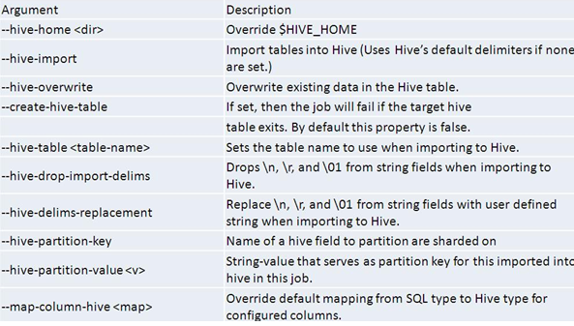
Importing data into Hive
Sqoop can also import data into Hive by generating and executing a CREATE TABLE statement to define the data layout in Hive.
If the Hive table already exists, you can specify the --hive-overwrite option to indicate that existing table in hive must be replaced.
Sqoop will generate a Hive script containing a CREATE TABLE operation defining your columns using Hive’s types, and a LOAD DATA INPATH statement to move the data files into Hive’s warehouse directory.

Slide 67
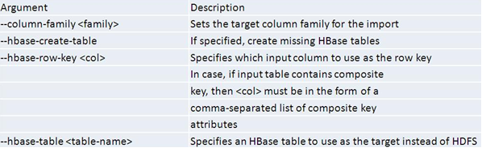
Importing data into HBase
Each row of the input table will be transformed into an HBase Put operation to a row of the output table.
By default Sqoop will use the split-by column as the row key column. If that is not specified, it will try to identify the primary key column, if any, of the source table. You can manually specify the row key column with --hbase-row-key.
Each output column will be placed in the same column family, which must be specified with --column-family.
67

Slide 68
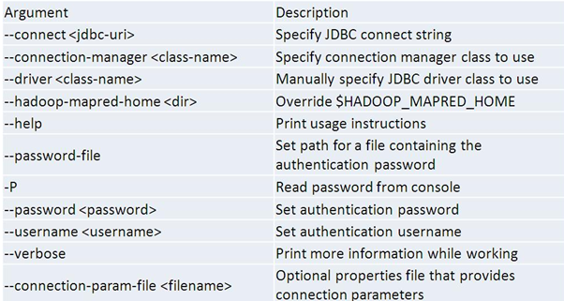
Sqoop Export
The export tool exports a set of files from HDFS back to an RDBMS. The target table must already exist in the database.
The default operation is to transform these into a set of INSERT statements that inject the records into the database. In "update mode," Sqoop will generate UPDATE statements that replace existing records in the database.
68

Slide 69
Sqoop-eval
The eval tool allows users to quickly run simple SQL queries against a database; results are printed to the console. This allows users to preview their import queries to ensure they import the data they expect.
Select ten records from the employees table:
$ sqoop eval --connect jdbc:mysql://db.example.com/corp \ --query "SELECT * FROM employees LIMIT 10“
Insert a row into the foo table:
$ sqoop eval --connect jdbc:mysql://db.example.com/corp \ -e "INSERT INTO foo VALUES(42, 'bar')"

Slide 70
Sqoop-list
sqoop-list-databases
List database schemas present on a server.
List database schemas available on a MySQL server:
$ sqoop list-databases --connect jdbc:mysql://database.example.com/ information_schema employees
sqoop-list-tables
List tables present in a database.
$ sqoop list-tables --connect jdbc:mysql://database.example.com/corp employees payroll_checks job_descriptions office_supplies

Slide 71
Acknowledgement
Some slides of this presentation has been taken from Passtalk given by Prof. David J. DeWitt
http://pages.cs.wisc.edu/~dewitt/includes/passtalks/passtalks.html

Slide 72
Acknowledgement
Some slides of this presentation has been taken from Passtalk given by Prof. David J. DeWitt
http://pages.cs.wisc.edu/~dewitt/includes/passtalks/passtalks.html

