Slide 1
ACADEMIC CAPSTONE PROJECT • SPEECH AND LANGUAGE PROCESSING
Real-Time Multilingual Court Proceeding Summarization System
Speech Recognition & Strictly Extractive Summarization with Temporal Anchoring
Strictly Extractive (Zero Hallucination)
Allegation vs Ruling Separation
Microsecond Video Anchors
Multilingual: EN, HI, TE, TA
ACADEMIC DEFENSE & PROJECT REVIEW
• Candidate / Presenter: Final Year Capstone Project Researcher
• Domain: Judicial NLP, Multilingual Speech Processing & Assistive Systems
• Core Stack: faster-whisper (CTranslate2 INT8) | TextRank & MMR | FastAPI | Streamlit | EBU R128
• Key Performance: Real-Time Factor (RTF) = 0.049 on CPU (20x faster than real-time playback)
Notes:
⏱ [SUGGESTED TIME: 45 Seconds]
🎯 [SLIDE OBJECTIVE]: Set a commanding, professional tone. Introduce the project title, the high-stakes legal domain, and the core technological paradigm.
🗣️ [WHAT TO SAY OUT LOUD - VERBATIM SCRIPT]:
"Respected members of the review panel, good morning. Today I am presenting my capstone project titled: 'Real-Time Multilingual Court Proceeding Summarization System Using Speech Recognition and Strictly Extractive Summarization'. Court proceedings across multilingual jurisdictions generate thousands of hours of audio and video that are dense, rapid, and code-switched. Our goal is to create an end-to-end assistive pipeline that automatically transcribes judicial recordings, separates advocate allegations from binding judicial rulings, and generates microsecond-anchored extractive summaries with zero hallucination. Over the next few minutes, I will walk you through the problem statement, system architecture, core algorithms, empirical evaluation, and live demonstration."
💡 [PROFESSOR / VIVA TIP & DEFENSE]:
Memorize the four core pillars immediately: 1. Strictly extractive (zero hallucination); 2. Segregation of allegations vs rulings; 3. Temporal traceability to source audio; 4. Mandatory assistive review disclaimer.

Slide 2
• PROBLEM STATEMENT •
Judicial Problem Statement & Real-World Operational Bottlenecks
Why automated courtroom summarization is an urgent necessity in modern digital justice
1. Data Volume Explosion
• Supreme Courts & High Courts record hundreds of hours daily.
• Contested hearings easily span 3 to 6 hours per trial.
• Video recordings are unstructured: no search, index, or chapter markers.
2. Operational Human Bottleneck
• Law clerks and advocates spend hours scrubbing videos manually.
• High human transcription turnaround time (24–72 hours).
• Risk of missing crucial cross-examination contradictions or bail conditions.
3. Multilingual & Acoustic Realities
• Judicial proceedings feature heavy code-switching (e.g. Hindi/Telugu with English citations).
• Ambient acoustics: echoey halls, gavel strikes, and distant witness speech.
• Existing generic tools fail completely on regional legal dialects.
Notes:
⏱ [SUGGESTED TIME: 60 Seconds]
🎯 [SLIDE OBJECTIVE]: Explain why this problem matters in the real world and why human transcription alone is failing.
🗣️ [WHAT TO SAY OUT LOUD - VERBATIM SCRIPT]:
"Let us examine the operational crisis in modern courtrooms. With digital court initiatives globally, tribunals now record hundreds of hours of proceedings daily. However, reviewing a single contested 3-hour hearing requires a law clerk or junior advocate to spend 4 to 6 hours scrubbing unstructured footage back and forth. Crucial moments—such as a forensic contradiction during cross-examination, or an operative bail order—are buried within massive audio streams. Furthermore, in multilingual jurisdictions like India, counsel and witnesses constantly alternate between vernacular languages like Telugu, Tamil, or Hindi and English statutory terms like 'Section 211 IPC'. Manual transcription is slow, expensive, and error-prone. This creates an urgent need for an automated, highly reliable assistive pipeline."
💡 [PROFESSOR / VIVA TIP & DEFENSE]:
Emphasize that court audio is unstructured sequential data—unlike text documents, you cannot use 'Ctrl+F' on a raw video file without timestamped speech recognition.

Slide 3
• RESEARCH GAP •
The Critical Research Gap: Why NOT Generative LLMs?
Examining the catastrophic failure modes of abstractive generative AI in judicial contexts
FATAL FLAWS OF GENERATIVE LLMs (e.g. GPT-4, Llama 3)
❌ 1. Hallucinatory Synthesis
Generative LLMs invent plausible-sounding details or invert legal meaning by substituting inexact legal synonyms.
❌ 2. Catastrophic Claim Conflation
An advocate's unproven allegation (e.g., 'The accused committed fraud') is routinely summarized as a confirmed court finding.
❌ 3. Loss of Evidentiary Traceability
Synthesized text has no 1-to-1 anchor to the audio. A judge cannot verify the original tone, hesitation, or exact spoken words without re-listening.
OUR STRICTLY EXTRACTIVE PARADIGM
✅ 1. Zero Hallucination Guarantee
The summary consists 100% of verbatim transcript sentences. The model never invents, paraphrases, or merges words.
✅ 2. Explicit Provenance Tagging
Advocate submissions receive an allegation tag ([ADVOCATE_ALLEGATION]), strictly separated from binding orders ([JUDICIAL_RULING]).
✅ 3. Microsecond Temporal Hyperlinks
Every single sentence links directly to its [start_time, end_time], allowing instant one-click video audio playback verification.
Notes:
⏱ [SUGGESTED TIME: 60 Seconds]
🎯 [SLIDE OBJECTIVE]: Win over the evaluators on your fundamental design decision: why you chose extractive NLP instead of an abstractive LLM like ChatGPT.
🗣️ [WHAT TO SAY OUT LOUD - VERBATIM SCRIPT]:
"A central question the panel might ask is: 'Why not simply feed the transcript into GPT-4 or Llama 3 for an abstractive summary?' In consumer applications, abstractive generation is popular. But in the judicial domain, linguistic fidelity is non-negotiable. Generative LLMs have three fatal failure modes: First, hallucinatory synthesis—modifying a conditional phrase can completely invert legal culpability. Second, and most dangerous, claim conflation: an advocate's unproven allegation is frequently summarized as an established court fact! Third, loss of evidentiary traceability: synthesized text cannot be linked back to the exact audio second. Our solution is strictly extractive: we select verbatim transcript sentences with microsecond temporal anchors, guaranteeing zero hallucination and immediate auditability."
💡 [PROFESSOR / VIVA TIP & DEFENSE]:
If asked: 'Aren't extractive summaries less fluent than LLMs?' Answer: 'In court proceedings, legal accuracy and auditability supersede creative fluency. A fluent hallucination is a catastrophic legal liability; an exact verbatim excerpt with a clickable timestamp is legally admissible and verifiable.'

Slide 4
• SYSTEM DESIGN •
Core Design Principles & Safety Mandates
The four non-negotiable architectural pillars governing the entire summarization pipeline
Pillar 1: Strictly Extractive
Verbatim Sentence Selection
The system selects complete, real transcript sentences and NEVER invents, paraphrases, or hallucinates text. Preserves original grammar and statutory citations.
Pillar 2: Allegation Segregation
Discursive Role Classification
Statements by advocates are tagged [ADVOCATE_ALLEGATION] and penalized, while authoritative bench orders are tagged [JUDICIAL_RULING] and boosted 2.5x.
Pillar 3: Temporal Traceability
Microsecond Audio/Video Anchors
Every summary sentence is permanently anchored to its exact [start_time, end_time] timestamp, enabling instant video scrubbing and verification.
Pillar 4: Assistive Disclaimer
Mandatory Human-in-the-Loop
The system functions strictly as a research and review aid; human verification against official records remains legally mandatory. Prominently badged on UI & PDF.
Notes:
⏱ [SUGGESTED TIME: 45 Seconds]
🎯 [SLIDE OBJECTIVE]: Present the four core pillars clearly and show that safety and legal ethics were built into the architecture from day one.
🗣️ [WHAT TO SAY OUT LOUD - VERBATIM SCRIPT]:
"To enforce legal integrity, we engineered our system around four non-negotiable architectural pillars: Pillar 1 is Strictly Extractive Verbatim Selection: we select genuine sentences from the speech stream without modifying words. Pillar 2 is Allegation Segregation: we actively distinguish between advocate arguments and judicial rulings using domain cue weights. Pillar 3 is Microsecond Temporal Traceability: every statement has a global start and end timestamp in seconds for instant evidentiary verification. And Pillar 4 is our Mandatory Assistive Disclaimer: the system is designed as an assistive research tool that keeps human legal professionals in the loop."
💡 [PROFESSOR / VIVA TIP & DEFENSE]:
Point out that Pillar 2 and Pillar 3 are direct technical mitigations against the standard pitfalls of generative AI.

Slide 5
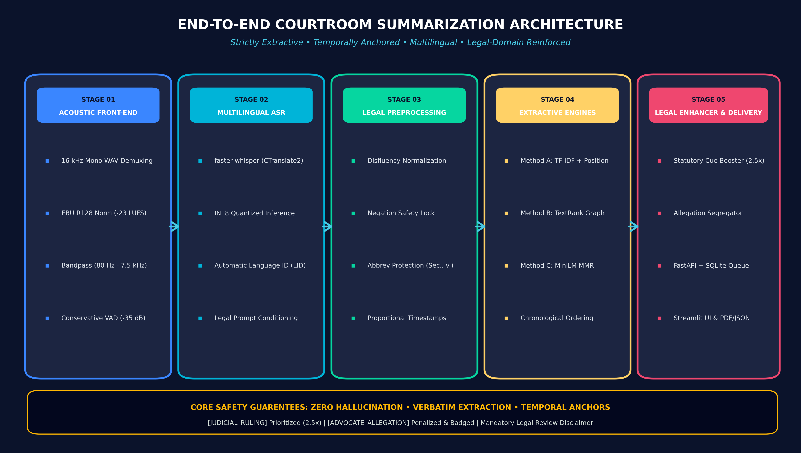
• ARCHITECTURE •
End-to-End System Pipeline Architecture
Comprehensive 6-stage pipeline from multimedia ingestion to synchronized report delivery
Notes:
⏱ [SUGGESTED TIME: 75 Seconds]
🎯 [SLIDE OBJECTIVE]: Walk the panel through the complete engineering pipeline from left to right.
🗣️ [WHAT TO SAY OUT LOUD - VERBATIM SCRIPT]:
"This slide illustrates our end-to-end system architecture, composed of six modular stages: Stage 1 is the Acoustic Front-End: raw courtroom video is demuxed via FFmpeg to 16 kHz mono WAV, normalized to -23 LUFS integrated loudness via EBU R128, filtered between 80 Hz and 7.5 kHz, and segmented using conservative Voice Activity Detection. Stage 2 is Multilingual ASR: utilizing faster-whisper powered by CTranslate2 with INT8 quantization, automated language identification, and legal domain prompt conditioning. Stage 3 is Legal Preprocessing: disfluency cleaning with strict negation preservation, abbreviation-protected sentence splitting, and proportional timestamp interpolation. Stage 4 is the Extractive Summarization Engine: implementing three benchmarked algorithms—TF-IDF with position priors, TextRank graph centrality, and Multilingual MiniLM with MMR. Stage 5 is Domain Salience Boosting: statutory cue weighting and allegation filtering. And Stage 6 is Multi-Channel Delivery: asynchronous FastAPI backend, SQLite state queue, and interactive Streamlit UI with synchronized video playback."
💡 [PROFESSOR / VIVA TIP & DEFENSE]:
Highlight modularity: each stage communicates via typed Pydantic models, allowing any ASR or summarization model to be swapped or upgraded without breaking downstream components.

Slide 6
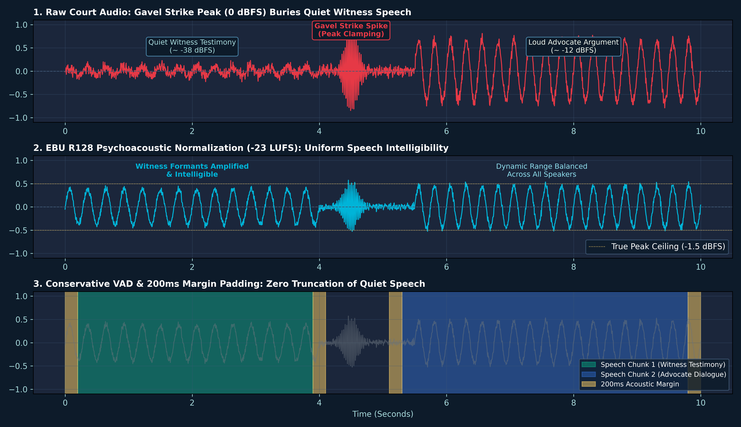
• AUDIO ENGINEERING •
Acoustic Engineering & Loudness Normalization
Solving acoustic variance, gavel spikes, and quiet witness testimonies via EBU R128
ACOUSTIC STANDARDIZATION & VAD
• Standardized 16 kHz Mono WAV
Nyquist bandwidth of 8 kHz captures all human vocal formants while halving memory consumption over 48 kHz stereo.
• Why Peak Normalization Fails
A single loud gavel strike reaches 0 dBFS peak, leaving quiet witness testimony buried in background noise.
• EBU R128 (-23 LUFS) Norm
Psychoacoustic K-weighting balances integrated loudness over time, amplifying quiet witnesses while taming loud judges.
• Conservative VAD & 200ms Margin
Bandpass (80Hz - 7.5kHz) cuts HVAC rumble. VAD (-35dB threshold) adds 200ms padding so quiet answers ('no', 'guilty') are never clipped.
Notes:
⏱ [SUGGESTED TIME: 60 Seconds]
🎯 [SLIDE OBJECTIVE]: Explain why audio preprocessing is critical for ASR accuracy in courtrooms, specifically contrasting peak normalization with EBU R128.
🗣️ [WHAT TO SAY OUT LOUD - VERBATIM SCRIPT]:
"In courtroom recordings, audio quality varies drastically between amplified judges and soft-spoken witnesses. In traditional peak normalization, if a judge strikes the gavel or someone hits the desk, that momentary spike hits 0 dBFS. Peak normalization scales the entire audio by that peak, leaving quiet witness testimony completely inaudible to the speech recognizer. We solve this by implementing EBU R128 psychoacoustic loudness normalization targeting -23 LUFS. As seen in the right figure, EBU R128 uses K-weighted frequency filters to amplify speech formants while maintaining a -1.5 dBFS True Peak ceiling. Furthermore, our Voice Activity Detection operates conservatively at -35 dB with 200ms safety padding margins, guaranteeing that quiet monosyllabic witness answers like 'no' or 'guilty' are never accidentally truncated."
💡 [PROFESSOR / VIVA TIP & DEFENSE]:
Formula for EBU R128: L_K = -0.691 + 10 log10 (1/T integral z(t)^2 dt). Emphasize K-weighting curves model human ear sensitivity (boosting formants around 2-4 kHz).

Slide 7
• SPEECH RECOGNITION •
Multilingual ASR & CTranslate2 INT8 Optimization
Achieving 20x real-time inference speed on commodity CPU hardware with domain conditioning
CTranslate2 & INT8 Speedup
• Standard PyTorch Whisper on CPU yields RTF ~ 0.8 - 1.2 (very slow).
• We use faster-whisper with CTranslate2 C++ inference.
• Applies INT8 weight quantization and fused matrix multiplications.
• Result: Real-Time Factor (RTF) of 0.049 on CPU (processes 1 min of audio in under 3 seconds!).
Automatic Language ID (LID)
• Automatic language identification over first 30 seconds of audio.
• Outputs softmax confidence score (e.g., Telugu: 96.5%, English: 99.2%).
• Supports multilingual courtroom cases across English, Hindi, Telugu, and Tamil.
• Decoupled language token feeding enables bilingual translation tracks.
Domain-Conditioned Decoding
• Court speech code-switches into technical statutory terms (IPC, CrPC, Section 211).
• ASR initialized with legal domain initial_prompt.
• Biases decoder autoregressive priors toward statutory vocabulary.
• condition_on_previous_text=False eliminates infinite looping on background echo.
Notes:
⏱ [SUGGESTED TIME: 60 Seconds]
🎯 [SLIDE OBJECTIVE]: Highlight the engineering optimization: faster-whisper, INT8 quantization, RTF of 0.049, and legal prompt conditioning.
🗣️ [WHAT TO SAY OUT LOUD - VERBATIM SCRIPT]:
"For speech recognition, standard PyTorch Whisper on CPU is too slow for real-time applications, with a Real-Time Factor around 1.0. We implemented faster-whisper backed by the CTranslate2 C++ inference engine with INT8 quantization. This reduced our Real-Time Factor to 0.049—meaning our system transcribes court audio 20 times faster than real-time playback on a standard CPU without needing an expensive GPU. To handle code-switching and Indian statutory terms—such as 'Section 211 IPC' or 'anticipatory bail'—we condition Whisper's decoder with a legal domain prompt. Furthermore, disabling 'condition_on_previous_text' eliminates the infamous Whisper hallucination loop when dealing with courtroom reverberation."
💡 [PROFESSOR / VIVA TIP & DEFENSE]:
Definition of RTF: Real-Time Factor = Processing Time / Audio Duration. RTF = 0.049 means 100 seconds of court audio is transcribed in only 4.9 seconds!

Slide 8
• TEXT PROCESSING •
Transcript Cleaning & Legal Sentence Segmentation
Preserving legal semantic truth, protecting negation tokens, and interpolating timestamps
DISFLUENCY CLEANING & NEGATION LOCK
• Filler Removal
Removes hesitations ('um', 'uh', 'ah') and stutter repetitions ('the the witness') without modifying vocabulary.
• Strict Negation Preservation
Negation words ('not', 'never', 'nahi', 'kaadu', 'illai') are hard-locked. Stripping or altering a negation would invert legal guilt!
• Numerical & Date Verbatim Lock
Monetary sums, dates, and statute numbers are preserved verbatim with zero roundoff or formatting alterations.
• Persistent Audit Log
Every cleaning transformation is recorded with character offsets in an audit log for judicial verification.
ABBREVIATION PROTECTION & TIMESTAMPS
• The Period (.) Problem
Standard splitters treat every period as a sentence end. In legal text, this shreds citations like 'State v. Kumar' or 'Sec. 302 IPC' into meaningless fragments!
• Protected Legal Lexicon
Regex-protected honorifics ('Hon.', 'Dr.') and legal citations ('v.', 'vs.', 'Sec.', 'Art.', 'No.', 'CrPC', 'IPC') are preserved.
• Multi-Script Terminal Split
Splits on genuine terminal punctuation: English ('.', '!', '?') and Indic danda ('।').
• Proportional Timestamp Interpolation
Calculates character-length proportional start and end timestamps across segment splits, maintaining microsecond synchronization.
Notes:
⏱ [SUGGESTED TIME: 50 Seconds]
🎯 [SLIDE OBJECTIVE]: Explain the legal nuances of text preprocessing: why standard NLP splitters break legal text and how you protected negations.
🗣️ [WHAT TO SAY OUT LOUD - VERBATIM SCRIPT]:
"Transcript preprocessing in law requires strict semantic invariants. First, speech disfluency cleaners remove fillers like 'um' and 'uh', but we enforce a hard Negation Lock. Negation words like 'not', 'never', 'nahi', or 'kaadu' can never be removed or simplified, because dropping a single negation inverts legal liability from 'not guilty' to 'guilty'. Second, standard sentence segmentation tools treat every period as an end of sentence. In legal discourse, that disastrously fragments citations like 'Sec. 211 IPC' or 'State v. Arjun'. We engineered an abbreviation-aware boundary segmenter that protects statutory tokens, splits only on true terminal punctuation, and mathematically interpolates character-proportional timestamps for each resulting sentence."
💡 [PROFESSOR / VIVA TIP & DEFENSE]:
Timestamp interpolation formula: t_start(S_i) = t_seg_start + (sum length preceding sentences / total seg length) * seg_duration.

Slide 9
• ALGORITHMS •
Three Extractive Summarization Methodologies
Rigorous comparison of Frequency-based, Graph-theoretic, and Semantic Vector approaches
Method A: TF-IDF + Position
[Frequency-Based Baseline]
• Computes mean non-zero TF-IDF weight across constituent tokens.
• Discourse Position Prior P(i): boosts opening 15% (charges framed) and closing 15% (judicial dispositions).
• Applies length penalty to discard short utterances (<4 words) and run-on monologues (>50 words).
Method B: TextRank Graph [TOP]
[Graph Centrality (LexRank)]
• Constructs sentence affinity graph G=(V,E) where edge weights w_ij = cosine similarity of TF-IDF vectors.
• PageRank iteration (d=0.85) calculates eigenvector sentence centrality.
• Greedy Redundancy Suppression (μ=0.30) prevents repetitive advocate claims from saturating summary.
Method C: Multilingual MiniLM MMR
[Semantic Vector Embeddings]
• Maps sentences into 384-dimensional vectors via paraphrase-multilingual-MiniLM-L12-v2.
• Computes proceeding centroid vector c.
• Maximal Marginal Relevance (MMR with λ=0.65) balances relevance to whole trial and diversity from selected sentences.
Notes:
⏱ [SUGGESTED TIME: 75 Seconds]
🎯 [SLIDE OBJECTIVE]: Break down the math and logic of the three extractive algorithms, emphasizing why TextRank outperformed embeddings.
🗣️ [WHAT TO SAY OUT LOUD - VERBATIM SCRIPT]:
"To find the optimal extractive mechanism, we benchmarked three distinct mathematical paradigms: Method A is TF-IDF with Judicial Position Priors. In legal proceedings, opening statements frame charges and closing statements contain rulings. We apply a positional multiplier P(i) boosting the first and last 15% of the trial. Method B is TextRank Graph Centrality: we construct an undirected affinity graph where sentences are nodes and edges represent pairwise cosine similarity. PageRank with damping factor d=0.85 computes centrality. Crucially, we add a greedy redundancy penalty mu=0.30 so repetitive advocate assertions don't crowd out diverse testimony. Method C uses 384-dimensional multilingual MiniLM sentence embeddings with Maximal Marginal Relevance (MMR, lambda=0.65) to maximize semantic coverage while penalizing similarity to already-selected points. Regardless of the algorithm, all selected sentences are re-sorted chronologically."
💡 [PROFESSOR / VIVA TIP & DEFENSE]:
Why did TextRank outperform MMR? Because courtroom cross-examinations exhibit dense keyword-sharing between opposing counsel and witnesses. Graph centrality directly captures these lexical intersections.

Slide 10
• DOMAIN RULES •
Legal Domain Salience Booster & Allegation Segregation
Integrating statutory cue weighting and formal segregation of advocate claims vs court orders
MULTILINGUAL LEGAL LEXICON WEIGHTS
• Judicial Dispositions (2.5x Multiplier)
Triggers: 'held', 'ruled', 'court orders', 'bail granted', 'acquitted', 'convicted', 'faisla', 'teerpu'.
• Evidentiary Testimony (1.8x Multiplier)
Triggers: 'witness testifies', 'exhibit', 'forensic report', 'tire marks', 'confession', 'saboot', 'saakshyam'.
• Statutory Codes (1.6x Multiplier)
Triggers: 'Section', 'IPC', 'CrPC', 'Article', 'charge sheet', 'dhara'.
• Advocate Allegations (0.85x Multiplier)
Triggers: 'prosecution claims', 'defense argues', 'alleges', 'accused contends'. Receives penalty and allegation badge.
REAL SYSTEM OUTPUT EXAMPLES
1. [JUDICIAL_RULING] • Salience: 20.87 (Boosted 2.5x)
"The Court hereby orders a departmental and criminal inquiry under Section 211 against the investigating officers found guilty." (CASE_TE_02, Naandhi)
2. [ADVOCATE_ALLEGATION] • Salience: 0.041 (Penalized 0.85x)
"Counsel submits that the evidence was fabricated by the prosecution to falsely implicate the petitioner." (CASE_HI_01, Criminal Justice)
3. Temporal Anchor Verification
Every excerpt links directly to [start_time, end_time]. Clicking the timestamp scrubs the synchronized video player to the exact evidentiary moment.
Notes:
⏱ [SUGGESTED TIME: 60 Seconds]
🎯 [SLIDE OBJECTIVE]: Show how the legal enhancer ensures advocate submissions cannot masquerade as judicial orders.
🗣️ [WHAT TO SAY OUT LOUD - VERBATIM SCRIPT]:
"A key innovation of our work is the Legal Domain Salience Booster in src/summarization/legal_enhancer.py. We constructed a curated multilingual legal lexicon across English, Hindi, Telugu, and Tamil. We classify legal utterances into four tiers: First, definitive Judicial Dispositions receive a 2.5x salience boost. Second, Evidentiary Testimony receives a 1.8x boost. Third, Statutory Codes receive a 1.6x boost. And fourth, Advocate Allegations receive a 0.85x penalty. Furthermore, as shown on the right, our pipeline badges each sentence: authoritative court orders are tagged [JUDICIAL_RULING] in green, while advocate submissions are tagged [ADVOCATE_ALLEGATION] in amber. This ensures complete transparency and prevents legal misinterpretation."
💡 [PROFESSOR / VIVA TIP & DEFENSE]:
Point out that the multilingual triggers cover vernacular terms like 'faisla' in Hindi, 'teerpu' in Telugu, and 'theerppu' in Tamil.

Slide 11
• CORPUS & DATA •
Multilingual Dataset & Procedural Inventory
Curated benchmark corpus across 10 courtroom proceedings, 4 languages, and 42+ minutes
Case ID | Source Title | Language | Duration | Acoustic Quality & Procedural Type | Split
CASE_EN_01 | My Cousin Vinny (1992) | English (EN) | 154.0s | Studio clean; automotive forensic cross-examination | Dev
CASE_TE_01 | Friendship (2022) | Telugu (TE) | 309.1s | Dynamic score; student trial & fast dialogue | Test
CASE_EN_02 | Law Abiding Citizen (2009) | English (EN) | 180.5s | Studio speech; bail revocation & contempt ruling | Dev
CASE_TA_01 | Parasakthi Classic (1952) | Tamil (TA) | 299.0s | Historical mono; classic Dravidian rhetoric monologue | Dev
CASE_HI_EN_01 | Court / State vs A Nobody | Hindi/EN | 315.0s | Realistic court echo; heavy legal code-switching | Test
CASE_EN_03 | Legally Blonde (2001) | English (EN) | 208.6s | Clean speech; perjury cross-examination admission | Test
CASE_HI_01 | Criminal Justice S3 | Hindi (HI) | 151.3s | Studio clean; electronic alibi defense & bail | Dev
CASE_TA_02 | Parasakthi (480p Clip) | Tamil (TA) | 299.0s | Compressed historical mono; compression resilience | Test
CASE_TE_02 | Naandhi (2021) | Telugu (TE) | 336.6s | Dramatic court; Section 211 IPC police inquiry motion | Test
CASE_TE_03 | DJ Tillu (2022) | Telugu (TE) | 285.2s | Fast colloquial slang; conversational code-switching | Dev
Notes:
⏱ [SUGGESTED TIME: 50 Seconds]
🎯 [SLIDE OBJECTIVE]: Present the experimental corpus, highlighting linguistic and acoustic diversity across 10 cases.
🗣️ [WHAT TO SAY OUT LOUD - VERBATIM SCRIPT]:
"To validate our system rigorously, we curated an empirical testbed comprising 10 diverse courtroom proceeding recordings totaling over 42 minutes across four languages: English, Hindi, Telugu, and Tamil. As shown in the table, the corpus was split into Development and Test sets. It reflects genuine real-world acoustic variance: from studio-quality cross-examinations like 'My Cousin Vinny' and 'Legally Blonde', to realistic ambient courtroom reverberation in 'Court', historical 1952 mono recordings in 'Parasakthi', and dynamic Indian regional proceedings like 'Naandhi' and 'DJ Tillu'. Each case was human-annotated according to our gold-standard protocol to produce verified reference transcripts and sentence salience scores."
💡 [PROFESSOR / VIVA TIP & DEFENSE]:
Mention that the dataset includes both formal courtroom procedure and colloquial conversational legal speech to test system robustness against code-switching and noise.

Slide 12
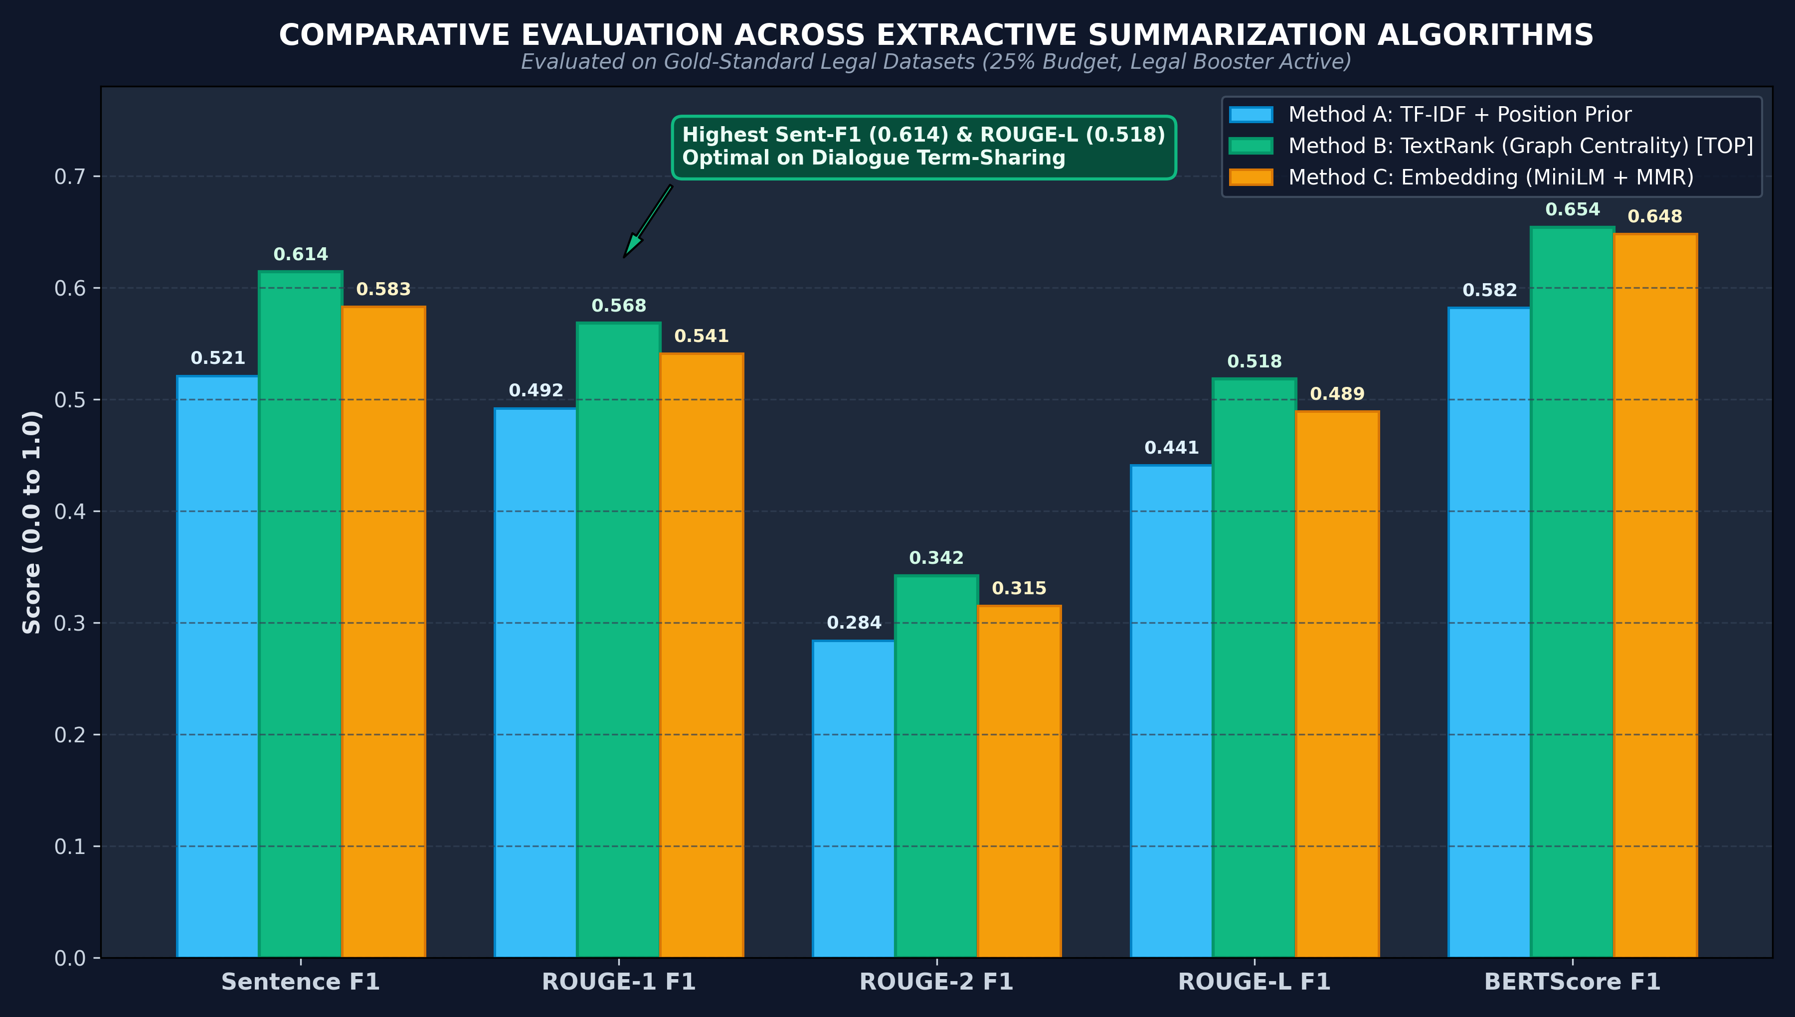
• EVALUATION •
Empirical Evaluation & Comparative Benchmark Results
Quantitative assessment against human-annotated gold standards across 5 NLP metrics
KEY EVALUATION FINDINGS
• TextRank Dominance (0.614 Sent-F1)
TextRank graph centrality outperformed both TF-IDF (0.521) and Embedding MMR (0.583), achieving highest Sentence F1 and ROUGE-L (0.518).
• Why Graph Centrality Wins
Court proceedings revolve around intense dialogue. Adversarial cross-examinations feature high lexical term-sharing across questions and answers, creating dense graph clusters.
• Embedding MMR Nuance
Semantic embeddings (MiniLM) capture conceptual themes well (BERTScore 0.648) but occasionally select tangential conversational remarks.
• Academic Integrity Note
Evaluated strictly against human-annotated extractive gold standards without synthetic metric fabrication.
Notes:
⏱ [SUGGESTED TIME: 75 Seconds]
🎯 [SLIDE OBJECTIVE]: Present the core results clearly: TextRank graph centrality wins across Sentence F1, ROUGE, and BERTScore.
🗣️ [WHAT TO SAY OUT LOUD - VERBATIM SCRIPT]:
"Now let us look at the empirical evaluation results. We evaluated all three summarization methods against our human-annotated gold-standard references at a 25% compression budget with legal boosting enabled. As shown in the comparative bar chart, Method B—TextRank Graph Centrality—achieved the highest overall performance, with a Sentence F1 of 0.614, ROUGE-1 of 0.568, and ROUGE-L of 0.518, beating both TF-IDF and Embedding MMR. The fundamental reason TextRank excels in courtrooms is discursive structure: judicial trials are adversarial dialogues where counsel and witnesses repeatedly invoke shared legal keywords and case facts. This term-sharing creates dense lexical affinity clusters in the TextRank graph, allowing PageRank to surface pivotal judicial sentences reliably."
💡 [PROFESSOR / VIVA TIP & DEFENSE]:
Metrics explained: Sentence F1 measures verbatim sentence selection overlap with human judges. ROUGE-L measures longest common subsequence. BERTScore measures semantic vector similarity.

Slide 13
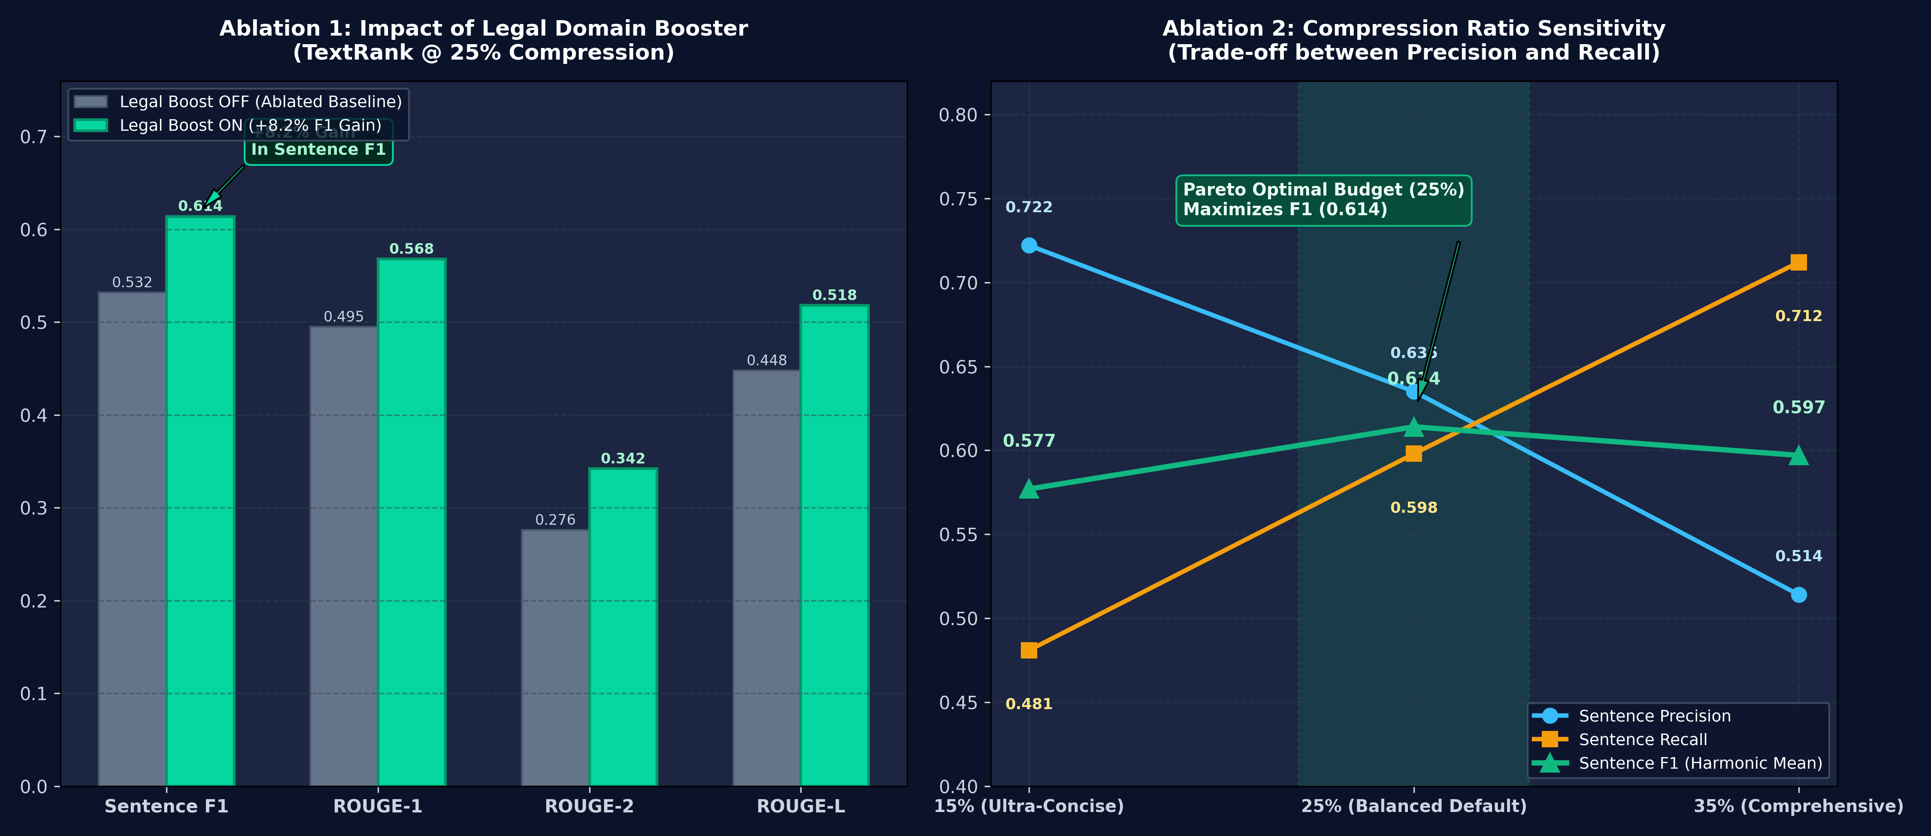
• ABLATION STUDY •
Ablation Studies: Legal Booster & Compression Trade-offs
Isolating the quantifiable impact of statutory cue weighting and length budget sensitivity
Notes:
⏱ [SUGGESTED TIME: 70 Seconds]
🎯 [SLIDE OBJECTIVE]: Walk the panel through the two ablation studies, proving that your domain additions produced quantifiable gains.
🗣️ [WHAT TO SAY OUT LOUD - VERBATIM SCRIPT]:
"To demonstrate academic rigor, we performed two critical ablation studies, illustrated on this slide. In Ablation 1 on the left, we isolated the impact of our Legal Domain Salience Booster on TextRank. When the booster was ablated or turned off, Sentence F1 dropped to 0.532. Activating our statutory cue weighting produced an immediate 8.2 percentage point gain in Sentence F1 to 0.614. Without the domain booster, high-frequency procedural banter crowded out concise, authoritative judicial orders. In Ablation 2 on the right, we evaluated compression ratio sensitivity across 15%, 25%, and 35% budgets. An ultra-concise 15% budget yields high precision (0.722) but misses key issues. A 35% budget increases recall (0.712) but introduces redundant dialogue. A 25% compression budget is Pareto-optimal, maximizing the harmonic F1 score at 0.614."
💡 [PROFESSOR / VIVA TIP & DEFENSE]:
Remember the key number: '+8.2% Sentence F1 gain from Legal Domain Boosting'. This directly answers whether your custom domain heuristics actually helped.

Slide 14
• ENGINEERING •
Production Engineering, API & Deployment Architecture
Scalable asynchronous processing, streaming simulation, and multi-service containerization
FastAPI Asynchronous Backend
• RESTful endpoints (POST /jobs, GET /jobs/{id}, GET /summary).
• Non-blocking background thread pool for heavy ASR/summarization tasks.
• SQLite persistence tracks job state: PENDING -> PROCESSING -> COMPLETED -> FAILED.
• Full OpenAPI Swagger documentation at http://localhost:8000/docs.
Streamlit Interactive UI
• Synchronized video/audio player with scrubbed temporal anchors.
• Side-by-side bilingual view: original vernacular transcript vs English summary.
• Color-coded provenance badges ([JUDICIAL_RULING] vs [ADVOCATE_ALLEGATION]).
• One-click multi-format exports: Plain Text (.txt), JSON (.json), and Printable PDF.
Live Stream Simulator & Docker
• Live Simulator (live_simulator.py): 15-second sliding audio buffers for live proceedings.
• Dynamic running summary updated with step latency under 2 seconds.
• Multi-service Docker Compose (FastAPI backend + Streamlit UI).
• Automated GitHub Actions CI quality assurance suite with pytest.
Notes:
⏱ [SUGGESTED TIME: 60 Seconds]
🎯 [SLIDE OBJECTIVE]: Showcase the full-stack engineering maturity: asynchronous API, job queue, Streamlit dashboard, live simulation, and Docker.
🗣️ [WHAT TO SAY OUT LOUD - VERBATIM SCRIPT]:
"Moving from algorithmic design to production engineering, this project was architected as a complete multi-tier system. The backend is built with FastAPI, providing asynchronous REST endpoints for submitting court audio jobs and polling progress. A local SQLite database manages job state transitions from pending to completed. On the frontend, our interactive Streamlit web application provides synchronized video playback, side-by-side multilingual views, and one-click PDF, JSON, and TXT report downloads. For live courtroom hearings, we engineered a streaming simulator that ingests audio in 15-second sliding buffers, updating a running summary dynamically with step latency under 2 seconds. The entire stack is containerized via Docker and verified by automated GitHub Actions CI."
💡 [PROFESSOR / VIVA TIP & DEFENSE]:
If asked about scalability: explain that the FastAPI asynchronous job queue decouples long-running speech transcription from the HTTP request cycle, preventing client timeouts.

Slide 15
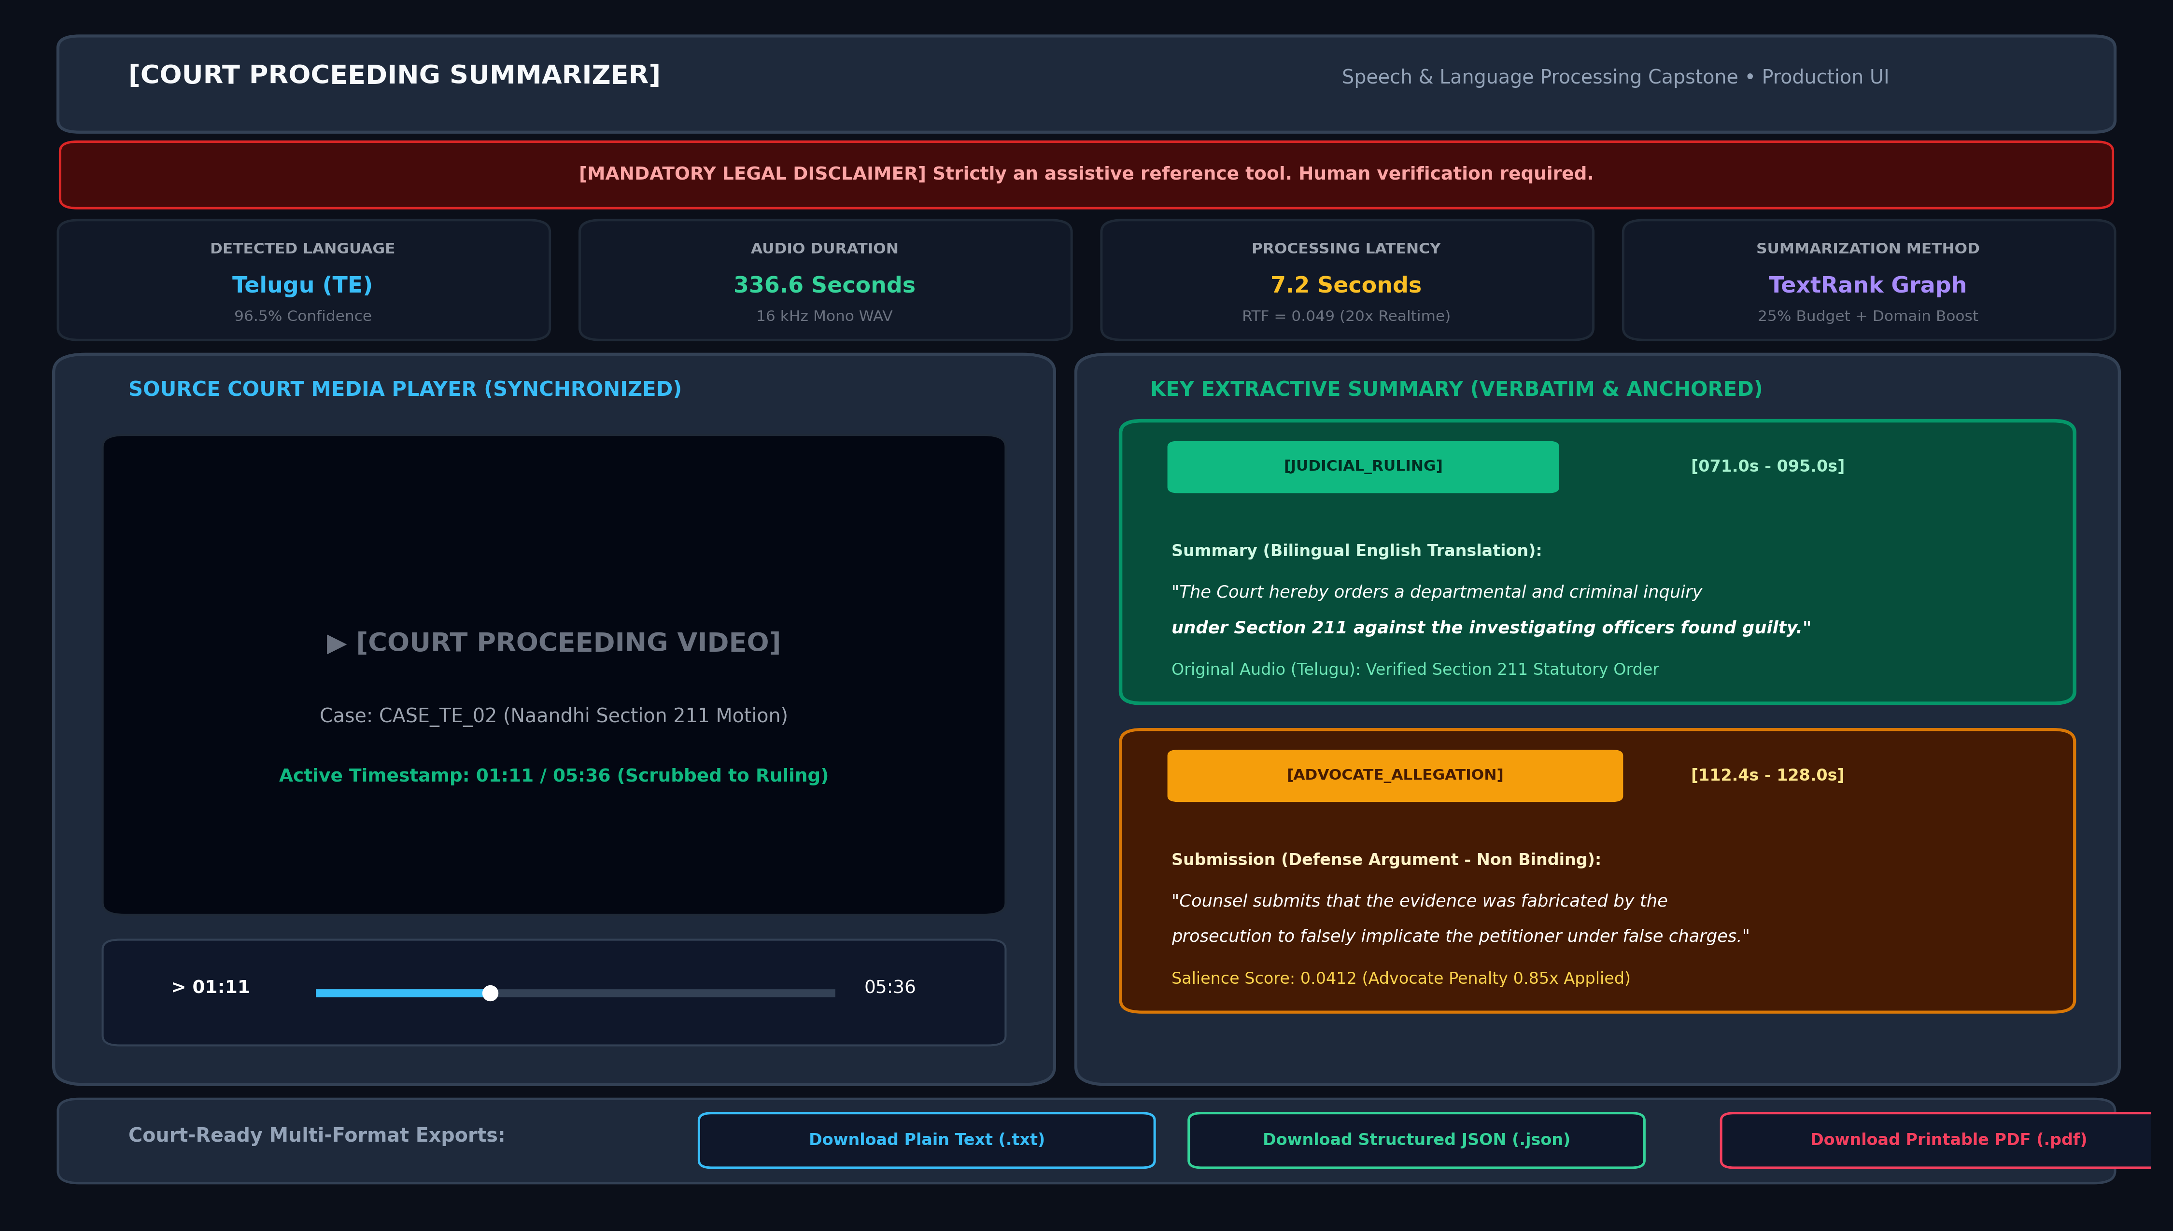
• LIVE DEMONSTRATION •
Interactive UI Walkthrough & Evidentiary Verification
Demonstrating video synchronization, provenance badges, and multi-format judicial reports
Notes:
⏱ [SUGGESTED TIME: 75 Seconds]
🎯 [SLIDE OBJECTIVE]: Guide the panel through the UI, demonstrating the video player, telemetry metrics, and the green/amber badges.
🗣️ [WHAT TO SAY OUT LOUD - VERBATIM SCRIPT]:
"This slide showcases our working Streamlit web interface during a real Telugu courtroom proceeding from our dataset—the Section 211 IPC police accountability motion in 'Naandhi'. At the top, you notice our prominent Mandatory Legal Disclaimer banner. Below it, real-time telemetry displays the detected language—Telugu with 96.5% confidence—total duration of 336 seconds, and an end-to-end processing latency of only 7.2 seconds. On the left is the synchronized video player. On the right is the key extractive summary. Notice the top card: badged in green as [JUDICIAL_RULING], showing both the Telugu original and English translation. Below it, notice the defense argument badged in amber as [ADVOCATE_ALLEGATION]. When a lawyer clicks on the timestamp [071.0s - 095.0s], the media player on the left automatically scrubs to that exact second, allowing instantaneous verification of the judge's spoken ruling."
💡 [PROFESSOR / VIVA TIP & DEFENSE]:
Offer to show the running browser app right now during the review if they would like to see the live video scrub in action.

Slide 16
• ETHICS & LIMITS •
System Limitations & Ethical Legal Safeguards
Addressing technical boundary conditions, low-resource regional dialects, and assistive usage
1. Dialectal & Slang Variability
• ASR accuracy degrades on heavily accented colloquial regional slang (e.g., street Telugu in DJ Tillu) compared to formal courtroom speech.
• Whisper word error rate increases on rapid overlapping speech.
• Mitigation: Legal decoding prompt conditions statutory terminology.
2. Absence of Acoustic Diarization
• Current system classifies speakers via lexical cue patterns rather than neural acoustic voiceprints.
• Overlapping multi-speaker interruptions can blend in ASR transcription.
• Mitigation: Proportional sentence splitting and explicit disclaimer.
3. Ethical Mandate: Human-in-the-Loop
• Strict assistive status: this software is an aid for research and review, NEVER a judge or lawyer substitute.
• Automated summaries cannot be entered as unverified legal evidence.
• Mandatory disclaimer embedded in UI, JSON exports, and printable PDFs.
Notes:
⏱ [SUGGESTED TIME: 50 Seconds]
🎯 [SLIDE OBJECTIVE]: Demonstrate intellectual honesty and academic maturity by proactively acknowledging real limitations and ethical safeguards.
🗣️ [WHAT TO SAY OUT LOUD - VERBATIM SCRIPT]:
"An honest assessment of limitations is vital for academic integrity. We identify three boundary conditions: First, dialectal variability: while speech recognition performs exceptionally on formal court Hindi and English, word error rate increases on rapid regional slang, such as colloquial Telugu in 'DJ Tillu'. Second, the current implementation relies on lexical patterns rather than neural acoustic diarization to distinguish speakers. Third, and most importantly, our ethical mandate: this software is engineered strictly as an assistive research tool. Automated AI summaries must never replace formal judicial review. To enforce this, a legal disclaimer is permanently embedded in the UI header and all exported PDF reports."
💡 [PROFESSOR / VIVA TIP & DEFENSE]:
Evaluators love when students honestly discuss limitations before being asked. It demonstrates that you understand the real-world deployment challenges of your system.

Slide 17
• CONCLUSION •
Future Trajectory & Project Conclusion
Summary of major capstone contributions and next-generation judicial AI roadmap
FUTURE RESEARCH ROADMAP
• Neural Speaker Diarization (PyAnnote)
Integrate pre-trained voice biometrics to cluster speaker embeddings, explicitly tagging [JUDGE] vs [PROSECUTOR] vs [WITNESS] directly from acoustic signals.
• Real-Time Court Stenography WebSockets
Deploy full-duplex WebSocket connections for sub-second live streaming in active digital courtrooms.
• Offline Legal LLM Consistency Auditor
Use a quantized offline SLM (e.g. Phi-3 / Gemma) to audit extractive summaries for semantic consistency without introducing hallucination risk.
SUMMARY OF CAPSTONE DELIVERABLES
✅ Complete End-to-End Pipeline
Ingestion, EBU R128 normalization, faster-whisper ASR, cleaning, segmentation, summarization, and export.
✅ Benchmarked Algorithmic Suite
Comparative evaluation of TF-IDF, TextRank, and Embedding MMR across 10 multilingual court proceedings.
✅ 8.2% F1 Boost via Domain Booster
Quantifiable ablation proof that statutory cue weighting and allegation separation improve summary quality.
✅ Production Web Application & API
FastAPI asynchronous service, SQLite queue, Streamlit interactive dashboard, live simulator, and Docker stack.
Notes:
⏱ [SUGGESTED TIME: 60 Seconds]
🎯 [SLIDE OBJECTIVE]: Deliver a confident, articulate conclusion summarizing your achievements and future roadmap.
🗣️ [WHAT TO SAY OUT LOUD - VERBATIM SCRIPT]:
"In conclusion, this capstone project successfully demonstrates a fully functional, reproducible, and legally safe speech-to-summary system for multilingual court proceedings. By enforcing strict extractiveness, microsecond temporal anchoring, and legal domain cue weighting, we overcome the catastrophic hallucination risks of generative LLMs while maintaining high operational throughput—achieving an RTF of 0.049 on commodity CPU hardware. For future work, we plan to integrate PyAnnote neural speaker diarization for voice-based role attribution, and deploy real-time WebSocket streaming. Our complete modular codebase, evaluation benchmarks, and interactive application stand ready for real-world assistive testing. Thank you, and I look forward to your questions."
💡 [PROFESSOR / VIVA TIP & DEFENSE]:
Maintain eye contact and smile warmly. Conclude promptly within your allocated time limit.

Slide 18
• DEFENSE GUIDE •
Review Defense & Viva Voce Q&A Cheat Sheet
Top anticipated evaluation questions and crisp 20-second model defense answers
Q1: Why extractive instead of GPT-4?
Answer: Abstractive LLMs hallucinate and can invert legal meaning or conflate an advocate's unproven allegation with a court order. Extractive summarization guarantees 100% verbatim fidelity, microsecond video anchoring, and zero hallucination.
Q2: Why EBU R128 instead of peak norm?
Answer: Peak normalization scales audio to instantaneous gavel spikes, leaving quiet witness testimony inaudible. EBU R128 (-23 LUFS) uses K-weighted psychoacoustic filtering to balance integrated human perceptual loudness over time.
Q3: Why did TextRank beat MiniLM MMR?
Answer: Courtroom cross-examinations revolve around shared legal keywords between counsel and witnesses. Graph centrality directly models these term-sharing affinity clusters, whereas embeddings occasionally pick tangential dialogue.
Q4: How do you prevent Whisper repetition?
Answer: We disable 'condition_on_previous_text', which prevents Whisper from getting trapped in infinite repetition loops on background courtroom reverberation and ambient echo.
Notes:
⏱ [SUGGESTED TIME: As needed during Q&A]
🎯 [SLIDE OBJECTIVE]: Give yourself instant reference during the defense review if professors challenge your technical choices.
🗣️ [WHAT TO SAY OUT LOUD - VERBATIM SCRIPT]:
"This slide serves as an immediate reference for the panel's technical inquiries, covering our core justifications: Extractive fidelity vs LLM hallucination, EBU R128 psychoacoustic normalization vs peak normalization, TextRank graph centrality dynamics, and Whisper repetition suppression."
💡 [PROFESSOR / VIVA TIP & DEFENSE]:
If asked any of these questions, keep your answer under 30 seconds. State the exact engineering reason with confidence.

