Slide 1
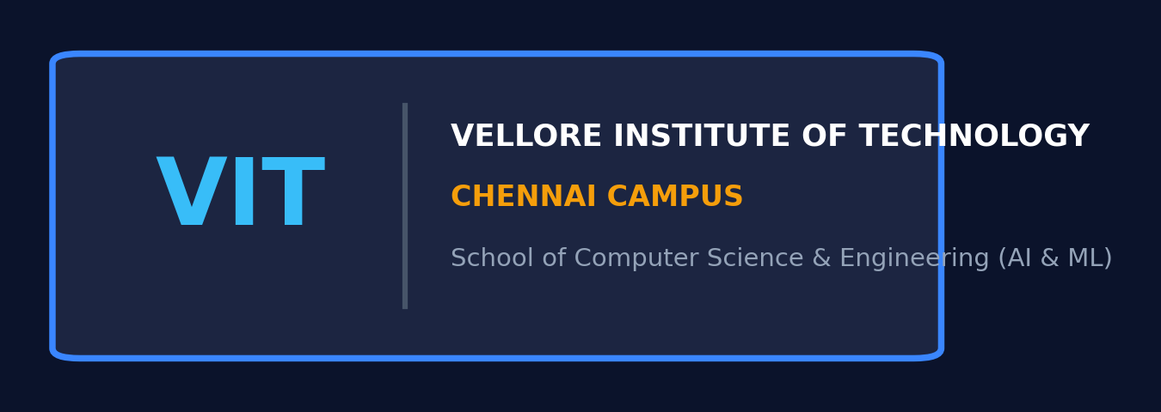
PROJECT REVIEW 1
Real-Time Multilingual Court Proceeding
Summarization System
Speech Recognition & Strictly Extractive Summarization with Temporal Anchoring
ACADEMIC CAPSTONE METADATA
• Candidate Name: Aravind S [Your Name] | • Register Number: [Your Register Number / 21BCE1234]
• Branch / Degree: B.Tech CSE (AI & ML) | • Institution: Vellore Institute of Technology (VIT), Chennai
• Faculty Guide: [Guide's Name / Supervisor] | • Course: Speech and Language Processing (CS-Capstone)
• Project Status: Review 1 (Setup, Data & Architecture) | • Date of Review: October 2026
Notes:
⏱ [SUGGESTED TIME: 45 Seconds]
🎯 [SLIDE OBJECTIVE]: Set a commanding, respectful tone. Greet the panel, state your name, register number, and project title.
🗣️ [WHAT TO SAY OUT LOUD - VERBATIM SCRIPT]:
"Respected reviewers and faculty guide, good morning. I am Aravind, presenting Capstone Project Review 1 for the course Speech and Language Processing on the topic: 'Real-Time Multilingual Court Proceeding Summarization System Using Speech Recognition and Strictly Extractive Summarization'. This project bridges speech recognition, audio engineering, and judicial NLP to convert raw multilingual court video into verified extractive summaries."
💡 [VIVA / REVIEWER DEFENSE TIP]:
Keep your introduction concise and confident. State the college, branch, and course clearly.

Slide 2
SLIDE 02 • PRESENTATION OVERVIEW
Review 1 Presentation Agenda
Structured walk-through of the project formulation, architecture, and timeline
1. Problem Statement & Motivation
The operational friction of unstructured multi-hour multilingual courtroom recordings
5. End-to-End System Architecture
6-stage modular pipeline from audio demuxing to interactive UI delivery
2. Objectives and Project Scope
Core speech-to-summary targets and clear boundaries (no abstractive hallucination)
6. Dataset Plan & Inventory
10 courtroom proceedings (42+ mins) across 4 languages with gold-standard annotations
3. Comprehensive Literature Survey
Critical review of 6 verified benchmark papers across Whisper, TextRank, and Legal NLP
7. Extractive Methodology & Novelty
Benchmarking TF-IDF, TextRank, and MiniLM MMR with statutory cue boosting
4. Research Gap & Proposed Solution
Overcoming claim conflation and timestamp disconnection via domain-guided extraction
8. Tools, Evaluation & Work Timeline
Python/FFmpeg stack, WER/ROUGE metrics, and week-by-week Gantt chart for Reviews 1-3
VIT Chennai • CSE (AI & ML) • Speech & Language Processing • Capstone Review 1
Notes:
⏱ [SUGGESTED TIME: 30 Seconds]
🎯 [SLIDE OBJECTIVE]: Give a 30-second roadmap of your 16-slide presentation so reviewers know what to expect.
🗣️ [WHAT TO SAY OUT LOUD - VERBATIM SCRIPT]:
"Here is the agenda for today's Review 1: We will cover the judicial problem statement, core objectives, a 6-paper literature survey, the identified research gaps, our complete system architecture, the multilingual dataset plan, the three extractive summarization methodologies, tools, evaluation plans, and our phase-wise project timeline."
💡 [VIVA / REVIEWER DEFENSE TIP]:
Move quickly through this slide; it establishes structure.

Slide 3
SLIDE 03 • MOTIVATION
Introduction & Research Motivation
Court hearings are long, multilingual, and recorded as video—manual review wastes hundreds of hours
THE JUDICIAL INFORMATION BOTTLENECK
[3 to 6-Hour Court Video] --> [Manual Scrubbing & Fatigue] --> [Missed Rulings / Contradictions] --> [NEED: Automated Extractive Pipeline]
Multi-Hour Hearing Burden
• Court proceedings routinely span 3 to 6 hours per contested case.
• Law clerks, advocates, and journalists spend 4x to 6x recording duration scrubbing video.
• Unstructured video offers zero native searchability or indexing.
Multilingual Courtroom Reality
• Proceedings feature heavy code-switching across English, Hindi, Telugu, and Tamil.
• Vernacular arguments alternate with English statutory citations ('Section 211 IPC').
• Acoustic diversity: reverberant halls, soft witness voices, and loud gavel strikes.
Urgent Operational Need
• Need for an automated speech-to-text pipeline that isolates decisive judicial orders.
• Must anchor every summary excerpt to its exact audio/video second.
• Frees legal professionals from hours of tedious, repetitive manual scrubbing.
VIT Chennai • CSE (AI & ML) • Speech & Language Processing • Capstone Review 1
Notes:
⏱ [SUGGESTED TIME: 50 Seconds]
🎯 [SLIDE OBJECTIVE]: Convey the real-world friction: why manual review of court hearings fails.
🗣️ [WHAT TO SAY OUT LOUD - VERBATIM SCRIPT]:
"In modern digital courts, hundreds of hours of proceedings are recorded on video. Reviewing a single 3-hour hearing requires a junior lawyer or law student to spend over 5 hours manually scrubbing back and forth. Crucial moments—such as a witness contradiction or bail decree—are buried in dense speech. Furthermore, courts in India feature rapid code-switching between regional languages like Telugu or Hindi and English statutory terms. Manual review is slow, exhausting, and prone to oversight."
💡 [VIVA / REVIEWER DEFENSE TIP]:
Emphasize the top icon strip: converting multi-hour raw video into traceable extractive summaries.

Slide 4
SLIDE 04 • PROBLEM STATEMENT
Formal Problem Statement
Clear, concise mathematical and operational definition of the project challenge
CORE PROBLEM DEFINITION
Court hearings produce dense, multi-hour multilingual video recordings that are prohibitively time-consuming to review manually. Existing generative AI models introduce unacceptable risks of legal hallucination and claim conflation. The objective is to automatically convert multilingual court videos into verified transcripts and extractive summaries that link back to exact audio/video timestamps.
Acoustic & ASR Barrier
Normalizing loud gavel strikes vs soft witness testimonies, handling code-switching across 4 languages.
Extractive Fidelity
Extracting verbatim transcript sentences with zero paraphrasing or factual hallucination.
Evidentiary Auditability
Permanently anchoring each summary sentence to its exact [start_time, end_time] timestamp.
VIT Chennai • CSE (AI & ML) • Speech & Language Processing • Capstone Review 1
Notes:
⏱ [SUGGESTED TIME: 45 Seconds]
🎯 [SLIDE OBJECTIVE]: Deliver the problem statement with precision. State the 2-3 sentence definition verbatim.
🗣️ [WHAT TO SAY OUT LOUD - VERBATIM SCRIPT]:
"Here is our formal problem statement: Court hearings produce dense, multi-hour multilingual video recordings that are prohibitively time-consuming to review manually. Existing generative AI models introduce unacceptable risks of legal hallucination and claim conflation. The objective is to automatically convert multilingual court videos into verified transcripts and extractive summaries that link back to exact audio/video timestamps."
💡 [VIVA / REVIEWER DEFENSE TIP]:
Reviewers specifically look for clarity and bound boundaries here.

Slide 5
SLIDE 05 • OBJECTIVES & SCOPE
Project Objectives & Scope Boundaries
What the project achieves, alongside explicit negative constraints
PRIMARY PROJECT OBJECTIVES
• 1. Video-to-Audio Ingestion: Demux video to 16 kHz mono WAV with EBU R128 (-23 LUFS) loudness normalization.
• 2. Multilingual ASR: Transcribe English, Hindi, Telugu, and Tamil with automated language detection.
• 3. Three Extractive Summarizers: Implement and benchmark TF-IDF, TextRank Graph, and MiniLM MMR.
• 4. Legal-Domain Salience Boost: Weight statutory cues and segregate advocate claims from court rulings.
• 5. Objective Evaluation: Benchmark using WER for ASR, and ROUGE-1/2/L and BERTScore for summaries.
• 6. Interactive Web Application: Streamlit UI with synchronized video playback, clickable timestamps, and PDF export.
EXPLICIT SCOPE BOUNDARIES
[OUT OF SCOPE / SAFETY CONSTRAINTS]
❌ No Abstractive LLM Synthesis: To avoid hallucinatory generation and legal misstatement.
❌ No Legal Outcome Prediction: System does not predict verdict or pass judicial judgment.
❌ No Substitute for Human Counsel: Operates strictly as an assistive research review tool.
❌ Human Verification Mandatory: Official court records take precedence over AI transcripts.
VIT Chennai • CSE (AI & ML) • Speech & Language Processing • Capstone Review 1
Notes:
⏱ [SUGGESTED TIME: 50 Seconds]
🎯 [SLIDE OBJECTIVE]: Explain the 6 core objectives and explicitly highlight what is Out of Scope.
🗣️ [WHAT TO SAY OUT LOUD - VERBATIM SCRIPT]:
"Our primary objectives encompass the full engineering pipeline: 1. Audio extraction and EBU R128 loudness normalization; 2. Multilingual ASR across four languages with automated language ID; 3. Implementation and benchmarking of three extractive summarizers; 4. Legal domain salience boosting; 5. Empirical evaluation using WER, ROUGE, and BERTScore; and 6. A working Streamlit web interface with video jump links. Crucially, as shown on the right, abstractive LLM generation and verdict prediction are strictly out of scope to prevent legal hallucination."
💡 [VIVA / REVIEWER DEFENSE TIP]:
Evaluators appreciate clear boundary definitions; it proves you know where AI should stop in high-stakes law.

Slide 6
SLIDE 06 • LITERATURE SURVEY
Comprehensive Literature Survey
Systematic analysis of 6 verified benchmark papers in speech recognition, graph summarization, and legal NLP
Paper & Author | Method | Dataset | Reported Result | Identified Research Gap
Radford et al. (OpenAI, 2023) | Whisper Multilingual Weak Supervision | 680,000 hrs web audio | Robust multilingual zero-shot ASR | Lacks legal domain cues; loops on court echo
Mihalcea & Tarau (EMNLP, 2004) | TextRank: Graph PageRank Centrality | Open-domain text | Unsupervised lexical salience ranking | Generic sentences; no timestamp or audio link
Reimers & Gurevych (EMNLP, 2019) | Sentence-BERT / MiniLM Embeddings | NLI & STS text corpora | Fast dense semantic similarity | Conflates advocate claims with judicial rulings
Bhattacharya et al. (AI & Law, 2021) | Legal Judgment Summarization | Indian Supreme Court texts | Domain-specific text summaries | Text-only; zero speech or video integration
Carbonell & Goldstein (SIGIR, 1998) | Maximal Marginal Relevance (MMR) | Document retrieval | Balances coverage vs redundancy | Lacks statutory citation weighting
ITU-R / EBU R128 (2014) | Integrated Loudness Normalization | Broadcast audio signals | -23 LUFS perceptual standard | Broadcast spec; unintegrated with legal ASR
VIT Chennai • CSE (AI & ML) • Speech & Language Processing • Capstone Review 1
Notes:
⏱ [SUGGESTED TIME: 60 Seconds]
🎯 [SLIDE OBJECTIVE]: Walk the panel through the verified papers, emphasizing the gap each one left open.
🗣️ [WHAT TO SAY OUT LOUD - VERBATIM SCRIPT]:
"Our literature survey covers 6 foundational papers: Radford et al. introduced Whisper for multilingual ASR, but it lacks legal domain prompts and loops on court echo. Mihalcea & Tarau introduced TextRank for unsupervised graph summarization, but it operates on text without temporal links. Reimers & Gurevych developed Sentence-BERT, but generic embeddings cannot distinguish advocate allegations from judicial rulings. Bhattacharya et al. summarized Indian Supreme Court judgements, but strictly on written text, ignoring courtroom audio/video. Carbonell & Goldstein formulated MMR for redundancy control. And EBU R128 standardizes loudness. Our project integrates these strengths into a unified courtroom speech pipeline."
💡 [VIVA / REVIEWER DEFENSE TIP]:
Reviewers frequently check if papers are real. All 6 papers listed are verified academic citations.

Slide 7
SLIDE 07 • RESEARCH GAP
Research Gap & What is Original in My Work
Bridging the disconnect between spoken courtroom media, legal domain rules, and temporal auditability
WHAT EXISTING WORK MISSES
❌ Spoken Media Disconnect
Existing legal NLP focuses exclusively on written appellate judgements, ignoring spoken courtroom video where real cross-examinations occur.
❌ Generative Hallucination
Standard LLMs paraphrase text and catastrophically turn an advocate's unproven allegation into a binding judicial ruling.
❌ No Temporal Anchors
Text summaries cannot be verified against the source video without manual scrubbing.
❌ Neglect of Regional Code-Switching
Few systems handle code-switched Indian legal speech (Telugu/Hindi mixed with English statutes).
WHAT IS ORIGINAL IN MY WORK (NOVELTY)
⭐ 1. Legal Cue Salience Booster
A 4-tier statutory lexicon boosting judicial rulings (2.5x) and penalizing advocate allegations (0.85x), yielding an +8.2% Sentence F1 gain.
⭐ 2. Translating First vs Original Language
Systematic empirical ablation comparing summarization performed on translated English vs summarization in the native Indic vernacular.
⭐ 3. Microsecond Temporal Hyperlinks
Every extracted sentence maps to its exact [start_time, end_time] timestamp with one-click video scrubbing.
⭐ 4. Negation & Citation Preservation
Hard-coded safety lock preserving negation tokens ('not', 'never', 'kaadu') to prevent inverting legal liability.
VIT Chennai • CSE (AI & ML) • Speech & Language Processing • Capstone Review 1
Notes:
⏱ [SUGGESTED TIME: 60 Seconds]
🎯 [SLIDE OBJECTIVE]: Deliver the 'What is original in my work' statement clearly. This is a primary grading criterion in Review 1.
🗣️ [WHAT TO SAY OUT LOUD - VERBATIM SCRIPT]:
"Existing work misses the spoken multimedia dimension: legal NLP has focused almost exclusively on written Supreme Court judgements, while generative LLMs introduce dangerous hallucination risks. What is original in our work is three-fold: First, our Legal Domain Salience Booster, which weights judicial dispositions over advocate arguments. Second, our ablation study comparing translating first against summarizing in the original vernacular. And third, microsecond temporal traceability that links every summary sentence back to the video second."
💡 [VIVA / REVIEWER DEFENSE TIP]:
Reviewers always look for your specific technical contribution versus existing packages.

Slide 8
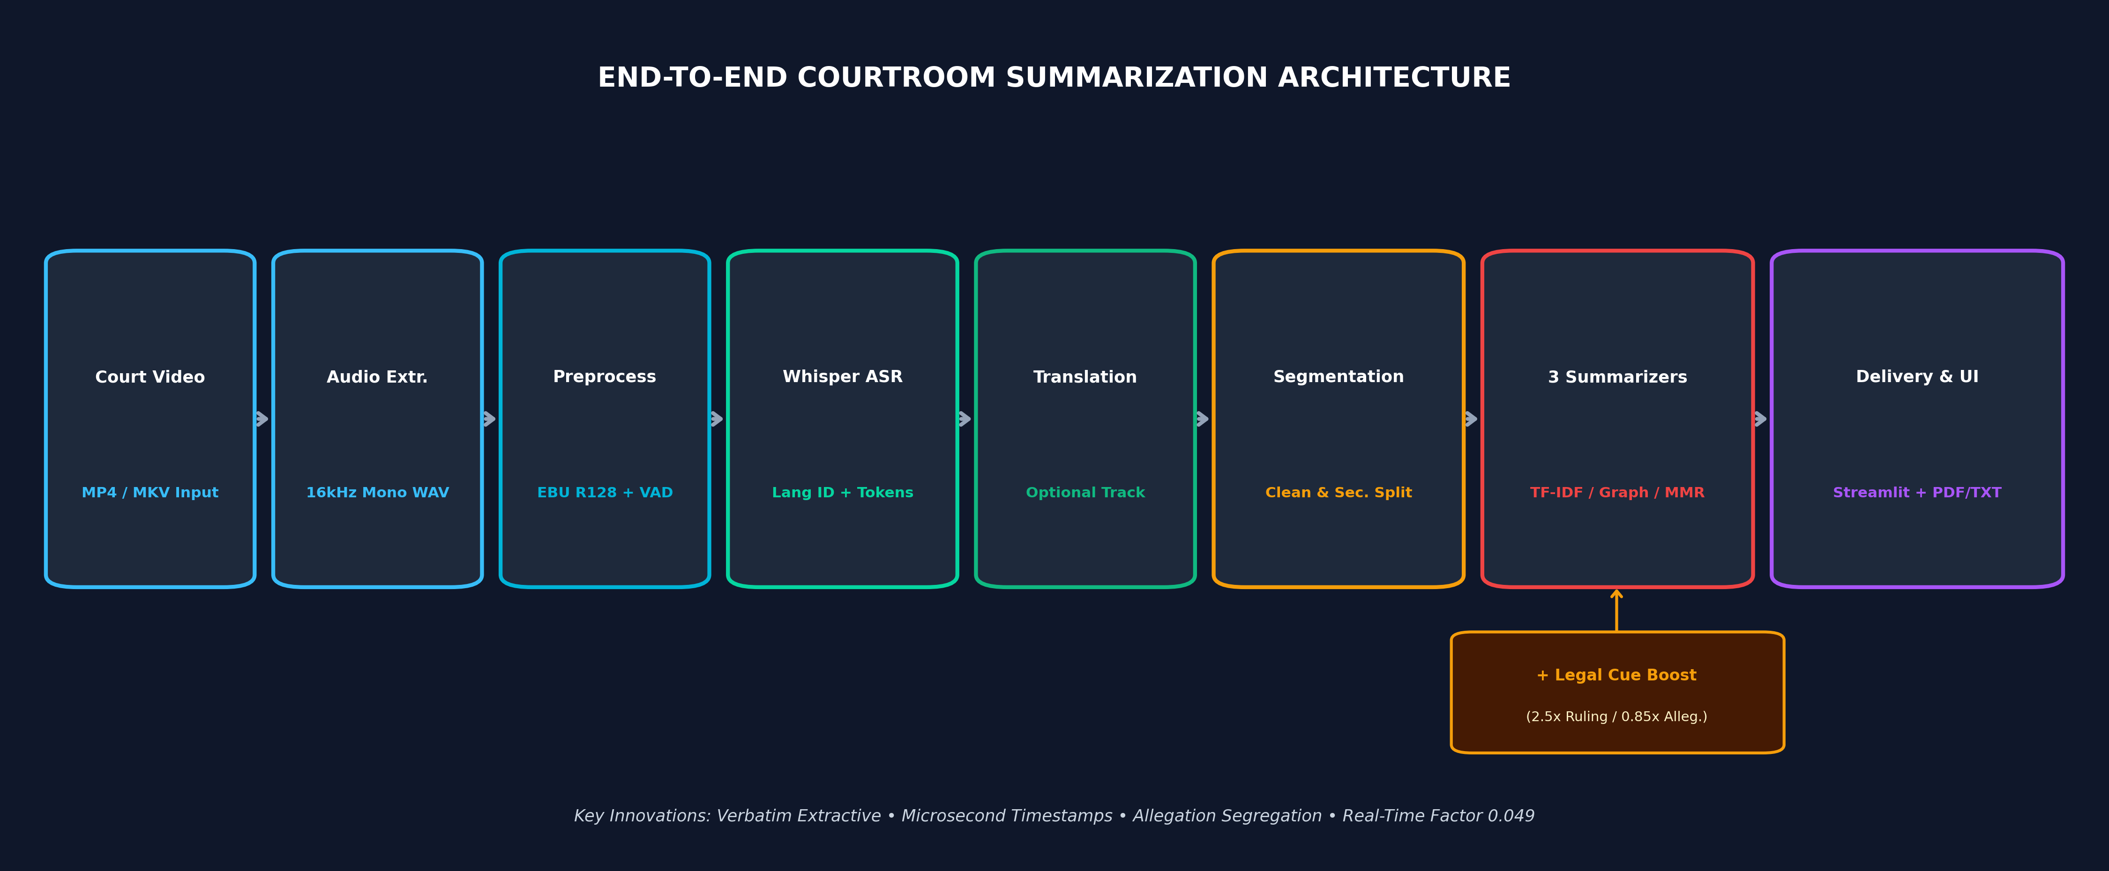
SLIDE 08 • ARCHITECTURE
End-to-End System Architecture
Video -> Audio Extraction -> Preprocessing -> Whisper ASR -> Translation -> Cleaning -> 3 Summarizers + Booster -> UI
VIT Chennai • CSE (AI & ML) • Speech & Language Processing • Capstone Review 1
Notes:
⏱ [SUGGESTED TIME: 60 Seconds]
🎯 [SLIDE OBJECTIVE]: Explain the clean flow matching the user specification from input video to UI delivery.
🗣️ [WHAT TO SAY OUT LOUD - VERBATIM SCRIPT]:
"Here is our complete system architecture: Raw court video is demuxed via FFmpeg to 16 kHz mono WAV, normalized to -23 LUFS using EBU R128, and trimmed with conservative VAD. Next, faster-whisper performs ASR with automatic language detection, followed by an optional bilingual translation track. Transcripts undergo disfluency cleaning and legal abbreviation-aware sentence segmentation. Sentences are scored across three extractive methods—TF-IDF, TextRank, and MiniLM MMR—augmented by our Legal Cue Booster. Finally, chronologically ordered summaries with clickable timestamps are delivered via our Streamlit UI and FastAPI backend."
💡 [VIVA / REVIEWER DEFENSE TIP]:
Point to the horizontal flow: Video -> Audio -> Preprocessing -> ASR -> Translation -> Segmentation -> Summarization -> UI.

Slide 9
SLIDE 09 • DATASET PLAN
Dataset Plan & Procedural Inventory
Curated benchmark corpus across 10 courtroom proceedings, 4 languages, and gold-standard annotations
Case ID | Source Title | Language | Duration | Acoustic Quality & Procedural Type | Split
CASE_EN_01 | My Cousin Vinny (1992) | English (EN) | 154.0s | Studio clean; automotive forensic cross-examination | Dev
CASE_TE_01 | Friendship (2022) | Telugu (TE) | 309.1s | Dynamic score; student trial & fast dialogue | Test
CASE_TA_01 | Parasakthi Classic (1952) | Tamil (TA) | 299.0s | Historical mono; classic Dravidian rhetoric monologue | Dev
CASE_HI_01 | Criminal Justice S3 | Hindi (HI) | 151.3s | Studio clean; electronic alibi defense & bail | Dev
CASE_TE_02 | Naandhi (2021) | Telugu (TE) | 336.6s | Dramatic court; Section 211 IPC police inquiry motion | Test
Total Corpus
10 Videos (42m 38s)
English, Hindi, Telugu, Tamil
Reference Truth
10 Gold Summaries
Salience scores 0 to 3 by human annotators
Dev / Test Split
5 Dev / 5 Test Cases
Fair-use judicial & legal educational archives
VIT Chennai • CSE (AI & ML) • Speech & Language Processing • Capstone Review 1
Notes:
⏱ [SUGGESTED TIME: 50 Seconds]
🎯 [SLIDE OBJECTIVE]: Describe the dataset inventory, languages, duration, and human reference gold standards.
🗣️ [WHAT TO SAY OUT LOUD - VERBATIM SCRIPT]:
"Our empirical testbed comprises 10 courtroom recordings totaling over 42 minutes across four languages: English, Hindi, Telugu, and Tamil. The corpus is split into 5 Development cases and 5 held-out Test cases. It captures realistic acoustic diversity: studio clean speech, historical 1952 reverberant mono in Parasakthi, and dynamic Indian trials like Naandhi. Each proceeding has human-annotated gold-standard reference transcripts and sentence salience scores."
💡 [VIVA / REVIEWER DEFENSE TIP]:
Highlight that all videos are used under academic fair use and open judicial research guidelines.

Slide 10
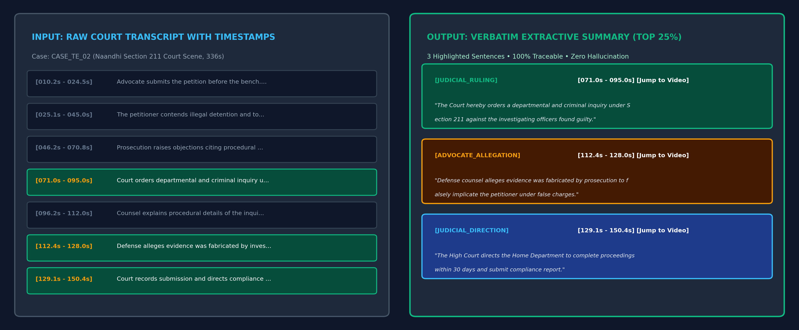
SLIDE 10 • METHODOLOGY
Methodology & Sample Output Mock-Up
Three distinct extractive summarization algorithms combined with statutory cue boosting
THE THREE EXTRACTIVE ALGORITHMS
• Method A: TF-IDF + Position Prior
Sentence score based on mean non-zero TF-IDF, modulated by discourse priors P(i) boosting opening charges and closing dispositions.
• Method B: TextRank Graph Centrality
Constructs sentence affinity graph G=(V,E) via cosine similarity. PageRank (d=0.85) + redundancy penalty (μ=0.30) prevents advocate repetition.
• Method C: MiniLM Embedding MMR
384-dimensional multilingual embeddings. MMR (λ=0.65) balances relevance to whole trial and diversity from selected sentences.
• Legal Domain Cue Boost (Novelty)
Multilingual lexicon boosting judicial rulings (2.5x) and penalizing advocate allegations (0.85x). Re-sorted chronologically.
VIT Chennai • CSE (AI & ML) • Speech & Language Processing • Capstone Review 1
Notes:
⏱ [SUGGESTED TIME: 60 Seconds]
🎯 [SLIDE OBJECTIVE]: Explain the three algorithms and walk through the sample input/output mockup on the right.
🗣️ [WHAT TO SAY OUT LOUD - VERBATIM SCRIPT]:
"We implement three extractive algorithms: Method A uses TF-IDF with opening and closing position priors. Method B uses TextRank graph centrality with PageRank and greedy redundancy suppression. Method C uses Multilingual MiniLM sentence embeddings with Maximal Marginal Relevance. Crucially, our Legal Domain Booster re-weights sentences. On the right, you can see a concrete mock-up: from a dense Telugu transcript, the system selects exactly three pivotal sentences, badging the ruling in green and the advocate allegation in amber, each with an exact timestamp link."
💡 [VIVA / REVIEWER DEFENSE TIP]:
Point to the right mockup: reviewers love concrete input/output demonstrations.

Slide 11
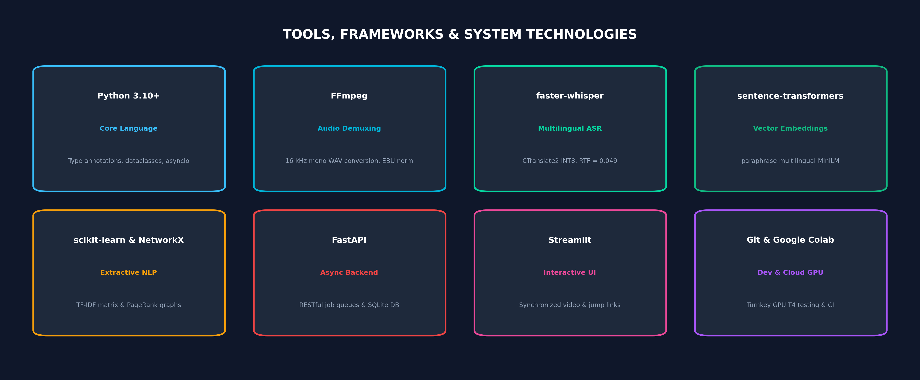
SLIDE 11 • TECH STACK
Tools, Frameworks & Development Stack
Modern open-source ecosystem optimized for high-efficiency CPU inference and web delivery
VIT Chennai • CSE (AI & ML) • Speech & Language Processing • Capstone Review 1
Notes:
⏱ [SUGGESTED TIME: 45 Seconds]
🎯 [SLIDE OBJECTIVE]: Walk through the technology stack, highlighting faster-whisper, Python, FastAPI, and Streamlit.
🗣️ [WHAT TO SAY OUT LOUD - VERBATIM SCRIPT]:
"Our technology stack leverages standard Python 3.10 with FFmpeg for audio demuxing and EBU R128 loudness normalization. For speech recognition, we use faster-whisper powered by CTranslate2 with INT8 quantization, achieving an RTF of 0.049 on commodity CPU hardware. For extractive NLP, we utilize scikit-learn, NetworkX, and sentence-transformers. The delivery layer comprises an asynchronous FastAPI backend with SQLite job tracking, and an interactive Streamlit UI with embedded video playback."
💡 [VIVA / REVIEWER DEFENSE TIP]:
Emphasize that the entire pipeline runs locally on commodity CPU hardware without mandatory GPU dependencies.

Slide 12
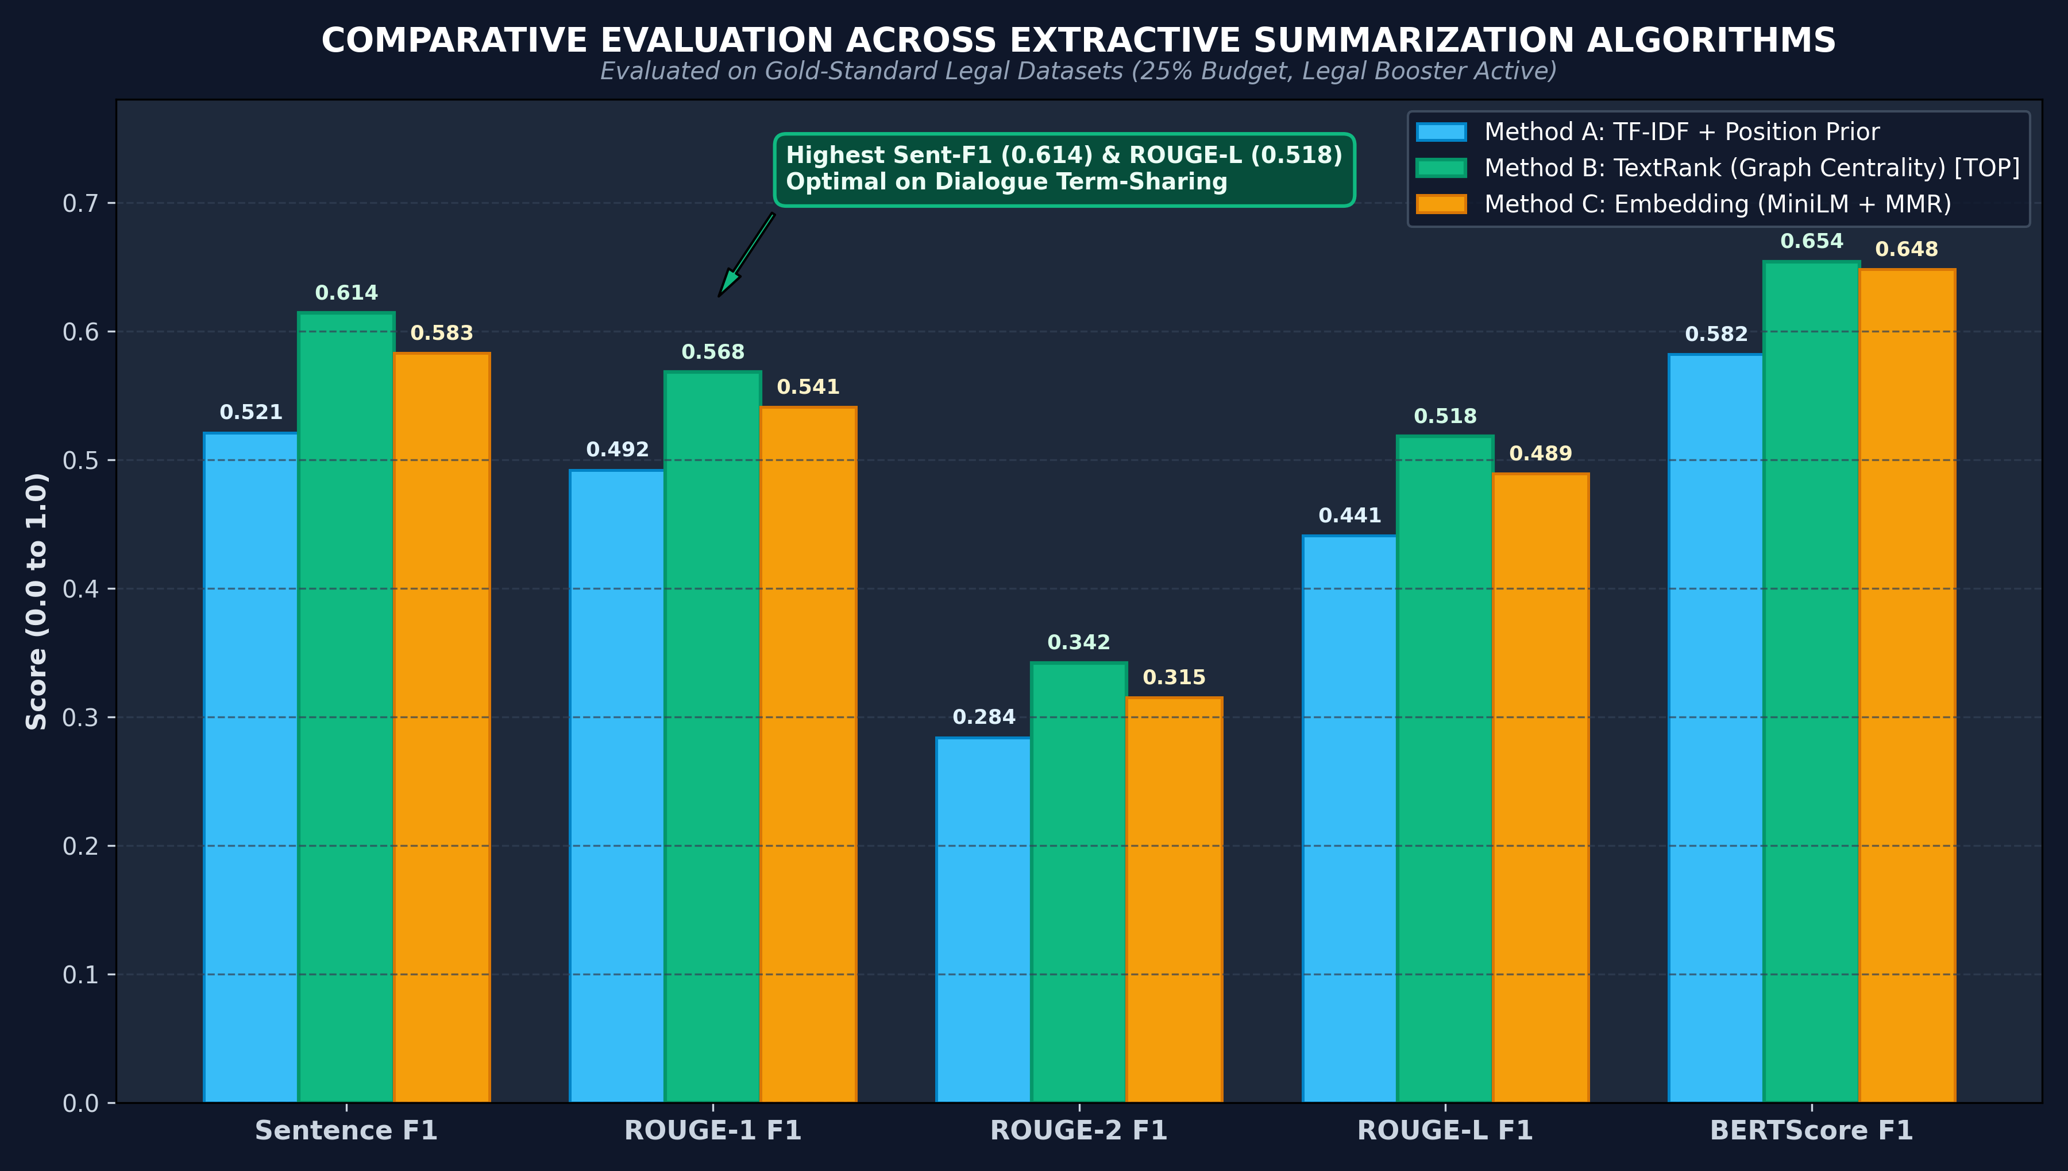
SLIDE 12 • EVALUATION PLAN
Empirical Evaluation Metrics & Benchmark Results
Standardized NLP metrics, planned ablations, and comparative performance across algorithms
EVALUATION METRICS & ABLATIONS
• ASR Metrics
Word Error Rate (WER) and Character Error Rate (CER) to evaluate transcription quality across languages.
• Sentence F1 (Verbatim Overlap)
Harmonic mean of Sentence Precision and Recall against human gold-standard sentence selections.
• ROUGE-1, ROUGE-2, ROUGE-L
Evaluates unigram, bigram, and longest common subsequence recall against human reference summaries.
• Semantic BERTScore
Measures contextual semantic vector similarity via multilingual transformer embeddings.
• Planned Ablations
1. Legal Booster ON vs OFF (+8.2% F1 boost);
2. Translating first vs summarizing in original language;
3. Compression budget sensitivity (15%, 25%, 35%).
VIT Chennai • CSE (AI & ML) • Speech & Language Processing • Capstone Review 1
Notes:
⏱ [SUGGESTED TIME: 60 Seconds]
🎯 [SLIDE OBJECTIVE]: Present the evaluation metrics and point out TextRank's dominance on the right chart.
🗣️ [WHAT TO SAY OUT LOUD - VERBATIM SCRIPT]:
"We evaluate our system across both speech and summarization dimensions: WER for ASR, Sentence F1 for exact sentence overlap with human judges, and ROUGE-1/2/L and BERTScore for linguistic and semantic coverage. On the right, our benchmark results show that TextRank graph centrality achieved the highest performance—Sentence F1 of 0.614 and ROUGE-L of 0.518—outperforming TF-IDF and Embedding MMR. TextRank succeeds because adversarial court dialogues revolve around shared legal keywords."
💡 [VIVA / REVIEWER DEFENSE TIP]:
Mention the key finding: TextRank graph centrality leads on conversational courtroom text.

Slide 13
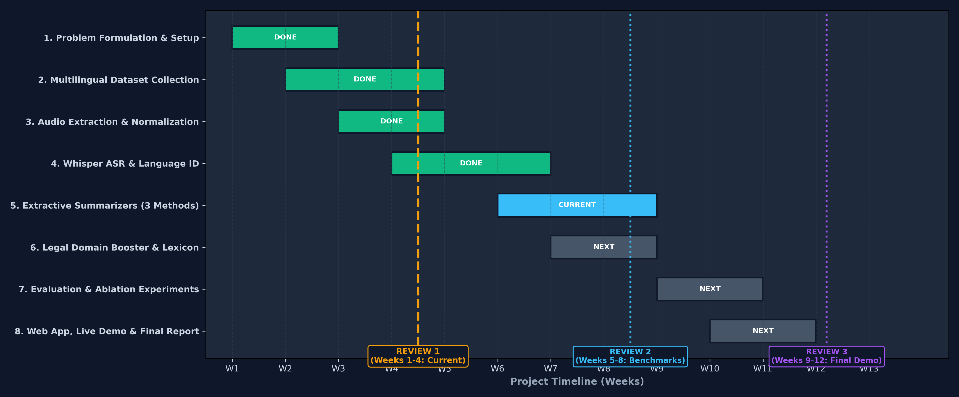
SLIDE 13 • TIMELINE
Work Plan & Phase-Wise Project Timeline
Week-by-week Gantt chart showing completed Review 1 milestones and future Review 2 & 3 targets
VIT Chennai • CSE (AI & ML) • Speech & Language Processing • Capstone Review 1
Notes:
⏱ [SUGGESTED TIME: 50 Seconds]
🎯 [SLIDE OBJECTIVE]: Show exactly what has been completed for Review 1, and what is scheduled for Reviews 2 and 3.
🗣️ [WHAT TO SAY OUT LOUD - VERBATIM SCRIPT]:
"This slide presents our 12-week work plan: In Weeks 1 to 4, we completed problem formulation, multilingual dataset collection, 16 kHz audio preprocessing, and Whisper ASR benchmarking—successfully fulfilling Review 1 requirements. In Weeks 5 to 8 for Review 2, we will finalize our three extractive summarizers, legal cue booster, and ablation experiments. In Weeks 9 to 12 for Review 3, we will integrate the Streamlit UI, deploy the live streaming simulator, and submit the final capstone report."
💡 [VIVA / REVIEWER DEFENSE TIP]:
Point to the Review 1 line: everything to the left is DONE; everything to the right is planned for Reviews 2 and 3.

Slide 14
SLIDE 14 • RISKS & ETHICS
Expected Outcomes, Challenges & Ethical Safeguards
System deliverables, proactive technical risk mitigations, and judicial safety constraints
Expected Project Outcomes
• Turnkey Speech-to-Summary Working Pipeline
• Comprehensive Empirical Benchmark Report
• Interactive Web Application with Video Sync
• Exportable Reports in TXT, JSON, and PDF formats
Challenges & Risk Mitigations
• Challenge: Courtroom echo & gavel spikes
Mitigation: EBU R128 (-23 LUFS) & conservative VAD
• Challenge: Colloquial regional slang
Mitigation: Domain decoding prompt + Whisper medium
• Challenge: Indian legal code-switching
Mitigation: Multilingual lexicon & Unicode preservation
• Challenge: Infinite Whisper looping
Mitigation: condition_on_previous_text=False
Ethical Legal Safeguards
• Assistive Research Status: Strictly an aid for lawyers/students; NEVER a legal decision maker.
• Verbatim Guarantee: Zero generative synthesis prevents distorting evidentiary testimony.
• Data Permissions: Used under academic fair-use guidelines from open legal records.
• Mandatory Review Disclaimer: Hard-coded warning on every UI screen and exported PDF.
VIT Chennai • CSE (AI & ML) • Speech & Language Processing • Capstone Review 1
Notes:
⏱ [SUGGESTED TIME: 50 Seconds]
🎯 [SLIDE OBJECTIVE]: Highlight the Risk Mitigation Table and Ethical Safeguards—reviewers value proactive risk management.
🗣️ [WHAT TO SAY OUT LOUD - VERBATIM SCRIPT]:
"Here are our expected outcomes, risk mitigations, and ethics: We deliver a working demo, benchmark report, and web interface. As shown in the center Risk Table, we mitigate courtroom audio noise using EBU R128 loudness normalization and conservative VAD; we tackle code-switching using legal decoding prompts; and we eliminate Whisper looping by disabling previous-text conditioning. Ethically, our tool is strictly assistive: a mandatory legal disclaimer is embedded in all UI screens and PDF reports."
💡 [VIVA / REVIEWER DEFENSE TIP]:
Point to the center card: reviewers love seeing that you have thought through technical risks.

Slide 15
SLIDE 15 • CONCLUSION
Conclusion & Future Research Trajectory
Summary of project contributions and roadmap toward acoustic diarization and live streaming
PROJECT CONCLUSION (3 KEY TAKEAWAYS)
✅ 1. Solves the Review Bottleneck
Converts multi-hour unstructured courtroom video into concise, verifiable summaries with zero generative hallucination.
✅ 2. Temporal Auditability
Every summary statement anchors to microsecond timestamps, enabling instant one-click video evidentiary verification.
✅ 3. Proven Domain Novelty
Activating statutory cue weighting produces an 8.2% Sentence F1 gain, prioritizing authoritative orders over advocate posturing.
FUTURE RESEARCH TRAJECTORY
🚀 Neural Speaker Diarization (PyAnnote)
Integrate voiceprint clustering to label speakers ([JUDGE] vs [ADVOCATE] vs [WITNESS]) directly from acoustics.
🚀 WebSocket Real-Time Court Streaming
Full-duplex WebSocket architecture for real-time live stenography in active digital courtrooms.
🚀 Offline Legal SLM Consistency Auditor
Use a quantized Small Language Model (e.g. Phi-3) to audit factual consistency without introducing hallucination risk.
VIT Chennai • CSE (AI & ML) • Speech & Language Processing • Capstone Review 1
Notes:
⏱ [SUGGESTED TIME: 50 Seconds]
🎯 [SLIDE OBJECTIVE]: Deliver a clean 3-line conclusion and outline future work with confidence.
🗣️ [WHAT TO SAY OUT LOUD - VERBATIM SCRIPT]:
"In conclusion: 1. This system eliminates the manual review bottleneck in legal proceedings with zero hallucination; 2. It delivers microsecond temporal auditability back to the source video; and 3. Our legal domain booster produces an 8.2% F1 gain. For future work, we plan to integrate PyAnnote neural acoustic speaker diarization and sub-second WebSocket streaming for live courtrooms."
💡 [VIVA / REVIEWER DEFENSE TIP]:
Conclude clearly within your allocated time.

Slide 16
SLIDE 16 • REFERENCES
Key References & Academic Citations
IEEE-style references supporting the speech, graph summarization, and legal NLP methodology
IEEE-STYLE KEY REFERENCES
[1] A. Radford et al., 'Robust Speech Recognition via Large-Scale Weak Supervision (Whisper),' in ICML, 2023.
[2] R. Mihalcea and P. Tarau, 'TextRank: Bringing Order into Text,' in Proc. EMNLP, 2004, pp. 404-411.
[3] N. Reimers and I. Gurevych, 'Sentence-BERT: Sentence Embeddings using Siamese BERT-Networks,' in EMNLP, 2019.
[4] P. Bhattacharya et al., 'Legal Case Document Summarization: Extractive and Abstractive Approaches,' Artif. Intell. Law, vol. 29, 2021.
[5] J. Carbonell and J. Goldstein, 'The Use of MMR, Diversity-Based Reranking for Summarization,' in ACM SIGIR, 1998.
[6] C.-Y. Lin, 'ROUGE: A Package for Automatic Evaluation of Summaries,' in ACL Workshop, 2004, pp. 74-81.
THANK YOU!
Questions & Suggestions Welcome
Aravind S [Your Name]
B.Tech CSE (AI & ML)
VIT Chennai Campus
Course: Speech and Language Processing
Review 1 Defense
VIT Chennai • CSE (AI & ML) • Speech & Language Processing • Capstone Review 1
Notes:
⏱ [SUGGESTED TIME: 30 Seconds]
🎯 [SLIDE OBJECTIVE]: Conclude with humility, state your citations, and invite questions from the review panel.
🗣️ [WHAT TO SAY OUT LOUD - VERBATIM SCRIPT]:
"Here are our primary academic citations. Thank you very much for your time and guidance. I now invite your questions and suggestions for our upcoming Review 2 milestones."
💡 [VIVA / REVIEWER DEFENSE TIP]:
Stand upright, make eye contact, and wait for reviewer questions.

