Slide 1
Explainability Analysis of Neural Networks Using Feature Attribution Methods Project Review – 1
by
ARAVIND SAI TEJA C [23BAI1058]
A project submitted to
Dr RAJIV VINCENT

Slide 2
Introduction
Deep Neural Networks (DNNs) have achieved remarkable performance across various domains, including healthcare diagnosis, financial prediction, and computer vision applications.
Despite their high accuracy, these models function as black-box systems, offering limited visibility into their internal decision-making processes.
In high-stakes applications, understanding why a model makes a particular prediction is essential to ensure trust, transparency, and accountability.
This project focuses on enhancing neural network interpretability through feature attribution techniques.

Slide 3
Project Objectives & Datasets Used
The key objectives of this project are:
Train neural networks on benchmark datasets
Implement feature attribution methods
Generate visual explanations
Compare different explainability techniques
Evaluate explanation stability and faithfulness
The project utilizes both image and tabular datasets:
MNIST – Handwritten digit classification
CIFAR-10 – Object recognition dataset
Breast Cancer Wisconsin Dataset – Medical diagnosis
Adult Income Dataset – Socioeconomic classification
Using diverse datasets ensures robustness of analysis.

Slide 4
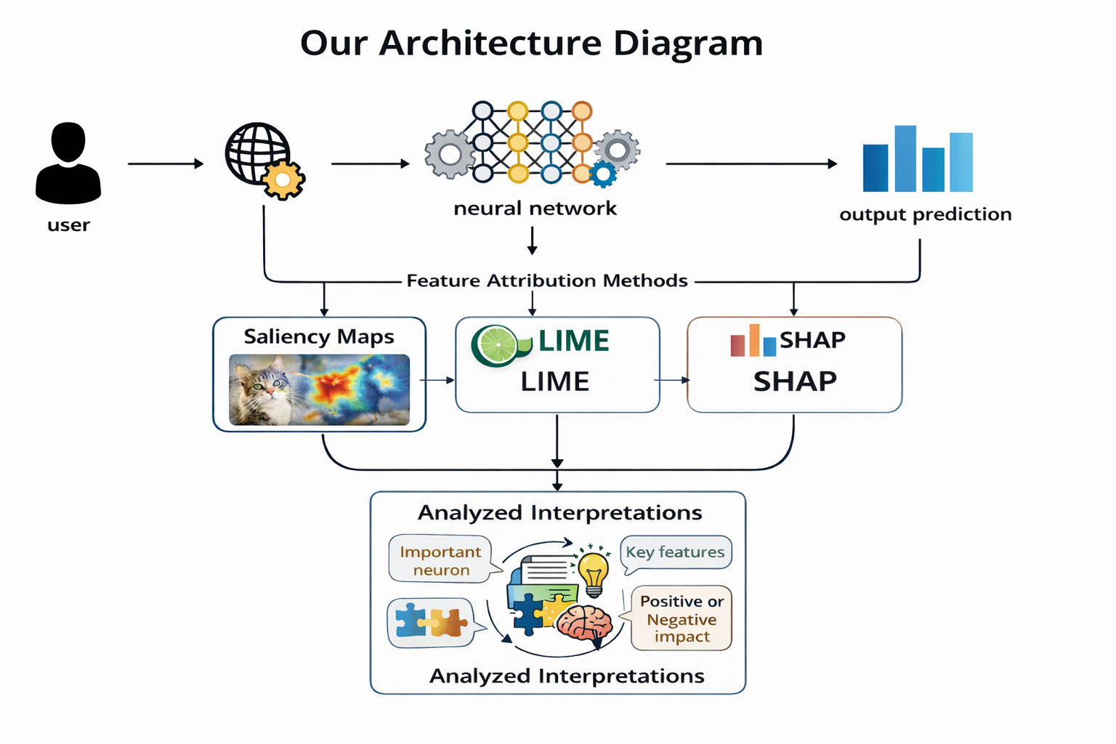

Slide 5
System Architecture Overview
The proposed explainability framework follows a structured pipeline consisting of the following stages:
User Input Image or tabular data is provided to the system.
Neural Network Model Training CNN models are used for image datasets, and MLP models are used for tabular datasets.
Output Prediction The trained model generates classification results.
Application of Feature Attribution Methods Post-hoc explainability techniques are applied to analyze feature contributions.
Interpretation and Analysis The generated explanations are evaluated to understand model behavior and feature influence.
This structured architecture ensures systematic and reliable explainability evaluation.

Slide 6
Feature Attribution Techniques
To interpret model predictions, we implement two categories of explainability methods:
Gradient-Based Methods
Saliency Maps – Highlight important input regions influencing predictions.
Integrated Gradients – Measure feature contributions by accumulating gradients along the input path.
Model-Agnostic Methods
LIME (Local Interpretable Model-Agnostic Explanations) – Provides local approximations of model behavior.
SHAP (SHapley Additive Explanations) – Computes feature contributions based on cooperative game theory principles.
Each method offers a distinct perspective on feature importance, enabling comprehensive interpretability analysis.

Slide 7
Workflow, Evaluation and Comparative Analysis
System Workflow
The explainability framework follows a structured pipeline:
Data Preprocessing Raw datasets are cleaned, normalized, and prepared for model training.
Model Prediction The trained neural network (CNN/MLP) generates classification outputs.
Feature Attribution Explainability methods (Saliency Maps, LIME, SHAP) compute feature importance scores to identify influential inputs.
Visualization Attribution results are visualized through heatmaps and feature importance plots.
Interpretation Assessment Generated explanations are systematically analyzed for reliability and consistency.

Slide 8
Evaluation and Comparative Analysis
To systematically assess the effectiveness of different explainability techniques, we compare them based on the following criteria:
Explanation Quality – The clarity, relevance, and interpretability of feature importance results.
Stability Across Runs – Consistency of explanations when the model is retrained or tested multiple times.
Faithfulness to Model Behavior – The degree to which explanations accurately reflect the model’s true decision-making process.
Computational Efficiency – Time and resource requirements for generating explanations.
This comparative evaluation enables us to identify the strengths and limitations of each feature attribution method.

Slide 9
Conclusion and Impact
This project contributes significantly to improving interpretability in deep learning systems by:
Enhancing transparency in AI models
Increasing trust in medical and financial decision systems
Promoting accountability in neural network predictions
Supporting the development of responsible and ethical AI
By integrating systematic evaluation with multiple attribution techniques, we transform neural networks from black-box models into interpretable and trustworthy AI systems.

