Slide 1
PLACEHOLDER: ESG Momentum Engine
PLACEHOLDER: Synthetic demonstration deck, not real investment research
PLACEHOLDER: Replace every slide before presenting. Current content is scaffold text only.
01 / ESG MOMENTUM ENGINE

Slide 2
PLACEHOLDER: ESG scores are slow; momentum is the product idea.
PLACEHOLDER: One sentence should carry the opening tension after Claude supplies final language.
02 / STATEMENT

Slide 3
PLACEHOLDER: The thesis is to separate static ESG level from change.
PLACEHOLDER: Explain the one-idea thesis here without bullets or unsupported performance language.
03 / STATEMENT

Slide 4
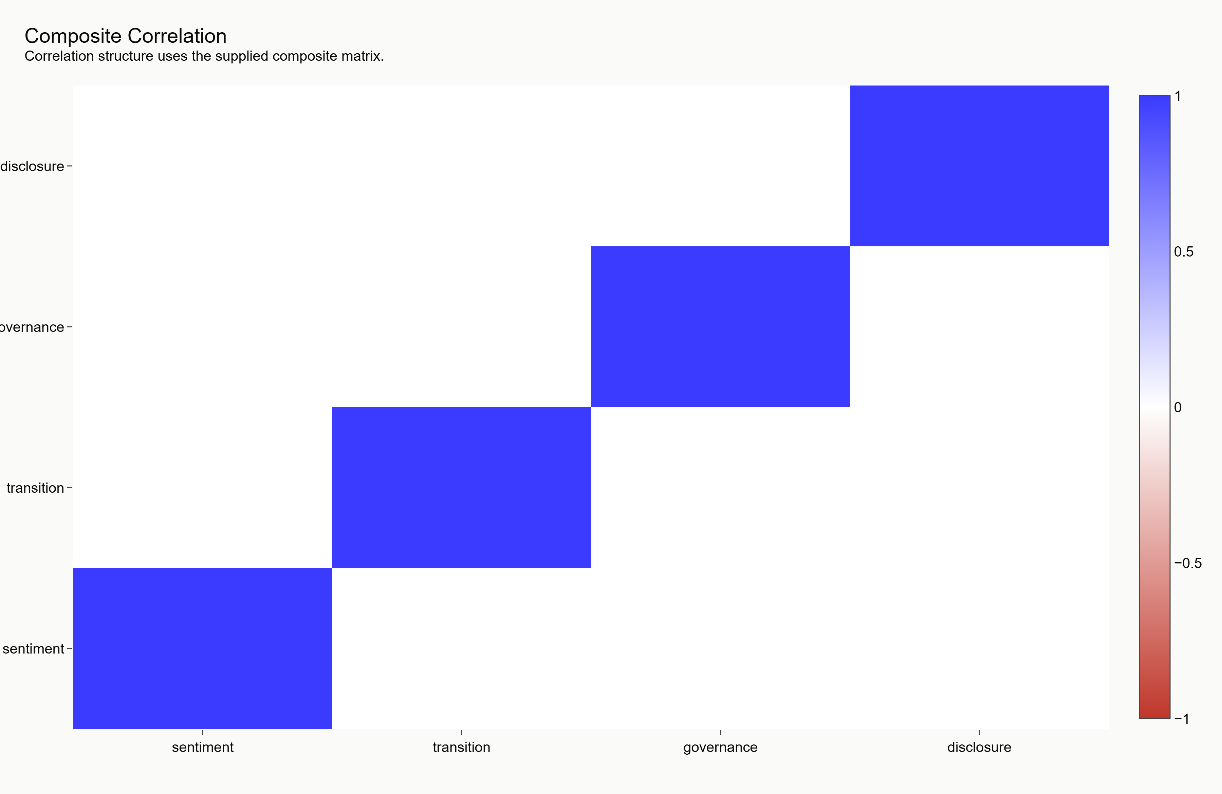
PLACEHOLDER: Architecture turns raw inputs into explainable ranks.
PLACEHOLDER: Describe fetchers, signals, validation, scoring, and frontend artifacts at a high level.
04 / SPLIT

Slide 5
PLACEHOLDER: Data honesty is a feature, not a footnote.
PLACEHOLDER: State synthetic mode, missing-data rules, and non-advice status clearly.
05 / STATEMENT

Slide 6
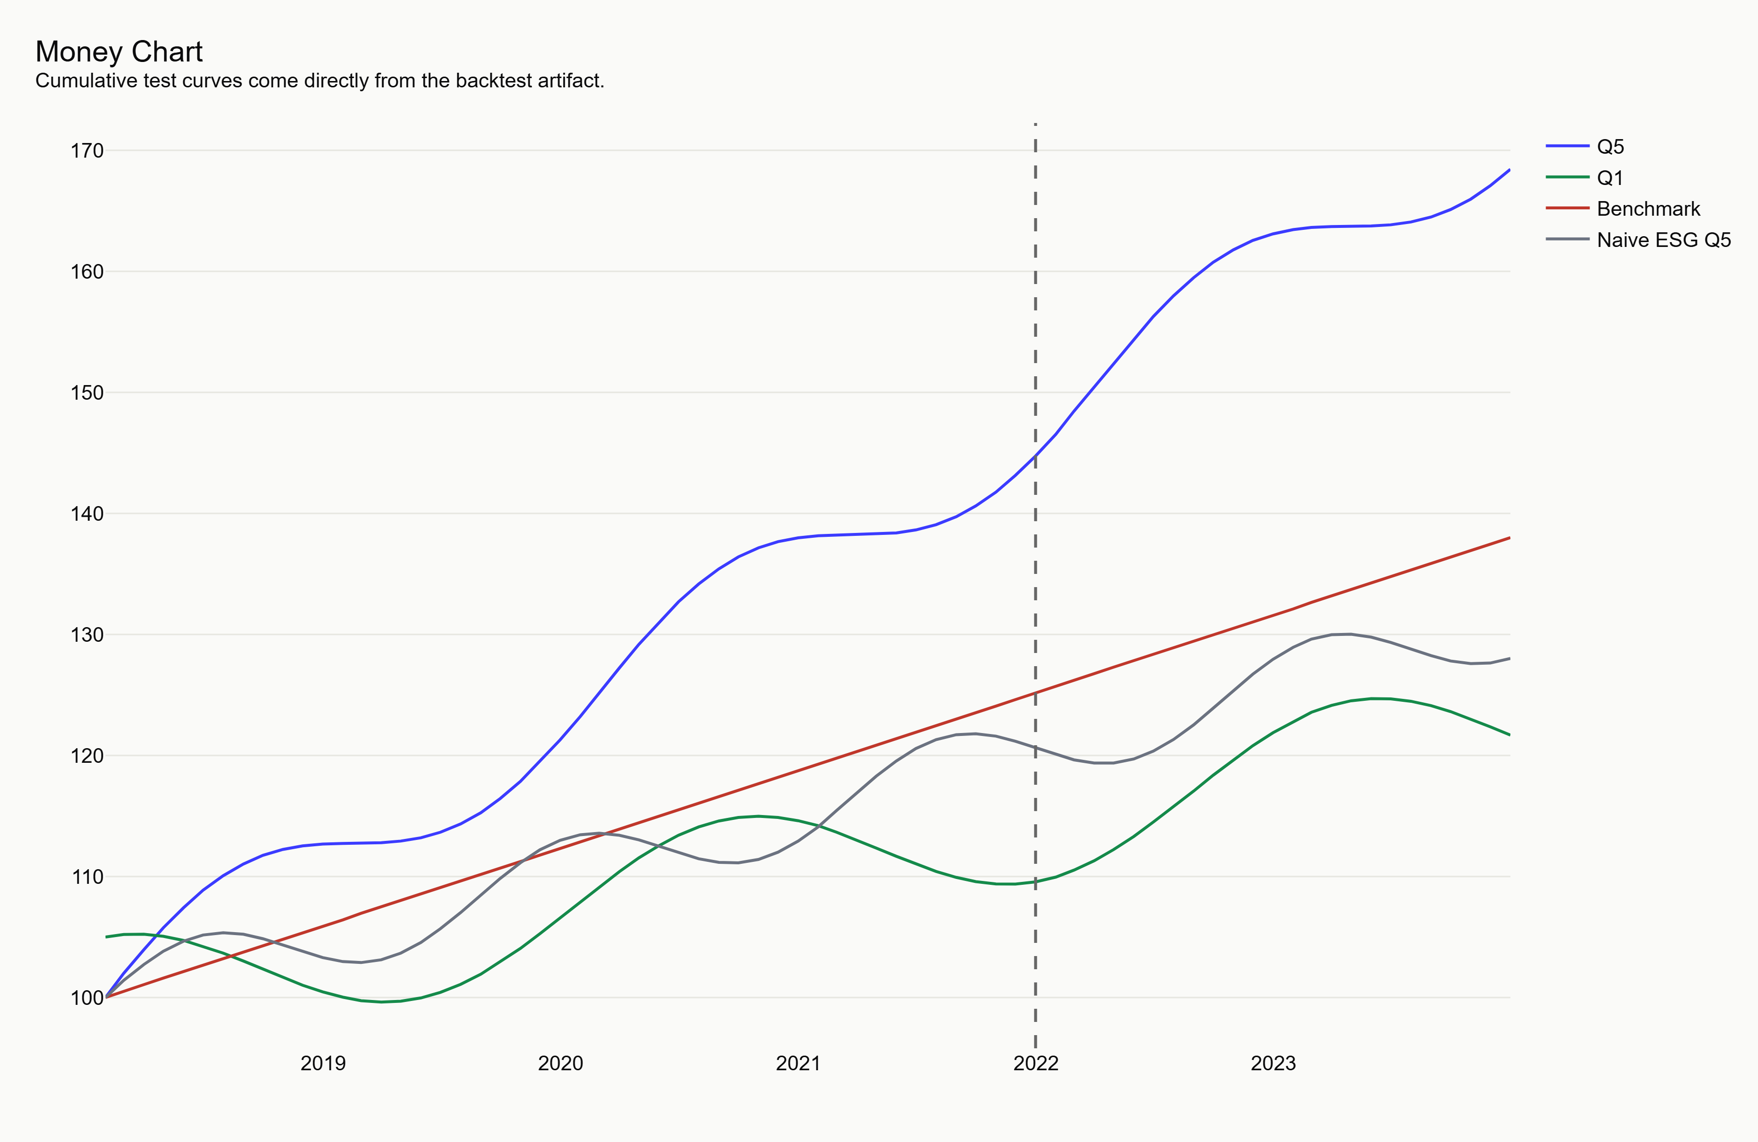
PLACEHOLDER: The money chart will carry the result.
PLACEHOLDER: Current chart is synthetic/demo output and must not be presented as live validation.
06 / FIGURE

Slide 7
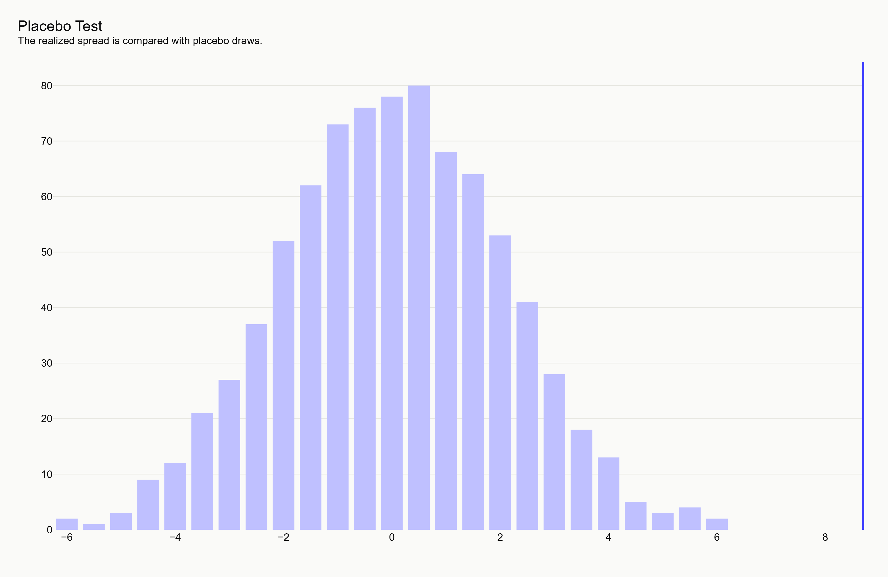
PLACEHOLDER: Placebo testing will guard against false signal.
PLACEHOLDER: Replace with final interpretation only after Claude-owned validation is complete.
07 / FIGURE

Slide 8
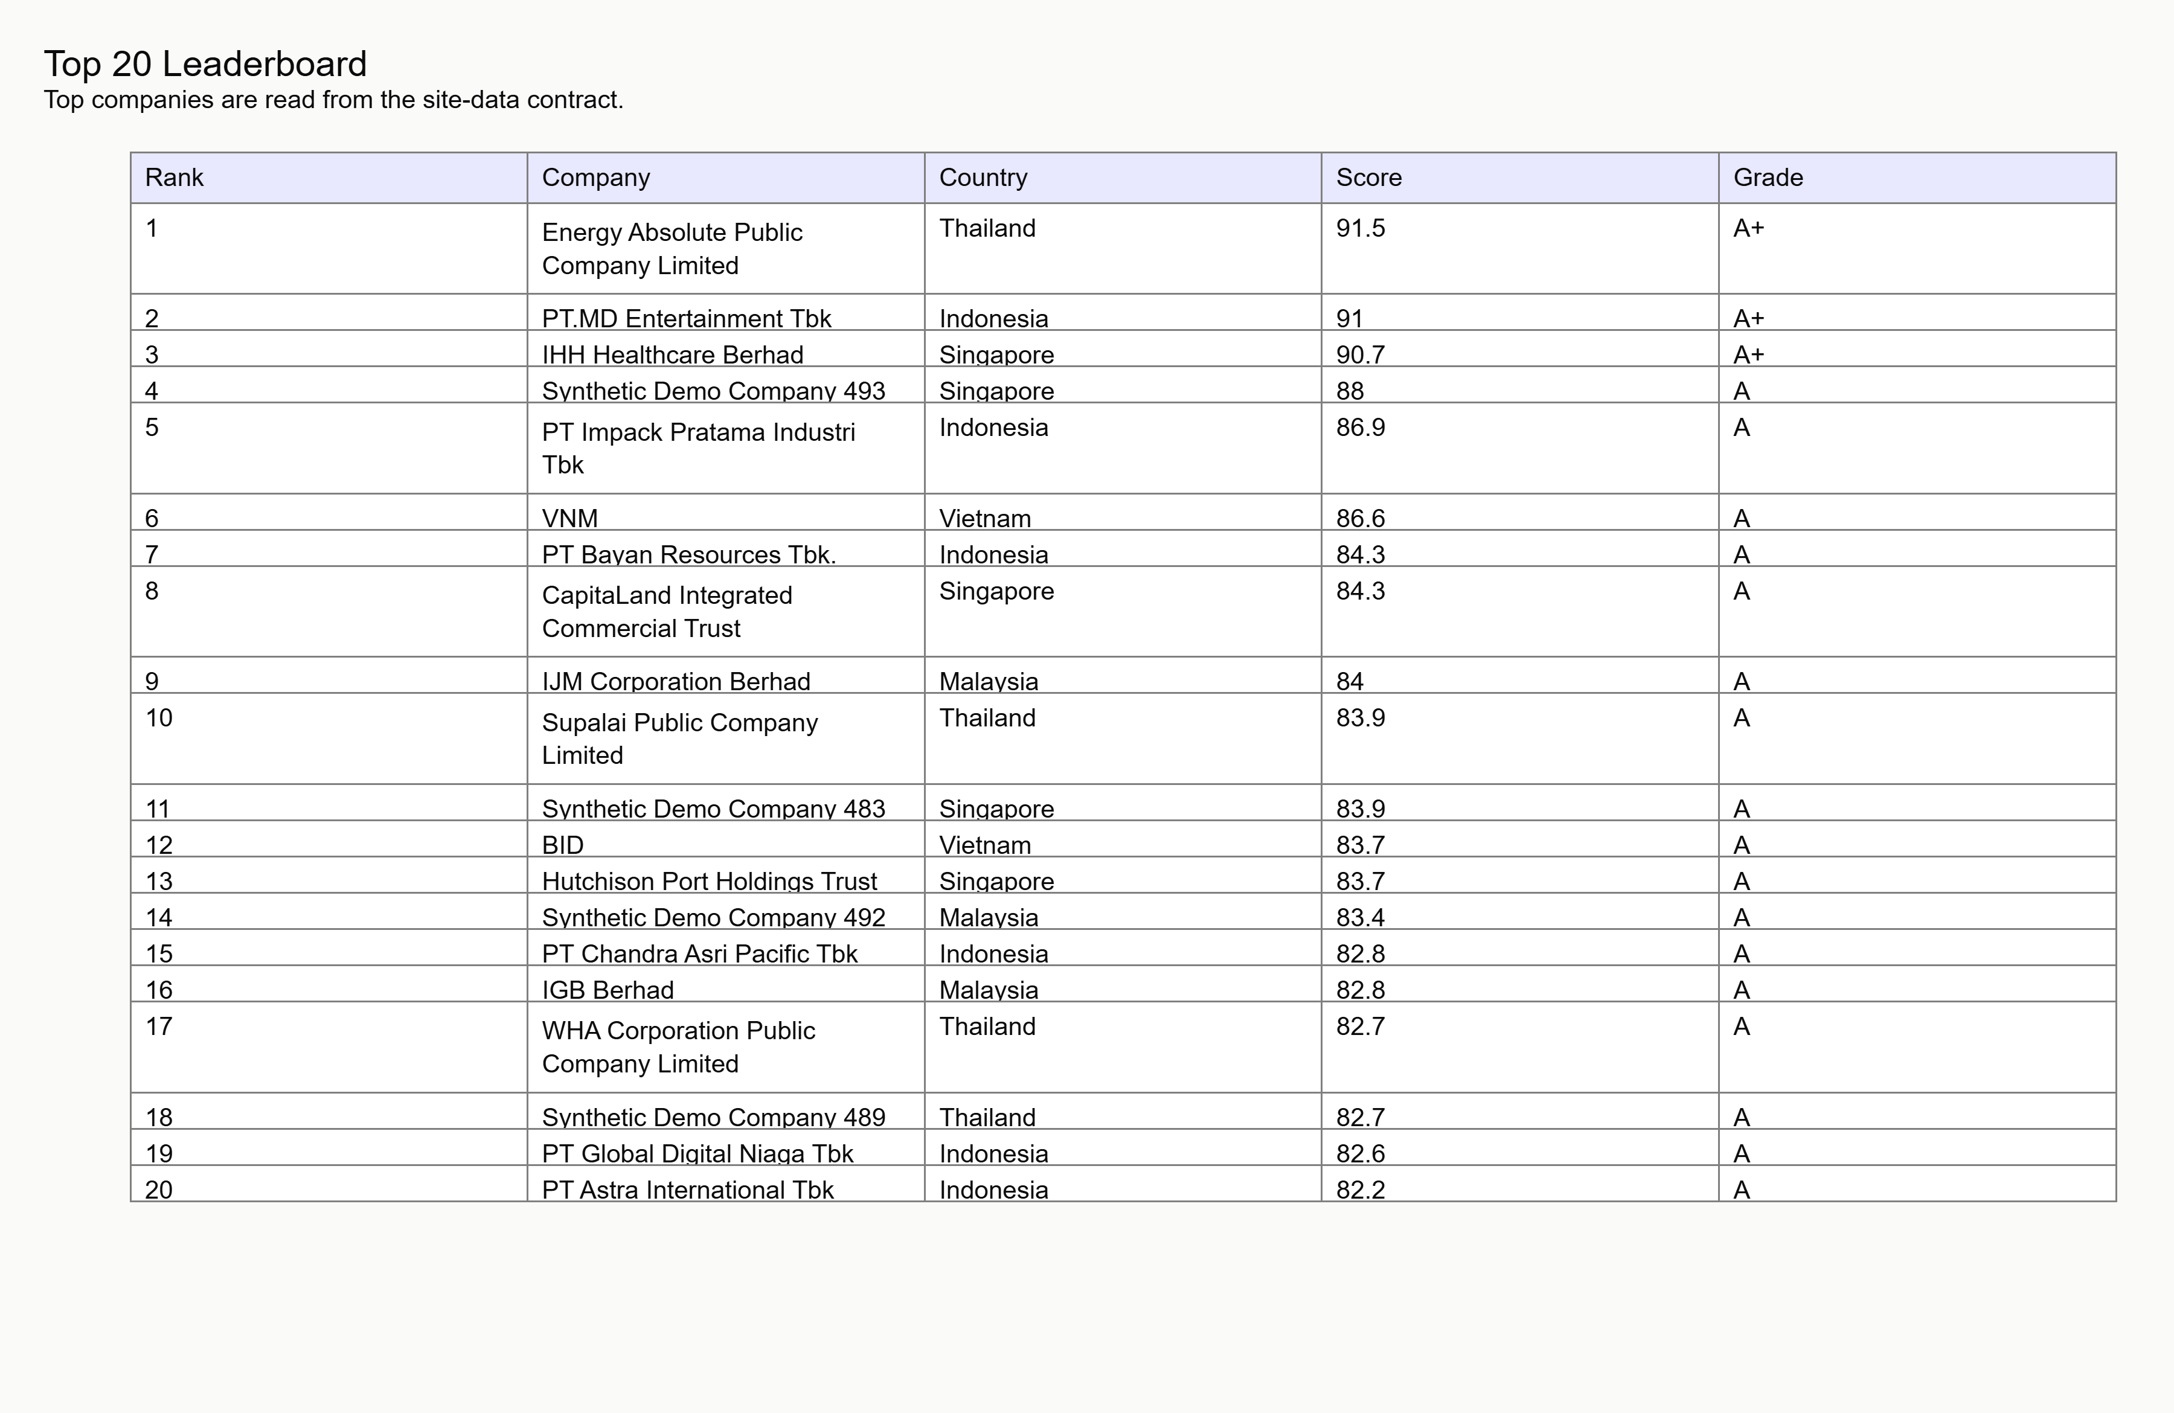
PLACEHOLDER: Product screenshots show the screening workflow.
PLACEHOLDER: Use actual browser screenshots after frontend QA; this figure is a placeholder artifact.
08 / SPLIT

Slide 9
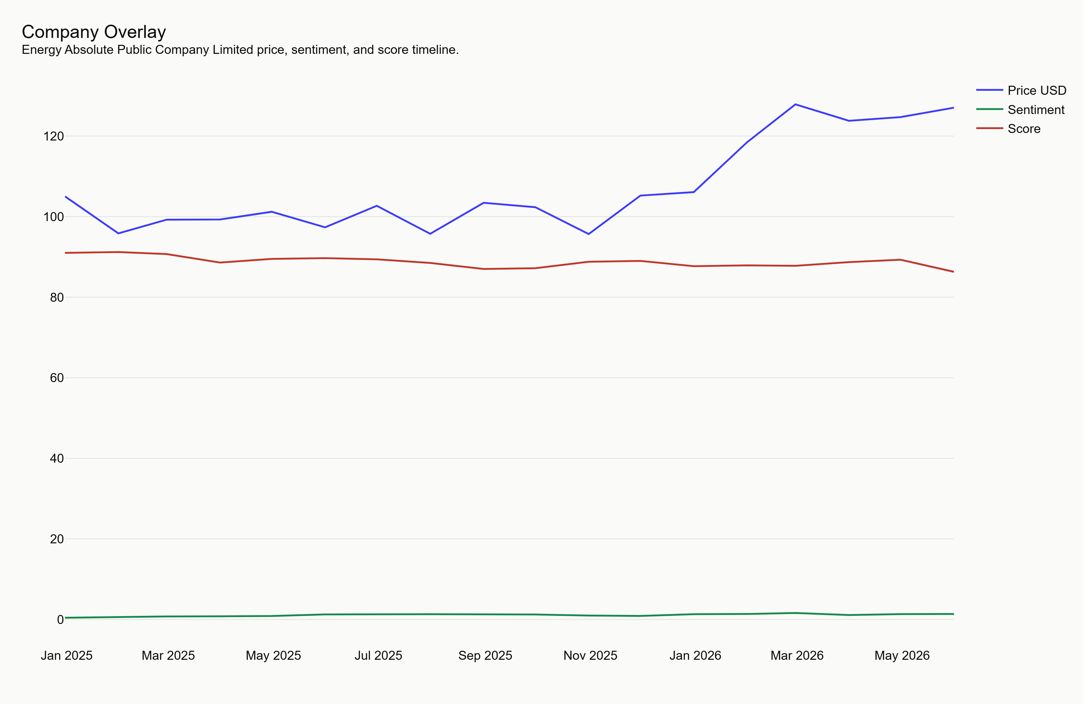
PLACEHOLDER: A case study should explain one company without overclaiming.
PLACEHOLDER: Insert a synthetic or approved live case study only with clear source status.
09 / SPLIT

Slide 10
PLACEHOLDER: The risks are data coverage, market structure, and model drift.
PLACEHOLDER: Keep this candid. Do not hide limitations behind product language.
10 / STATEMENT

Slide 11
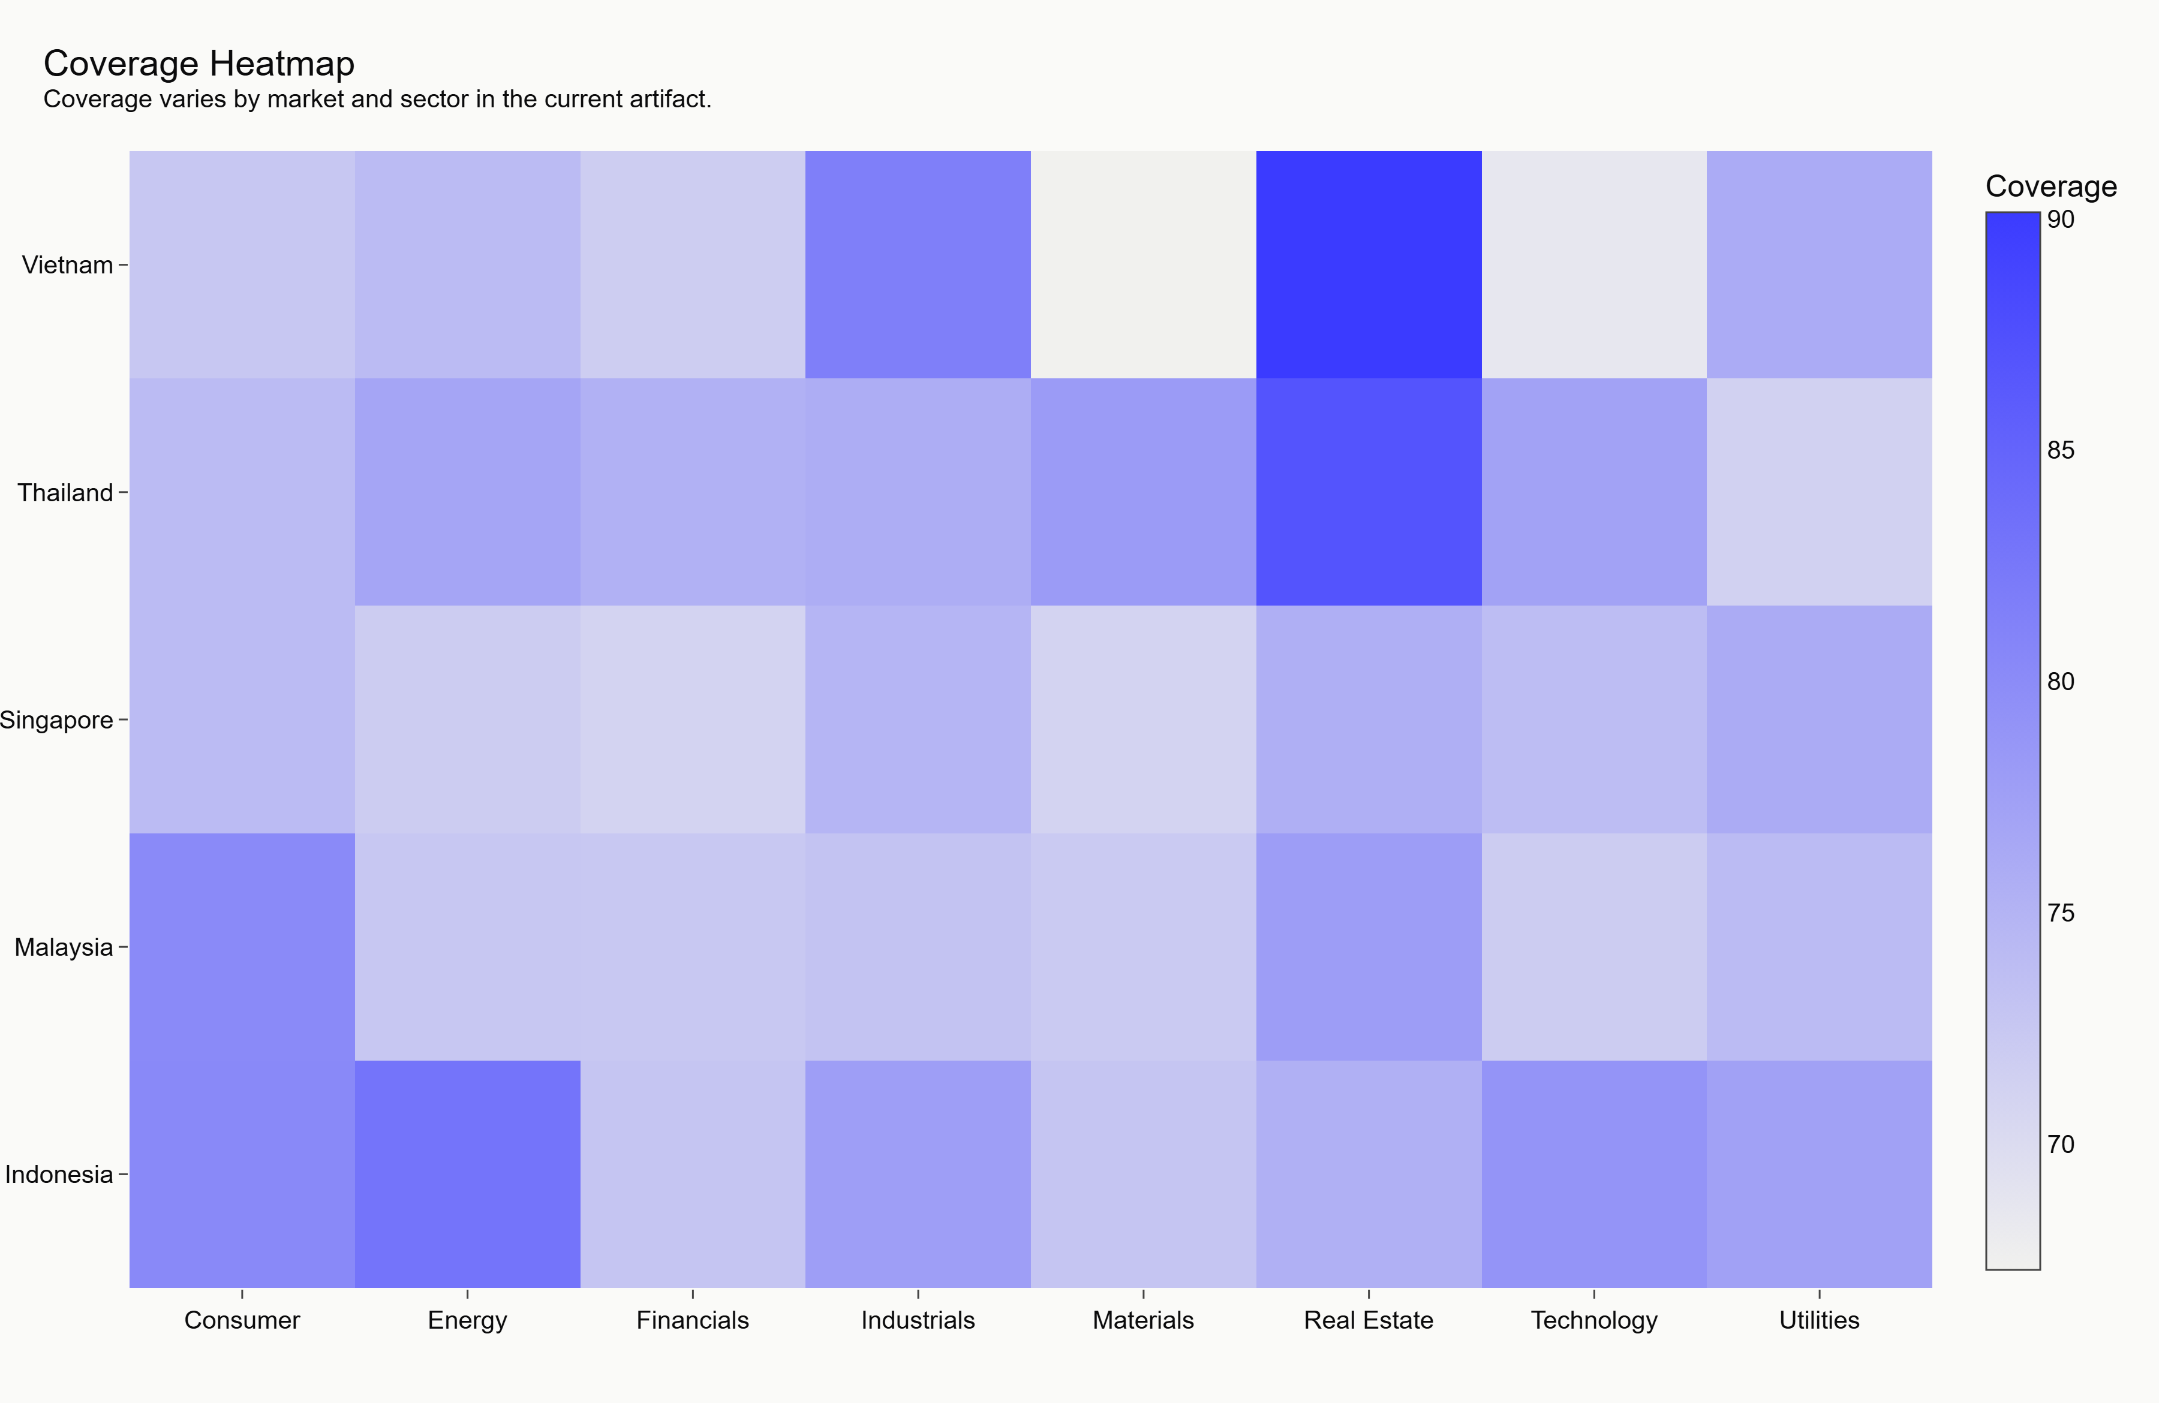
PLACEHOLDER: The upgrade path moves from synthetic JSON to governed live inputs.
PLACEHOLDER: Describe validation gates, licensed data, and human review before production use.
11 / SPLIT

Slide 12
PLACEHOLDER: Summary: explainable ESG momentum, honestly labelled.
PLACEHOLDER: End with what is proven by the prototype and what remains unproven.
12 / CLOSING

