Slide 1

AIRFLY INSIGHTS
Data Visualization and Analysis of Airline Operations
Presented by
Aravintakshan

Slide 2
Overview
Project Statement
Data Acquisition and Understanding
Data Cleaning and Feature Engineering
Univariate and Bivariate Analysis
Delay Cause Analysis
Route and Airport-Level Exploration
Cancellation and Seasonal Trends
Final Dashboard
Challenges
Future Scope
Conclusion

Slide 3
Project Statement
The objective of this project is to analyze large-scale airline flight data to uncover operational trends, delay patterns, and cancellation reasons using data visualization techniques. It involves cleaning the data, creating meaningful features, and exploring patterns across airlines, airports, and seasons.
The goal is to help understand airline and airport-level performance and contribute to actionable insights using visual analysis

Slide 4
Data Acquisition and Understanding
Dataset Source (Kaggle)
Chosen for its large, reliable, and well-organized flight data.
Contains 484,552 rows x 30 columns,
Initial Data Exploration
Defined goals, KPIs, and workflow - Set the project direction and identified key metrics to focus on.
Loaded data using pandas - Imported the dataset into Python for easy handling and analysis.
Checked schema, data types, size, and null values - Reviewed the structure, column types, dataset size, and missing data.
Performed sampling and memory optimization - Reduced memory load and created smaller samples for faster processing.
Why This Dataset?
Comprehensive coverage of U.S. domestic flights.
Includes detailed delay categories and cancellation reasons.
Suitable for trend analysis, operational insights, and visualization.

Slide 5
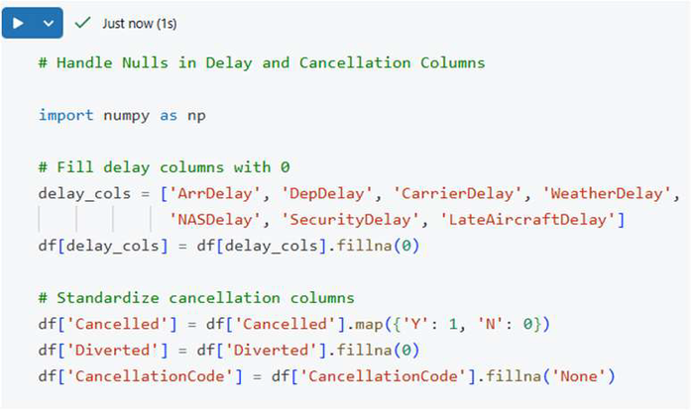
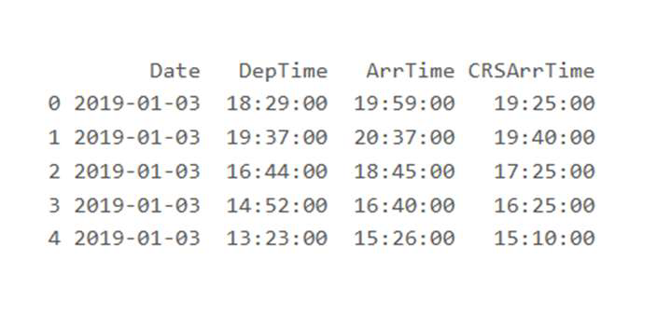
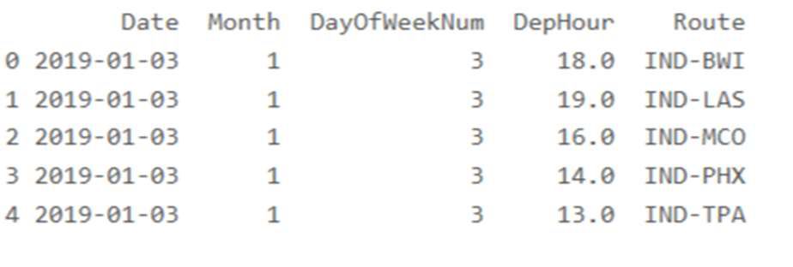
Data Cleaning and Feature Engineering
Handled nulls – Cleaned missing values in delay and cancellation columns.
Created features – Added Month, Day of Week, Hour, and Route for better analysis.
Formatted datetime – Converted time columns into proper datetime format.
Saved processed data – Stored the cleaned dataset for quicker future use.

Slide 6
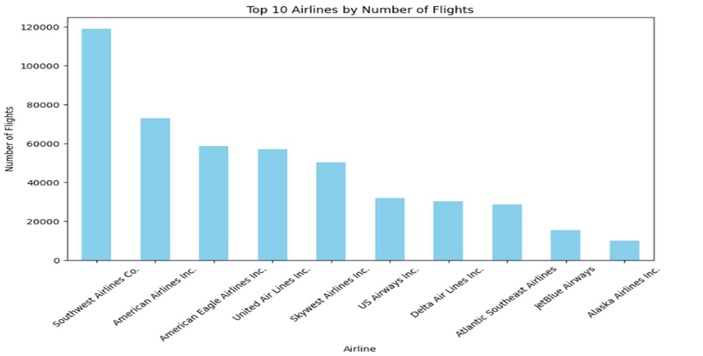
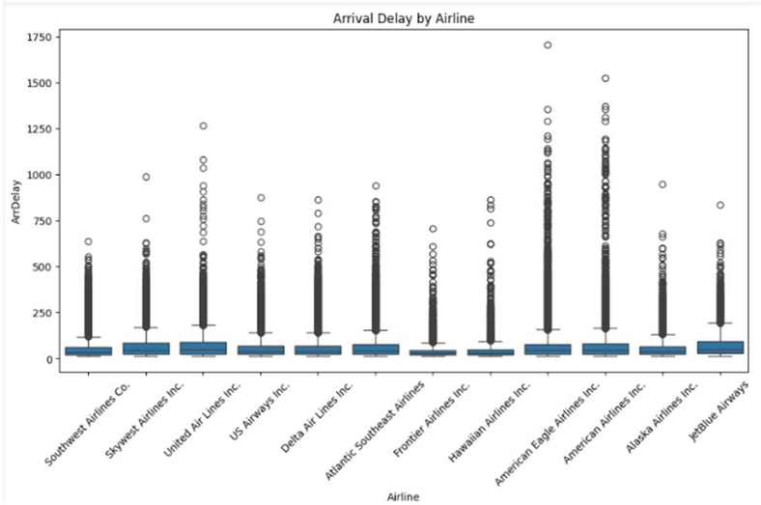
Univariate and Bivariate Analysis
Univariate Analysis – Examined individual columns like airlines, months, departure hours, and delay types to understand basic distributions and patterns.
Bivariate Analysis – Compared two variables (e.g., Airline vs Delay, Airport vs Cancellations, Time vs Delay) to identify relationships and trends.
Visualizations Used – Bar charts, line charts, histograms, and boxplots to clearly show patterns.
Outcome – Identified peak delay times, top delay-prone airlines, busy routes, and seasonal flight patterns.

Slide 7
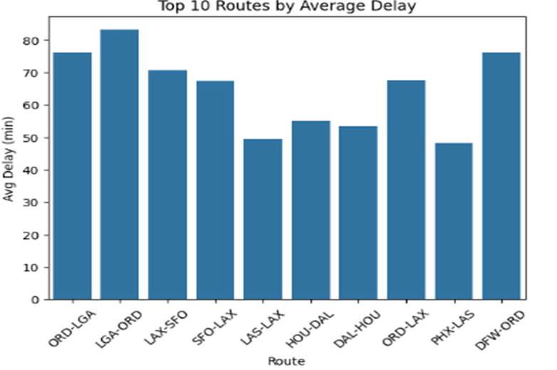
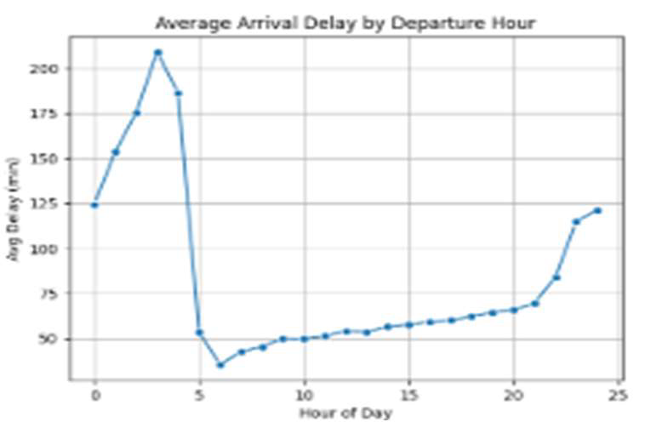
Delay Cause Analysis
Studying the reasons and patterns behind flight delays to understand which factors impact on-time performance.
What’s Done –
Analyzed major delay categories: Carrier, Weather, NAS, and Late Aircraft.
Compared delay durations across airlines, airports, and time of day.
Identified which airlines and routes experience the highest delays.
Used visualizations to highlight peak delay hours and major delay contributors.

Slide 8
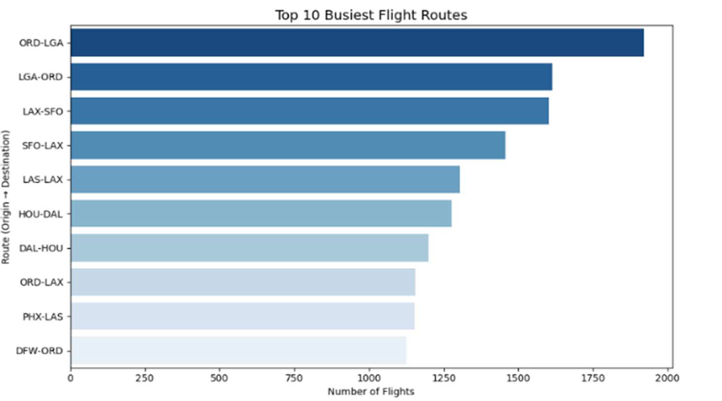
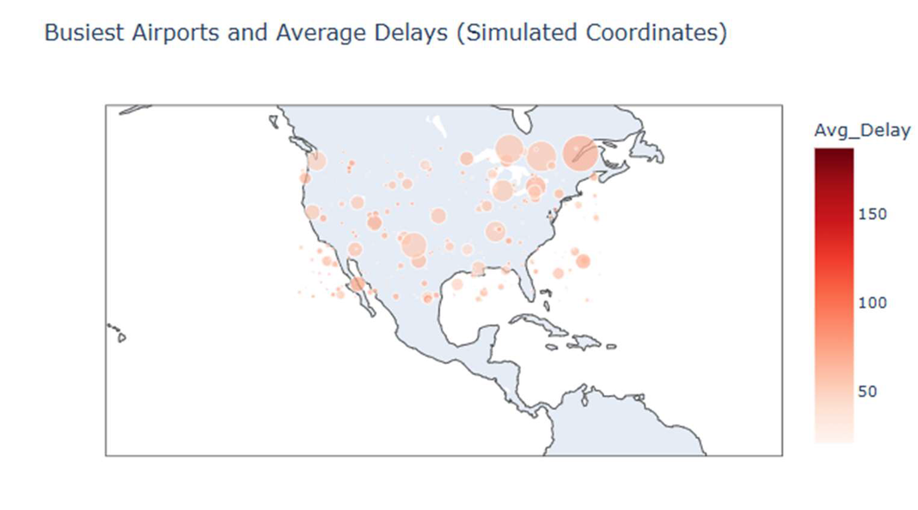
Route and Airport-Level Exploration
Studying how different routes and airports perform in terms of traffic, delays, and cancellations.
What’s Done –
Identified top origin–destination routes based on flight volume.
Analyzed airport-wise delays to find the most delay-prone and busiest airports.
Created route-level visuals to compare average delays across major flight paths.
Checked how airport congestion and route distance impact flight performance.

Slide 9
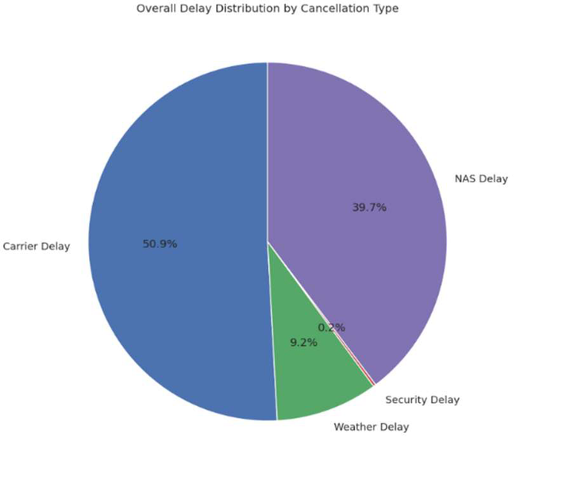
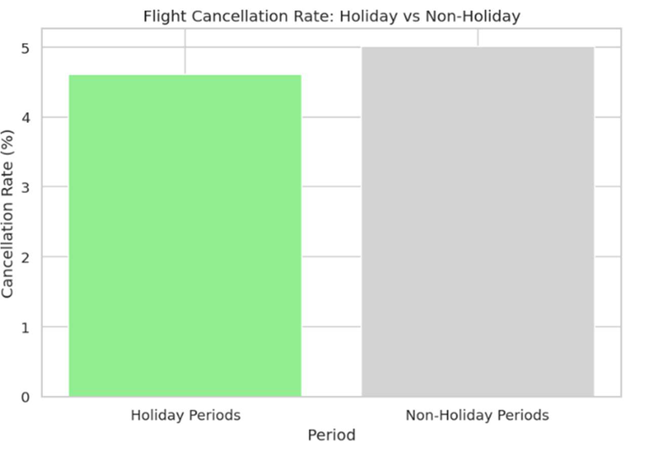
Cancellation and Seasonal Trends
Understanding why flights get cancelled and how cancellation patterns change across months, airlines, and airports.
What’s Done –
Analyzed monthly and seasonal cancellation patterns to see when cancellations peak.
Studied cancellation reasons such as Carrier, Weather, NAS, and Security.
Mapped cancellation codes (A, B, C, D, N) to their correct reasons and assigned them properly for analysis.
Compared cancellations across airlines and routes to find which ones face the most disruptions.

Slide 10
Challenges
Large Dataset Size – Handling a big dataset caused slow processing and required memory optimization.
Missing and Inconsistent Data – Many delay and cancellation columns had null or incorrect values that needed careful cleaning
Complex Date & Time Formatting – Converting multiple time columns into proper datetime formats was challenging.
Mapping Cancellation Codes – Cancellation codes (A, B, C, D, N) had to be correctly mapped to their reasons.

Slide 11
Future Scope
Build Predictive Models – Use machine learning to predict flight delays and cancellations in advance.
Real-Time Dashboard – Develop a live Power BI or Streamlit dashboard using updated flight data.
Integrate Weather & Traffic Data – Combine external datasets to improve accuracy of delay analysis.
Route Optimization Insights – Suggest the best-performing routes and airports based on historical trends.

Slide 12
Conclusion
Cleaned and analyzed large airline datasets to understand operational patterns.
Identified key delay causes, cancellation trends, and high-risk routes.
Visual insights revealed peak delay times, seasonal trends, and airline performance.
The findings support better decision-making and future real-time improvements.

Slide 13
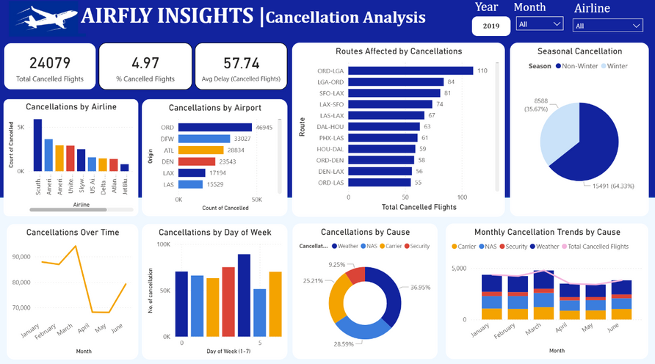
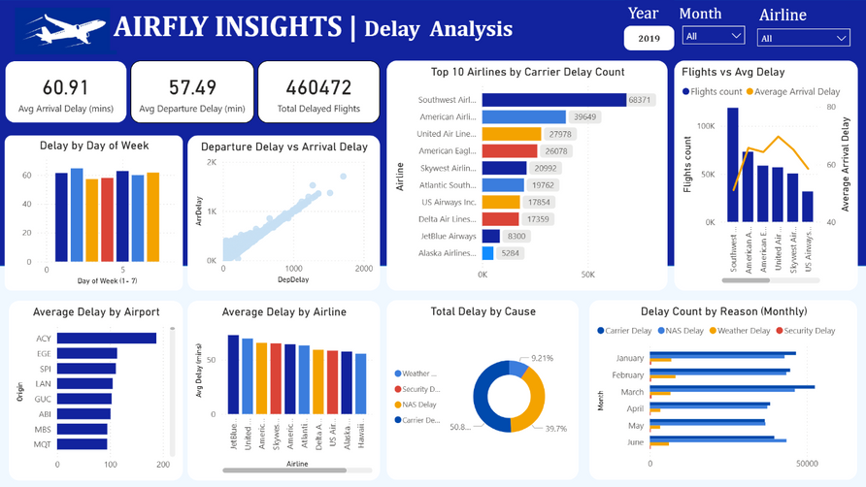
Final Dashboard
Import Data: Load the cleaned dataset into Power BI.
Clean & Transform: Use Power Query to fix data types and create new fields (Month, Route, Delay Type).
Model Data: Build relationships and calculated columns if needed.
Create Visuals: Add charts like bar, line, map, and pie for key metrics.
Add KPIs: Show total flights, % cancelled, and average delay.
Apply Filters: Use slicers for Airline, Airport, Month, and Cause.
Design Layout: Arrange visuals neatly with clear titles and colors.
Publish & Share: Upload to Power BI Service for interactive viewing.

Slide 14
Thank You!

