Slide 1


Department of Artificial Intelligence and Data Science
Next-Gen On-Duty Automator
Dr. P. Indira Priya, M.E.,Ph.D.,
Professor
Aravinth.S
(2116221801003)
Lio Godwin.BR
(2116221801029)

Slide 2
Problem Statement and Motivation
Develop an automated system for managing student on-duty (OD) requests with multi-level approval mandatory document upload, and automatic decline if not approved within a set timeframe. The system should also maintain accurate CGPA records and generate performance reports.
Motivation:
The motivation behind developing this automated on-duty (OD) request management system is to streamline and digitize the current manual processes, thereby reducing errors and saving time for both students and administrators.
Final Review

Slide 3
Objectives
The primary objective is to create an efficient and user-friendly automated system for managing student on-duty (OD) requests. This system aims to provide a structured multi-level approval process, ensuring timely and fair handling of requests.
Final Review

Slide 4
Abstract
It aims to revolutionize the management of student on-duty (OD) requests by developing an automated, digital system. Educational institutions traditionally use a paper-based system for OD requests, where students fill out and submit forms manually and staff respond through direct communication. This method is challenging for tracking and managing requests, time-consuming, and lacks transparency. Using various web framework, the new system will automate the OD request process, making it faster and more accurate. Students can submit requests online, and staff can approve them with a few clicks. Digital records will eliminate the need for physical storage, reduce paper usage, and provide real-time updates to keep everyone informed. This system will enhance efficiency, accuracy, and transparency in handling OD requests while also minimizing paperwork.
Final Review

Slide 5
Introduction and Overview of the Project.
By using several web framework to streamline the process. This system will enable online submissions, automate workflows, provide real-time tracking, and storing digital records, enhancing efficiency and transparency while reducing paper usage and administrative burdens.
Final Review

Slide 6
Literature Survey
S.No | Author Name | Paper Title | Description | Journal | Volume/ Year
1. | José Fonseca Marco Vieira | Mapping Software Faults with Web Security Vulnerabilities |  | Published in IEEE International Conference | VOL. 12, NO. 1, July 2008
To review and analyze security patches, focusing on identifying and categorizing software faults.
Methods to compare security-related faults with general software faults from other field studies.
Drawbacks:
Limited Fault Types: The study shows that only a small subset of faults is related to security, potentially missing broader vulnerability contexts.
Restricted Analysis Scope: The focus on specific applications and fault types might not cover all real-world scenarios, limiting the applicability of findings to other contexts.
Final Review

Slide 7
Literature Survey
S.No | Author Name | Paper Title | Description | Journal | Volume/ Year
2. | Devdatta Akhawe, Adam Barth, Peifung E. Lam, John Mitchell, and Dawn Song | Towards a Formal Foundation of Web Security | In this paper various verification techniques are used to systematically analyze the security of web applications.The goal is to check whether the applications comply with specified security policies, such as preventing cross-site scripting (XSS) and other common vulnerabilities. Drawbacks: Scalability Issues: The approach might face scalability challenges when applied to large, complex web applications, making it difficult to analyze larger systems efficiently. Precision vs. Generality Trade-off: The model is accurate for the specific web applications it checks, but it might not work as well for different types of web platforms, which means it may need updates to stay effective. | IEEE Computer Security Foundations | 23rd Augest,2010
Final Review

Slide 8
Literature Survey
S.No | Author Name | Paper Title | Description | Journal | Volume/ Year
3. | J. Fonseca, N. Seixas, M. Vieira, and H. Madeira | Analysis of Field Data on Web Security Vulnerabilities |  | (IEEE) Transactions on Dependable and Secure Computing | VOL. 11, NO. 2, March/April 2014
The study analyzes the source code of security patches and attack scripts to understand how vulnerabilities like SQL Injection and XSS are patched and exploited. This approach reveals common exploitation techniques and provides insights into real-world tactics used by hackers.
Drawbacks:
⁠The study’s focus on SQL Injection and XSS might miss other significant vulnerabilities and does not always capture dynamic or runtime issues that arise in real-world scenarios.
Evolving and Language-Specific Limitations: Findings may become outdated due to the evolving threat landscape and may not apply across different programming languages.
Department of Artificial Intelligence and Data
Science

Slide 9
Literature Survey
S.No | Author Name | Paper Title | Description | Journal | Volume/ Year
4. | J. Smith and A. Johnson | Implementation and Analysis of Web Application Security Measures Using OWASP Guidelines |  | Published in the IEEE Access journal | Volume 8,in the Jan. 2024
Vulnerability Scanning: These algorithms check for known security issues in web applications by looking for patterns or specific flaws like SQL Injection and XSS.
Anomaly Detection: Machine learning algorithms find unusual patterns in web traffic that might signal a security threat, using techniques like clustering and classification.
Drawbacks:
Scope Limitation: May not catch new or emerging threats not covered by existing patterns or guidelines.
False positives & False negatives:False positives occur when a security scanner incorrectly identifies a harmless issue as a threat, while false negatives happen when it fails to detect a real security vulnerability.y
Final Review

Slide 10
Literature Survey
S.No | Author Name | Paper Title | Description | Journal | Volume/ Year
5. | Biswas A.K Ahmed S.I Bankefa T Ranganathan P Salehfar H | Performance analysis of short and mid-term wind power prediction using ARIMA and hybrid models. |  | 2021 IEEE Power and Energy Conference at Illinois (PECI) | 1–2 April 2021
Objective: Develop wind energy prediction models for Nala Danavi wind farm, Sri Lanka.
Input Variables: Wind speed and ambient temperature.
Output Variable: Daily wind energy production.
Techniques Used : Multiple Linear Regression (MLR), Power Regression (PR).Machine Learning: SVR, GPR, FFBPNN, CFBPNN, RNN.
Key Findings: Positive correlation between wind energy and input variables.FFBPNN model performed best with low errors.
Evaluation Metrics: Coefficient of determination, RMSE, Bias, NSE.Significance: Supports Sri Lanka's renewable energy expansion and reduces coal dependency.
Final Review

Slide 11
Existing System
The current OD request system in many educational institutions relies on traditional paper-based methods, causing inefficiencies and errors. Students fill out paper forms, which staff manually collect, review, and verify. Approval or rejection is then communicated to students manually.
Final Review

Slide 12
Drawback of Existing System
Tracking and managing multiple OD requests is challenging
Time-consuming
Lack of transparency
Delay in results
Human errors
Final Review

Slide 13
Proposed system
Efficiency: Automates the OD request process, drastically reducing approval time.
Transparency: Provides real-time updates, keeping students and faculty informed of request progress.
Accuracy: Minimizes errors by digitizing submissions, approvals, and record management.
Accessibility: Staffs can manage student OD requests anytime, anywhere.
Scalability: Easily handles increasing users and requests without performance issues
Final Review

Slide 14
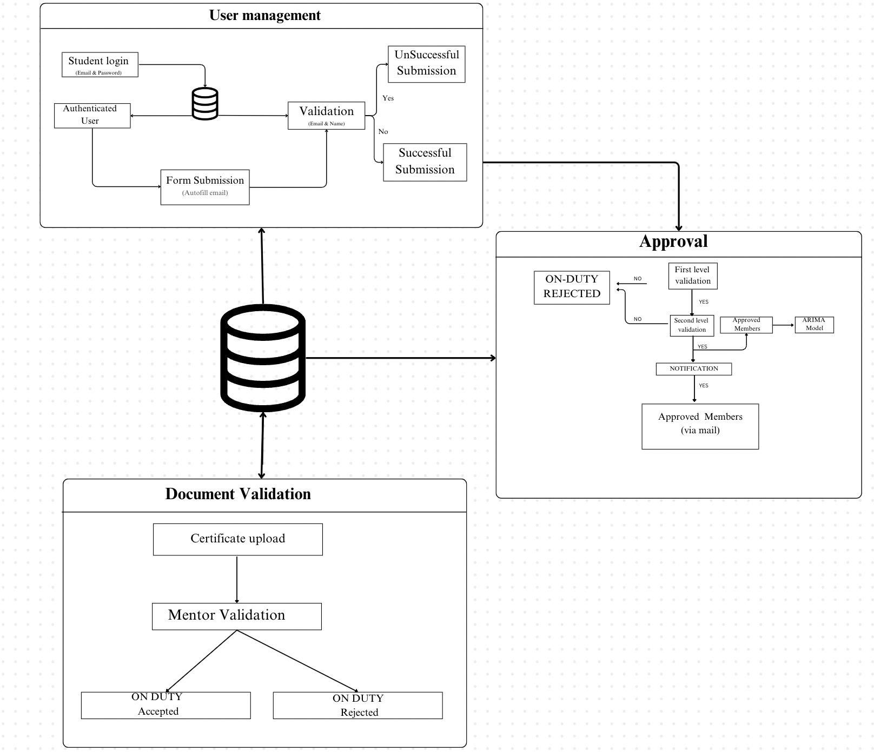
System Architecture
Final Review

Slide 15
List of Modules
User Management Module
Document Validation Module
Approval Module
Final Review

Slide 16
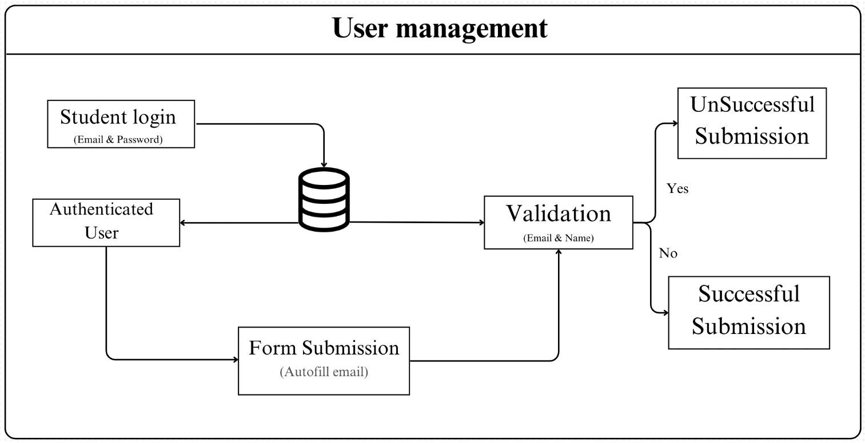
User Management Module
Final Review

Slide 17
User Management Module
Step1: Prompt user to enter login credentials
Step2: Collect user input (e.g., email, password).
Step3: Verify credentials against stored information in the database.
Step4: If credentials are correct, grant access to the system.
Step5: If credentials are incorrect, display an error message and prompt the user to retry.
Final Review

Slide 18
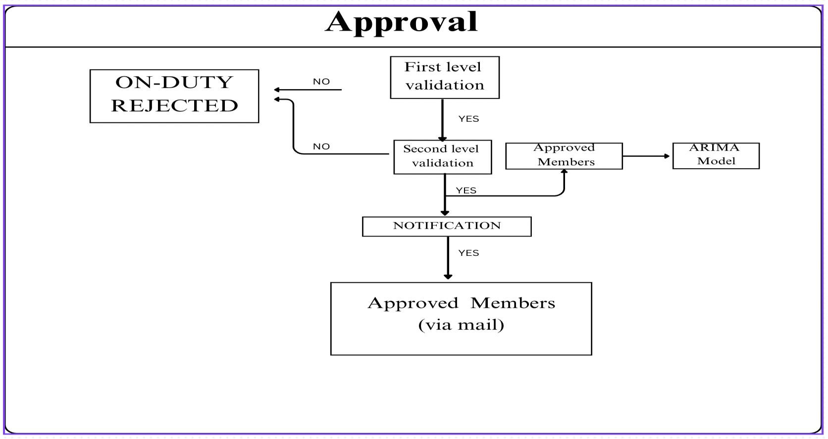
Approval Module
Final Review

Slide 19
Approval Module
Step 1: Collect and organize student submissions for review by the designated reviewer (e.g., mentor or administrative staff).
Step 2: Display each submission with relevant details for the reviewer to examine all required documents and information.
Step 3: Evaluate each submission against the established criteria to determine if it meets the standards for approval.
Final Review

Slide 20
Approval Module
Step 4: If the submission meets all criteria, approve it and update the student's status to reflect approval.
Step 5: If issues or discrepancies are found, reject the submission, recording the reason for rejection and providing feedback for the student.
Final Review

Slide 21
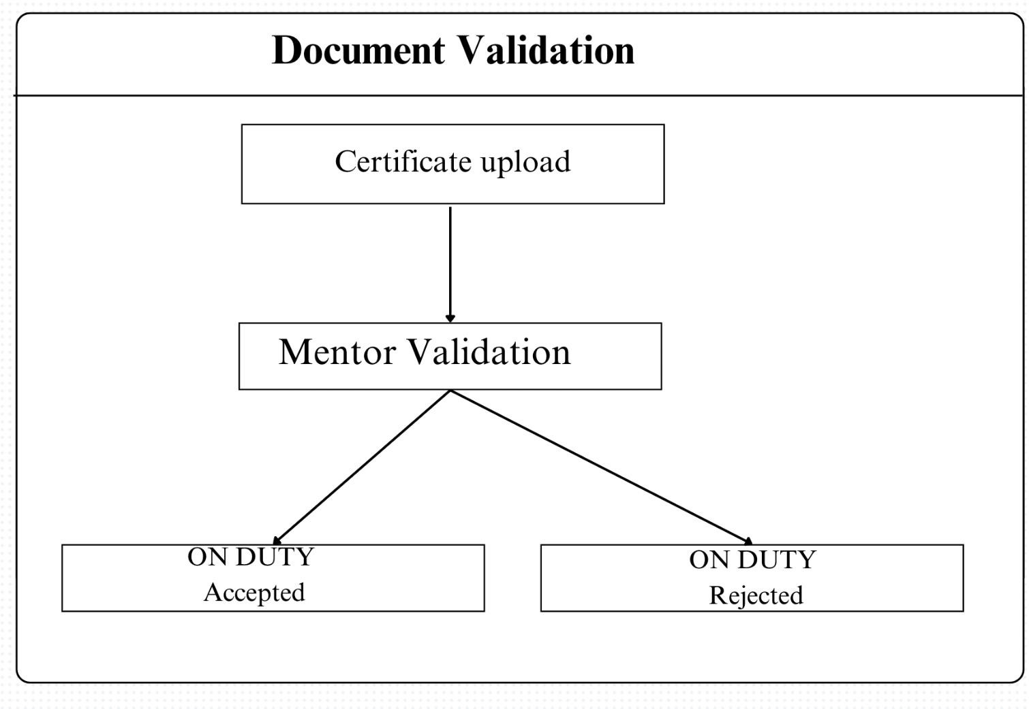
Document Validation Module
Final Review

Slide 22
Document Validation Module
Step 1: Prompt the student to upload required certificates (e.g., academic transcripts, proof of identity).
Step 2: Collect the uploaded documents from the student.
Step 3: Validate the uploaded certificates, including verifying file format and checking for completeness.
Step 4: Integrate with external verification services (if available) to check certificate authenticity and validity.
Final Review

Slide 23
Document Validation Module
Step 5: If the certificate is validated, proceed to the mentor validation step otherwise, notify the student of any issues.
Step 6: Route the validated documents to the assigned mentor for further review and approval (if required).
Step 7: Allow mentors to review the documents, provide feedback, or reject submissions if they do not meet criteria.
Step 8: Update the student on the approval or rejection status
.
Final Review

Slide 24
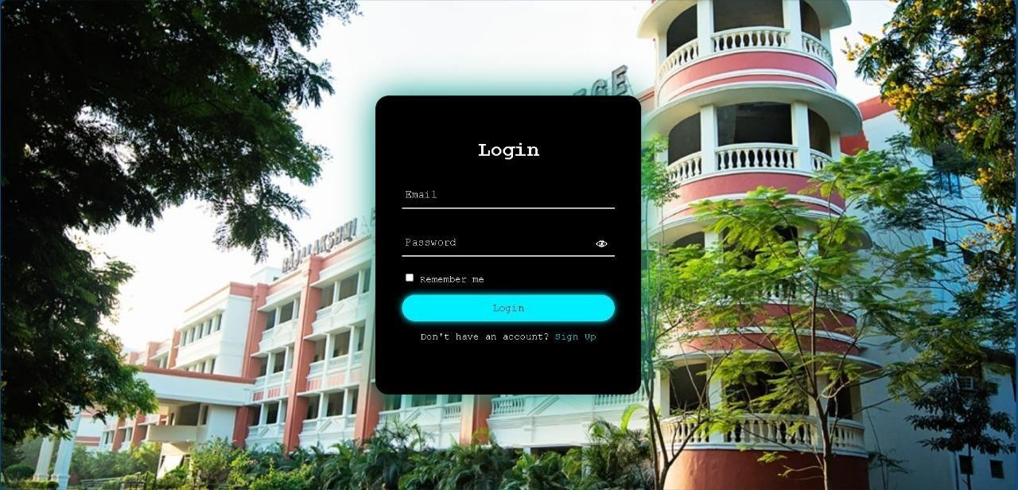
Output Screenshots
Final Review

Slide 25
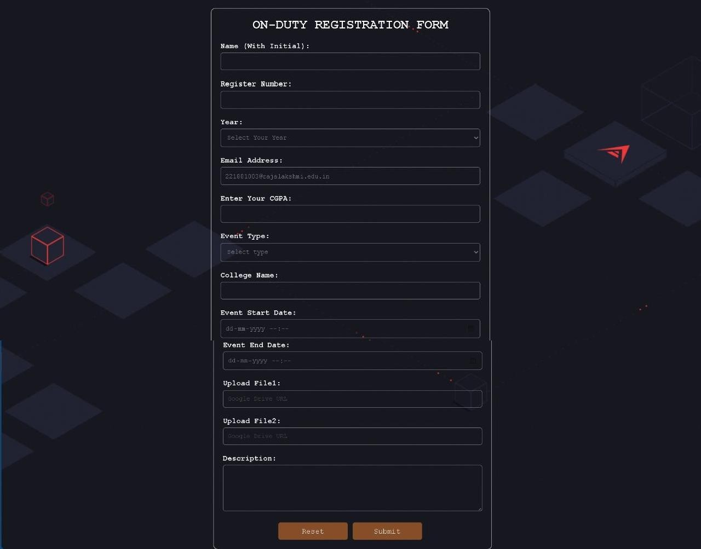
Output Screenshots
Final Review

Slide 26
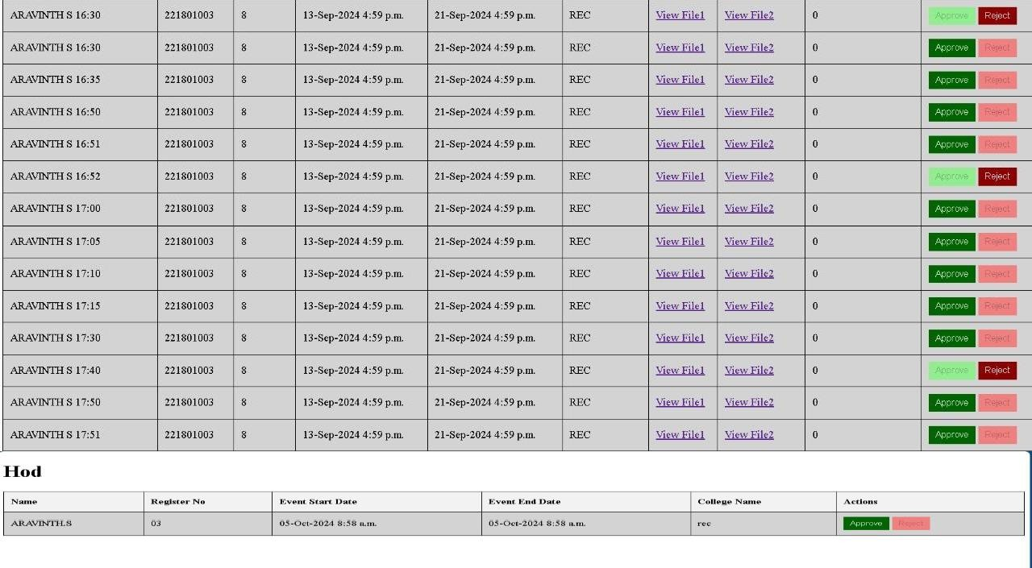
Output Screenshots
Final Review

Slide 27
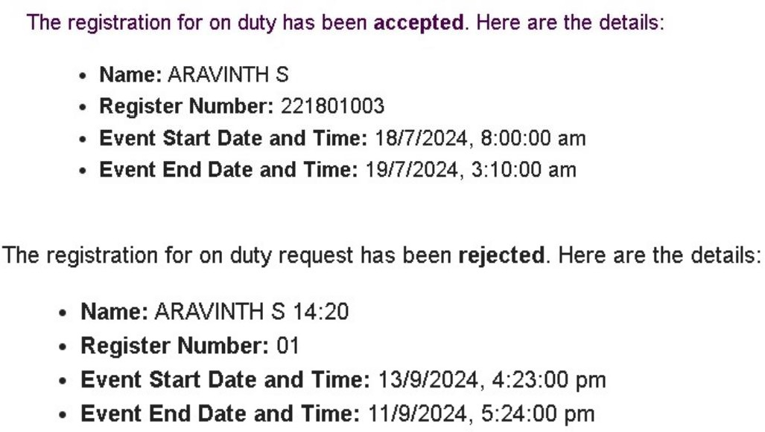
Output Screenshots
Final Review

Slide 28
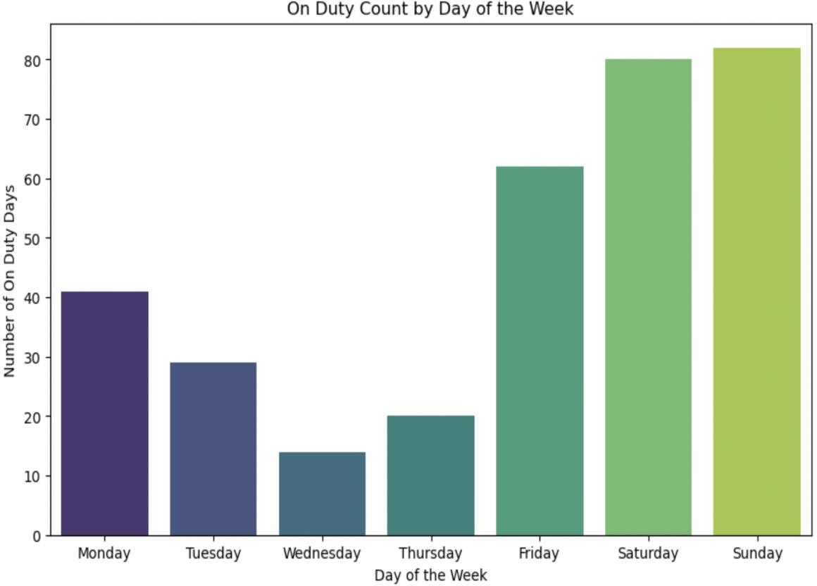
Output Screenshots
Final Review

Slide 29
Conclusion
The ON DUTY management system addressed inefficiencies in the manual process by automating workflows, enabling real-time notifications, and providing a transparent approval process. Its data analytics feature allowed faculty to monitor patterns and make informed decisions, while post-event validation ensured accountability. Future enhancements include developing a mobile app for better accessibility, integrating with institutional systems for a holistic view of student performance. Backend optimization will improve scalability and performance to handle larger user bases effectively.
Final Review

Slide 30
References
[1] Devdatta Akhawe, Adam Barth, Peifung E. Lam, John Mitchell, and Dawn Song, "Towards a Formal Foundation of Web Security," University of California, Berkeley.
[2] J. Fonseca, N. Seixas, M. Vieira, and H. Madeira, "Analysis of Field Data on Web Security Vulnerabilities," VOL. 11, NO. 2, MARCH/APRIL 2014
[3] Faculty of Security Studies, University of Belgrade, 11000 Belgrade, Serbia,2 Laboratory for experimental psychology, Faculty of Philosophy, University of Belgrade, 11000 Belgrade, Serbia"Factors Related to Cyber Security Behavior",Received June 27, 2020, accepted July 4, 2020, date of publication July 8, 2020, date of current version July 20, 2020.
[4]J. Smith and A. Johnson, "Implementation and Analysis of Web Application Security Measures Using OWASP Guidelines," IEEE Access, vol. 8, pp. 1234-1245, Jan. 2024. doi: 10.1109/ACCESS.2024.1234567.
[5] Biswas, A.K.; Ahmed, S.I.; Bankefa, T.; Ranganathan, P.; Salehfar, H. "Performance analysis of short and mid-term wind power prediction using ARIMA and hybrid models." Proceedings of the 2021 IEEE Power and Energy Conference at Illinois (PECI), Urbana, IL, USA, 1–2 April 2021, pp. 1–7.
Final Review

Slide 31
Thank You
Final Review

