Slide 1


Department of Artificial Intelligence and Data Science
AI-Powered Face Detection for Energy-Efficient Home Automation: An IoT-Integrated Computer Vision Approach
Aravinth S(221801003)
Lio Godwin BR(221801029)
Maiyazhagan V(221801032)

Slide 2
Problem Statement
Traditional smart home automation systems rely heavily on Passive Infrared (PIR) sensors, which detect motion through thermal changes. However, these sensors often fail to detect stationary individuals and are vulnerable to false triggers from non-human heat sources, reducing reliability. While computer vision (CV)-based gesture recognition offers intuitive control, its continuous operation is energy-intensive and unsuitable for low-power devices like Raspberry Pi. Moreover, current systems often overlook accessibility, offering limited support for users with disabilities or visual impairments. The lack of customizable and inclusive interfaces further hampers user engagement. Hence, there is a pressing need for a smart home solution that is energy-efficient, accurate, and user-centric. This drives the development of a hybrid CV and sensor-based system that ensures reliable detection, intuitive gesture control, and inclusive access for all users.

Slide 3
Abstract
Smart home automation is evolving through the integration of computer vision (CV) and IoT technologies. Traditional PIR sensors often fail to detect stationary individuals and can trigger false alerts. This work proposes a hybrid system combining microwave sensors and CV on a Raspberry Pi for accurate presence detection and energy-efficient control. Eye tracking and gesture recognition modules enable intuitive, contactless interaction, which is especially beneficial for users with disabilities. A customizable, high-contrast web/mobile app allows users to assign finger gestures to control appliances. The system ensures better accessibility, reduces energy waste, and enhances reliability compared to conventional methods. This multi-modal approach makes smart home technology more inclusive, responsive, and practical for real-world deployment.

Slide 4
OBJECTIVE
Develop an energy-efficient system that optimizes indoor lighting and ventilation through automation.
Utilize the RCWL-0516 microwave radar sensor for real-time motion detection, ensuring lights are activated only when occupancy is detected.
Integrate temperature and humidity sensors to control ventilation, activating fans only when environmental conditions exceed predefined thresholds.
Minimize manual intervention by implementing a responsive dual-sensor setup that enables real-time adjustments and reduces unnecessary power consumption.
Design a scalable and adaptable framework suitable for residential, commercial, and educational environments, promoting sustainable energy usage and smart building practices.

Slide 5
Literature Survey
Author(s) | Paper Title | Journal/Publisher | Year/Volume | Description
Rahman et al. | Occupancy Detection in Smart Homes Using PIR Sensors: A Low-Power Approach | IEEE Sensors Journal | 2020, Vol. 20(5) | Proposed a low-power PIR-based occupancy detection system for energy-saving in smart homes.
Wang & Chen | Comparative Study of PIR and Microwave Radar Sensors | Journal of Intelligent Systems | 2021, Vol. 30(4) | Compared PIR and microwave sensors, showing microwave sensors are better for complex scenarios.
Kim et al. | Multi-PIR Sensor Networks for Improved Motion Detection | Sensors | 2019, Vol. 19(12) | Introduced a networked PIR approach to improve motion tracking and reduce blind zones.
Zhang et al. | AI-Powered PIR Sensors: Integrating Machine Learning | IEEE Transactions on Smart Systems | 2022, Vol. 15(3) | Enhanced PIR sensor accuracy using AI to reduce false alarms in automation systems.
Singh et al. | Sensor Fusion for Human Activity Recognition | Journal of Ambient Intelligence and Smart Environments | 2021, Vol. 13(2) | Combined PIR with CV for human activity recognition, improving accuracy and context-awareness.

Slide 6
Existing Systems
Manual Control: Lighting and fans are typically operated manually via physical switches, relying on users to turn them on or off as needed.
Energy Inefficiency: Manual operation often leads to energy waste, as lights and fans are frequently left on in unoccupied rooms or when not needed.
Basic Automation: Some existing systems use wifi and blutooth modules to automate lighting or fan control, but these are usually limited to controlling one device at a time.
Lack of Integration: Existing automated systems often lack integration, meaning they do not simultaneously manage multiple devices or adapt to varying environmental conditions.
Suboptimal User Experience: Current systems may not provide optimal energy savings or user comfort due to their limited flexibility and adaptability.
Complex Installation: Automated systems in place may be more expensive and complicated to install, especially in older buildings or homes.

Slide 7
Advantages and Disadvantages of Existing System
ADVANTAGE:
Simplicity: Manual switches are straightforward to use and require no technical knowledge, making them accessible to everyone.
Low Cost: Traditional systems with manual switches are inexpensive to install and maintain, with no need for complex technology or sensors.
Basic Automation: Some existing systems offer basic automation, like motion sensors or timers, which can reduce energy usage in certain situations.
Reliability: Manual systems are generally reliable, with fewer points of failure compared to more complex automated systems.
DISADVANTAGE:
Energy Inefficiency: Lights and fans are often left on unnecessarily, leading to significant energy waste and higher electricity bills.
Inconvenience: Manual operation requires users to remember to turn devices on or off, which can be inconvenient and prone to human error.
Limited Automation: Basic automated systems often control only one device at a time and lack integration, reducing their effectiveness in managing overall energy consumption.
Lack of Adaptability: Existing systems do not adapt to changes in environmental conditions or user presence, resulting in suboptimal comfort and energy savings.

Slide 8
Proposed System
The proposed smart home automation system combines computer vision (CV) and microwave radar sensors to enhance motion detection accuracy and energy efficiency. Unlike conventional PIR-based systems, it reliably detects both moving and stationary individuals. The microwave sensor ensures low-power, real-time motion tracking, while a Raspberry Pi with a camera enables eye tracking and gesture recognition.
To support users with physical or visual impairments, the system includes a gesture recognition module for non-contact control and a customizable web/mobile app with a high-contrast, accessible UI. Users can assign specific gestures to control devices, ensuring personalized and intuitive interaction.This hybrid, context-aware system minimizes false triggers, reduces manual effort, and makes smart home technology more inclusive, adaptive, and user-friendly.

Slide 9
Advantages of Proposed System
Accurate Human Presence Detection: Combines computer vision and microwave sensors to identify both moving and stationary individuals, reducing false triggers common with PIR sensors.
Energy Efficiency: Automates appliances based on actual presence and conditions, ensuring devices like lights and fans operate only when needed, conserving power.
Enhanced Accessibility: Gesture recognition and eye tracking allow individuals with physical or visual impairments to control devices without physical interaction.
Customizable User Interface: Offers a high-contrast, visually accessible web/mobile app for easy configuration of gesture-to-action mappings.
Low Power Consumption: Efficiently uses microwave sensors for basic detection, reducing the need for constant high-power computer vision processing.

Slide 10
Novelty
Inclusive HCI Gesture and eye-tracking enable control for differently-abled users.
Context-Aware Automation Combines vision and environmental sensing for smart decision-making.
Customizable Gesture Mapping High-contrast web app allows easy, no-code device configuration.
Privacy-Preserving CV On-device face/gesture detection ensures data privacy and low latency.
Low-Cost & Scalable Design Built using affordable, modular components suitable for wide adoption.
“A wheelchair-bound user enters a room, the microwave sensor detects presence and turns on lights. The user waves two fingers toward the camera to start the fan. All without touching a switch.”

Slide 11
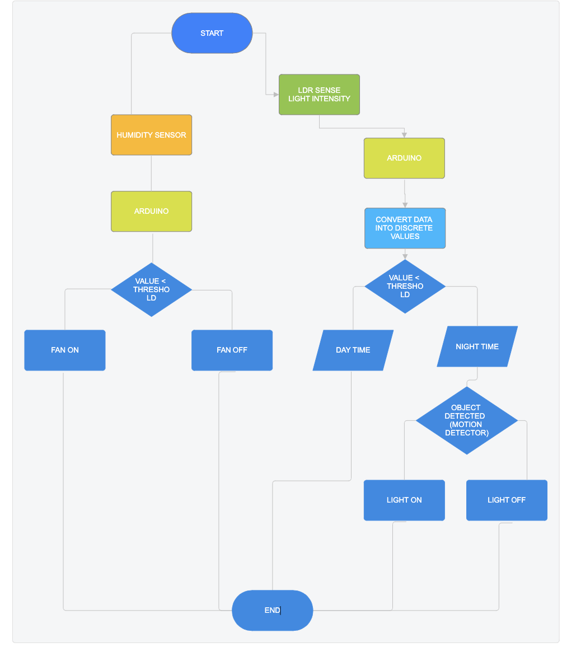
ARCHITECTURE DIAGRAM

Slide 12
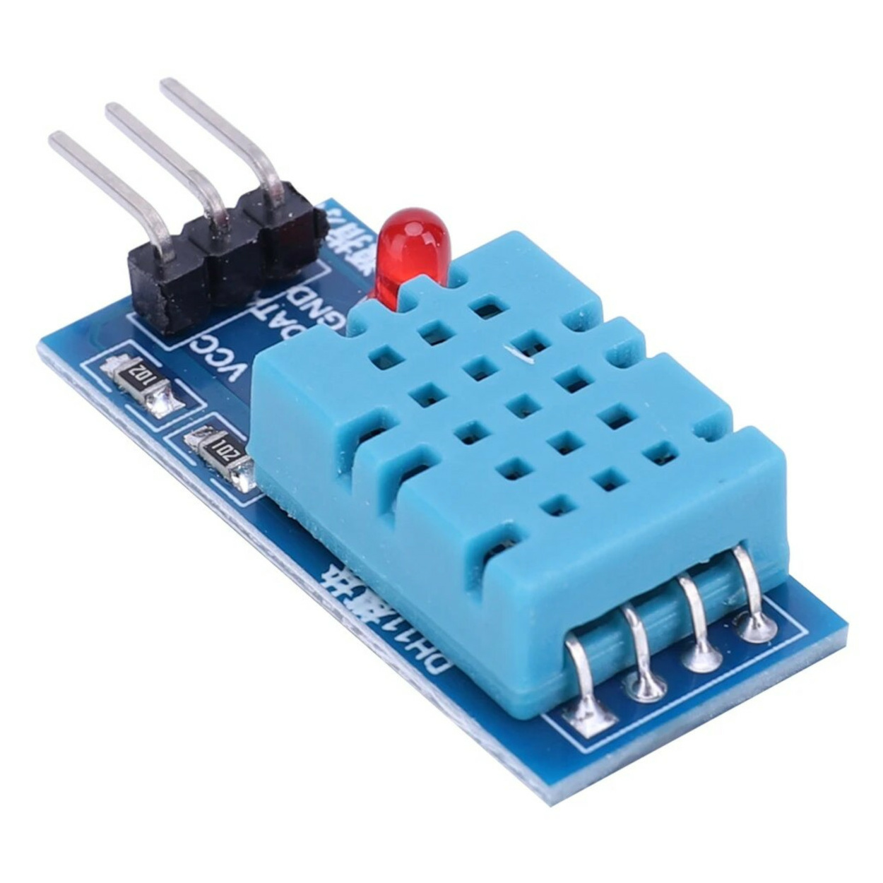
HUMIDITY SENSOR MODULE

Slide 13
HUMIDITY SENSOR MODULE
Pin Description (Left to Right in Image):
VCC – Connects to 3.3V or 5V power supply
DATA – Digital output pin (connects to GPIO of microcontroller/Raspberry Pi)
GND – Ground
Working Principle:
The DHT22 uses a capacitive humidity sensor and a thermistor to measure humidity and temperature.
It sends digital signals directly, eliminating the need for analog-to-digital conversion.
Communication follows a single-wire protocol, making it resource-friendly for microcontrollers.

Slide 14
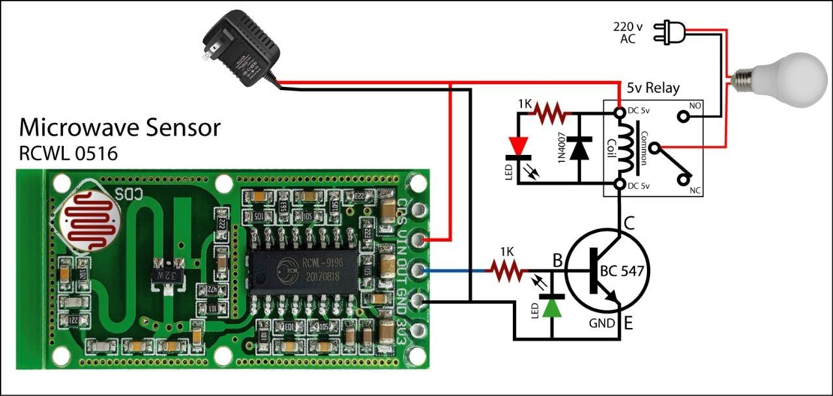
MICROWAVE SENSOR MODULE

Slide 15
MICROWAVE SENSOR MODULE
Pin Description (Left to Right on the Module):
3V3 / VIN – Power supply (typically 4–28V DC)
GND – Ground
OUT – Digital output (HIGH when motion is detected)
CDS – Optional LDR connection to disable detection in light
VIN – Alternate power input
Working Principle:
Operates using Doppler shift by transmitting and receiving microwave signals (~3.2 GHz).
Detects motion through walls, glass, plastic, etc., unlike PIR.
Ideal for real-time detection in environments with low visibility or obstructions.

Slide 16
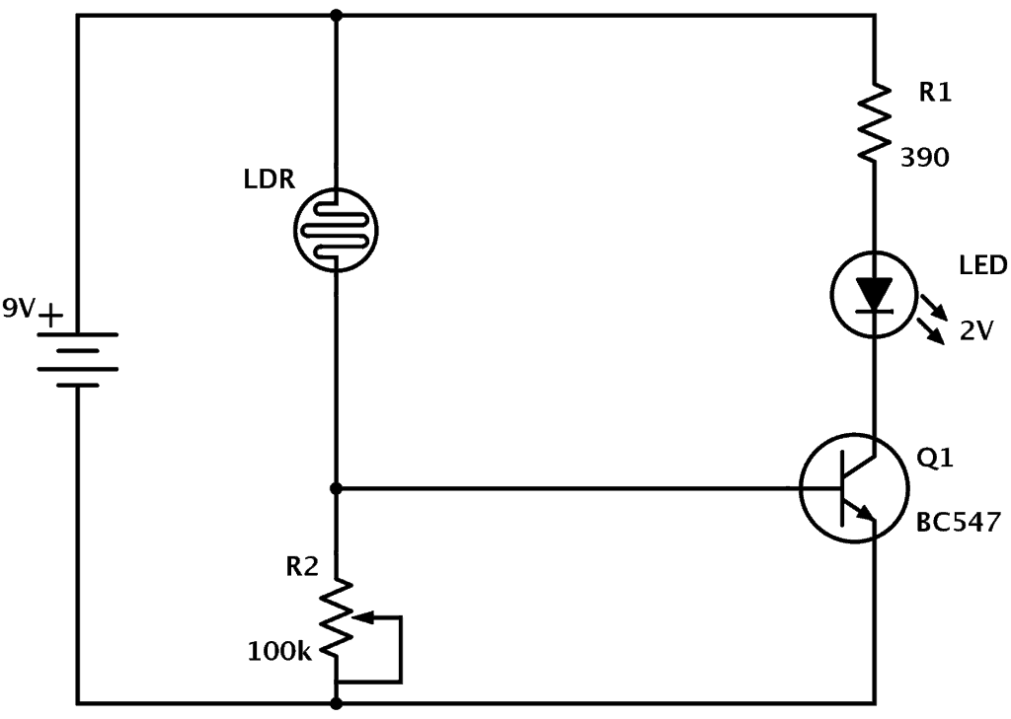
LDR MOTION SENSOR MODULE

Slide 17
LDR MOTION SENSOR
The Light Dependent Resistor (LDR) sensor in this circuit is used to detect light levels. An LDR's resistance decreases when exposed to light and increases in darkness, making it suitable for light-sensing applications.
Circuit Explanation:
The circuit is powered by a 9V battery.
The LDR is connected in series with a variable resistor (R2, 100kΩ), creating a voltage divider. This allows adjusting the sensitivity of the circuit to different light levels.
When there is low light (dark conditions), the LDR’s resistance is high, increasing the voltage across the base of the NPN transistor (Q1, BC547).
The base voltage turns on Q1, allowing current to flow from the collector to the emitter, lighting up the LED.
R1 (390Ω) limits the current through the LED to protect it from excess current.

Slide 18
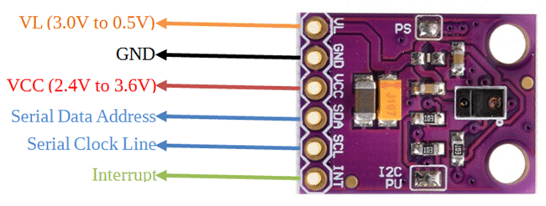
APDS-9960 Gesture

Slide 19
APDS-9960 Gesture
VCC/VIN: Connects to your microcontroller's 3.3V or 5V output, providing power to the sensor. The APDS-9960 typically operates at 3.3V, but many modules include voltage regulators allowing 5V input.
GND: Connects to your microcontroller's ground, completing the power circuit.
SDA & SCL: These pins form the I²C communication interface that allows data exchange between the sensor and your microcontroller. They should connect to the corresponding I²C pins on your microcontroller. Remember that I²C is a shared bus, so you can connect multiple I²C devices to these same pins.
INT: This interrupt pin triggers when specific events occur (such as gesture detection), allowing your microcontroller to respond immediately without constant polling. It's typically connected to a digital input pin that supports external interrupts.

Slide 20
Challenges and Solutions
Challenges:
Hardware-software integration
Ensuring real-time response
Managing energy efficiency
Solutions:
Effective sensor calibration
Real-time testing tools.

Slide 21

PROGRAM OUTPUT

Slide 22
References
[1] Abergel T, Dean B, Dulac J. Towards a zero-emission, efficient, and resilient buildings and construction sector: Global Status Report 2017. UN Environment and International Energy Agency: Paris, France. 2017. [2] https://www.iea.org/reports/global-energy-review-2020/global-energy-and-CO2-emissions-in-2020. Accessed 9 July 2020. [3] Ahmad AS, Hassan MY, Abdullah H, Rahman HA, Majid MS, Bandi M. Energy efficiency measurements in a Malaysian public university. In International Conference on power and energy 2012 (pp. 582-7). IEEE. [4] Hassan JS, Zin RM, Abd Majid MZ, Balubaid S, Hainin MR. Building energy consumption in Malaysia: an overview. Jurnal Teknologi. 2014; 70(7): 33-8. [5] Dudley B. BP statistical review of world energy. BP Statistical Review, London, UK.2016. [6] https://www.mgtc.gov.my/annualreport2019/. Accessed 9 July 2020. [7] Ministry of Energy, Green technology and water Malaysia. Green technology master plan Malaysia (2017-30). [8] Mansur TM, Baharudin NH, Ali R. Optimal sizing and economic analysis of self-consumed solar PV system for a fully DC residential house. In international conference on smart instrumentation, measurement and application 2017 (pp. 1-5). IEEE. [9] Ananda-Rao K, Ali R, Taniselass S, Baharudin NH. Microcontroller based battery controller for peak shaving integrated with solar photovoltaic. 4th IET clean energy and technology conference 2017. [10] https://www.iea.org/policies/124-national-energy-efficiency-action-plan-4-2017-2020. Accessed 9 July 2020. [11] Tenaga S. Guidelines on no-cost and low-cost measures for efficient use of electricity in buildings. Suruhanjaya Tenaga (Energy Commission). 2014. [12] File M. Commercial buildings energy consumption survey (CBECS). US Department of Energy: Washington, DC, USA. 2015. [13] Wagiman KR, Abdullah MN, Hassan MY, Radzi NH. A review on sensing-based strategies of interior lighting control system and their performance in commercial buildings. Indonesian Journal of Electrical Engineering and Computer Science. 2019; 16(1):208-15. [14] Imam MT, Afshari S, Mishra S. Smart lighting control systems. In intelligent building control systems 2018 (pp. 221-51). Springer, Cham. [15] Firdaus R, Mulyana E. Smart building lighting system. In IOP conference series: materials science and engineering 2018 (pp. 1-7). IOP Publishing.

Slide 23
Thank You

