Slide 1
2-DG

Slide 2
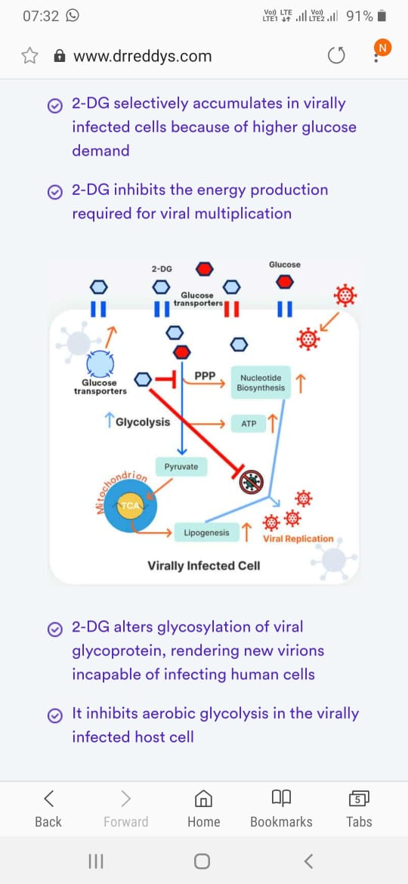
2 DEOXY-D-GLUCOSE:
2-DG
Used in cancer treatment like prostate cancer
Works by inhibiting glycolysis by formation of 2-DG6P,inhibit hexokinase and cause cell death.
Tritium,carbon14-lab research in animal models
Covid,reduces oxygen demand-DRDO with Dr Reddy.DCGI-7 May 2021
PITFALLS:
Lack of access to data from clinical trial
Phase 3 only 220 participants,inadequate sample size by US FDA(300-3000)
Lack of peer reviewed research papers

